Slide 1

Subject Matter Expert Search Engine
February 2019

Slide 2
Team
Adam Noonan – DSI
Jean Kong – DSI
Sean Hoang – DSI
Bridgette Boody – DSI
Saitarun Irigala – Cyber Security Intern

Slide 3
Project Description
Develop and Deploy a system used to query subject matter experts (SMEs) leading in their field
Functional Requirements:
User can access website
User can search for SME by field of study
Ranked list of SMEs returns to user
Non-Functional Requirements:
Operate on all commonly run browsers, mobile
24/7, 365 Uptime

Slide 4
Potential Solutions
Profile and Tag System (P&T)
P&T with Google Scholar
Webfront for Google Scholar
Web crawler based search engine

Slide 5
Profile & Tag System (P&T)
Concept: Scrape an online source for HTML data on SMEs. Parse & index data in database used to create profiles for SMEs. End user queries profiles via website by field of study.
Pros:
Most control over information
Cons:
Potential Sources: arXiv.org, doaj.org, academic.oup.com/journals, journals.sage.pub.com
Relatively extensive development process

Slide 6
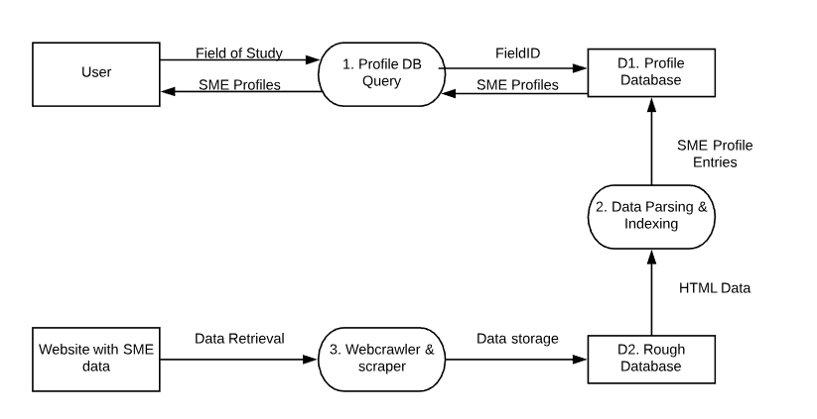
P&T Dataflow Diagram

Slide 7
P&T with Google Scholar
Concept: Similar in concept to Profile & Tag system, except using Google Scholar as the data source. Still requires parsing data & creating objects, benefit of GS content & author profiles.
Pros:
Ideal data source
Control of data
Cons:
Google Scholar query limit
Possibly most extensive development requirements

Slide 8
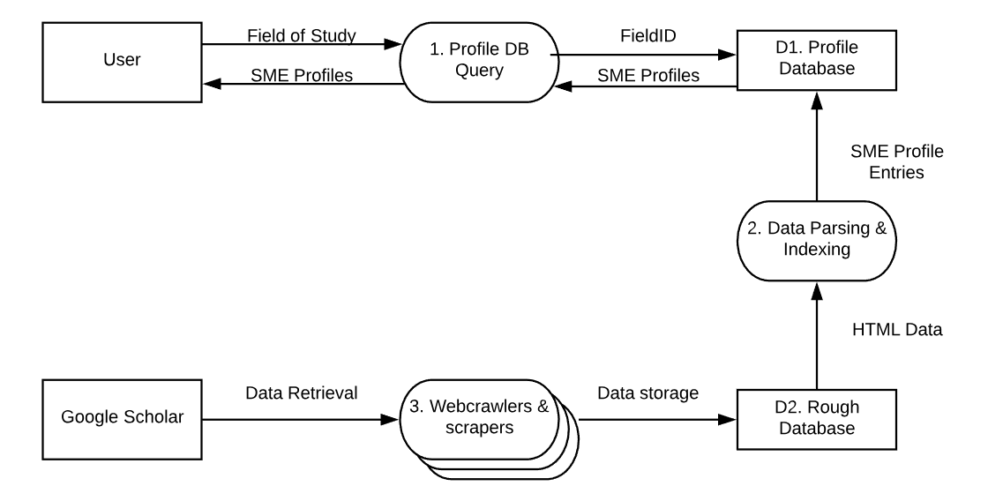
P&T with GS Dataflow Diagram

Slide 9
Webfront for Google Scholar
Concept: Develop a webpage that queries Google Scholar profiles for user. Link GS profiles with various social media accounts for SME (Twitter, LinkedIn, Mastadon) and apply ranking system.
Pros:
Unaffected by GS query limit
Shortest development time, most functionality
Lack of data storage requirement
Cons:
Totally dependent on external services
Google Scholar ranking issues (“Scientist Data”, Outdated)

Slide 10
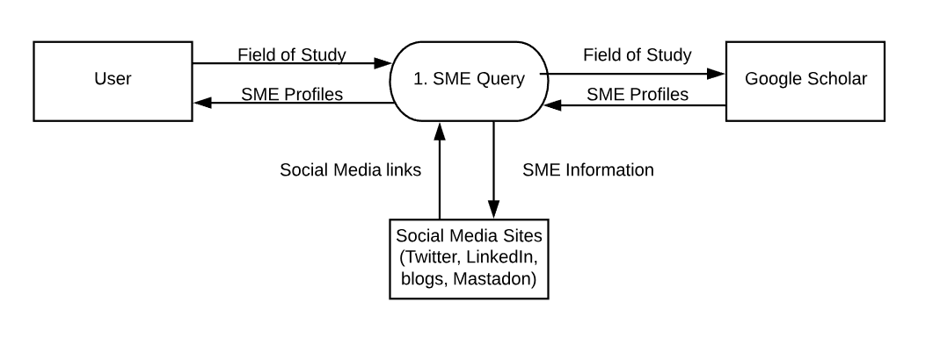
Webfront for GS Dataflow Diagram

Slide 11
Webcrawler Search Engine
Concept: Use crawler to query Google Scholar profiles/ linkedin profiles and then store the indexed pages in a database. Design a ranking algorithm based on relevant citations/other features to rank the profiles given the field.
pros:
more control in ranking;
no query limits;
preprocessing available;
cons:
requires efforts to build the database and update it;
data storage issues

Slide 12
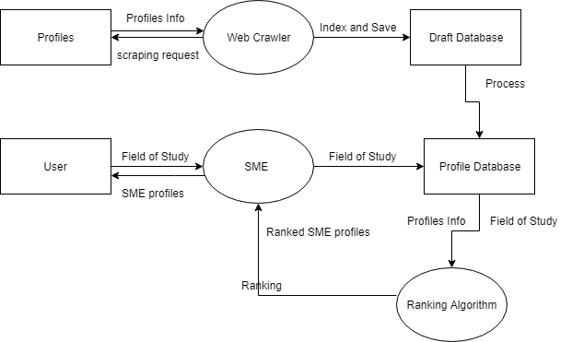
Webcrawler Search Engine example

Slide 13
Webcrawler Search Engine
Functionality:
refined search to areas
search correction
(external link to social media)

Slide 14
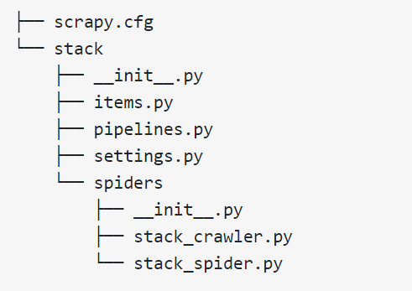
Crawler Implementation
Attempt implementation for web crawler

Slide 15
Database
Concept: Store scraped data using MySQL, with related fields for later indexing and ranking
MySQL
Web Server
Web Browser
Python

Slide 16
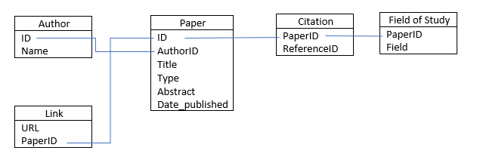
Database
Simplified Schema

Slide 17
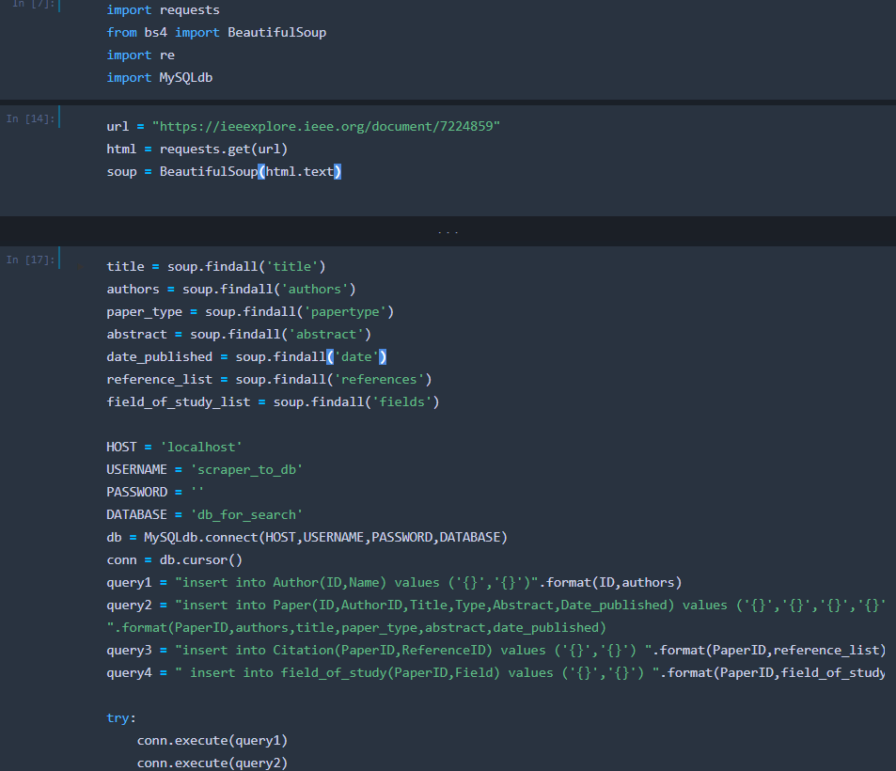
Python Pseudo

Slide 18
Conclusion
Potential Models
Profile and Tag System (P&T)
P&T with Google Scholar
Webfront for Google Scholar
Webcrawler search engine

Slide 19
Research Sources (1)
Search Engines:
http://aakashjapi.com/fuckin-search-engines-how-do-they-work/
http://www.zackgrossbart.com/hackito/search-engine-python/
http://infolab.stanford.edu/~backrub/google.html
https://buildsearchengine.blogspot.com/
https://jorin.me/python-search-engine/
https://stackoverflow.com/questions/18383669/building-a-search-engine
https://en.wikipedia.org/wiki/Search_engine_indexing#The_forward_index
Data Gathering (Webcrawling/scraping):
https://www.r-bloggers.com/google-scholar-scraping-with-rvest-package/
https://datascienceplus.com/google-scholar-scraping-with-rvest/
http://lernpython.de/scrape-google-scholar
https://mystudentvoices.com/scraping-google-scholar-to-write-your-phd-literature-chapter-2ea35f8f4fa1
https://www.openarchives.org/OAI/openarchivesprotocol.html
https://github.com/lcdm-uiuc/info490-sp17/blob/master/Week8/lesson3.md
https://doaj.org/features

Slide 20
Research Sources (2)
Google Scholar:
https://academia.stackexchange.com/questions/34970/how-to-get-permission-from-google-to-use-google-scholar-data-if-needed
https://academia.stackexchange.com/questions/2567/api-eula-and-scraping-for-google-scholar#comment4170_2567
https://www.otago.ac.nz/library/pdf/Google_Scholar_Tips.pdf
https://developers.google.com/webmaster-tools/search-console-api-original/v3/limits
GitHub:
https://github.com/c-data/pysearch
https://github.com/mthbernardes/fses
https://github.com/zlmoment/Magnet-Links-Search-Engine
https://github.com/qoda/python-searchengine
https://github.com/dileep98490/A-simple-Search-Engine-in-Python
DBMS:
https://www.thoughtspot.com/codex/why-relational-search-harderand-why-we-it
https://www.upwork.com/hiring/data/sql-vs-nosql-databases-whats-the-difference/
http://www.ideaeng.com/database-full-text-search-0201

