Slide 1
R Programming Week 9: Rstudio / Rmarkdown / ggplot2
Sungpil Han, M.D/Ph.D
2017-05-09 UOU Lecture

Slide 2
Outline
Rstudio (10 min)
Rmarkdown (10 min)
ggplot2 (30 min)

Slide 3
What is Rstudio?
Rstudio.com

Slide 4
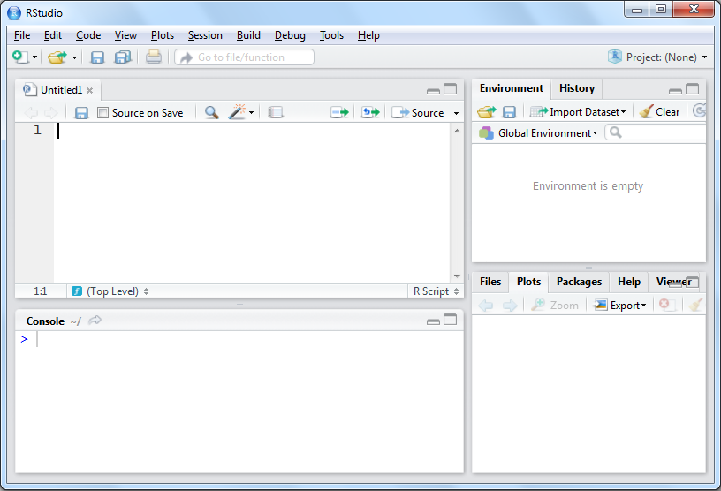
RStudio
Active Coding Area
Some Point-and-Click
Place to Enter Single Commands
View Some Output

Slide 5
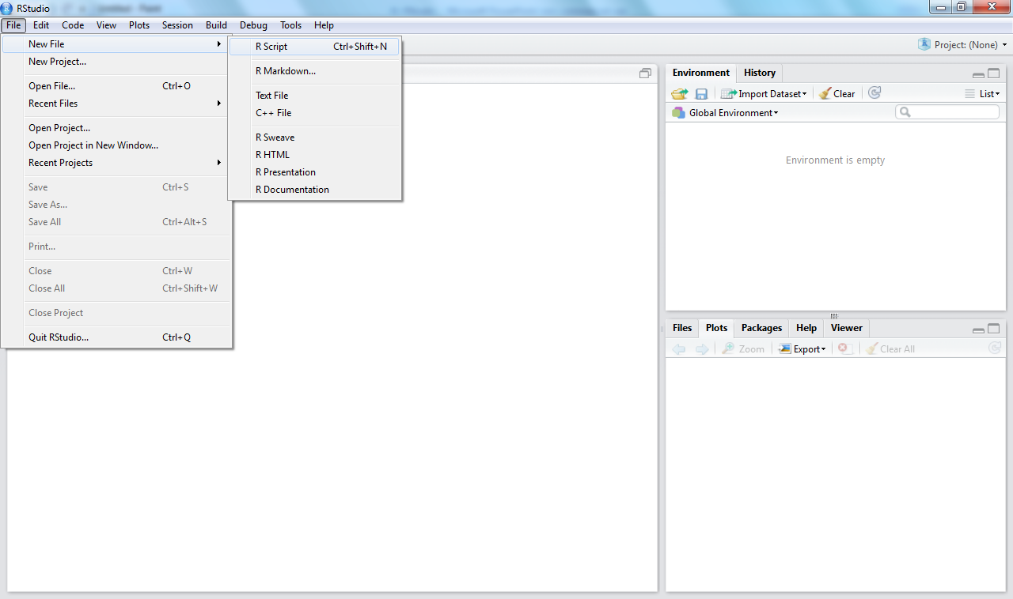
Open up a New Script Window

Slide 6
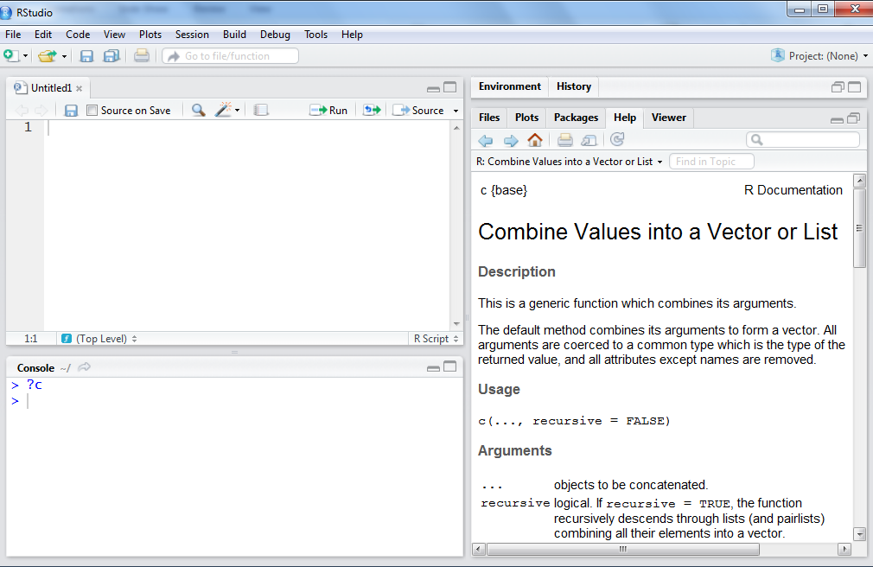
How to Get Help on a Function
?c

Slide 7
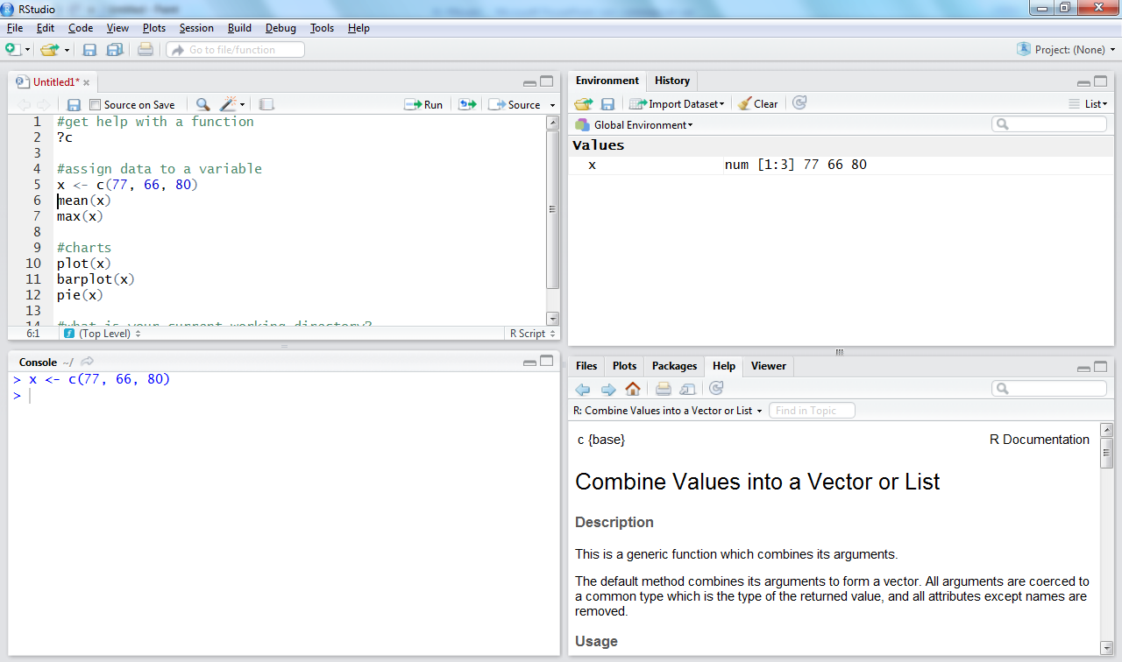
RStudio Environment
1
Enter Code
2
Run
4
Variable shows up in the environment panel
Or CTRL-Enter
Code is Ran
in the Console
3

Slide 8
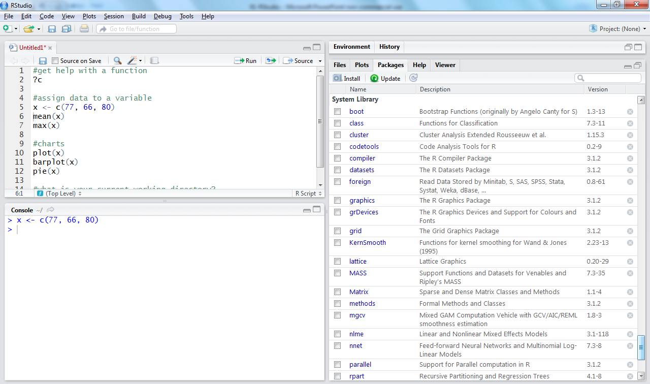

Slide 9
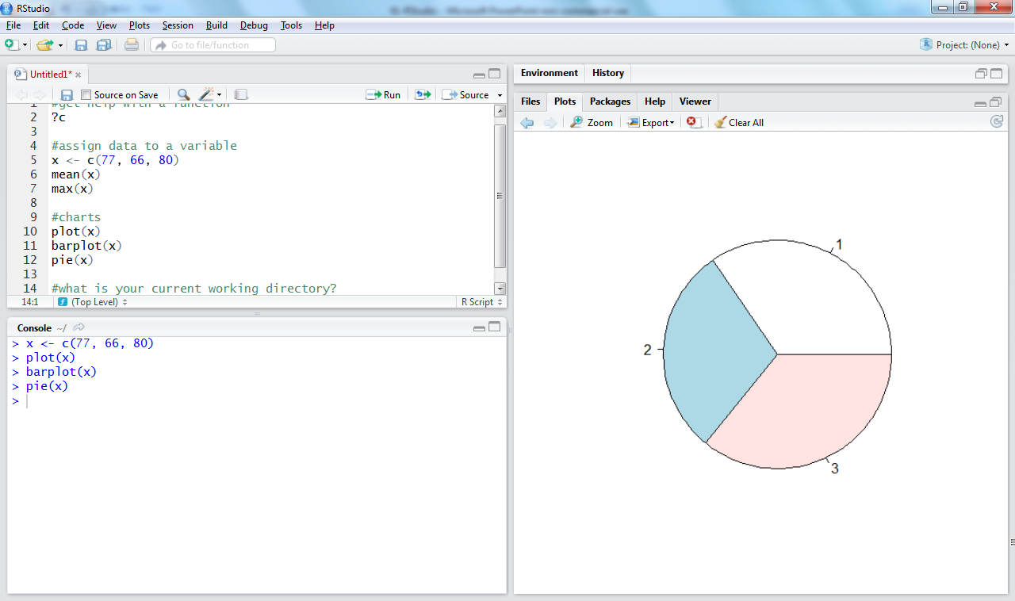
Plots
Page Back
Zoom or Export
To Clear Console:
CTRL-L

Slide 10
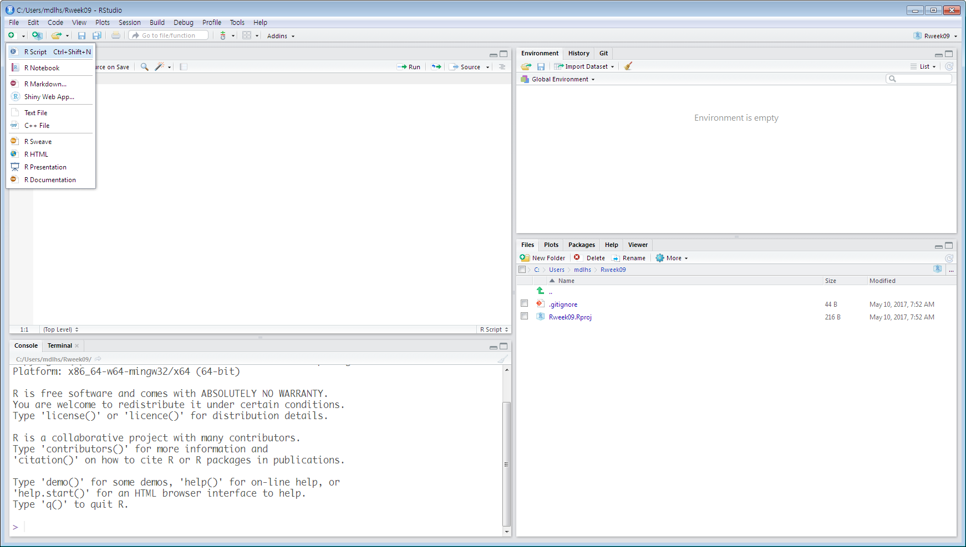
Getwd()

Slide 11
Demo: RStudio

Slide 12
Demo: Rmarkdown

Slide 13
What is ggplot2?
An implementation of the Grammar of Graphics by Leland Wilkinson
Written by Hadley Wickham (while he was a graduate student at Iowa State)
A “third” graphics system for R (along with base and lattice)
Available from CRAN via install.packages()
Web site: http://ggplot2.tidyverse.org

Slide 14
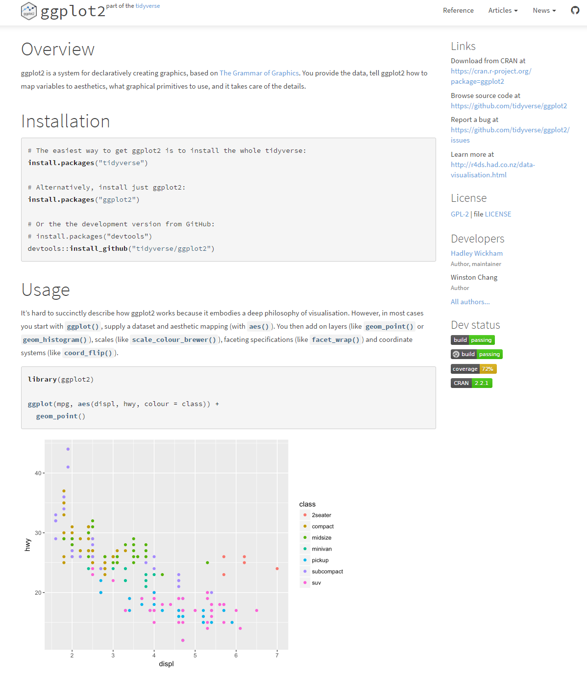
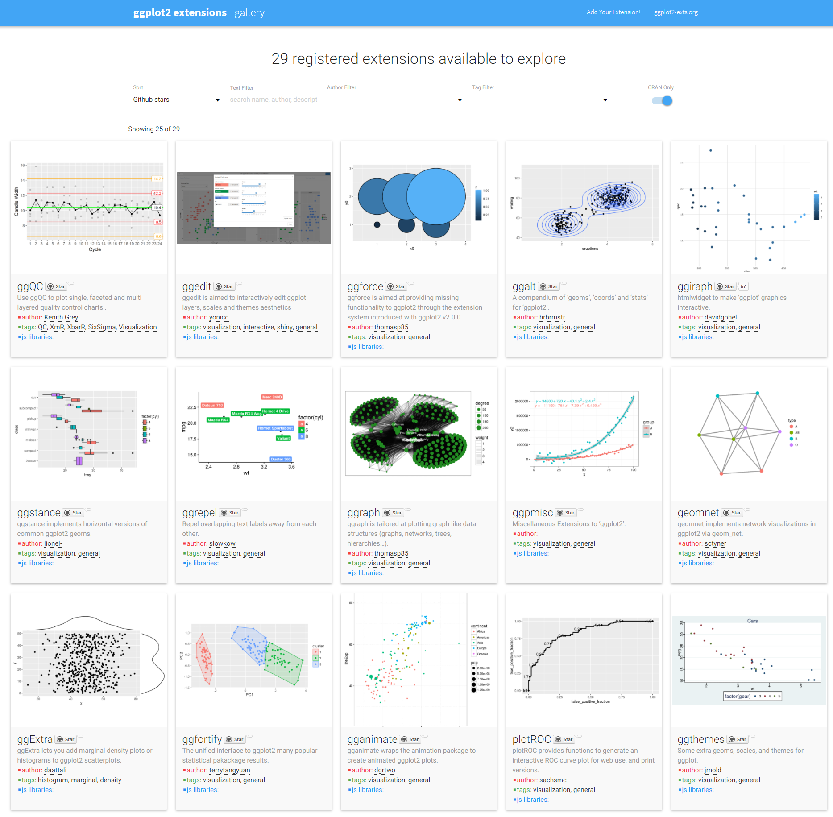

Slide 15
What is ggplot2?
Grammar of graphics represents and abstraction of graphics ideas/objects
Think “verb”, “noun”, “adjective” for graphics
Allows for a “theory” of graphics on which to build new graphics and graphics objects
“Shorten the distance from mind to page”

Slide 16
Grammar of Graphics
“In brief, the grammar tells us that a statistical graphic is a mapping from data to aesthetic attributes (colour, shape, size) of geometric objects (points, lines, bars). The plot may also contain statistical transformations of the data and is drawn on a specific coordinate system”
from ggplot2 book

Slide 17
Plotting Systems in R: Base
“Artist’s palette” model
Start with blank canvas and build up from there
Start with plot function (or similar)
Use annotation functions to add/modify (text, lines, points, axis)

Slide 18
Plotting Systems in R: Base
Convenient, mirrors how we think of building plots and analyzing data
Can’t go back once plot has started (i.e. to adjust margins); need to plan in advance
Difficult to “translate” to others once a new plot has been created (no graphical “language”)
Plot is just a series of R commands

Slide 19
Plotting Systems in R: Lattice
Plots are created with a single function call (xyplot, bwplot, etc.)
Most useful for conditioning types of plots: Looking at how y changes with x across levels of z
Thinks like margins/spacing set automatically because entire plot is specified at once
Good for putting many many plots on a screen

Slide 20
Plotting Systems in R: Lattice
Sometimes awkward to specify an entire plot in a single function call
Annotation in plot is not intuitive
Use of panel functions and subscripts difficult ot wield and requires intense preparation
Cannot “add” to the plot once it’s created

Slide 21
Plotting Systems in R: ggplot2
Split the difference between base and lattice
Automatically deals with spacings, text, titles but also allows you to annotate by “adding”
Superficial similarity to lattice but generally easier/more intuitive to use
Default mode makes many choices for you (but you can customize!)

Slide 22
The Basics: qplot()
Works much like the plot function in base graphics system
Looks for data in a data frame, similar to lattice, or in the parent environment
Plots are made up of aesthetics (size, shape, color) and geoms (points, lines)

Slide 23
The Basics: qplot()
Factors are important for indicating subsets of the data (if they are to have different properties); they should be labeled
The qplot() hides what goes on underneath, which is okay for most operations
ggplot() is the core function and very flexible for doing things qplot() cannot do

Slide 24
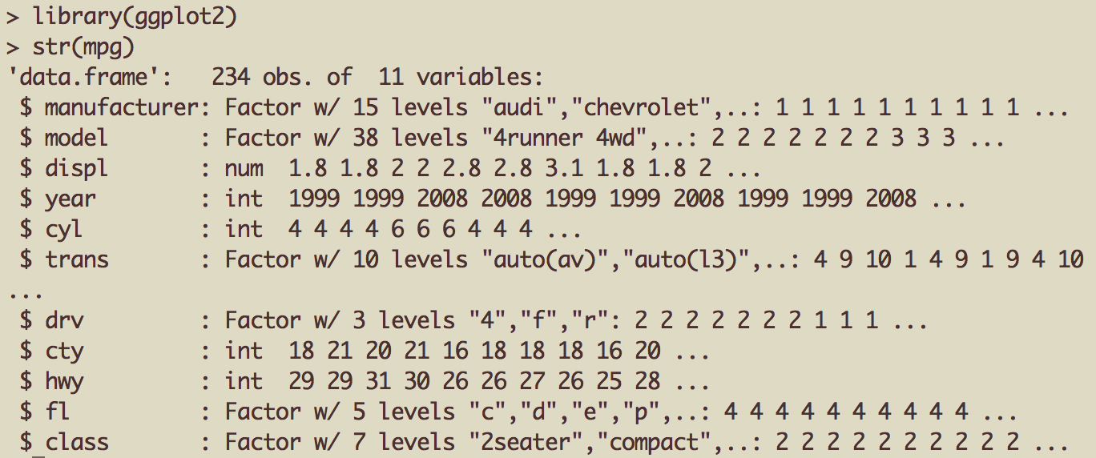
Example Dataset
Factor label information important for annotation

Slide 25

ggplot2 “Hello, world!”
x coord
y coord
data frame

Slide 26
Modifying aesthetics
auto legend placement
color aesthetic
qplot(displ, hwy, data = mpg, color = drv)

Slide 27
Adding a geom
qplot(displ, hwy, data = mpg, geom = c("point", "smooth"))

Slide 28
Histograms
qplot(hwy, data = mpg, fill = drv)

Slide 29
Facets
qplot(displ, hwy, data = mpg, facets = . ~ drv)
qplot(hwy, data = mpg, facets = drv ~ ., binwidth = 2)

Slide 30
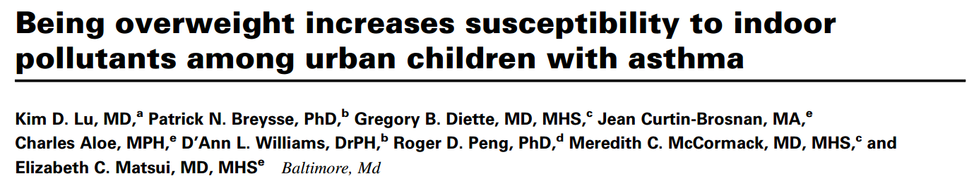
MAACS Cohort
Mouse Allergen and Asthma Cohort Study
Baltimore children (aged 5—17)
Persistent asthma, exacerbation in past year
Study indoor environment and its relationship with asthma morbidity
Recent publication: http://goo.gl/WqE9j8

Slide 31
Example: BMI, PM_{2.5}, Asthma
Does BMI (normal vs. overweight) modify the relationship between PM_{2.5} and asthma symptoms?

Slide 32
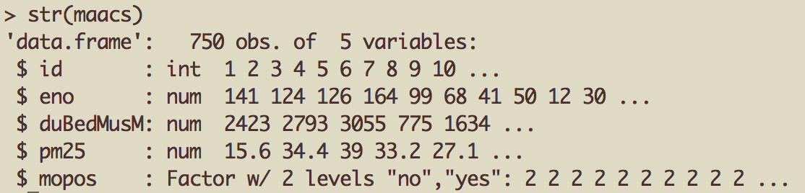
Example: MAACS
Exhaled nitric oxide
Fine particulate matter
Sensitized to mouse allergen

Slide 33
Histogram of eNO
qplot(log(eno), data = maacs)

Slide 34
Histogram by Group
qplot(log(eno), data = maacs, fill = mopos)

Slide 35
Density Smooth
qplot(log(eno), data = maacs, geom = "density")
qplot(log(eno), data = maacs, geom = "density", color = mopos)

Slide 36
Scatterplots: eNO vs. PM_{2.5}
qplot(log(pm25), log(eno), data = maacs)
qplot(log(pm25), log(eno), data = maacs, shape = mopos)
qplot(log(pm25), log(eno), data = maacs, color = mopos)

Slide 37
Scatterplots: eNO vs. PM_{2.5}
qplot(log(pm25), log(eno), data = maacs, color = mopos, geom = c("point", "smooth"), method = "lm")

Slide 38
Scatterplots: eNO vs. PM_{2.5}
qplot(log(pm25), log(eno), data = maacs, geom = c("point", "smooth"), method = "lm", facets = . ~ mopos)

Slide 39
Summary of qplot()
The qplot() function is the analog to plot() but with many built-in features
Syntax somewhere in between base/lattice
Produces very nice graphics, essentially publication ready (if you like the design)
Difficult to go against the grain/customize (don’t bother; use full ggplot2 power in that case)

Slide 40
Basic Plot
qplot(logpm25, NocturnalSympt, data = maacs, facets = . ~ bmicat, geom = c("point", "smooth"), method = "lm”)

Slide 41
Building Up in Layers
> head(maacs)
logpm25 bmicat NocturnalSympt
2 1.5361795 normal weight 1
3 1.5905409 normal weight 0
4 1.5217786 normal weight 0
5 1.4323277 normal weight 0
6 1.2762320 overweight 8
8 0.7139103 overweight 0
> g <- ggplot(maacs, aes(logpm25, NocturnalSympt))
> summary(g)
data: logpm25, bmicat, NocturnalSympt [554x3]
mapping: x = logpm25, y = NocturnalSympt
faceting: facet_null()
Data Frame
Aesthetics
Initial call to ggplot
Summary of ggplot object

Slide 42
No Plot Yet!
> g <- ggplot(maacs, aes(logpm25, NocturnalSympt))
> print(g)
Error: No layers in plot
> p <- g + geom_point()
> print(p)
> g + geom_point()
Explicitly save and print ggplot object
Auto-print plot object without saving

Slide 43
First Plot with Point Layer
g <- ggplot(maacs, aes(logpm25, NocturnalSympt))
g + geom_point()

Slide 44
Adding More Layers: Smooth
g + geom_point() + geom_smooth()
g + geom_point() + geom_smooth(method = "lm”)

Slide 45
Adding More Layers: Facets
Labels from facet variable
Add facets
Faceting (factor) variable
g + geom_point() + facet_grid(. ~ bmicat) + geom_smooth(method = "lm")

Slide 46
Annotation
Labels: xlab(), ylab(), labs(), ggtitle()
Each of the “geom” functions has options to modify
For things that only make sense globally, use theme()
Example: theme(legend.position = "none")
Two standard appearance themes are included
theme_gray(): The default theme (gray background)
theme_bw(): More stark/plain

Slide 47
Modifying Aesthetics
g + geom_point(color = "steelblue”, size = 4, alpha = 1/2)
g + geom_point(aes(color = bmicat), size = 4, alpha = 1/2)
Constant values
Data variable

Slide 48
Modifying Labels
labs() function for modifying titles and x-, y-axis labels
g + geom_point(aes(color = bmicat)) + labs(title = "MAACS Cohort") + labs(x = expression("log " * PM[2.5]), y = "Nocturnal Symptoms")

Slide 49
Customizing the Smooth
Modified smoother
g + geom_point(aes(color = bmicat), size = 2, alpha = 1/2) + geom_smooth(size = 4, linetype = 3, method = "lm", se = FALSE)

Slide 50
Changing the Theme
g + geom_point(aes(color = bmicat)) + theme_bw(base_family = "Times”)

Slide 51
A Notes about Axis Limits
testdat <- data.frame(x = 1:100, y = rnorm(100))
testdat[50,2] <- 100 ## Outlier!
plot(testdat$x, testdat$y, type = "l", ylim = c(-3,3))
g <- ggplot(testdat, aes(x = x, y = y))
g + geom_line()

Slide 52
Axis Limits
Outlier missing
Outlier included
g + geom_line() + ylim(-3, 3)
g + geom_line() + coord_cartesian(ylim = c(-3, 3))

Slide 53
More Complex Example
How does the relationship between PM_{2.5} and nocturnal symptoms vary by BMI and NO₂?
Unlike our previous BMI variable, NO₂ is continuous
We need to make NO2 categorical so we can condition on it in the plotting
Use the cut() function for this

Slide 54
Making NO₂ Deciles
## Calculate the deciles of the data
> cutpoints <- quantile(maacs$logno2_new, seq(0, 1, length = 11), na.rm = TRUE)
## Cut the data at the deciles and create a new factor variable
> maacs$no2dec <- cut(maacs$logno2_new, cutpoints)
## See the levels of the newly created factor variable
> levels(maacs$no2dec)
[1] "(0.378,0.969]" "(0.969,1.1]" "(1.1,1.17]" "(1.17,1.26]"
[5] "(1.26,1.32]" "(1.32,1.38]" "(1.38,1.44]" "(1.44,1.54]"
[9] "(1.54,1.69]" "(1.69,2.55]"

Slide 55
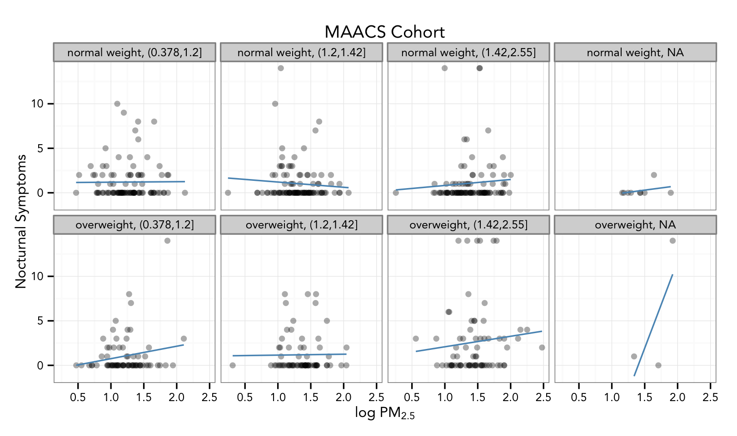
Final Plot
Non-default font
Multiple panels
Transparent points
Smoother
Labels/Title

Slide 56
Code for Final Plot
Add points
## Setup ggplot with data frame
g <- ggplot(maacs, aes(logpm25, NocturnalSympt))
## Add layers
g + geom_point(alpha = 1/3)
+ facet_wrap(bmicat ~ no2dec, nrow = 2, ncol = 4)
+ geom_smooth(method="lm", se=FALSE, col="steelblue")
+ theme_bw(base_family = "Avenir", base_size = 10)
+ labs(x = expression("log " * PM[2.5])
+ labs(y = "Nocturnal Symptoms”)
+ labs(title = "MAACS Cohort”)
Add smoother
Make panels
Change theme
Add labels

Slide 57
Summary
ggplot2 is very powerful and flexible if you learn the “grammar” and the various elements that can be tuned/modified
Many more types of plots can be made; explore and mess around with the package

Slide 58
Resources
The ggplot2 book by Hadley Wickham
The R Graphics Cookbook by Winston Chang (examples in base plots and in ggplot2)
ggplot2 web site http://ggplot2.tidyverse.org

Slide 59
Reference
This material is mainly based on the presentation of “Plotting with ggplot2” – Computing for Data Analysis https://github.com/jtleek/modules/tree/bf6eb222287be1cc7165ae927704258b5fb22786/04_ExploratoryAnalysis/ggplot2/ppt

