Slide 1

Test skryptu
Test skryptu

Slide 2
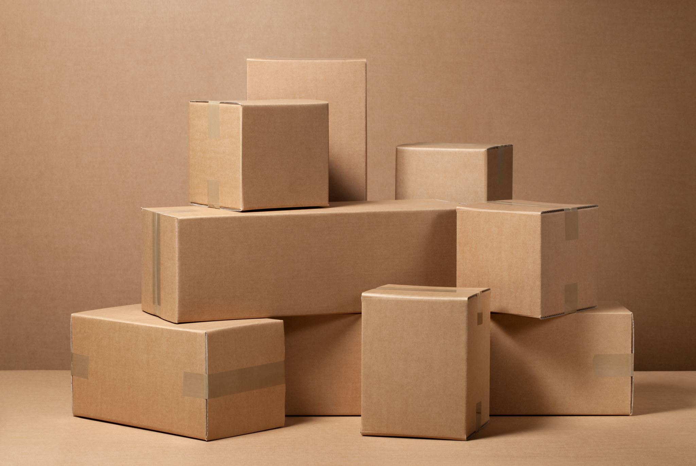
Pusty slajd
Taki pusty

Slide 3
Hello, World!
python-pptx was here!

