Slide 1

Multivariate Analysis Presentation
Sai Prateek Katkam – ES20BTECH11024
Nikhil Kongara – MA20BTECH11011

Slide 2
Techniques Used
Factor Analysis
Principal Component Analysis
K-means Clustering

Slide 3
Libraries Used
Corrplot
Cluster
Psych

Slide 4
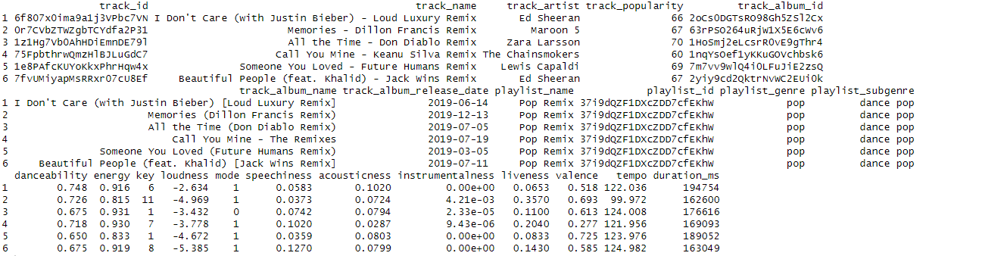
Dataset details
Dataset from Kaggle – Spotify.csv
The head of the data is given below

Slide 5
Details(Continued)
Number of Columns – 23
Number of Rows – 32833
Names of Columns –
[1] "track_id"
[2] "track_name"
[3] "track_artist"
[4] "track_popularity"
[5] "track_album_id"
[6] "track_album_name"
[7] "track_album_release_date"
[8] "playlist_name"
[9] "playlist_id"
[10] "playlist_genre"
[11] "playlist_subgenre"
[12] "danceability"
[13] "energy"
[14] "key"
[15] "loudness"
[16] "mode"
[17] "speechiness"
[18] "acousticness"
[19] "instrumentalness"
[20] "liveness"
[21] "valence"
[22] "tempo"
[23] "duration_ms"

Slide 6
Details(Continued)
Datatypes of the columns

Slide 7
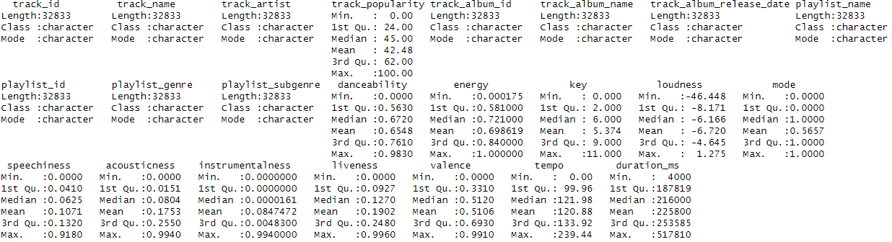
Summary of the data

Slide 8
Details(Continued)
Genres – edm, latin, pop, r&b, rap, rock
Subgenres - album rock ,big room, classic rock, dance pop, house , electropop, gangster rap, hard rock, hip hop , hip pop , poptimism , latin hip hop, latin pop, soul, new jack swing , permanent wave, pop edm , pop, progressive electro house , reggaeton, southern hip hop, trap, tropical, contemporary
Number of unique playlist – 449
Number of unique artists - 10693

Slide 9
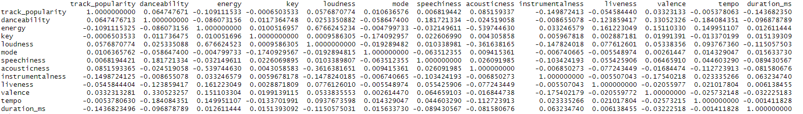
Correlation Matrix

Slide 10
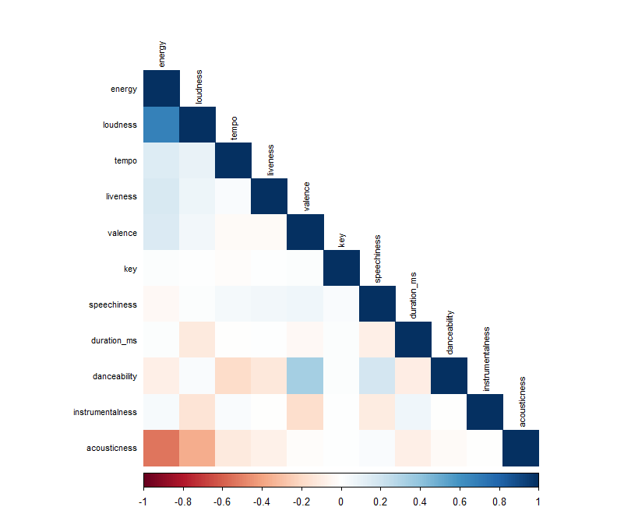
Correlation Heatmap

Slide 11
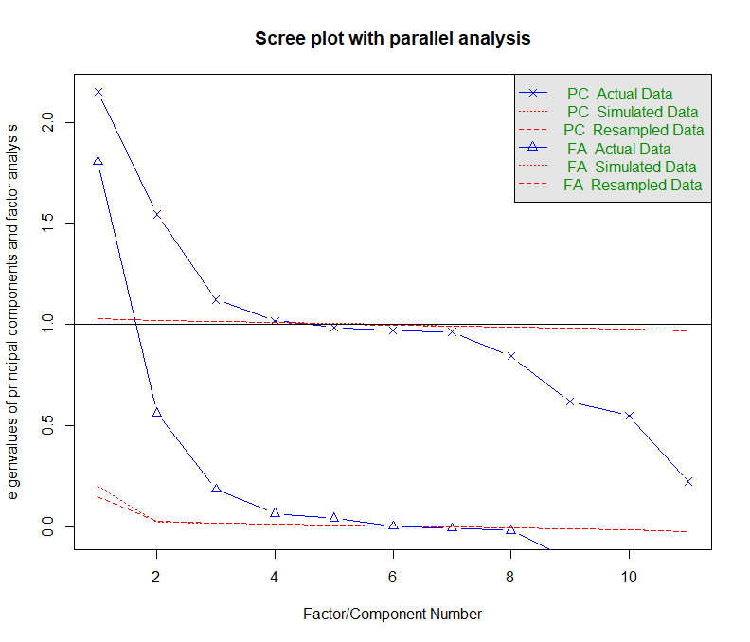
Scree Plot after 100 iterations
Parallel analysis suggests that the number of factors = 5 and the number of components = 4

Slide 12
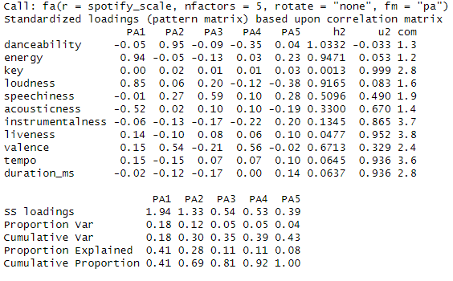
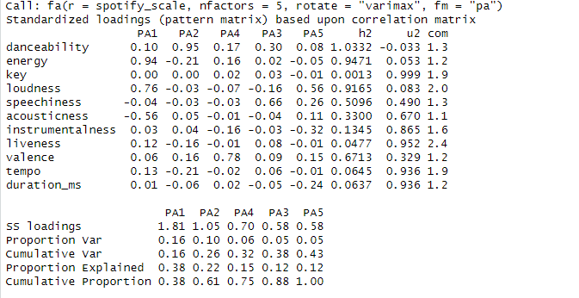
Factor Analysis
Without Varimax Rotation
With Varimax Rotation
There is no significant change due to rotation
The root mean square of the residuals (RMSR) is 0.01

Slide 13
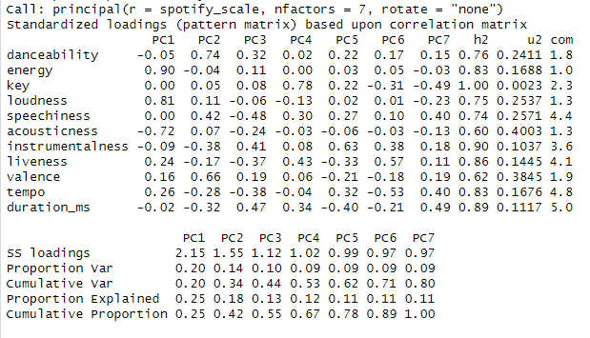
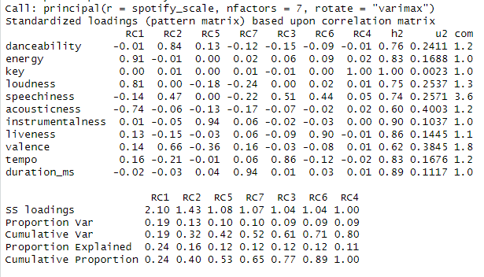
PCA
Without Varimax Rotation
With Varimax Rotation
There is no significant change due to rotation
The root mean square of the residuals (RMSR) is 0.09

Slide 14
Using prcomp function

Slide 15
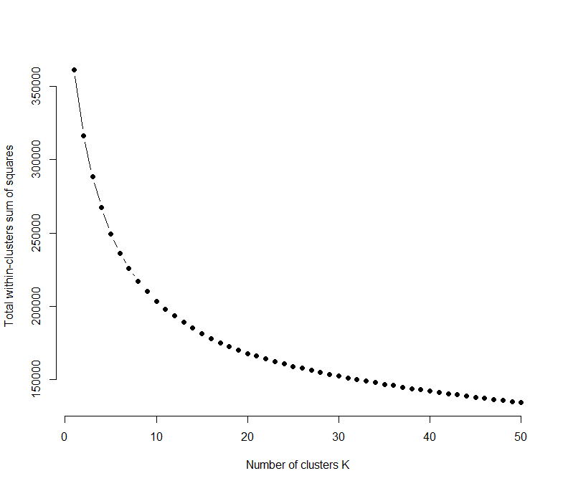
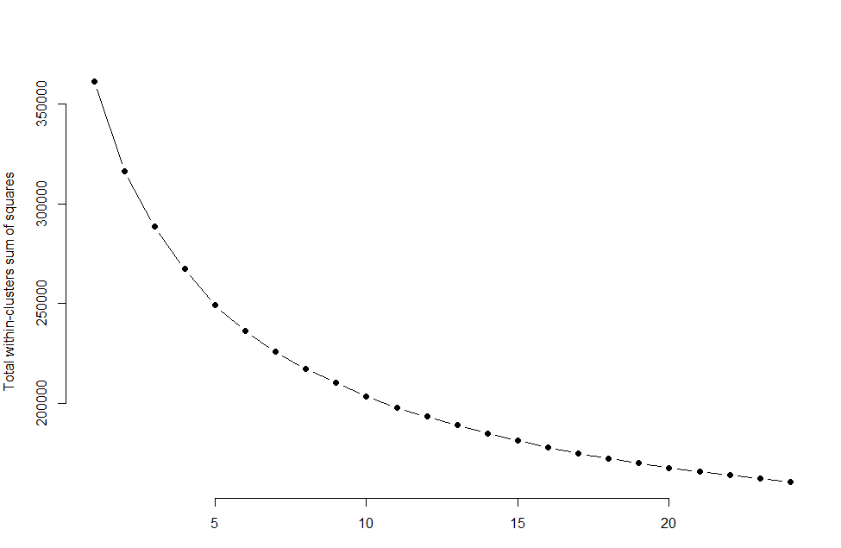
Wss(Within Sum of Squares) plots for K- means clustering
50 clusters wss plot
25 clusters wss plot

Slide 16
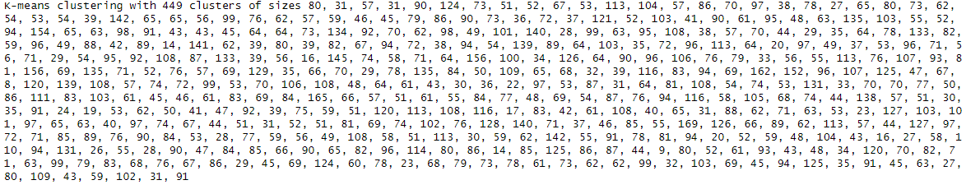
K- means clustering with different number of clusters
(between_SS / total_SS = 57.8 %)
(between_SS / total_SS = 62.7%)
(between_SS / total_SS = 79.2 %)

