Slide 1
Least Squares Approach in Valuing American
Options
A Anish
ES20BTECH11001
Adha Satwik
ES19BTECH11020
Sai Prateek K
ES20BTECH11024

Slide 2
Introduction
The optimal strategy would be to compare the immediate value if we exercise the option and the
expected value of the stock from continuing, and then exercising the option if the immediate value is greater.
We use regression in this approach.

Slide 3
Sections
There are four major parts to the paper:
1. Giving a numerical example
2. Explaining the Algorithm
3. Applying the algorithm
4. Problems and Implementation Issues in the Algorithm

Slide 4
Explaining the algorithm
1. The valuation framework
2. The LSM algorithm
3. Convergence results

Slide 5
Implementation of the algorithm
1. Valuing American Put Options
2. Valuing an American-Bermuda-Asian Option
3. Valuing Cancelable Index Amortizing Swaps
4. Jump-Diffusions and American Option Valuation
5. Valuing Swaptions in a String Model

Slide 6
Numerical and implementation issues in the algorithm
1. Higher-dimensional problems
2. Types of Least squares
3. Choice of basis Functions
4. Computational Speed of the algorithm

Slide 7
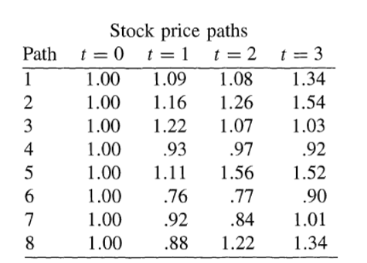
A Numerical Example
In this project, we will look at the implementation of the algorithm in valuing American put options.
Take an American put option with a strike price at times 1,2,3 and the risk-free interest rate is 6%. Let the stock prices at the different times be represented by the below matrix. We have e^−0.06 = 0.94176

Slide 8
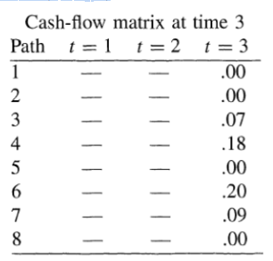
The cash flows realized by the option holder from exercising at time 3 are given below. We calculate this using the
Put option payoff = max(K − S , 0)

Slide 9
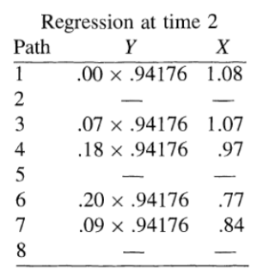
We have five paths in which the put option is in the money at time t=2.
Let X denote the stock prices at time 2 for these five paths and Y denote
the corresponding discounted cash flows received at time 3 if the put is not
exercised at time 2.

Slide 10

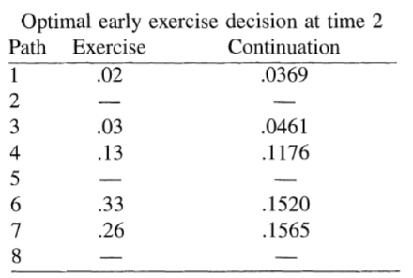
The resulting conditional expectation function is
Then we take a matrix comparing the exercise value with the value that we
get from the conditional expectation function

Slide 11
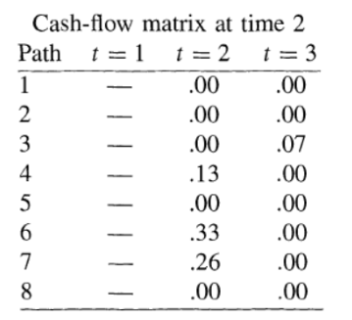
So we can see that it is optimal to exercise the option at time 2 for the fourth, sixth, and seventh paths. This leads to the following matrix, which shows the cash flows received by the option holder conditional on not exercising prior to time 2.

Slide 12
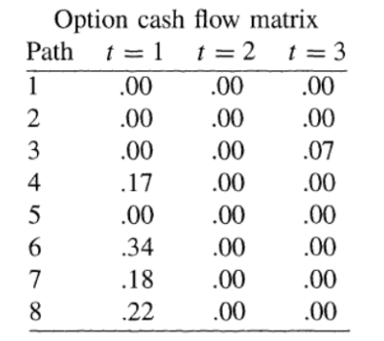
Similarly, we repeat the same steps to get the final cash flow matrix as given below:

Slide 13
As shown by this example, the LSM approach is easily implemented
since nothing more than simple regression is involved. After identifying the
cash flows generated by the American put at each date along each path, the
option can now be valued by discounting each cash flow in the option cash
flow matrix back to time zero, and averaging over all paths.

Slide 14
Algorithm
Framework :
The objective of the LSM algorithm is to provide a pathwise approximation to the optimal stopping rule that maximizes the value of the American option.
The value of the option is maximized pathwise, and hence unconditionally, if the investor exercises as soon as the immediate exercise value is greater than or equal to the value of continuation.
LSM Algorithm :
We use regression methods to estimate the continuation values from simulated sample paths.
Each continuation value C( t_{i} ) is the regression of the (discounted) option value V ( t_{i+1} ) on the current state S( t_{i} ),
approximate C( t_{i} ) by a linear combination of known functions(here for simplicity we take these functions to be polynomials) of the current state S( t_{i} ). We estimate the coefficients of the functions in the linear combination using numpy polyfit function.
The American option is then valued by starting at time zero, moving forward along each path until the first stopping time occurs, discounting the resulting cash flow from exercise back to time zero, and then taking the average over all paths ω.

Slide 15
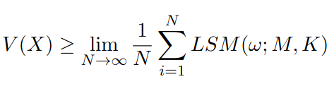
Convergence of LSM algorithm
We examine the theoretical convergence of the algorithm to the actual value V(X) of the American Option.
For any finite choice of M, K, and vector θ ∈ R^{M * (K-1)} representing the coefficients for the M basis functions at each of the K -1 early exercise dates, let LSM(ω; M, K) denote the discounted cash flow resulting from following the LSM rule of exercising when the immediate exercise value is positive and greater than or equal to the unknown functional form of F(w;t_{k}) can be represented as a linear combination of a countable set of basis functions.
Then the following inequality holds almost surely
The LSM algorithm results in a stopping rule for an American-style option, if we consider the most optimal stopping rule, it is greater than or equal to all other stopping rules, including the stopping rule implied by the LSM algorithm.

Slide 16
Valuing American Stock Options
Let us assume that we are interested in pricing an American-style put option on a share of stock, where the risk-neutral stock price process follows the stochastic differential equation
dS = rSdt + σsdZ
and where r and G are constants, Z is a standard Brownian motion, and the stock does not pay dividends. Furthermore, assume that the option is exercisable 50 times per year at a strike price of K up to and including the final expiration date T of the option. (Bermuda exercise feature).
Thus we regress discounted realized cash flows on a constant and functions of the stock price.

Slide 17
Numerical and implementation issues in the algorithm
Higher-Dimensional Problems:
The numerical examples in the paper benchmark the performance of the LSM algorithm for several low-dimensional problems which can be solved by standard finite difference techniques.
Least-Squares:
Using weighted least squares or GMM in estimating the conditional expectation function may be more efficient.
Using least square regressions, R2s from the regressions are often low. Since LSM algorithm is based on conditional first movements, their impact should be little on the quality of the LSM approximation to the American option value.
Choice of Basis Functions:
A few basis functions are required to closely approximate the conditional expectation function over relevant range where early exercise may be optional.
Computational Speed:
Regression needs to use cross-sectional information in the simulation, that is the only constraint of LSM algorithm on parallel computing.
Given the speed at which regressions can be estimated, however, this bottleneck involves little loss of computational efficiency.

Slide 18
Conclusion
This approach presents a simple new technique for approximating the
value of American-style options by Monte Carlo simulation. This approach
is intuitive, accurate, easy to apply, and computationally efficient.

