Slide 1

Programming for Data Science
Renewable Energy and Socioeconomic Indicators
Group 05

Slide 2
The Research Question
What are the key socioeconomic indicators that are driving the adoption rate of renewable energy consumption for a given country profile?

Slide 3
The Main Objectives
Data Processing
Country Classification
Statistical
Analysis
Effects Analysis
Transforming uncompiled raw datasets into one balanced panel data
Grouping countries into different profiles based on socioeconomic indicators
Analyzing the significance of all the different variables based per classification
Understanding the magnitude of the effects from the significance indicators
01
02
03
04

Slide 4



The Data Sources
World Bank Group
Our World in Data
Understanding the magnitude of the effects
International Energy Agency

Slide 5
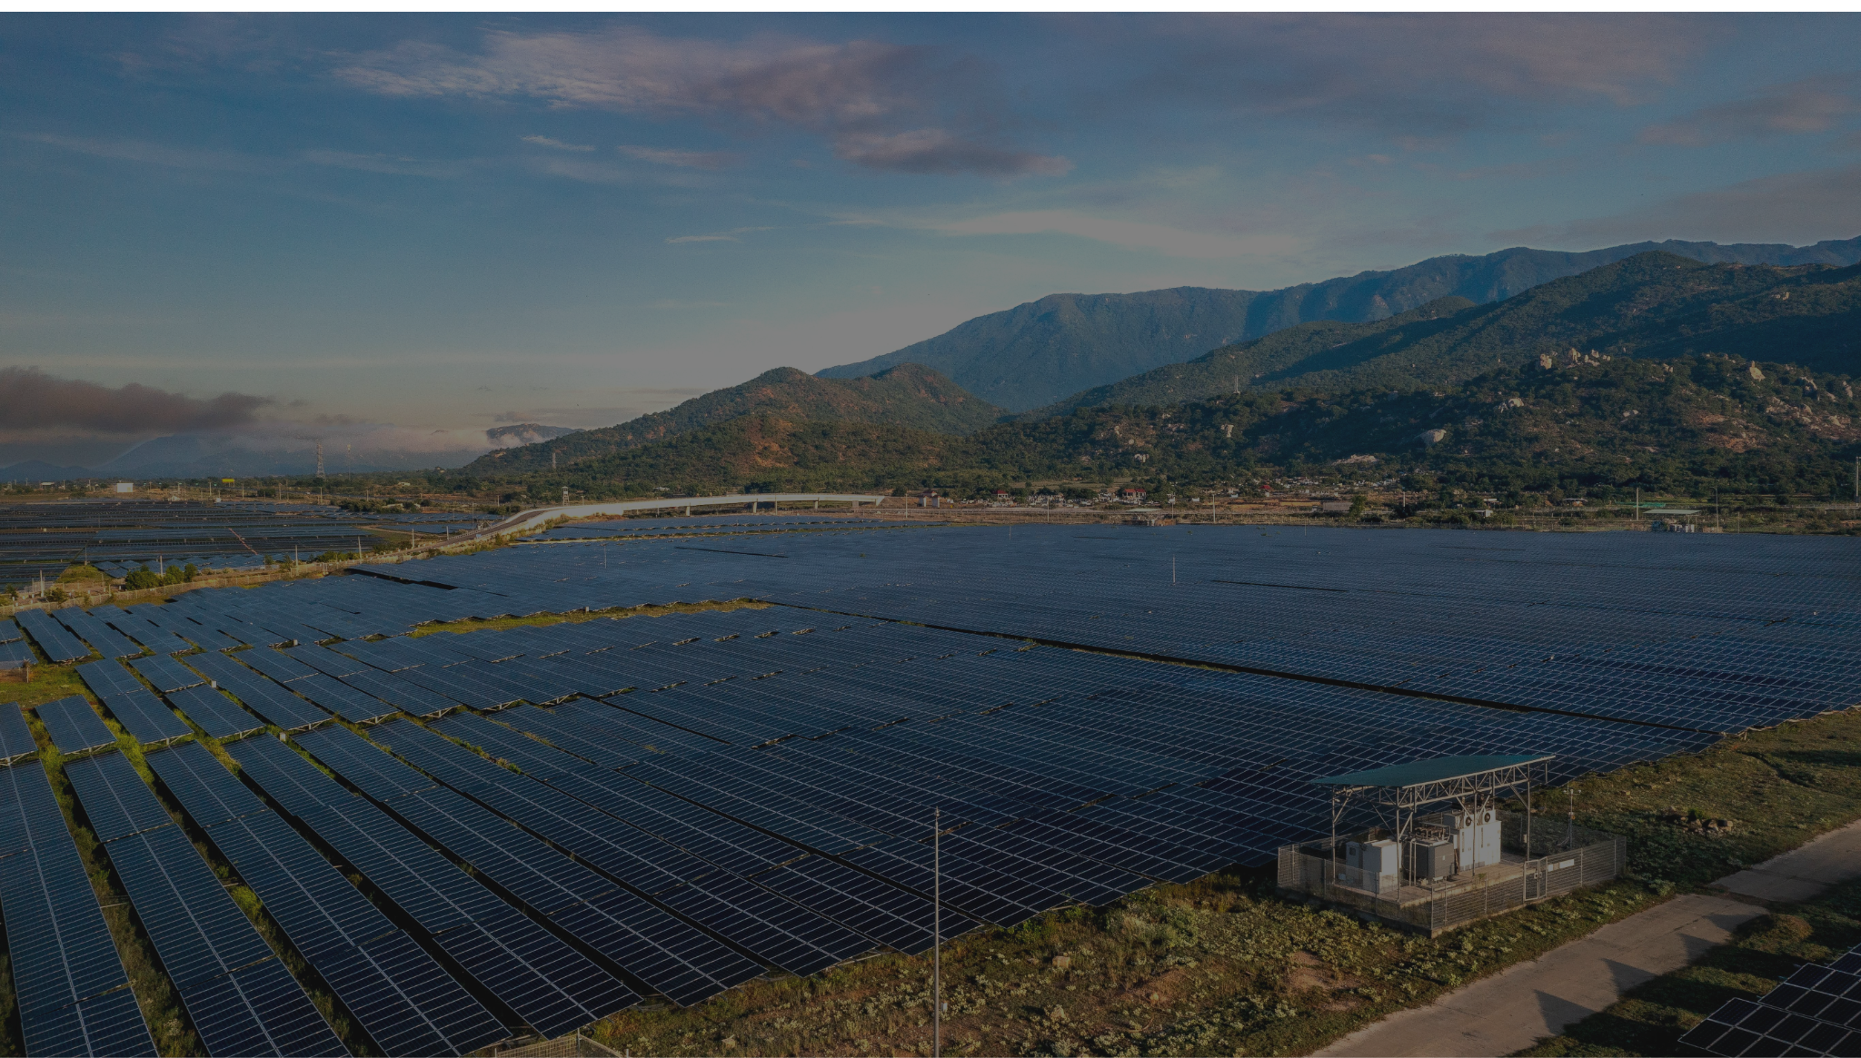
Programming for Data Science
Thank You
REZA BARZEGAR 65118
CHENG QIAN 59040
PAULINA KALIWODA 66692
DANIL DEDOV 65109

