Slide 1
{Energy, Position Cutoff, Position Spread, Angular Spread, Angular Cutoff}
e-
X-ray target
Primary collimator
Collimator Thickness
Up-stream aperture radius
Secondary collimator
Down-stream aperture radius
Water tank

Slide 2
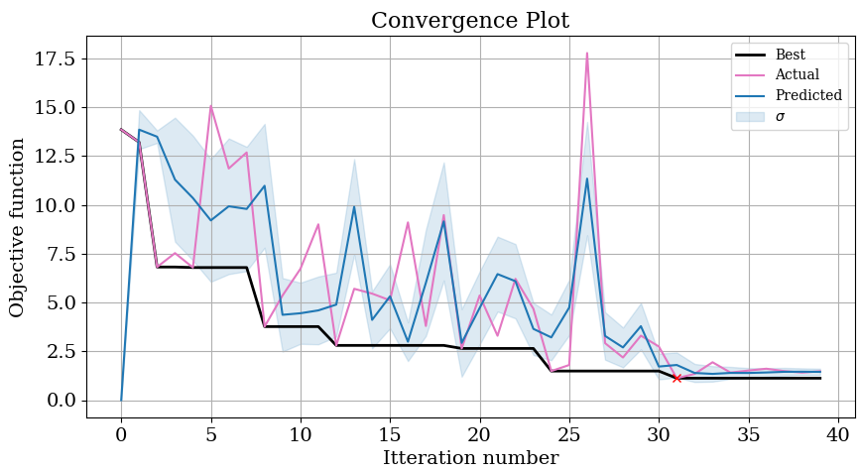
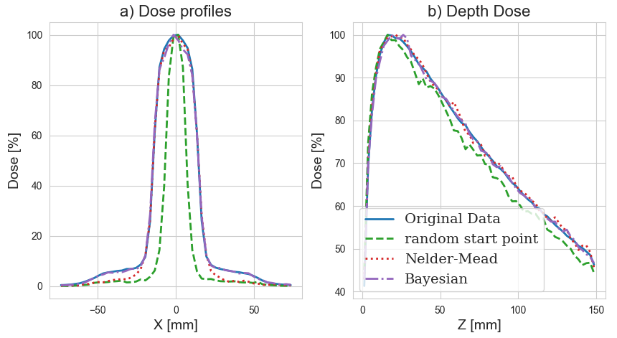
{Energy, Position Cutoff, Position Spread, Angular Spread, Angular Cutoff}
e-
X-ray target
Primary collimator
Collimator Thickness
Up-stream aperture radius
Secondary collimator
Down-stream aperture radius
Water tank

Slide 3
Nelder-Mead Optimiser
Bayesian Optimiser
Other optimisers
TopasOpt Base Class
Set up directory structure
Model generation
Run model
Find and call objective function

Slide 4
Generate model
Run model

