Slide 1
Acaca Results
UCB, 19 Feb 2009

Slide 2
Ten fold increase in PDB data since 1996.
Acaca 1996 ~50 PDB structures.
Acaca 2009 ~523 PDB structures.
A pipeline has been built to automate the application of Acaca to new data.

Slide 3
  Can the canonical classes defined in 1996 from clustering 50 PDB structures be applied in 2009 to 500+ structures?
  In 1996 Acaca failed to define classes for H3 is it possible now?

Slide 4
The Old Clusters work pretty well.

Slide 5
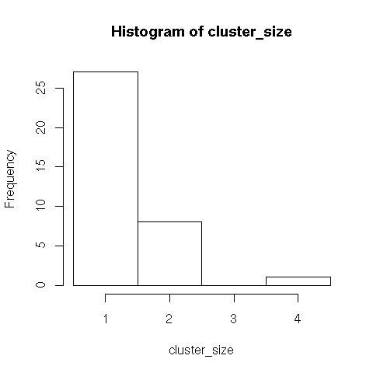
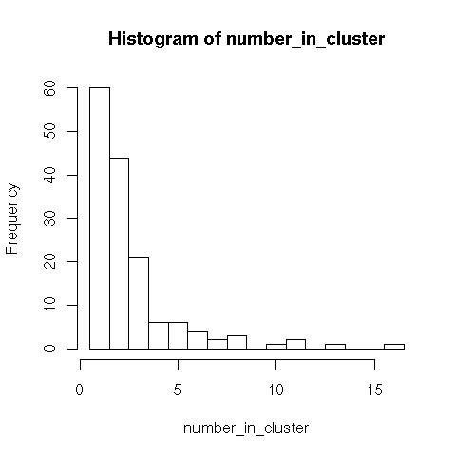
In 2009 H3 can form clusters?
1997 2009

Slide 6
Large cluster size
!= very small insert

