Slide 1
ACS Course
Component, Container, Lifecycle Management
6st ACS Workshop UTFSM, Valparaiso, Chile
H. Sommer, G. Chiozzi
6st ACS Workshop UTFSM

Slide 2
Container/Component
My container starts
and stops me
and offers its services,
some of which
I don’t notice
Component
Component
I only care about
the Lifecycle IF of
my components
ACS container
UTFSM Valparaiso, Chile, Nov 2009
6st ACS Workshop UTFSM

Slide 3
Component
Deployable unit of ALMA software
  same concept from device level to data flow application
  1…many PL classes per component
  1…many components per subsystem
Functional interface defined in CORBA IDL
Deployed inside a Container
Well-defined lifecycle (initialization, finalization)
Accessible as a plain CORBA object if required
Focus on functionality with little overhead for remote communication and deployment
Concept promotes modular and decoupled application code
Similar ideas in EJB, .NET, CCM
UTFSM Valparaiso, Chile, Nov 2009
6st ACS Workshop UTFSM
Notes:
IDL definition is PL-neutral
plain CORBA access allows using generic tools, e.g. the RSI IDL bridge for data display mentioned by the HPT project
Deployment of a component instance in a particular container can be done
statically at deployment time if the instance is known beforehand
dynamically at runtime
Modular design with well-defined interfaces facilitates simulations and testing, and to some extent also reuse and refactoring.

Slide 4
Container
Centrally handles technical concerns and hides them from application developers
  Deployment, Start-up
  Selection und configuration of various ORBs; here CORBA alone is much too complicated.
  Selection of CORBA Services, integration with ACS Services (Error, Logging, configuration, …)
  Convenient access to other components and resources
New technical aspects can be integrated in the future, w/o modifying application software
UTFSM Valparaiso, Chile, Nov 2009
6st ACS Workshop UTFSM
Notes:
Developing distributed code is intrinsically more difficult, even if a middleware less powerful than CORBA would be used. The container can shield off some of this complexity.
Technical aspects shielded by container could be
multi-level call tracing from user action to remote services
security checks
support for other communication mechanisms (e.g. web services)

Slide 5
Container/Component IFs
functional
interface:
observe
readValue
container service IF
getName
getLogger
getComponent
lifecycle
interface:
init
run
shutdown
Comp
Comp
container
CORBA
ORBs Services
Manager
deployment
configurations
other
ACS
services
UTFSM Valparaiso, Chile, Nov 2009
6st ACS Workshop UTFSM
Notes:
Functional IF (impl. by component)
Contains the non-infrastructural methods, i.e. those that perform the (scientific) tasks
defined in IDL. PL-specific interface (class) created by IDL compiler
Lifecycle IF (impl. by component)
PL-specific interface through which the container manages the component’s lifecycle (e.g. initializing the comp., cleanly shutting it down, or announcing emergency shutdown)
ContainerServices IF (impl. by container)
API provided by container (like a library)
Encapsulation of various services that the component can explicitly request

Slide 6
Tight vs. Porous Container
functional interface is intercepted by container,
for logging/exception handling, security, …
container manages Lifecycle and offers services, but exposes the component’s functional interface directly – less overhead
Comp
Comp
Comp
tight container
por. container
CORBA, ACS services
UTFSM Valparaiso, Chile, Nov 2009
6st ACS Workshop UTFSM
Notes:
Tight container currently only in Java
Allows for transparent XML string <-> Java binding class conversion
C++: tight container model would require ACS to generate component-specific code from the IDL interfaces, or to use gruesome CORBA interceptors.

Slide 7
Component Offshoots
Remotely visible object created by a component
Life is limited to that of the component
Offshoots are conceptually “in between” components and PL-objects
See FAQ http://almasw.hq.eso.org/almasw/bin/view/ACS/FAQGOffshoots
Offshoot uses same Container Services instance
Comp
Comp
Comp
CORBA, ACS services
UTFSM Valparaiso, Chile, Nov 2009
6st ACS Workshop UTFSM
Notes:
Offshoots are available in all PL, regardless of tight/porous container.
From the FAQ:
Like PL objects, offshoots have no instance name and therefore no identity aside from a direct reference. Components always have an instance name that can be used as a system-wide unique identifier.
Like PL objects and dynamic components, instances of offshoots can be created dynamically. Their number is only limited by system resources. Many offshoots of the same type can be created either by the same component or by different components.
Like PL objects, offshoot instances can only be created locally to the "mother component". In contrast, components can be created on other containers or physical machines.
Like dynamic components, offshoots can be visible remotely, which PL objects are not. (There is no client side lookup of offshoots available. The mother component must communicate the offshoot reference in order for a client to use the offshoot.)
With the usual CORBA ORB settings, IDL-declared offshoot methods are automatically called in separate threads and therefore execute asynchronously from the component that created them. In case of PL objects, separate threads would need to be created by the application component.
It's legal to pass an offshoot reference to another component or offshoot. This is not the case for component references, c.f. FAQPassComponentReference.
Unlike dynamic components, offshoots don't need to be (partially) configured in advance in the CDB.
For dynamic components, the ACS manager determines when the component should be unloaded, based on the client count and the unloading settings in the CDB. For offshoots, only the component that created the offshoot determines when the offshoot should be destroyed. This can happen independently of the component's own life (using ContainerServices#deactivateOffshoot), or forcefully when the component itself is unloaded.
in Java, remote calls to offshoot methods get intercepted (and optionally logged) by the container, at least when the offshoot class uses the "tie POA approach". This is quite similar to how it works for components (where the tie POA approach is always used).

Slide 8
Interactions
(component activation & retrieval)
Comp1
Comp2
Comp1
Comp2
CORBA stubs
and skeletons
are everywhere,
but not shown…
Container IF
Container IF
C++ Container
Java Container
(0)
login
(1)
get(“myComp”)
(3)
activate(“myComp”)
returns a reference
to that component
Manager IF
Manager
CDB
deployment
configurations
(2) which Container
can run “myComp”?
UTFSM Valparaiso, Chile, Nov 2009
6st ACS Workshop UTFSM
Notes:
Text from the next 2 slides should be presented to this picture.

Slide 9
Interactions
(component activation & retrieval)
Manager and CDB (with deployment info) run
Containers are logged in to the Manager with their names, e.g. “TelescopeContainer” or “PipelineContainer1”
We assume that one Component is running already…
The Component requests a reference to another Component from its Container
Container asks Manager for that other Component
Manager asks CDB which Container can host the Component
(can be the same or a different container as before)
Manager tells Container to load the new Component
UTFSM Valparaiso, Chile, Nov 2009
6st ACS Workshop UTFSM
Notes:
Manager is often a system-wide singleton, but ACS also offers federated managers a manager is only unique inside a manager domain.
Manager delegates work to the CORBA Naming Services
side benefit: non-ACS aware software sees components as CORBA objects, only needed when extending the normal ACS ways.
All containers must implement an IDL-defined interfaces that manager uses when talking to them.

Slide 10
Interactions
(component activation & retrieval)
Container returns reference to new Component to the Manager
Manager returns reference to new Component to first Container
Now the Container gives its Component the reference to the other Component.
It is not allowed
to pass directly Component references
between Components
as parameters of interfaces.
Components must be passed around ALWAYS by name and a
request to the Manager must be issued using the
Container Services getComponent() interface.
UTFSM Valparaiso, Chile, Nov 2009
6st ACS Workshop UTFSM

Slide 11
Component’s client view
ACS
Manager
IDL
functional
interface:
observe()
1 -Ask for reference
to component
2a – invoke c.observe()
Client
(a component)
IDL stub
Comp
2b.2 - Dynamic invocation
2b.1 - Retrieve interface
Interface repository
UTFSM Valparaiso, Chile, Nov 2009
6st ACS Workshop UTFSM
Notes:
A component exposes its IDL interface to clients.
A client (possibly itself a component) that wants to access the component, needs to ask the Manager for a reference.
The client is completely unaware of any deployment and lifecycle issues for the component it wants to talk to.
Once the client has a reference, can call directly the interface via the IDL stubs.
Alternatively a generic client can retrieve the interface from the Interface Repository and use Dynamic Invocation (CORBA Introspection).
The Object Explorer is such a generic client.
The Executive could also probably be also such a generic client.

Slide 12
Interactions
(Administration)
Generic client for any component, allows to call IF methods
Client IF
Object
Explorer
Admin
Client
Client IF
Manager IF
IF Repository
knows
component IFs
All about clients, containers, components
Manager
Comp1
Comp2
Cont. IF
CDB
(static) deployment
configurations
Container
UTFSM Valparaiso, Chile, Nov 2009
6st ACS Workshop UTFSM
Notes:
vollautomatische Ablaufsteuerung
Ueberwachung durch Admin/Operator

Slide 13
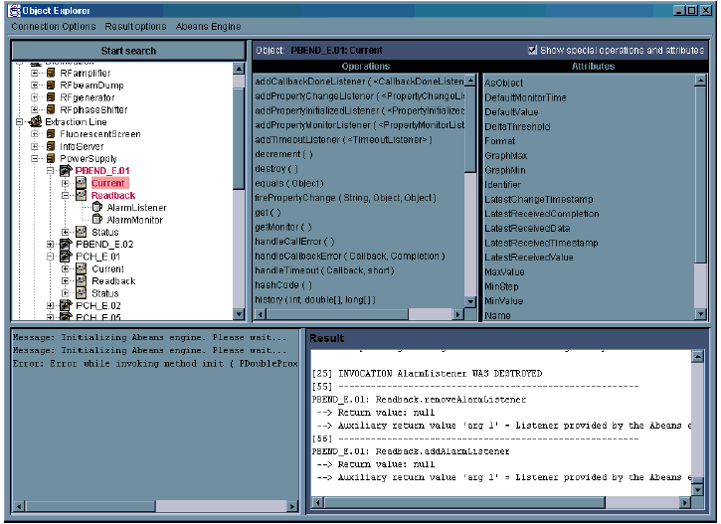
Object Explorer
UTFSM Valparaiso, Chile, Nov 2009
6st ACS Workshop UTFSM
Notes:
The Object Explorer (OE):
Is a generic tool used for low-level inspection of objects in ACS. It can be used as a debugging or testing tool by the developers and maintainers of a system.
Allows to interact with any CORBA Object known to the system (I.e. whose reference can be retrieved from the Manager - see following slides - and whose IDL interface can be retrieved from the Interface Repository).
Is aware of the design patterns implemented by the DO-Property-Characteristic paradigm - see following slides - and can for example monitor the values of properties and draw trend plots, as will be shown in the demo.
Is a standalone Java program designed using a “plug-in”concept and has been adapted to different systems than ACS.

Slide 14
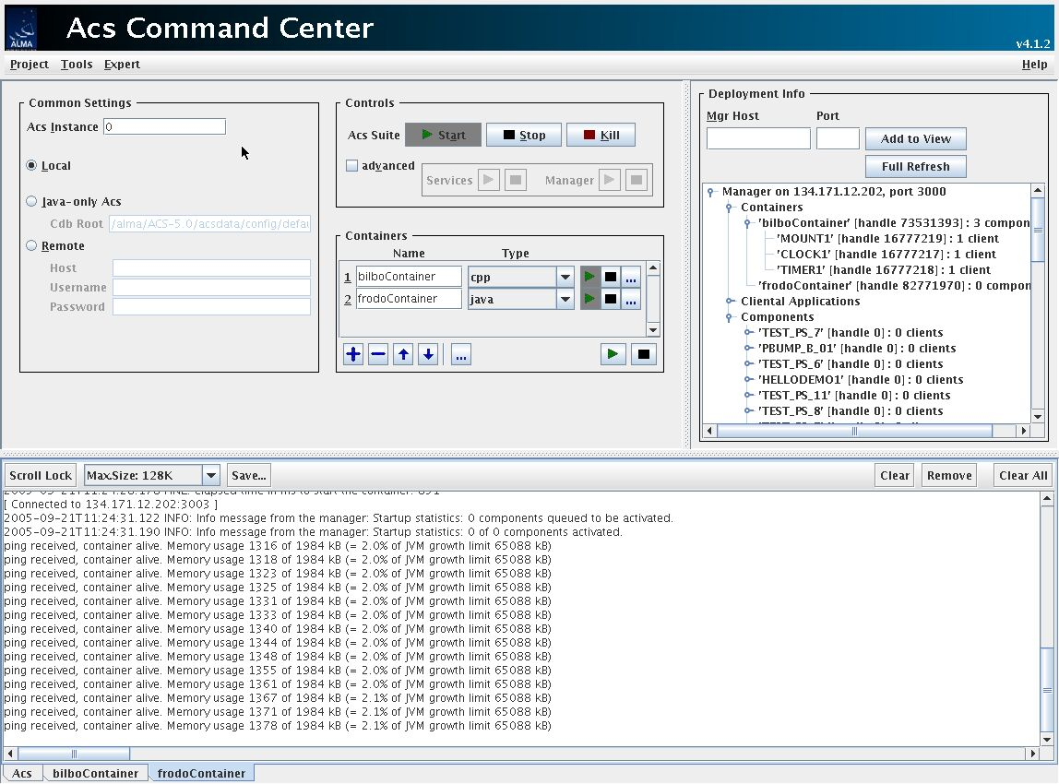
ACS Command Center
UTFSM Valparaiso, Chile, Nov 2009
6st ACS Workshop UTFSM
Notes:
Administrator Client (AC) uses a specific Administrator interface part of MACI to allow ACS System Administrators to inspect and configure the deployment view of a running ACS system.
The Administrator Client:
Displays the information about CORBA objects on the local network. This includes MACI defined objects, such as Containers and Managers as well as Components (or, more in general, Controlled Objects (COBs), since the Manager is able to provide information and partially manage not only Components but also other CORBA servants that do not implement the full MACI interface , like the standard CORBA Services). Both currently active COBs and potentially active COBs (i.e. COBs that the Manager is able to bring online on request) are displayed.
Interact with the MACI Manager through IDL Administrator interface, by receiving notifications about other clients and activators in the system from the Manager.
Is a standalone Java program.

Slide 15

Container/Component evolution
In recent releases we have improved decoupling of Components and Containers:
  Full separation between Container and Container Services
    Cleaner interfaces
    Easier to replace Container implementation
  Dynamic components
  Tasks
We have implemented automatic and dynamic deployment of Containers (ACS Daemon).
Configuration of the runtime system is being discussed. We are working on better tools to keep aligned the configuration of the various ALMA deployments
UTFSM Valparaiso, Chile, Nov 2009
6st ACS Workshop UTFSM

Slide 16

Questions (& Answers)
UTFSM Valparaiso, Chile, Nov 2009
6st ACS Workshop UTFSM
Notes:
20 minutes for discussion (probably some of this time will be spent during the presentation).

Slide 17
Additional slides for discussion
UTFSM Valparaiso, Chile, Nov 2009
6st ACS Workshop UTFSM

Slide 18
Component/Container: buy vs. build
Same idea as .NET, EJB, CCM
  .NET binds to Microsoft platform
  EJB binds to Java programming language
  CCM is still immature and there are no reliable free implementations
Off-the-shelf Component Container implementations are complex and require a wholesale commitment from developers to use the languages and tools supplied.
Focus for these Component/Container implementations are big enterprise business systems
We aim at staying as much a possible compatible with CMM concepts to allow adopting an implementation, when available.
UTFSM Valparaiso, Chile, Nov 2009
6st ACS Workshop UTFSM
Notes:
Commercial implementations of the Component-Container model are quite popular (EJB, .NET).
A vendor-independent specification, the CORBA Component Model (CCM), is under development, but it is not complete, and production implementations do not yet exist.
These are rather comprehensive systems, and require a wholesale commitment from developers to use the languages and tools supplied.
The learning curve for the ACS Component/Container model should be much smoother that for any of these systems, that are thought for complex enterprise distributed commercial systems

Slide 19
Component/Container vs. EJB
ALMA components mostly stateless
  manipulate entity objects (passed by value)
  talk to backend systems
Thus stateless session beans or Message Driven Beans would be used
Would only gain instance pooling with resulting thread-safety
Availability of free application servers more doubtful than with CORBA
Integration with CORBA not as easy (IDL, services, exceptions)
Modifications of EJB container for XML entities more difficult…
UTFSM Valparaiso, Chile, Nov 2009
6st ACS Workshop UTFSM
Notes:
Commercial implementations of the Component-Container model are quite popular (EJB, .NET).
A vendor-independent specification, the CORBA Component Model (CCM), is under development, but it is not complete, and production implementations do not yet exist.
These are rather comprehensive systems, and require a wholesale commitment from developers to use the languages and tools supplied.
The learning curve for the ACS Component/Container model should be much smoother that for any of these systems, that are thought for complex enterprise distributed commercial systems

