Slide 1

ACS Course
JUnit for
Java Unit Testing
H. Sommer
Notes:
A number of papers on the ALMA project and on ACS have been presented in August at the SPIE Conference in Kona, Hawaii:
the ALMA Project has been introduced in the paper 4837-12
ACS in paper 4848-05 (G.Chiozzi et al.)
the overall ALMA software Architecture in 4848-06 (J.Schwarz, G.Raffi).
theALMA Test Interferometer Control Software in paper 4848-07 (R.G..Marson, B.Glendenning).
In this presentation we are going to describe the ALMA Common Software (ACS) that is under development as a set of common software component to be used for the development of any ALMA subsystem.
This work is responsibility of an international team mainly based at ESO and in tight collaboration with the JSI in Ljubljana.
A part from the authors of the paper, we want to thank here the essential contributions to ACS from other members of the ALMA SW community.

Slide 2
Simple Example see ACS/LGPL/CommonSoftware/acserr/test
public class AcsJExceptionTest extends TestCase { mandatory base class
public AcsJExceptionTest(String name) {
super(name);
}
public void testErrorTraceToAcsJExConversion() { test method, recognized by
try { “test” prefix
throwConvertedAcsJException(); // throws a MyException
}
catch (AcsJException e) {
  assertTrue(e instanceof MyException); various assert methods
  assertEquals("remote call failed", e.getMessage());
  Throwable cause1 = e.getCause();
  assertNotNull(cause1);
  assertTrue(cause1 instanceof MyException && cause1 != e);
  assertEquals("low level ex", cause1.getMessage());
} } }
Notes:
vollautomatische Ablaufsteuerung
Ueberwachung durch Admin/Operator

Slide 3
Simple Example (2) see ACS/LGPL/CommonSoftware/acserr/test
public static void main(String[] args)
{
junit.textui.TestRunner.run(AcsJExceptionTest.class);
}
abeansStart alma.exceptions.AcsJExceptionTest
...
Time: 0.148
OK (3 tests)
Notes:
vollautomatische Ablaufsteuerung
Ueberwachung durch Admin/Operator

Slide 4
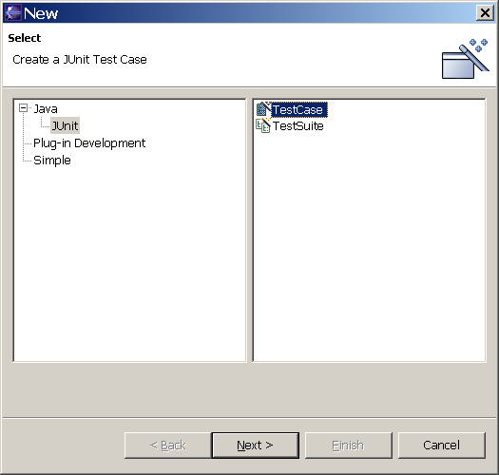
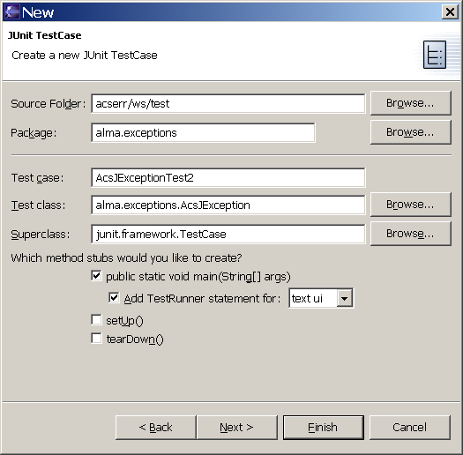
Eclipse support
Class generation
Notes:
vollautomatische Ablaufsteuerung
Ueberwachung durch Admin/Operator

Slide 5
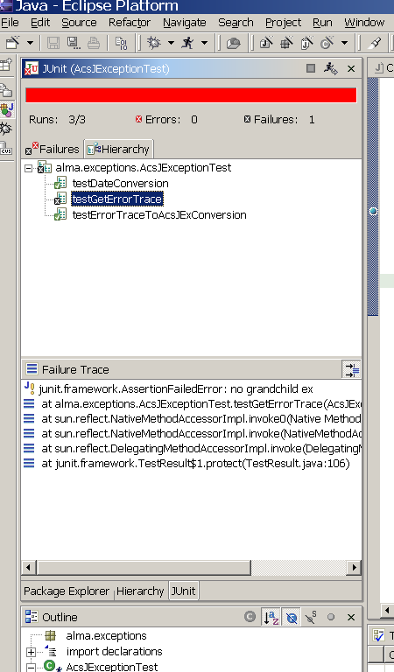
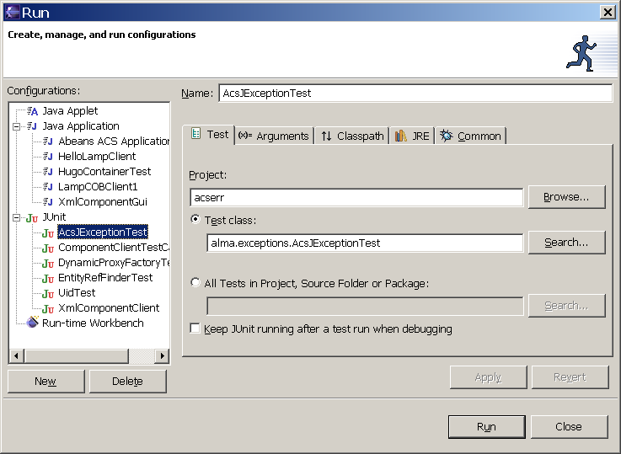
Eclipse support
Test runs
Notes:
vollautomatische Ablaufsteuerung
Ueberwachung durch Admin/Operator

Slide 6
Example from jcontexmpl
Looking at
alma.demo.client.XmlComponentClient
live in Eclipse
Notes:
vollautomatische Ablaufsteuerung
Ueberwachung durch Admin/Operator

Slide 7
Where to put Java test classes see http://junit.sourceforge.net/doc/faq/faq.htm#organize_1
Place the tests under your module’s test directory in a parallel directory structure with package alignment:
mymodule/src
alma
xyz
SomeClass.java
mymodule/test
alma
xyz
SomeClassTest.java
This approach allows the tests to access all the public and package visible methods of the classes under test.
Notes:
vollautomatische Ablaufsteuerung
Ueberwachung durch Admin/Operator

Slide 8
Test Suites group tests see http://junit.sourceforge.net/doc/faq/faq.htm#organize_2
import junit.framework.*;
public class AllTests {
public static Test suite() {
TestSuite suite = new TestSuite();
suite.addTest(SomeTest.suite());
suite.addTest(AnotherTest.suite());
return suite;
}
public static void main(String args[]) {
junit.textui.TestRunner.run(suite());
}
}
Running AllTests will automatically run all of its contained tests in one fell swoop.
You can arbitrarily group any tests into test suites as appropriate by package, logical layers, test type, etc.
Notes:
vollautomatische Ablaufsteuerung
Ueberwachung durch Admin/Operator

Slide 9
Documentation, Links
http://www.junit.org
Cookbook:
http://junit.sourceforge.net/doc/cookbook/cookbook.htm
Very good FAQ
http://junit.sourceforge.net/doc/faq/faq.htm
JUnit for components:
http://jakarta.apache.org/cactus/index.html
ALMA SE, I&T might want to look at this…
Other unit testing frameworks (xUnit)
http://www.xprogramming.com/software.htm
Notes:
vollautomatische Ablaufsteuerung
Ueberwachung durch Admin/Operator

Slide 10
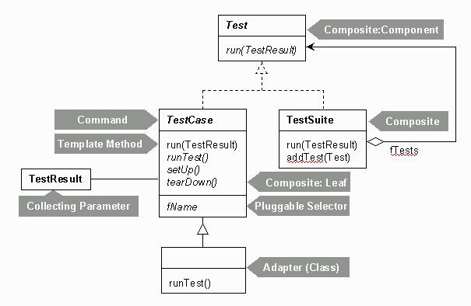
Pattern Invasion…
Notes:
vollautomatische Ablaufsteuerung
Ueberwachung durch Admin/Operator

