Slide 1


Abeans

Slide 2
What are Abeans?
Abeans are Java beans of the IDL interfaces (for the client Java classes created by the IDL compiler).
These wrappers are especially useful in GUI IDEs.
Do not have to be used for GUIs though.
To some extent, they are the Java equivalent of the SimpleClient interface.
Easy to create so even non-programmers like astronomers can develop GUIs.
Abeans are really just clients like objexp. Because of this, we do not care about anything other than the IDL interface.

Slide 3
What are Abeans? (continued)
The only thing an abean GUI needs is the corbaloc of manager (i.e., the hostname and port number that Manager is running on).
A number of widgets have already been designed by CosyLab and are available for use in the ALMA project.
Widgets are specifically designed to interact with BACI properties.
At this point, abeans can really only be generated for C++ and Java Components where exists BACI

Slide 4
The “Bigger Picture”
Linux box
running
Manager
Java GUI
Manager
Abeans Wrapper
JacORB
Java stubs
generated from
IDL
Container
Windows PC
Component

Slide 5
How do I Create Abeans?
Specify IDLs in ABEANS tag in the makefile

Slide 6
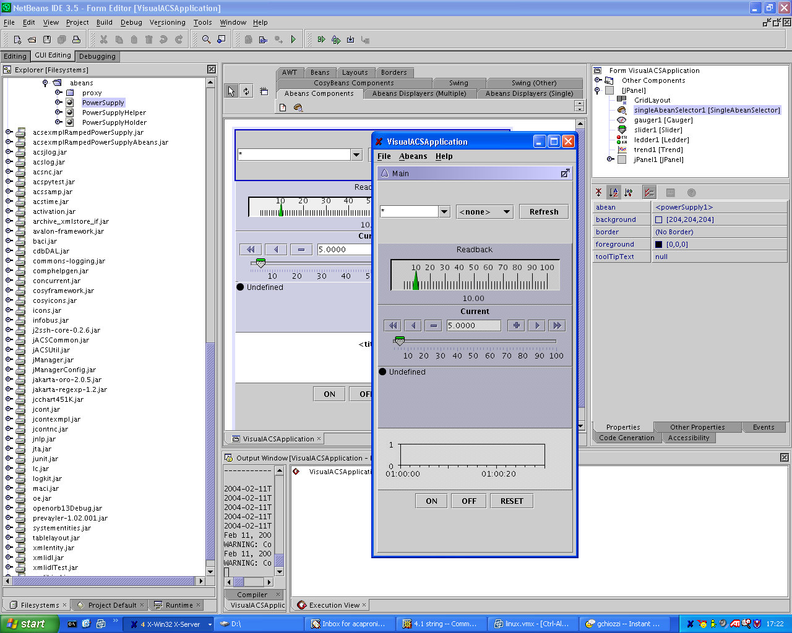
Sample Java Client in NetBeans

Slide 7
Net Beans
The simplest way to get started with abeans is to follow the instructions
located in:
Power Supply Tutorial: coding with ABeans (html):
  http://www.cosylab.com/ProjectDocs/Demo/Documentation/MAN-Power_Supply_Tutorial.html
Visual Bean Composition Tutorial With NetBeans(html)
  http://www.eso.org/projects/alma/develop/acs/Releases/ACS_3_0_Docs/abeans/doc/TUT-Abeans_Visual_Composition_with_NetBeans.html
NetBeans installation and configuration for ABeans(html)
  http://www.eso.org/projects/alma/develop/acs/Releases/ACS_3_0_Docs/abeans/doc/MAN-NetBeans_Installation.html

Slide 8
ACS Training
Developing the Java Client in the NetBeans Tutorial

