Slide 1

ACS
Configuration Database
Bogdan Jeram
(bjeram@eso.org)
European Southern Observatory
Notes:
A number of papers on the ALMA project and on ACS have been presented in August at the SPIE Conference in Kona, Hawaii:
the ALMA Project has been introduced in the paper 4837-12
ACS in paper 4848-05 (G.Chiozzi et al.)
the overall ALMA software Architecture in 4848-06 (J.Schwarz, G.Raffi).
theALMA Test Interferometer Control Software in paper 4848-07 (R.G..Marson, B.Glendenning).
In this presentation we are going to describe the ALMA Common Software (ACS) that is under development as a set of common software component to be used for the development of any ALMA subsystem.
This work is responsibility of an international team mainly based at ESO and in tight collaboration with the JSI in Ljubljana.
A part from the authors of the paper, we want to thank here the essential contributions to ACS from other members of the ALMA SW community.

Slide 2
CDB: the purpose
The ACS Configuration Database addresses the problems related to defining, accessing and maintaining the configuration of a system.
For each Component on the system, there might be a set of static (or quasi-static) configuration parameters that have to be configured in a persistent store and read when the Component is started up or re-initialized.
CharacteristicComponents MUST have configuration information in the CDB

Slide 3
Configurable deployment
This includes the “structure” of the system, i.e. which statically deployed Components are part of the system and their inter-relationships.
  looking at the CDB only you should be able to see how the Components are distributed among the Containers and on what hosts the Containers are running.
  For Components connected to HW, this would tell you as well what HW you are using and where it is located.
  Changing the CDB you can move Components around and distribute them in a different way in the system.
Deployment for dynamic components is not part of the CDB

Slide 4
CDB Issues
input of data by the user
System configurators define the structure of the system and enter the configuration data. Easy and intuitive data entry methods are needed.
storage of the data
The configuration data is kept into a database.
maintenance and management of the data (e.g. versioning)
Configuration data changes because the system structure and/or the implementation of the system’s components changes with time and has to be maintained under configuration control.
loading data into the ACS Containers
At run-time, the data has to be retrieved and used to initialize and configure the Components.

Slide 5
Three-tier database-access architecture
DB Engine independent
Tiers:
Database engine
Database Access Layer (DAL).
Database clients:
  Data clients
  CDB administrators
3 – Database clients
Data client
CDB Administration
Read-only
Data interface
Read-write
admin. interface
2 – Database Access Layer (DAL)
DAL/CDB Server
1 – Database engine
Database
Notes:
The ACS Configuration Database addresses the problems related to defining, accessing and maintaining the configuration of a system based on ACS.
There are 4 different issues related to this problem:
1. input of data by the user
System configurators define the structure of the system and enter the configuration data.
2. storage of the data
The configuration data is kept in a database.
3. maintenance and management of the data (e.g. versioning)
Configuration data changes because the system structure and/or the implementation of the system’s components changes with time and has to be maintained under configuration control.
4. loading data into the ACS Components
At run-time, the data has to be retrieved and used to initialize and configure the DOs.
The architecture of the ACS configuration database is based on three layers[]:
1. The Database Itself
2. The Database Access Layer (DAL)
3. The Database Clients access data from the database using only the interfaces provided by the DAL.

Slide 6
CDB Modeling and Population
The DAL server(s) is the interface to the database engine
A Database Loader is used to manipulate database description files and load them using the DAL administrator interfaces.
The Visual Configuration Tool (CT) allows to visually edit the structure/schema of the CDB and to fill in the values.
The modeling tool is used by a System Architect to define the structure of the system itself.
Development will be in phases
User
User
Visual CT
Modeling Tool
Database Loader
Reverse engineering
Optimal path
DAL/CDB Server

Slide 7
CDB data organization
Data is organized/structured as hierarchy of nodes – objects (DAO) that can contain fields (=data values).

Slide 8
An example of data organization
root
node1
field
node2
Field_1
Field_2
Field_3
node3
f1
f2

Slide 9
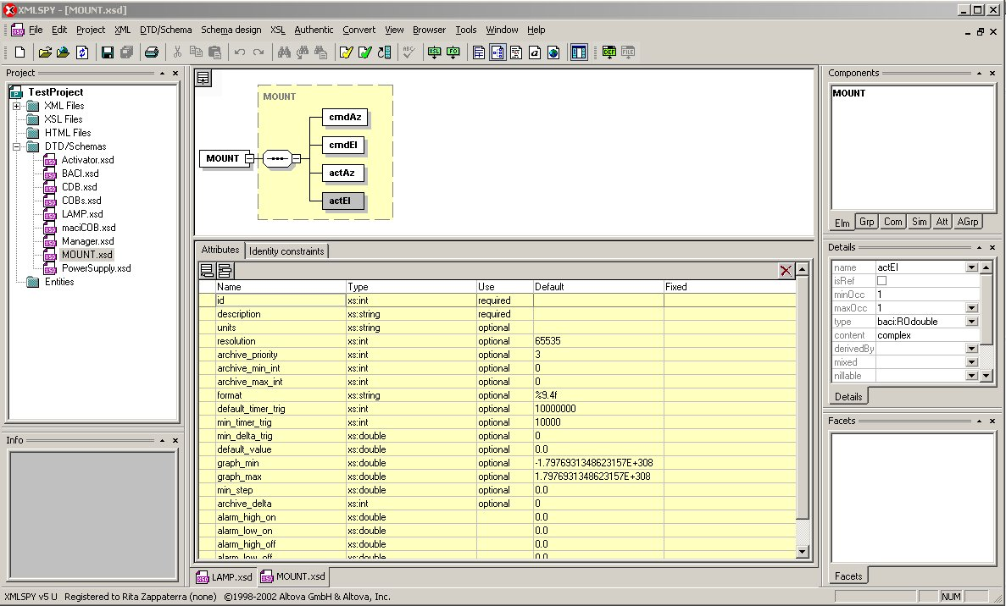
Configuration Database:
Component Schemas

Slide 10
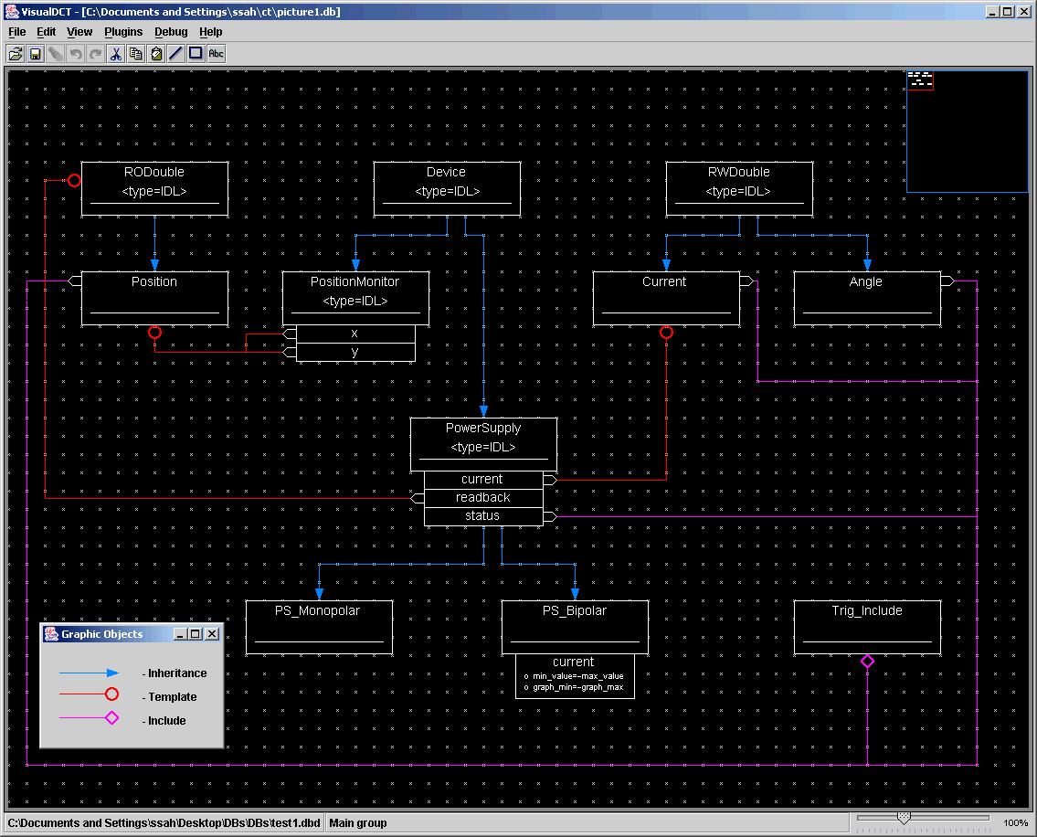
Modeling tool mockup

Slide 11
DAL Server
DAL server implements DAL IDL:
interface DAL {
string get_DAO( in string curl )
raises (RecordDoesNotExist,XMLerror);
DAO get_DAO_Servant( in string curl )
raises (RecordDoesNotExist,XMLerror);
oneway void shutdown();
//data change handling
long add_change_listener( in DALChangeListener listener );
void listen_for_changes( in string curl, in long listenerID );
void remove_change_listener( in long listenerID );
// listing
string list_nodes( in string name );
};

Slide 12
DAO IDL
interface DAO {
long get_long( in string propertyName ) raises (WrongDataType, FieldDoesNotExist);
double get_double( in string propertyName )
raises (WrongDataType, FieldDoesNotExist);
string get_string( in string propertyName )
raises (WrongDataType, FieldDoesNotExist);
string get_field_data( in string propertyName )
raises (WrongDataType, FieldDoesNotExist);
stringSeq get_string_seq( in string propertyName )
raises (WrongDataType, FieldDoesNotExist);
longSeq get_long_seq( in string propertyName )
raises (WrongDataType, FieldDoesNotExist);
doubleSeq get_double_seq( in string propertyName) raises (WrongDataType, FieldDoesNotExist);
};

Slide 13
Component retrieves data from C++
MyComponent::MyComponent(
ACE_CString _name,
maci::ContainerServices* pCS)
{
try {
CDB::DAL_ptr dal_p = pCS->getCDB();
CDB::DAO_ptr dao_p = dal_p->get_DAO_Servant(curl);
description = dao_p->get_string( "description" );
m_units = dao_p->get_string( "units" );
m_min_step = dao_p->get_double( "minStep" );
}
catch( ... ) {
ReportError( m_name, "Unable to read configuration!" );
return false;
}
}

Slide 14
Write DAL interface
for administrating CDB (Database Loader)
used only by specialized applications
interface WDAL : DAL {
WDAO get_WDAO_Servant(in string curl) raises(RecordDoesNotExist, RecordIsReadOnly, XMLerror);
void add_node(in string curl, in string xml) raises(RecordAlreadyExists, XMLerror, CDBException);
void remove_node(in string curl) raises(RecordDoesNotExist, RecordIsReadOnly);
void set_DAO(in string curl, in string xml) raises(RecordDoesNotExist, FieldDoesNotExist, RecordIsReadOnly, XMLerror, CDBException);
};

Slide 15
Write DAO interface
interface WDAO : DAO {
void set_long(in string propertyName, in long value) raises(FieldDoesNotExist, FieldIsReadOnly);
void set_double(in string propertyName, in double value) raises(FieldDoesNotExist, FieldIsReadOnly);
void set_string(in string propertyName, in string value) raises(FieldDoesNotExist, FieldIsReadOnly);
void set_field_data(in string propertyName, in string value) raises(WrongDataType, FieldDoesNotExist, FieldIsReadOnly);
void set_string_seq(in string propertyName, in stringSeq value) raises(FieldDoesNotExist, FieldIsReadOnly);
void set_long_seq(in string propertyName, in longSeq value) raises(FieldDoesNotExist, FieldIsReadOnly);
void set_double_seq(in string propertyName, in doubleSeq value) raises(FieldDoesNotExist, FieldIsReadOnly);
};

Slide 16
Different CDB implementation
Supported only in C++
Abstract interface: DAO
Several implementation of “DAO”:
  INI
  IMDB (memory)
  CCS
  DAL

Slide 17
DAL change notification
Get notification from CDB in case of changes
interface DALChangeListener : ACS::OffShoot {
void object_changed( in string curl );
};
interface DAL {
long add_change_listener(in DALChangeListener listener);
void listen_for_changes(in string curl, in long listenerID);
void remove_change_listener(in long listenerID);
};

Slide 18
DAL navigation interface
Retrieve the list of all children of the given node to allow navigation of the CDB hierarchical structure:
interface DAL {
string list_nodes( in string name );
};
This allows an application to discover the CDB structure. Is essential to build a CDB generic browser

Slide 19
DAL implementation
jDAL – Java implementation of DAL interface
CDB data organization/structure is achieved by:
  file system
  XML schema (XSD) – defines structure of DAO
Data is stored in XML files in directory hierarchy
(Characteristic)Component -> DAO -> XSD
implementator has to provide XSD

Slide 20
jDAL
Started as part of acsStartORBSRVC
$ACS_CDB points to CDB entry point
Default location: $ACSDATA/config/defaultCDB
Test configuration data:
  test/CDB

Slide 21
Data organization
(directory hierarchy)
CDB (root)
  MACI (system deployment data)
    Managers
    Containers
    Components (just component deployment data)
  alma (component specific data)

Slide 22
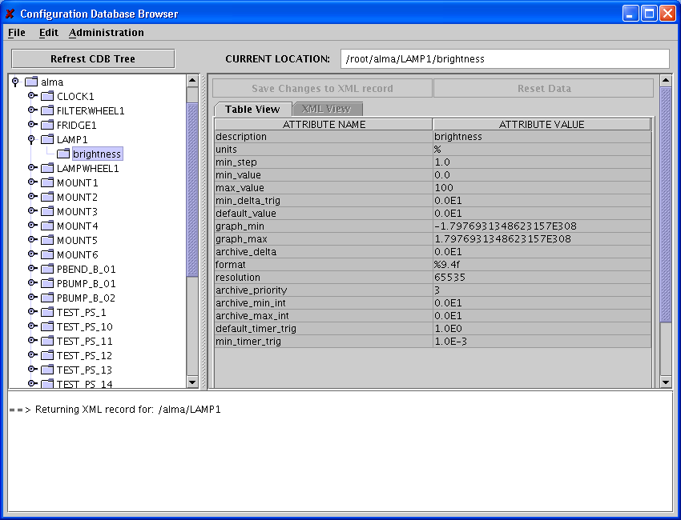
CDB Browser

Slide 23
Documentation
ACS home page
http://www.eso.org/projects/alma/develop/acs/OnlineDocs/CDB.pdf
CDB Browser:
http://www.eso.org/projects/alma/develop/acs/OnlineDocs/CDB_Browser_Users_Manual.pdf

