Slide 1

Property interfacing to Hardware:
DevIO
ACS Development Team

Slide 2
Contents
problem
DevIO concept
implementations
implementing new DevIO
Notes:
Firstly I am going to say something about requirements for Error System than I will explain the architecture of the Error System after we’ll take a look at how the error system works through examples

Slide 3
Problem Statement
Connecting properties with (physical) devices (sensors, motors, controllable units) in a generic way
This implies:
  Communication with hardware device (points)
  Data conversion (i.e. from raw data (binary, hex, …) into engineer units (ampers, …))

Slide 4
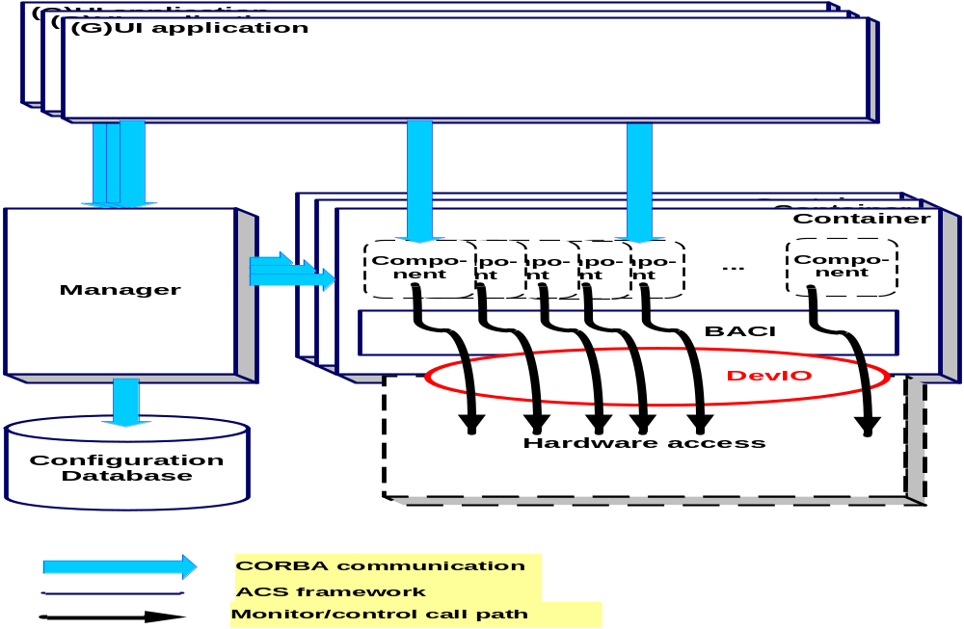
ACS Architecture

Slide 5
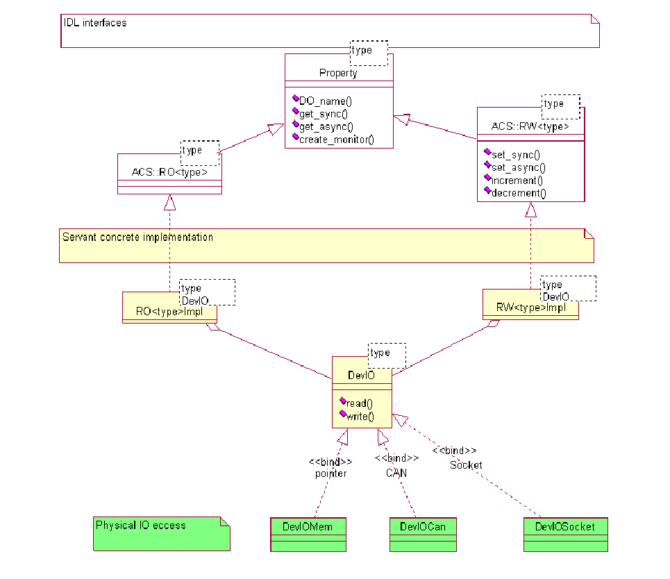
Property Servant Implementation Class Diagram
See p. 24, ACS Architecture

Slide 6
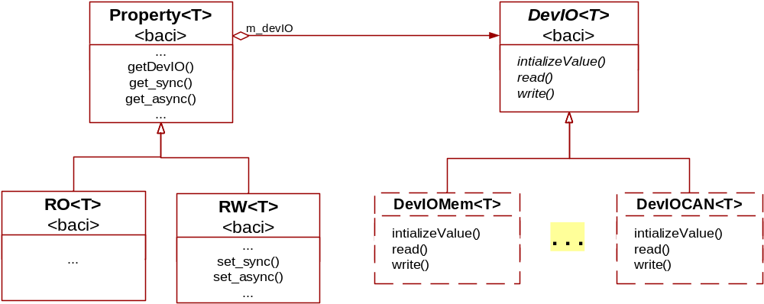
Bridge pattern and DevIO
bridge design pattern is used:

Slide 7
Implementation (C++)
DevIO: C++ abstract template class
DevIOMem: Default implementation provided by ACS
HW specific access provided by specific DevIOXXX implementation
one method for read and one for write data
example:
  ROdouble/RWdouble uses read/write methods from DevIOXXX<double>

Slide 8
DevIO Implementations
Current implementations:
  Memory: DevIOMem
  TICS: CAN bus: devIOCAN
  APEX: Socket: DevIOSock, DevIOUDPSock
  HPT: Shack-Hartmann sensor unit, Heidenhains encoder board, …
DevIOMem default implementation used by properties

Slide 9
DevIO interface class
Template <class T> class DevIO {
public:
virtual ~DevIO(){};
virtual bool initializeValue()=0;
virtual T read(int& errcode,
unsigned long long& timestamp);
virtual void write(const T& value, int& errcode, unsigned long long& timestamp);
};//class DevIO

Slide 10
Usage
creating a property that uses the default DevIO (DevIOMem):
p = new ROdouble(…, …);
createing a property that uses another DevIO (DevIOXXX) implementation:
m = new devIOXXX<double>(…);
p = new ROdouble(…, …, m);
accessing a DevIO
DevIO *dev = p->getDevIO();

Slide 11
Drawbacks
It may need different implementation for different conversions
Split:
  Conversion
  communication (read & write)

Slide 12
New DevIO implementation
Inherit DevIO template class
Implement:
  read
  write (if needed)

Slide 13
Future Improvements
Error handling should be done using ACS Error System
Decouple communication and conversion:
  structure for representing raw data
  conversion interface

Slide 14
References
ALMA Common Software Architecture, ALMA-SW-0016
ALMA Common Software Release Notes
ACS web site

