Slide 1

ALMA SW Development Tools, Standards and Integration Procedures
P. Sivera, M. Zamparelli
European Southern Observatory
Garching – 2003-06-27
ESO

Slide 2
Table of Contents
Generalities
SE issues: QA and Coding standards
Environment
Directory structures
Makefile
Configuration Management
Integration Procedures

Slide 3
Contact persons
  alma-sw-it@nrao.edu
  alma-sw-semgr@nrao.edu

Slide 4
Web pages
  http://www.eso.org/projects/alma/develop/alma-se/
  http://www.eso.org/projects/alma/develop/software/alma-it/

Slide 5
Reference documents
ALMA-SW-NNNN Rev.2 ALMA Software and Hardware Standards, M. Zamparelli (http://almaedm.tuc.nrao.edu/forums/alma/dispatch.cgi/Standards/docProfile/100004/d20030527130011/No/ASHS.pdf)
ALMA-SW-0013 Rev. 3 ALMA Software Engineering Practices, M. Zamparelli (http://alma.nrao.edu/development/computing/docs/joint/draft/ASEP2.pdf)
ALMA-SW-NNNN Rev.0.2 ALMA Software Development Tools and Integration Guidelines, P. Sivera http://almaedm.tuc.nrao.edu/forums/alma/dispatch.cgi/ipt7080docs/docProfile/100051/d20030528101604/No/t100051.htm
VLT-MAN-ESO-17200-0908 Rev 1.4 Tools for Automated Testing User Manual, P. Sivera http://www.eso.org/projects/vlt/sw-dev/wwwdoc/MAR2001/VLT-MAN-ESO-17200-0908/Output/FrontCoverNew.html
ALMA-SW-0010 Rev.5 C++ Coding Standards, A. Bridger, J. Pisano http://www.alma.nrao.edu/development/computing/docs/joint/0010/2001-08-10.pdf
ALMA-SW-0009 Rev.4 C Coding Standards, A. Bridger, M. Brooks, J. Pisano (http://alma.nrao.edu/development/computing/docs/joint/0009/2001-08-21.pdf )

Slide 6
Changes, changes, changes…
configuration management: from CMM to CVS
build system: from pkgin (VLT) to Makefiles
standard env. : from PECS to …. anything else.
Shells for various support tasks: from ksh to bash
OS: RH-6.2,7.2, 7.3 (gcc 2.95 to 2.96)
OS: VxWorks to RTLinux
ORB for Java: from Orbacus to JacORB
directory structure: ALMASW2002101, ALMASW2002102
build system: Ant, Python distutils

Slide 7
Development Environment
Controlled set of development tools:
O.S.: essential to document and standardize the installation and configuration of the OS(s) used.
the same applies to all tools used to develop the software (ACS uses the GNU family for C++ and some more commercial products)
build system (adapted GNU Makefile)
GOAL: be capable at any moment to rebuild a known configuration where the software can be developed or operated.

Slide 8
Your daily bread
CVS
ddd
emacs
Eclipse
gcc
JDK
make
doxygen
JacORB
ACE/TAO
OmniORB

Slide 9
Non QC Tools
Configuration Management: CVS
Documentation extractors: doxygen for C++/Java
Design tools: Rational Rose (33)
Editors: XMLSpy (17)
Communication: VNC, Yahoo Messanger
Change Management: Remedy’s Action Request

Slide 10
Coding Standards
What they bring:
  homogeneity, maintainability
What they are:
  industry standard best practices, naming conventions, guidelines for proper documentation
Languages:
C++: archived, pending review
Java: missing, presumably Sun Microsystems (minor modifications)
Python: draft in preparation
GUI Guidelines: Draft in preparation

Slide 11
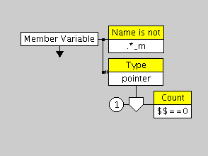
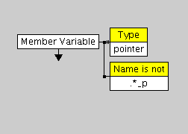
Custom Coding Standards
(example from ALMA-SW-0010)
member variables shall end with _m
member pointer variables shall end with _p

Slide 12
Documentation Standards
In-line documentation standards (Doxygen):
Use @Include to include files for related classes..
Use @see (where appropriate) for class documentation. Author and version are stored in the code repository.
Use @exception, @return, @pre, @post, and @param (where appropriate) for C++ methods.
Use a standard configuration file to store doxygen options.
Document private members. In general it seems better to provide more rather than less documentation about the class.
Use upwards arrows in the class graphs to conform with accepted generalisation convention.

Slide 13
Testing
“increasing to an acceptable level the user’s confidence that the system under test behaves as expected under all circumstances of interest”
  Organizational Measures:
    Independent, unbiased central integration team
    Customer proximity
    Inspection (human)
    Unit tests

Slide 14
Testing (2)
  Technical Measures/Tools:
    testing infrastructure (exercising unit tests)
    separate testing environment under restricted control of I&T
    testing support tools for unit tests generation
    simulators and generators of data sets
    periodic automatic assessment of effective coverage of unit tests
    ease of reference to requirements
    assess “emulability” of physical hardware devices

Slide 15
Purify
Compiled
Test DIR
Makefile
Purify
Make all
UNDETERMINED
UNDETERMINED
TAT
test target
TAT
Purify
make test
test output
FAILED
PASSED

Slide 16
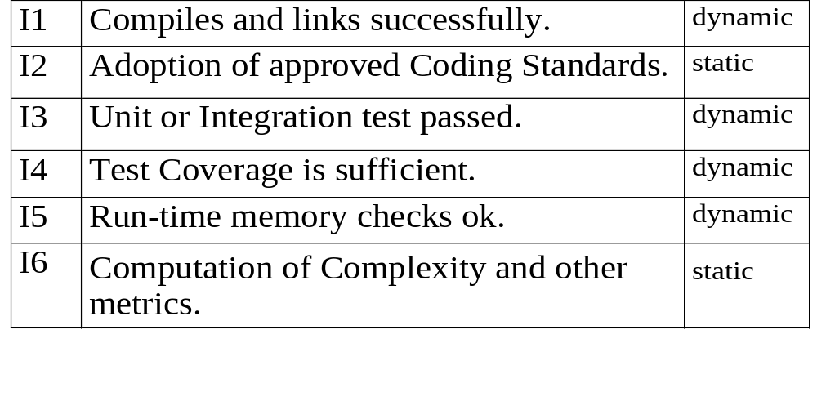
Integration Procedure

Slide 17
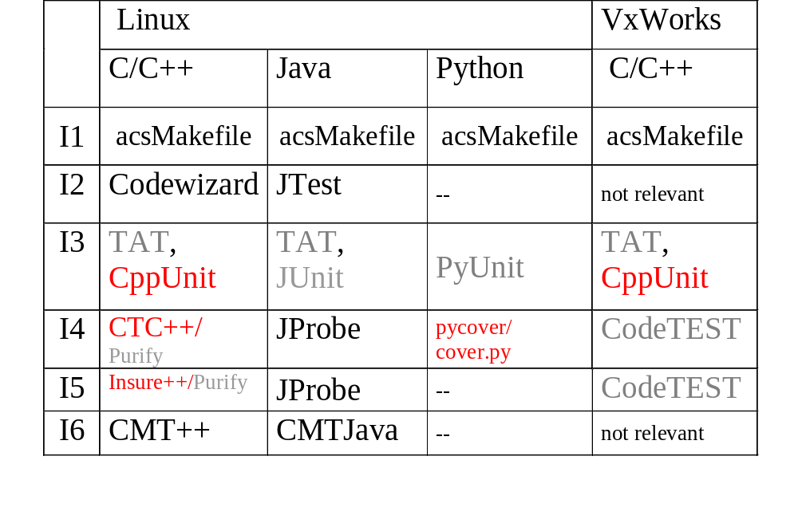
Quality Assurance Tools

Slide 18
Web Page for ALMA SE
Central reference point for SE activities, should contain all information of common interest:
reference info, manually updated (deliverables for each phase, assigned port numbers, delivery procedures, procedures for meetings, list of tools, planned dates for releases, etc.)
reference info, automatically updated (API, integration reports, software measurements, etc.)
templates repository (use cases, packages, installation guide, comments list for reviews, configuration files for various tools, etc.)
Frequently Asked Questions (FAQ) (on tools and procedures)

Slide 19
Night Reporting Infrastructure
Implementation of Integration steps on a “daily” basis
Daily build report on appropriate OS from last code revision
Coding Standards (actually industry best practices) reports:
Naming conventions, dependency diagrams, subsystem partition in modules.
McCabe Cyclomatic Complexity and Halstead Volume, in-line documentation sufficency
in-line documentation
Lines of code at subsystem and global level
test lines of code at subsystem level
Unit test coverage
amount of check-in operations
SPRs per subsystem

Slide 20
Night Reporting Infrastructure (2)
Status:
Daily build report on Linux (last version of code is extracted from CMM and CVS repositories)
Coding Standards (actually industry best practices) reports:
    Scott Meyers’ Effective and More Effective C++ books
    Martin Klaus, Dr. Dobbs’ Journal 1997
    Motorola C and MISRA C
McCabe Cyclomatic Complexity and Halstead Volume, in-line documentation sufficency
Lines of code at subsystem and global level
Unit test coverage (almost…)

Slide 21
Night Reporting Infrastructure (3)
Problems:
no check for LCU code yet (missing compiler for Linux)
avoid false positives
handling exceptions impossible/difficult
data gathering for trend analysis not in place yet
inspection is only possible for compilable (C++) or compiled (Java) code
avoid collecting info on generated code, not always trivial
infrastructure can break easily and requires frequent maintenance
Python is missing

Slide 22
Environment
  Installation user:
    $HOME/.acs/.bash_profile.acs
  ACS libraries installation:
    $ACSROOT/config/.acs/.bash_profile.acs

Slide 23
Environment – cont’d
  Bash is the interactive shell
  Command to source the file:
    . $ACSROOT/config/.acs/.bash_profile.acs
  Edit the file yourself!

Slide 24
Directory Structures - 1
$ getTemplate
  Templates are available for:
  ______________ directoryStructure
  ______________ code

Slide 25
Directory Structures - 2
directoryStructure:
______________createWS_MODROOTarea
______________ createLCU_MODROOTarea
______________createWS_LCU_MODROOTarea
______________ createINTROOTarea
______________ createACSROOTarea
______________ createACSDATAarea

Slide 26
Definition of a module
A software module is a piece of software able to perform functions and having an interface available to an external user to access the functions provided.
Technically a module is a way to organize functions in homogeneous groups. The interface hides the implementation and system dependencies from the user.
Managerially the module is the basic unit for planning, project control and configuration control.
There is no rule to define how big a module shall be. Common sense and programming experience should be enough to identify what can be gathered and treated as a unique item.

Slide 27
Module name
Each module is identified by a name. It is suggested that the module name length is not too long and shall be unique in the project.
Names equal or too similar to UNIX names shall be avoided.
The case cannot be used to build different names, i. e. the following are referring to the same module: xyz, XYZ, xYz.
The module name shall be used in the naming of all elements that belong to the software module.

Slide 28
Module Directory Structure
Separation of WS from LCU code
Separation of source from headers (for C,C++)
Separation of application code from test code
Separation of generating patterns (idl, xsd) from contributed code

Slide 29
Subdirectories
src is the directory where you will be putting the sources you are working on
include is the directory where you will be putting the “.h” files
lib is where the libraries get installed (after running “make all”)
bin is where the binaries get installed (after running “make all”)
idl is for the Interface Definition language files and XML files
man is for the man pages (they are installed after running “make man”)
object is where the dependencies files get installed (when running “make all”)
doc is for other automatic generated (again with “make man”) documentation (for example, .text files to be imported in WORD documents)
test is where the test source code has to be put

Slide 30
INTROOT
$INTROOT variable
Meaning of INTROOT
Shared location for many developers
Frequent clean-up

Slide 31
Hierarchy
src
MODROOT
../bin
bin
make all
make install
INTROOT
bin
$INTROOT/bin
ACSROOT
bin
$ACSROOT/bin
PATH=../bin:$INTROOT/bin:$ACSROOT/bin

Slide 32
acsMakefile
a project wide set of rules, centrally stored and managed.
every developer has to add only the module specific part: the name of the files to be treated!
allows exceptions (it is a normal Makefile)
Based on the features of GNUmake and strictly correlated with the environment variable set up and the directory and Software Module standards.

Slide 33
acsMakefile (2)
allows:
  C/C++ binary applications
  C/C++ library, also local libraries
  Shell, Tcl/Tk, Python scripts and modules
  IDL stubs generation
  Java applications, through Jarfiles
  XmlIdl and XSD generation
  generic files to be installed

Slide 34
<modName>/src/Makefile
For every software modules:
defines what has to be build as a list of variables
includes the project-wide rules ($ACSROOT/include/acsMakefile)
defines the standard targets: all, man, install, clean (if necessary, they can be customized)

Slide 35
<modName>/src/Makefile example
USER_CFLAGS =
USER_LIB = -lACE -lTAO -lTAO_DsLogAdmin -lTAO_CosNaming -lTAO_IORTable -lTAO_PortableServer -lTAO_Svc_Utils -lTAO_CosTrading -lTAO_DynamicAny -lTAO_CosProperty -lTAO_IFR_Client -lacsutil -lcdb -llogging -lCCS -lrecovery -lacserr
INCLUDES = baciDevIO.h baciDevIOMem.h baciExport.h ….
LIBRARIES = baci
baci_OBJECTS = baciDevIOMem baciError \
baci baciTime baciThread baciValue baciDB \
baciRecovery baciCORBA baciDLL baciC baciS ……
DBL_CLASSES = acsDefine acsDistributedObject acsProperty
IDL_FILES = baci
USER_IDL = -I$(ACE_ROOT)/TAO/orbsvcs/orbsvcs/
EXECUTABLES = maciActivate maciManager maciManagerShutdown maciActivatorShutdown \
nslist nsadd
maciActivate_OBJECTS = maciActivate
maciActivate_LIBS = maci
maciManager_OBJECTS = maciManager
maciManager_LIBS = maci
JARFILES = abeansgen
abeansgen_DIRS = si/ijs/kgb/generators

Slide 36
#
# INCLUDE STANDARDS
# -----------------
MAKEDIR = $(ACSROOT)/include
include $(MAKEDIR)/acsMakefile
#
# TARGETS
# -------
all: do_all
@echo " . . . 'all' done"
clean : clean_all
@echo " . . . clean done"
clean_dist : clean clean_dist_all
@echo "Removing files generated by eclipse"
$(RM) -rf ../bin/* hs_err* ../test/logs/*
@echo " . . . clean done"
man : do_man
@echo " . . . man page(s) done"
install : install_all
@echo " . . . installation done"

Slide 37
Makefile rules for Java
added support for Java source code, compiled following standard environment CLASSPATH construction scheme, plus local jarfiles/zipfiles in module’s lib directory
Java source code can be build out of src and test directories
Additional non class files can be added to the jarfiles
User compiler options are supported
JARFILES = DRUI
DRUI_DIRS = alma com atm
DRUI_EXTRAS = skycat
USER_JFLAGS = -O

Slide 38
ACS XmlIdl compler
IDL_FILES
XML_IDL
ACE/TAO
JacORB
Omniorb
C++ Stubs
Java Stubs
Python Stubs
Java Component Wrappers for Container
XSDBIND (XSDBIND_INCLUDE)
Java Entity Classes
COMPONENT_HELPERS
Java Component Helper Classes

Slide 39
Configuration Management
“The discipline of identifying the configuration of a system at discrete points in time for purposes of systematically controlling changes to this configuration and maintaining the integrity and traceability of this configuration throughout the system life cycle”.
Archive is a coordination point:
    if a software is in the archive it means that is READY to be used, because has been TESTED and all files are CONSISTENT. It is used for deliveries and integration thereof.
Centralized CVS Server:
    remotely accessible, secured, backed up, spare parts available, password protected, encrypted communication on demand

Slide 40
ACS
LGPL
NOLGPL
CommonSoftware
Tool
Kit
abeans
tat
vlt
…
doxygen
doc
xmljbind
expat
acstempl
…
acs

Slide 41
EXEC
almaadmin
security
errormonit
schedsync
execmaster
operclient
mailer
statetree
watchdog
sysinfo
useradmin

Slide 42
Integration Procedures
  PREREQUISITES:
Every subsystem must arrive at center already integrated with ACS
Unit tests should be prepared at module level within the framework/tool indicated by the SE Subsystem

Slide 43
ALMA SW Releases:
Subsystem Releases
  R0 → 2003-04-30
  RX.0 major release → 200n-09-31
  RX.1 bug fixing release → 200n-03-31
  X=1,…,4
  n=3,…,7

Slide 44
ALMA SW Releases:
Integrated Releases
  R0 → 2003-06-30
  RX.0 major release → 200n-11-30
  RX.1 bug fixing release → 200n-05-31
  X=1,…,4
  n=3,…,7

Slide 45
Integration periodicity
Monthly integration
CVS tag: MONTHLY-YYYY-MM
CVS command:
cvs tag MONTHLY-YYYY-MM subsystem_name

Slide 46
Cvs tag for milestone releases
MONTHLY-YYYY-MM and
MONTHLY-YYYY-MM-n where n=1,…,∞
cvs tag MONTHLY-YYYY-MM subsystem_name
cvs co –rMONTHLY-YYYY-MM subsystem_name
cvs tag –b MONTHLY-YYYY-MM-B subsystem_name
cvs co -rMONTHLY-YYYY-MM-B subsystem_name
cvs tag MONTHLY-YYYY-MM-1 subsystem_name
cvs update -j

Slide 47
Build and test procedures
Subsystem Makefile
  from the SE web page
  from getTemplate -> code
  <subsystem_name>/Makefile
List of modules belonging to the subsystem
Targets:
  “make build”
  “make test”
where to find it
where to put it

Slide 48
Reports
Portability issues and compilation problems
Test coverage and other metrics
Test results
http://www.eso.org/projects/alma/develop/software/alma-it/

Slide 49
The END
dedicated to Gianluca

Slide 50
Directory Structure
ACSROOT
MAR2001
ACSROOT
OCT2000
INTROOT
nextrelease
INTROOT
mypart
INTROOT
subsystemX
M
C
C
M
C
M
C
C
CMM
Archive

Slide 51
8. Change Management (SPR)
User Submission
Work Completed:
1) Duplicated SPR or ___Incorreclty submitted.
2) SPR Solved.
3) SPR is already Fixed or __User Error.
4) SPR Acknowledged, __but no work will be __undertaken.
Open
The SPR has been entered into the DB.
The SPR has been discussed and suspended.
Suspended
Progress
The SPR has been assigned and work is in progress.
1 Deleted
Close
4 Rejected
2 Solved
3 Clarified

Slide 52
8. Change Management (SPR)
central database implemented as an Action/Remedy application
all access done via WEB interface.
the users that have been added to the system can submit new SPR or query and modify the existing ones.
comments can be added at any time and by any user.
every modification concerning the status or the work-log of an SPR is automatically mailed to all interested people, namely: the author, the responsible, the people responsible for the package to which the SPR belongs, anybody else in the CC field.

