Slide 1
ALMA Control SW & ACS
Ralph Marson (NRAO)

Slide 2
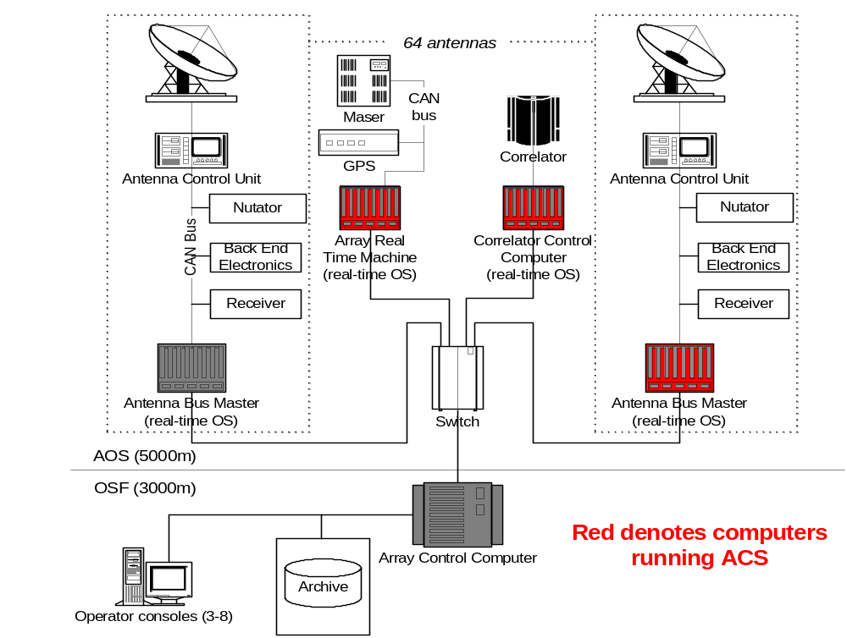
Physical Layout of the M&C network

Slide 3
AMB Characteristics
1Mbit/sec data rate
  Leads to a theoretical maximum cable length of 35m
29-bit addressing
  Split into 11-bit (2048) node address and 18-bit (256k) monitor/control point address
Broadcast mechanism and serial numbers allow automatic device discovery and identification.
All hardware devices are passive and only speak when requested (response in 150 micro-seconds)
  This leads to deterministic communications.

Slide 4
Control SW use of ACS
Uses the “bag of properties” paradigm.
Begins with an Interface Control document (ICD), which is a binding agreement describing the M&C interface of the hardware (next two slides).
Assign one or more properties for each monitor or control point (show slide)
Implement each property, perhaps using a customized device IO classes. (show C++ implementation).

Slide 5
Monitor Point description (summary)
Table 1: Summary of Monitor Points
Name
Relative CAN Address (hex)
Data Size
(bytes)
Sugested Interval
(secs)
Timing Event
related?
GET_COMP_STATE
0x0 00 06
1
300
No
GET_CONTROL_BOX_TEMP
0x0 00 13
2
300
No
GET_CROSSHEAD_CURRENT
0x0 00 08
2
300
No
GET_ELEC_CAGE_TEMP
0x0 00 12
2
300
No
GET_FAN_AIR_TEMP
0x0 00 10
2
300
No
GET_FAN_MOTOR_TEMP
0x0 00 11
2
300
No
GET_FRIDGE_DRIVE_STATE
0x0 00 07
1
300
No

Slide 6
Monitor Point description (details)
4.6.1.1 GET_COMP_STATE
Relative CAN Address 0x0 00 06
Description Get current state of the helium compressor system. On power
up or when power is cycled, the helium compressors will be in
a state determined by a front-panel switch. This monitor point
returns that state, independent of the SET command of the
same name.
Suggested Interval 300 secs
TE Related No
Data 1 byte: (ubyte)
bit 0: 0 -> The compressor is off
1 -> The compressor is running
bits 1 – 7: Unused and always set to zero

Slide 7
IDL file
#include "enumpropMACRO.idl"
#pragma prefix "ALMA"
module ticsFECOMP {
// A baci enum for compressor and fridge drive states
enum DriveState { DISABLED,
ENABLED };
ENUM(DriveState);
interface Fecomp : AMBSI::AmbsiNode
{
// hecomp-specific monitor points
readonly attribute RODriveState get_comp_state;
readonly attribute RODriveState get_fridge_state;
readonly attribute ACS::ROpattern get_status;
readonly attribute ACS::ROdouble get_gm_return_pressure;

Slide 8
Constructor
Example1::Example1(PortableServer::POA_ptr poa, const ACE_CString& name)
:TICS_Device_i(poa, name)
{
// getExampleStatus property
getExampleStatus_mp = new ROpattern(name+":getExampleStatus", getCOB());
ACSDO_PROPERTY(getExampleStatus, getExampleStatus_mp);
// getPowerState property
Member function
ACS::ROpattern_ptr Example1::
getExampleStatus(CORBA::Environment& ACE_TRY_ENV = TAO_default_environment ())
ACE_THROW_SPEC ((CORBA::SystemException)) {
if (getExampleStatus_mp == 0) return ACS::ROpattern::_nil();
ACS::ROpattern_var prop =
ACS::ROpattern::_narrow(getExampleStatus_mp->getCORBAReference(),
ACE_TRY_ENV);
return prop._retn();
}

Slide 9
Include
class fecompState: public devIOCAN
{
public:
fecompState(const ACE_CString & name, ambSimpleCANNode *Node)
: devIOCAN(name, Node) {};
virtual void writePattern(long value, int &errcode, unsigned long long &timestamp);
virtual long readPattern(int &errcode, unsigned long long &timestamp);
};

Slide 10
Implementation
long fecompState::readPattern(int &errcode,
unsigned long long &timestamp)
{
unsigned char uch[8];
int data_len;
errcode = m_Node->Read(m_RCA, data_len, uch, timestamp);
if (uch[0] == 0) {
return ticsFECOMP::DISABLED;
} else {
return ticsFECOMP::ENABLED;
}
}

Slide 11
Device communication
Uses a specialized Device IO class (devIOCAN)
Derive a specific class containing custom conversions or status bit interpretation. This leads to many small classes and a lot of code duplication.

Slide 12
Demo of objexp & antMount GUI

