Slide 1
The New Abeans and CosyBeans
Cutting Edge Application and User Interface Framework
Igor Verstovsek (igor.verstovsek@cosylab.com), Janez Dovc, Miha Kadunc, Jernej Kamenik, Igor Kriznar, Gasper Pajor, Mark Plesko, Ales Pucelj, Gasper Tkacik
Jozef Stefan Institute, Cosylab Ltd.
Notes:
My name is Igor Verstovsek and I will present The new Abeans and CosyBeans - our new frameworks for application development.
-------------------
ToDo:
- Replace ws's in PSMultipleDemo with gaugers.
- poprvi slikico od Gaugerje, ki ima exception.

Slide 2
Application Frameworks
What are they good for?
  Factor out shared functionality
  Provide extension points
  Try to insure high quality of the code
Cosylab experience with application frameworks:
  6 years of continous development
  Projects: ANKA, DESY, ESO, RIKEN, SNS,...
Abeans and CosyBeans
Release 3
Need for a new design
Notes:
I will talk about Frameworks for application building. By using the frameworks, the programmer should be more productive. This means that in the same unit of time, he or she writes an application with more functionaliuty and of higher quality.
In order to delive on these promises, the frameworks must do the things enumerated on the slide.
The concept of Abeans as an application development framework is not new and some of you have already heard of it - Abeans (now called R2) are widely used and well tested in a variery of environmenst: at ANKA - synchrotron light source, DESY, ESO - telescope array, RIKEN, and others.
Experience gained indicated from these procjects indicated the need for a new design ->
<ENTER>
result: 2 fmwks, fully functional and complementary: Abeans and CosyBeans.
In short, Abeans handle the modelling of complex systems and data exchange with such systems, while CosyBeans take care of data visualisation and provide the application outline. By using them, visual and manual development of applications is greatly facilitated, platform independence is achieved, and much more.
---------------------------------------------------------------------------------------
John Galambos, SNS, a client said: "It solves problems we did not know that exist."

Slide 3
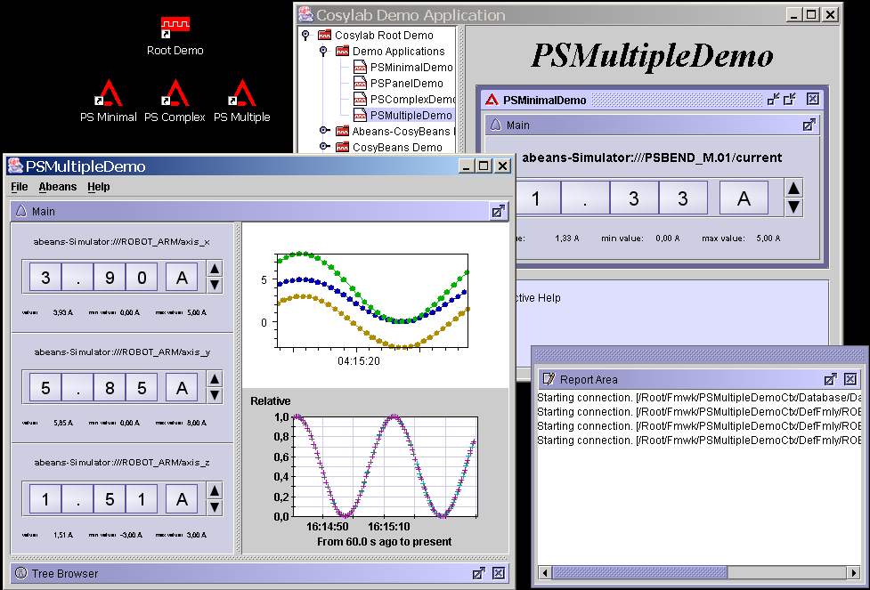
Demonstration
Notes:
To demonstrate, what our team was doing for the last two years, I have prepared a demonstration:
1. Sorted Task Manager
2. RootDemo: A RootDemo for all Cosylab Demonstrations: Observe Abeans Launcher - a lot of hidden functionality, consistency, etc.
3. PSMinimalDemo: Starts inside a JInternal Frame, uses Abeans Simulator. A Fully functional Abeans Application
3a. Open TaskManager: Java's common problem: More applications running in parallel - high Memory consumption
4. PSMultipleDemo: Start another applcation in another JVM, look at TaskMan: JVM sharing, we have gained 20Mb of RAM!!!
5. SimulatorSettings: Configurable, testing. GUI design guidelines - poster by Miha Kadunc
5a. x-axis - harmonic, x-axis, dynamic values dialog open.
5b. Say something about charts: a) Fast, developed at home, b) a commercial, used via adapter.
6. Produce a timeout: Clock, report Area.
7. Smart, drag out: All new features of CosyBeans.
8. I could go on like this with CosyBeans features, but we have to return to the presentation.

Slide 4
Functionality Overview
Integration
User-friendly application building
Abeans
Models (Channel, BACI)
Plugs (TINE, EPICS, ACS)
Services (Configuration, Loaders, Debug,...)
CosyBeans
Utility components
Adapters and Displayers
Launcher, Engine, Plugins
Common
Automatic ANT builds
Definition of Properties
Notes:
Now that we have seen the frameworks at work, we will look into them in some more detail:
The code is organised into CVS projects as follows:
1) The foundation for both fmwks, the "Common",
2) the two application building frameworks - "Abeans" and "CosyBeans",
3) and the integration projects that enables rapid applicion development.

Slide 5
Common
Automatic builds
  Using ANT build tool
Definition of basic CS Specific interfaces
  Property, Access, Monitor,...
Utility classes for the Java platform
Notes:
The Common Project handles automatic ANT builds by the Apache-Ant group tool. Builds are performed via executong build tasks. We chose Ant because:
it is easier to manage than makefiles, it integrates with eclipse and is customized for Java.
In addition, the Common defines basic CS property interfaces, used by both fmwks, and additional utility classes for the Java platform.

Slide 6
Abeans
1/2
Models
  Logical containment of CS Objects
  Channel, BACI
Device
Channel 1
Property 1
Channel 2
Property 2
Property 3
Plugs
  Connection to remote modeling layer
  TINE, EPICS, ACS CORBA
Notes:
Abeans is basically a framework for modeling complex systems: Abeans can be used to build a MODEL, build a PLUG and to organize SERVICES, not directly related to CS, but to app. building.
MODELS:
Abeans model defines the contaiment of Objects (in OOP sense) that represent
- remote controllable entities
- their lifecycle
- and bindings to other services, offered to abeans.
We have implemented Channel and specified BACI models. I will not go into details, let's just say that in the BACI model the properties can be organised hierarchically, and in Channel they are not. The first is especially useful for the ACS system Mark has presented, and the second for EPICS and TINE systems.
PLUGS:
Usually, Abeans communicate with an existing software that offers access to the data. Plugs handle the communication with this software. We have implemented plugs for
TINE at DESY, and EPICS - communicates with the JCA library. In this manner we have effectively joined Abeans and EPICS !!!, giving the app. developer the best of both worlds. Ales Pucelj will say more on the subject. Besides, we are also planning to implement a plug for ACS CORBA

Slide 7
Abeans
2/2
Services
  Implementation of shared functionality
  Error reporting, Logging, Debug,...
Abeans are usually used by
  Visualization libraries (CosyBeans)
  Calculation packages (XAL, OrbitCorrection)
Abeans are not a GUI framework
  Abeans prepare the data for visualisation
Notes:
Services provide implementations of commonly used sofware, like
error reporting, logging, resource loading, debugging, configuration management, etc.
In addition, Abeans offer standrard interfaces for access to distributed services - distrib. naming service, or a disr. archive.
Abeans are usually used as clients - as a data consumer of remote data. They manage the connection, lifecycle and prepare remote data for:
- either some visualisation library, like for CosyBeans,
- or some calcuational package, like XAL by SNS - spallation neutron source. Integration of XAL with Abeans has greatly simplified XAL code, making it cleaner and job-specific.
The Abeans framework does not provide GUI functionality. However, Abeans have been designed to be used as JavaBeans - to be used in VCE as invisible components.

Slide 8
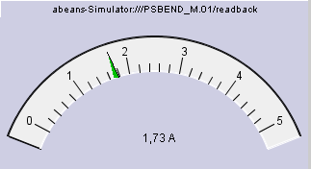

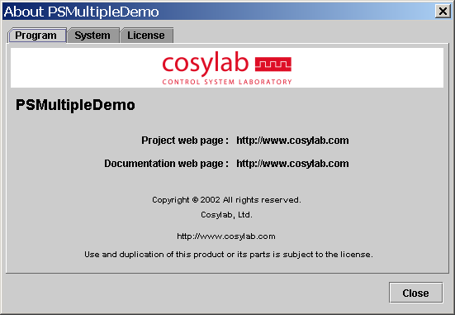
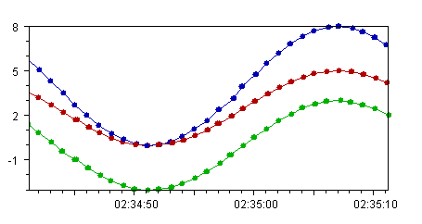

CosyBeans
1/3
Utility graphics components
Notes:
Where the path of the data ends with Abeans, it continues with CosyBeans.
CB are basically data visualisation library,
but also provide core stand-alone Java GUI components, that are would normally be implemented from scratch every time. You have seen some of them in the demonstration.
Here we have the gauger, spike chart, about dialog, a ledder for displaying status array and a wheelswitch.
This components can be used in a similar way to ordinary Java Swing gui classes.

Slide 9
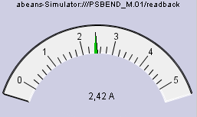
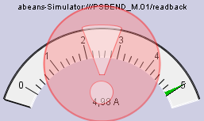
CosyBeans
2/3
Adapters and Displayers
  Lifecycle
  Connection status
  Data quality
    timeouts, errors, etc.
Displayer
Adapter
Abeans
Infobus
...
Notes:
CosyBeans Displayers are used for rendering the values of the remote data, INCLUDING all the additional info, such as
connection status, data quality, etc. For example - you have seen in the demo what happens if a timeout occurrs. Similarly, if some error in communication occurs,
<ENTER>
Displayers show a semi-transparent exlcamation mark over them. Note - semitransparency is a new feature, offered by the latest version of Java 1.4. It is features like this, that make CosyBeans a "cutting-edge" visual fwrk.
<ENTER>
To couple the core visual classes to data sources, we provide ADAPTERS: these are thin pieces of software that connect to a data source, that can be either Abeans or some other data source, like the infobus, which is a standard Java data providing fmwk.
The communication between and adapter and displayer is quite complex, but the point is that the details are not important to the user: He or she just constructs a displayer and assigns an adapter to a remote source to it, everithing else is handled automatically.

Slide 10
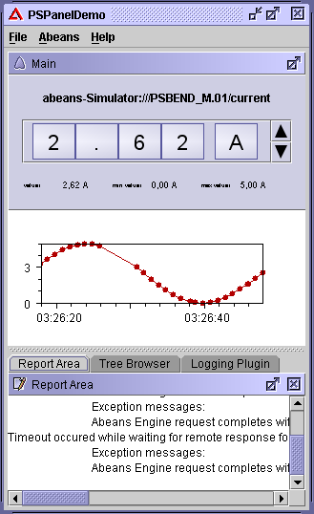
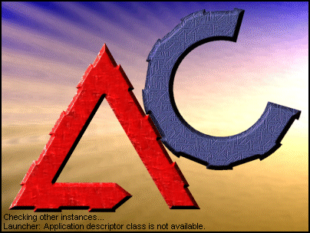
CosyBeans
3/3
Application Outline: CosyPanel and Launcher
Application
JVM Sharing
Applet
Internal Frame
Webstart
Notes:
Finally, CosyBeans go even further than just provide visualisation. They define a complete application outline:
All CosyBeans applications are written inside the main entry point - the CosyPanel. Besides being the main entry point, it contains many useful application features, some of which you have seen in the demonsration (smart dragging, support for report areas, etc.)
By using the Launcher and Launchable API, provided by CosyBeans, the SAME application can be launched as
- a normal application, an applet, as an InternalFrame inside a Java desktop o via Webstart.
To emphasise: When the user writes the application he does not care HOW it will be ran, by Using CosyBeans application framework, all possibilites are covered by default.
Furthermore, as demonstrated, the launcher enables JVM sharing, thus providing a hige boost in Java memory performance.

Slide 11
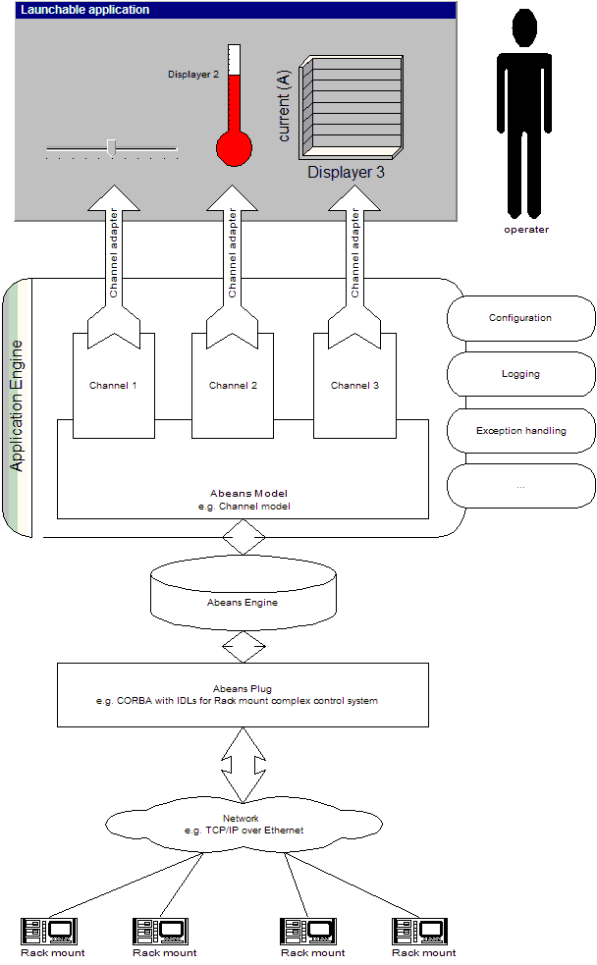
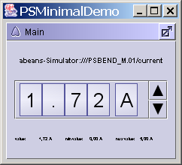

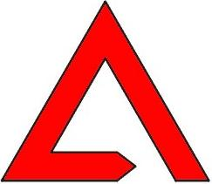
Integration of Abeans and CosyBeans
Abeans Engine and Abeans Launchable
  Facade Pattern ⇒ Simple Syntax
MinimalDemo
MinimalDemo
Abeans
Engine
getEngine()
getCurrent()
Notes:
Abeans and CosyBeans can be used separately. However - a true pleasure for the Application deveopler is to use them together.
The Integration Project provides the facade for Application developer: It hides the details of the application - common abeans services are installed by default, etc.
Lets look at an example from the demonstation: A simple application that displays a value from the remote source: The porgrammer just has to provide the GUI part of the application: He pust a wheelswwitch inside the CosyPanel. In the engine part of the application he has to specify to which remote source the dispayer shall connect to. All other details are then handled automatically by the Abeans.
In this manner, the a fully functional application is produced, as displayed on this figure.

Slide 12
Quality Assurance
The libraries are very well documented
Same core code is used everywhere
  Fix for one customer, enjoy everywhere
Automatic JUnit tests are used
  Run with every build
Request Tracker bug management tool
Plan: Automatic bug reporting
  Similar to Netscape or MS IE
Notes:
QA / QC are of central importance for the app. fmwk developer, since the code will run in many places.
On this slide you can see that we have taken care to produce a professional quality product.

Slide 13
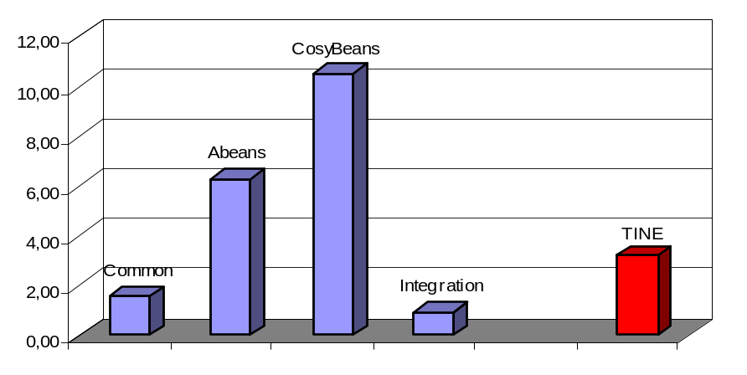
Frameworks at Work
Investment into the frameworks is large
Frameworks must be widely used
  the 3:1 rule
Current Users
  TINE
Near Future Users
  SNS, ESO, ANKA, RIKEN,...
Product
SLOC
Work
Cost
Common
7,343
1.58 my
$ 213,000
Abeans
26,715
6.30 my
$ 851,000
CosyBeans
44,931
10.54 my
$ 1,423,000
Integration
4,214
0.91 my
$ 122,000
Together
83,203
20.76 my
$ 2,804,000
TINE
14,120
3.22 my
$ 435,000
Notes:
To give you a feeling of the framework complexity, we have run a statistical program throug the code, the resutls of which are displayed in the table and the figure:
- As you can see, the investment into the fmwk development is large, more than the usual investment into the equivalent part of a CS. This alone makes our fmwks a contribution to the community, since working for a concrete project you never have the resources to develop something like that.
- times and cost estimate (20 man-years and 2.8 M$) are greater than the actual time we have spent on the development -
<SALA>Mark didn't pay not eve a fraction of this sum.
We have actually spent about 8 man-years on the project which speaks in favour of the programming expertise of our group.
- We have tried to show that fmwks are good, but to be a true success, the fmwks must be widely used. The general rule is that fmwk development must be offset by at leat three times the time devoted to writing apps without framework.
- currently, the fmwk users is the TINE group from DESY. As you can see, we are still way behind the 3:1 rule.
However, in the near future we will finish the implementation of the plug for SNS, port R3 to our CS, that is running at ANKA, we have protorypes for RIKEN.

Slide 14
Conclusion
Advantages of Application Frameworks
Abeans and CosyBeans are mature
Frameworks are fun
  Much more fulfilling to write an application framework than it is to develop tons of similar applications
  Thank You!
Notes:
We have showed tha advantages and features of the new frameworks.
We believe that the fmwks are mature. Our direct experience from DESY is that for one-man year they have invested into us, they got 20 man-years equivalent of code.
Even EPICS people from SNS are enthusiastic about the Framewroks - John Galambos said that Abeans and CosyBeans that: "It solves problems we did not know that exist."
And Finally: Developpment of Abeans and CosyBeans proved to be fun - much better than to develop tons of monolithic applications, solving the same problems every time.

