Slide 1

ALMA
Common Software
Training-Course
Session 1a - What is ACS
G.Chiozzi, H.Sommer, B.Jeram, D.Fugate, B.Gustafsson,
J.Ibsen, P.Sivera, M.Zamparelli …..
Notes:
A number of papers on the ALMA project and on ACS have been presented in the past years at various conferences (SPIE,ICALEPCS, ADASS).
in August at the SPIE Conference in Kona, Hawaii:
You can find them here:
http://www.eso.org/projects/alma/develop/acs/OtherDocs/ACSPapersAndSlides/index.html
This work is responsibility of an international team mainly based at ESO and in tight collaboration with the JSI in Ljubljana.
A part from the authors of the paper, we want to thank here the essential contributions to ACS from other members of the ALMA SW community.

Slide 2
Contents
Why and what is a common software?
ACS Packages and Architecture Overview
How can you get more information
Notes:
Participants to this ACS Course have experience with the VLT Common Software and are therefore vey familiar with many of the concept introduced in this course.
This first introduction is clearly for the newcomers, to provide the general framework for the ACS concept.
In the presentation we will try to explain:
What the ALMA Project is
Why did we decide that a Common Software was essential for the development of ALMA
How did we get to the current architecture
What this architecture actually is and which are the key components
How are we going to go on
We will finally provide some conclusions and pointers to resources to get more information on ACS and, more in general on the ALMA project.

Slide 3
ALMA Common Software (ACS)
  ALMA project is highly distributed:
  many sites and many “development cultures”
ACS aims at providing an answer to the following needs:
  common application framework and programming model, not just libraries
  well tested software that avoids duplication
  make upgrades and maintenance reasonable
  incremental development via Releases
  standardisation offering environment with design patterns and their implementation (rather than pure rules).
  common configuration control/installation procedures
Notes:
The ALMA project is characterized by the fact of being an highly distributed effort, with many sites and many “development cultures” involved. The Computing Group is scattered across 3 continents and many more institutes.
Early in the ALMA project it was decided that an ALMA Common Software (ACS) would be developed as a way to provide to all partners involved in the development a common software platform. The original assumption was that some key middleware like communication via CORBA and the use of XML and JAVA would be part of the project. It was intended from the beginning to develop this software in an incremental way based on releases, so that it would then evolve into an essential embedded part of all ALMA software applications. In this way we would build a basic unity and coherence into a system that will have been developed in a distributed fashion.
The ALMA Common Software (ACS) is a comprehensive framework on top of the operating system, offering a complete environment and structures at the base of application software developments. ACS is meant to be a general system, based on available middleware (CORBA) and the easy embedding of languages like Java and Python.
We believe that the use of a common software layer in a very geographically distributed development situation will be the best way to enforce the use of common constructs. ACS shall provide a well tested platform that embeds standard design patterns (much better than a set of written rules) and avoids duplication of effort. At the same time this will provide a platform where upgrades can be incorporated and brought to all developers. It will also standardize the underlying architecture of software modules, making maintenance affordable.
This approach worked very well for the VLT Project and the VLT Common Software.

Slide 4
ACS start-up: Summer 1999
Preliminary discussions on ACS objectives and structure:
  experience from VLT and other projects
  New technology: CORBA, Java, XML
Decided to start from existing product, to make use of CORBA experience.
Collaboration with JSI-Ljubljana to further develop existing system built for High Energy Physics (ICALEPCS ‘99, Trieste).
Notes:
The experience from VLT and other projects helped identify the advantages and disadvantages of using the same technology.
In many core concepts, ACS and VLT’s CCS are very similar which has been proven by the successful Kitt Peak tests. However, ACS is an open project using already existing technology that is based on the motto: “”Write once, run anywhere.”
We should mention that ACS has a bigger footprint than VLT but it does not affect its performance.
Some parts with emphasis on real-time performance have been implemented in C++ (the low-level architecture, the Event System, Notification Channel, etc.) whereas for others (high-level architecture, the Data Flow) Java is to be used. Java achieves what C++ does with less code. Additionally, Python has been selected as a scripting language. Its advantages:
clean syntax,
dynamic type checking,
powerful library,
portability,
object-orientation,
good community support,
easy to use and learn (also its ORB implementation),
easy to integrate with C++ (important for TICS),
can be seamlessly integrated with Java (important for GUIs).

Slide 5
ACS Development Plan
ACS long term development is specified in the ACS SW Development Plan:
http://www.eso.org/~almamgr/AlmaAcs/Plan/ACSDevelopmentPlan_2.0.pdf
6-months cycle. Driven by ALMA Subsystem’s requirements
ALMA using ACS 4.1 (the 9th release)
Content of each release discussed with user’s community
Notes:
The ACS development is based on the ACS SW Development Plan document, that is updated at each ALMA SW Design Review. This document gives the long term direction of development.
The ACS release plan is further based on a 6-months release cycle, synchronized with ALMA SW releases to allow subsystems to develop the code for their releases based on a stable ACS release. We alternate:
Major releases, with the main objective of introducing new features
Minor releases, with the main objective of bug fixing
Between release we have “third number” patch releases, if and when necessary.
The detailed content of each release is discussed with the user’s community beforehand, based on a proposal of the ACS team that takes into account both the long term development plan and the requests from the ALMA subsystems (and eventually other external users).
This scheme allows ACS development to follow a clearly defined roadmap, being at the same time very responsive to user’s needs.

Slide 6
ACS 5.0 and after
Objective until ACS 2.1:
  support Control SW Development (TICS)
Objective for ACS 3.x:
  Support Pipeline, OT and high level software
  requirements
ACS 4.x and after:
  Bulk data transfer
  IDL generic simulator
  RTAI support
  Cleanup and refactoring
  Code generation from UML (Data Model)
ACS 5.0
  Alarm System and other planned packages
  RPM packaging
  Optimization, scalability, performances, security
  “Operation” support at the ATF
Notes:
The first releases of ACS concentrated on supporting Control SW development, because of the priority of TICS for the project.
With ACS 3.0 we have moved the focus of the development to satisfying the requirements from higher level subsystems and in particular the Pipeline and the OT. For the first “customer” we have therefore implemented much stronger support for Python scripting and dynamic deployment that are needed for the integration of AIPS++ in ACS. For the OT we have implemented pure Java installation features based on Java Web Start technology, allowing the automatic installation and update of applications on the astronomer’s desk.
In ACS 4.0 we have done some major cleanup and refactoring or important classes based on the experience accumulated up to this moment.
With ACS 5.0 will provide updates on the operating systems supported and push as a main objective to get the system as much as possible stable to support “operatio” at the ATF with the ALMA software develped with R3.
On top of that we will introduce the new ALMA Alarm System (a prototype is available already now, but is very limited and does not implement the desired architecture) and new work to support Offline development.

Slide 7
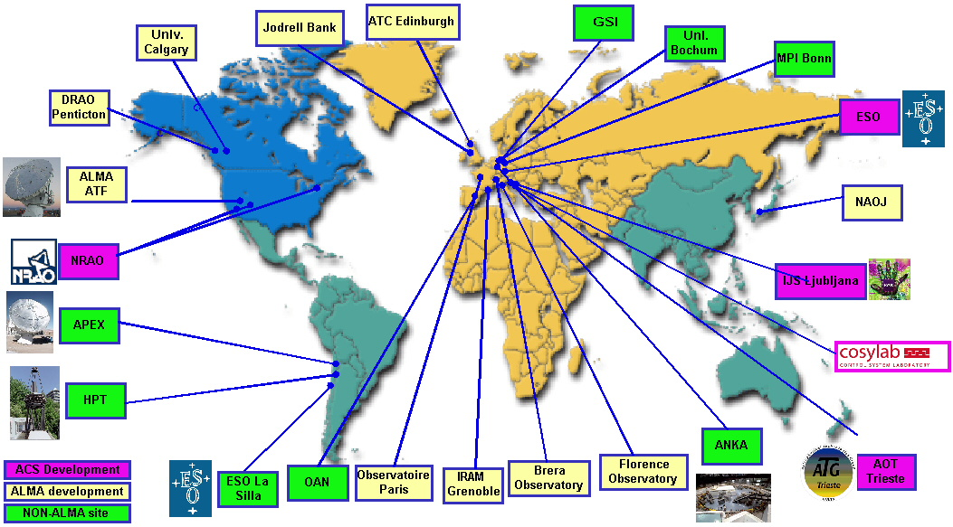
ACS installations and projects
Notes:
ACS is installed in all ALMA development sites, but it is also used or under evaluation by a number of other projects.
On March 8th and 9th there will be a workshop in at ESO in Garching with all current and potentially interested users of ACS.
ABeans have been developed by JSI/Cosylab independently from ACS and are used on different projects, in particular on a number of EPICS projects.

Slide 8
Supported Platforms
Operating system: Linux (MS-Windows)
Real-time: VME,VxWorks (Phase1), RTAI, CAN bus
Languages: C++, JAVA, Python
CORBA middleware: TAO (& ACE) (C++), JacORB (Java), Omniorb (Python), CORBA services.
Notes:
The platforms and development environments supported by ACS are decided for each release, based on the requests coming from the user’s base.
Our main development platform is Linux
Real time systems run under VxWorks (being phase out) and RTAI (that will soon completely replace VxWorks).
For example ACS 5.0 will provide complete support for:
Linux (RH Enterprise 4) development and run time
Cross development for VxWorks (Tornado 2.0.2) from Linux workstations (Sun Solaris 2.8 needed for VxWorks tools), upload on VxWorks run time and debugging
RTAI on Linux
Development of Java applications takes place on Windows or Linux platforms using the Eclipse IDE. Java applications can run both on Linux and Windows.
Future releases of ACS will also support small-footprint run time only installations.
An MS-Windows version of most ACS core components is used at JSI for development and testing

Slide 9
ACS Packages
Applications
4 - Hi-level
UIF
Scripting
ACS Application
ACS Installer
...more to
APIs and tools
libraries
Framework
come...
5 - Integrated
APIs and tools
3 - Services
ACS Container
Serializati
Archiving
Command
Alarm
Sampling
FITS libraries
on Plugs
System
System
System
(from Commercial/Shared packages)
2 - Core
ACS Component
Configuration
Data
Error
Logging
Time
Astro libraries
components
Database
channel
System
System
System
(from Commercial/Shared packages)
Device Drivers
1 - Base tools
Developm
CORBA Middleware
ACE
ent tools
Notes:
This package diagram summarizes the status of ACS with the respect to the foreseen final architecture.
It is a simplified version of the complete ACS Package Diagram from the Architecture document
Here I would discuss mainly the layers saying what characterizes each layer.
An important aspect is that the “base tools” layer is made up of “off the shelf” publicly available tools and software packages.
This includes or defines as pre-requisite for ACS installation:
A standardized set of development tools (like compilers, Makefile extensions, installation procedures and tools, JUnit and other test support tools, emacs configuration and so on)
CORBA implementation and services for the different languages
ACE and other public domain libraries used by ACS and available for application developers.
I will describe the purpose of the layers one by one from bottom up and quickly list the most important packages.
Most of the packages in this diagram will be described with more details in the presentation and we will give also information about the development status.
In this layered architecture, each package is allowed to use only packages in the lower layers or in the same layer. This allows us to keep under control the dependencies between packages.
The ACS distribution will be used also to package and distribute other APIs and tools that are not part of ACS and that are not used by ACS, but are used by a number of ALMA subsystems and that is therefore convenient to distribute as one single entity together with ACS. This can include for example FITS libraries, Astronomical Calculation libraries or device drivers.
Most of the packages in this diagram are in a stable state and mainly need extensions that are foreseen in the ACS development plan according to the need of the various ALMA subsystems.
The next ACS release, ACS 3.1, will concentrate on providing as new developments:
A first usable prototype of the ALMA Alarm System (a prototype is available already now, but is very limited and does not implement the desired architecture).
A first implementation of the bulk data transfer
ACS support for HTTP and email communication for higher level subsystems
IDL Generic Simulator

Slide 10
CORBA + Container/Component
container service
interface:
getComponent(other)
Logger getLogger()
functional
interface:
observe()
lifecycle
interface:
init()
run()
restart()
Comp
Comp
container
CORBA
ORBs Services
Manager
deployment
configurations
other
ACS
services
Notes:
The ACS Architecture is founded on the Component-Container model.
A Component-Container based architecture emphasizes Separation of Concerns.
The Container hides as much as possible CORBA and the underlying architecture to the developers of Components, that can concentrate on the functional aspects of their specific Component.
The Container manages Component’s
Lifecycle interface (init, start, stop, update)
Functions interface (what component offers)
Optional: security, persistency, transactions…
A client (which would typically be itself be a Component residing in another Container) accesses the services of Components via their published service interfaces, defined in IDL.
Containers provide an environment for Components to run in, with support for basic services like logging system, configuration database, persistency and security. Developers of Components can focus their work on the domain-specific “functional” concerns without having to worry about the “technical” concerns that arise from the computing environment in which their components run.
The division of responsibilities between components and containers enables decisions about where and when individual components are deployed to be deferred until runtime, at which point configuration information is read by the container. If the container manages component security as well, authorization policies can be configured at run time in the same way.

Slide 11
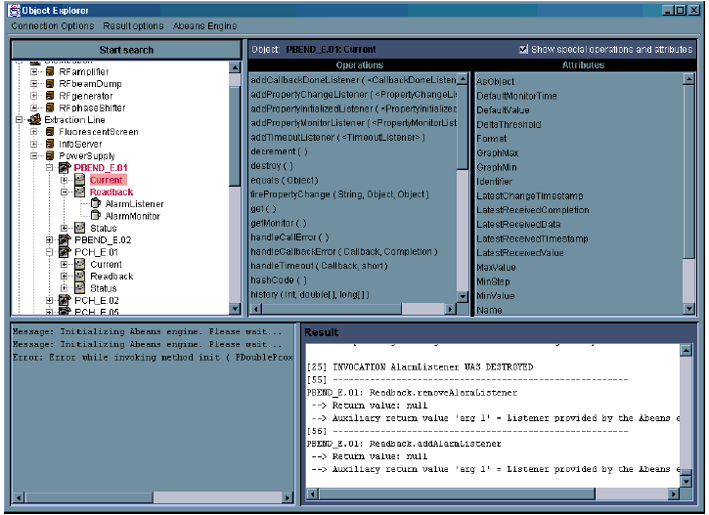
Object Explorer
Notes:
The Object Explorer (OE):
Is a generic tool used for low-level inspection of objects in ACS. It can be used as a debugging or testing tool by the developers and maintainers of a system.
Allows to interact with any CORBA Object known to the system (I.e. whose reference can be retrieved from the Manager - see following slides - and whose IDL interface can be retrieved from the Interface Repository).
Is aware of the design patterns implemented by the Component-Property-Characteristic paradigm - see following slides - and can for example monitor the values of properties and draw trend plots, as will be shown in the demo.
Is a standalone Java program designed using a “plug-in” concept and has been adapted to different systems than ACS.

Slide 12
Component’s Administrator View
An administrator defines deployment by customizing the Configuration Database for the Manager
Manager is responsible for managing and checking the lifecycle of Components
Containers are directly responsible for the Components that are assigned to them
Administrator
Abeans
Client
GUI for
Control
federation
Manager
Manager
(domain A)
(domain B)
CDB
Cont 1
Cont 2
Cont 3
DO 1
DO 2
DO 3
DO 2
DO 4
DO 5
Device
Notes:
Deployment and lifecycle of Components is implemented as a separate and independent logical layer based on two major elements:
Containers. They are deployed locally on all hosts involved in the system, ranging from real-time local control units to high-performance workstations. Their primary task is preparing the local environment in which Components are created, giving them all the resources they need to perform their tasks, such as CORBA connectivity, connection establishment with other Components and Configuration Database access. Containers provide the process space where Components are running.
Manager, which is set up at one central location that is widely known across the entire system (Manager federation will be implemented at a second stage). The Manager is acquainted with all the Components and Containers in the system, as well as other resources, such as configuration database and CORBA services. In particular, the Manager closely cooperates with the CORBA Naming Service, in which it publishes all of its acquaintances, making them accessible to non-MACI-aware CORBA software.
The contract between Manager and Containers is defined in the Management and Access Control IDL Interface (MACI), that defines how they interact. Containers implemented in any programming language have to implement this interfaces to be administered by the Manager.

Slide 13
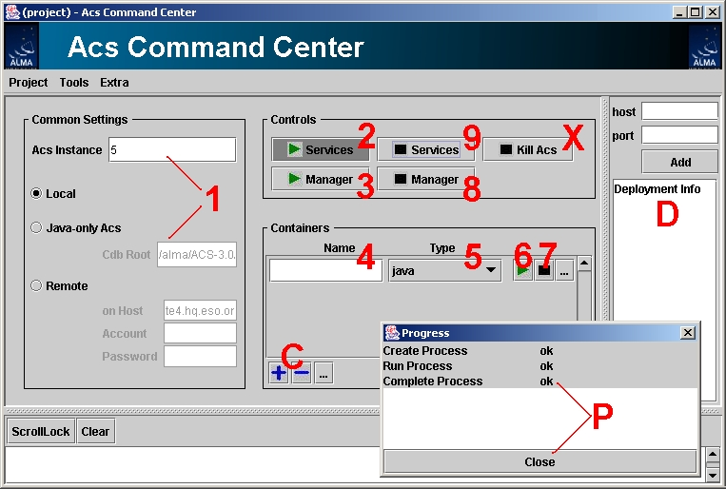
ACS Command Center
Notes:
The ACS Command Center is the administrative application used to start and stop ACS services, managers and container.
It allows to manage the system distributed on several hosts, start tools and inspect the deployment of the system.
ACS Command Center uses a specific Administrator interface part of MACI to allow ACS System Administrators to inspect and configure the deployment view of a running ACS system.
The Command Center:
Displays the information about CORBA objects on the local network. This includes MACI defined objects, such as Containers and Managers as well as Components (or, more in general, Controlled Objects (COBs), since the Manager is able to provide information and partially manage not only Components but also other CORBA servants that do not implement the full MACI interface , like the standard CORBA Services). Both currently active COBs and potentially active COBs (i.e. COBs that the Manager is able to bring online on request) are displayed.
Interact with the MACI Manager through IDL Administrator interface, by receiving notifications about other clients and activators in the system from the Manager.
Is a standalone Java program.

Slide 14
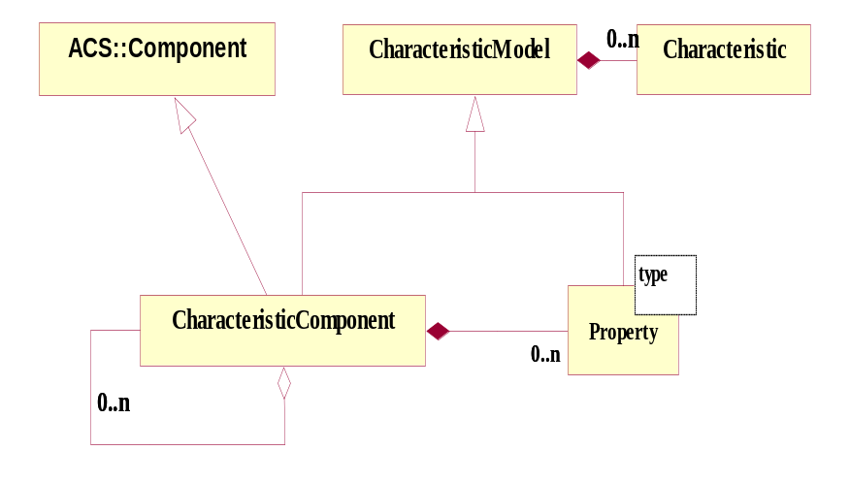
Component-Property-Characteristics
(Characteristic) Component: base class for any physical/logical Device
(e.g. temperature sensor, motor)
Each Component has Properties (e.g. status value, position - control/monitor points)
Characteristics of Components and Properties
(Static data in Configuration DB, e.g. units, ranges, default values)
ABeans
Notes:
The heart of BACI is a distributed object model.
All common telescope components such as antenna mount, antenna control unit, correlator, etc. are Components defined by means of Characteristic Components. Characteristic Components are implemented as CORBA objects that are remotely accessible from any computer through the client-server paradigm.
Each Characteristic Component is further composed of Properties. A Characteristic Component can also contain references to other Characteristic Component s to build hierarchical structures of components.
Both Characteristic Components and Properties have specific Characteristics, e.g. a Property has a minimum, a maximum, units…. The common behavior of Characteristic Component and Property has been factorized in the Characteristic Model common base class. Notice that programmatically characteristics are read-only. For example, all constants related to a Property such as min/max, and description are obtained by clients directly from the Property by means of remote methods - no direct access to the configuration database is necessary.
Values of the Properties are updated asynchronously by means of monitor objects. While there are in principle an infinite number of Characteristic Component types, for example one for each physical controlled device, there are very few different Property types
ACS provides a basic Component implementation (called BACI, standing for Basic Access Control Interface) based on the
Component - Property - Characteristic
paradigm, well established in the world of accelerator control systems.
All common telescope components such as antenna mount, antenna control unit, correlator, etc. are CharacteristicComponents.
Design patterns for synchronous and asynchronous value retrieval/setting, monitoring and archiving or alarms are part of the Property definition

Slide 15
Configuration Database
Defining accessing and maintaining the configuration of a system
Three-tier database-access architecture:
  Database engine
  Database Access Layer (DAL).
  Database clients
CORBA access interface
XML/Schemas for object data definition and access.
3 – Database clients
Data client
CDB Administration
Read-only
Data interface
Read-write
admin. interface
2 – Database Access Layer (DAL)
DAL/CDB Server
1 – Database engine
Database
Notes:
The ACS Configuration Database addresses the problems related to defining, accessing and maintaining the configuration of a system based on ACS.
There are 4 different issues related to this problem:
1. input of data by the user
System configurators define the structure of the system and enter the configuration data.
2. storage of the data
The configuration data is kept in a database.
3. maintenance and management of the data (e.g. versioning)
Configuration data changes because the system structure and/or the implementation of the system’s components changes with time and has to be maintained under configuration control.
4. loading data into the ACS Components
At run-time, the data has to be retrieved and used to initialize and configure the Characteristic Components.
The architecture of the ACS configuration database is based on three layers:
1. The Database Itself
2. The Database Access Layer (DAL)
3. The Database Clients access data from the database using only the interfaces provided by the DAL.
There are two separate interfaces to the CDB:
Read-Only Data interface, used by all clients that need to retrieve their own configuration. Is very simple and can be very easily implemented using minimal resources.
Read/Write administrator interface, used to modify and administer the Configuration Database. Few high level applications need to access this interface.

Slide 16
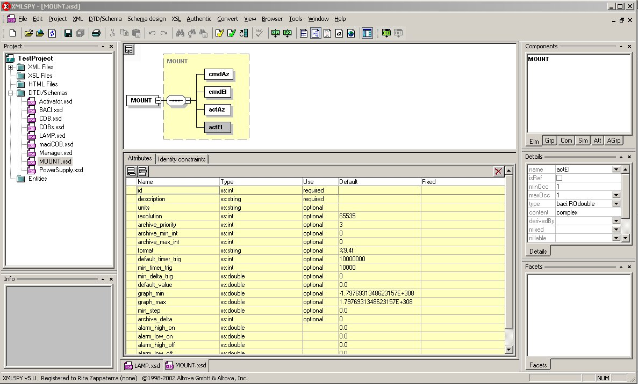
Configuration Database:
DO Schemas
Notes:
The choice of XML for the definition of the Configuration Database allows to use off-the-shelf tools to administer the Configuration Database itself.
Per each Component type in the system, an XML Schema defines its configuration structure.
Per each Component instance in the system, an XML file defines the actual configuration, based on the XML Schema.
This allows to define default configuration values in the Schema, “inheriting” from other schemas and override them in the instance XML files.
In this slide we use XMlSpy to edit the XML Schema

Slide 17
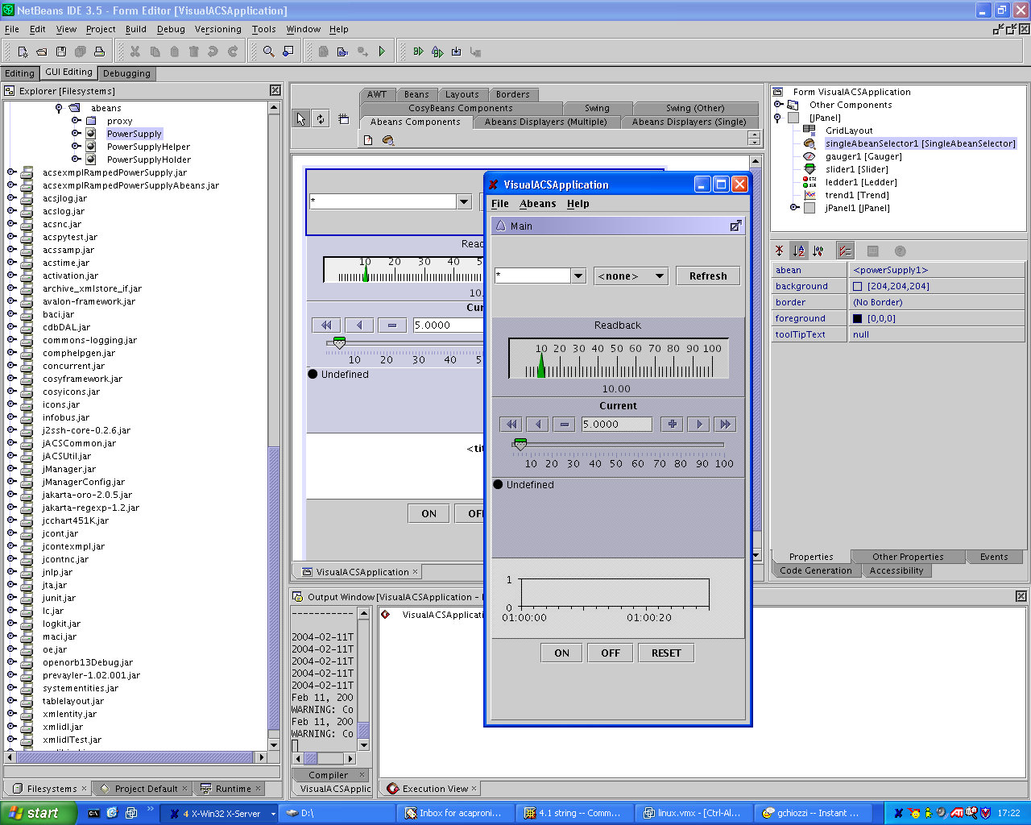
Abeans and visual editing
Notes:
Abeans are Java Beans that are aware of the MACI and BACI paradigms.
In this way it is possible to use any Java Visual Builder (we provide an Eclipse plugin on top of the Eclipse Visual Editor extension) to visually build use interfaces for ACS Components.
A set of graphical Java Beans implements the most useful widgets for the development of Control System applications, aware of the concepts of Components, Properties and Characteristics.
At the same time a code generator produces Java Beans based on the IDL interface of ACS Components. These Beans are therefore automatically integrated in any Visual Builder.
For example, a Gauge widget can be associated to an ACS Property to display the value, draw trend plots and configure automatically itself based on the Characteristics stored in the Configuration Database.
The suggested Java IDE is Eclipse, because it provides extremely good functionality and performance.

Slide 18
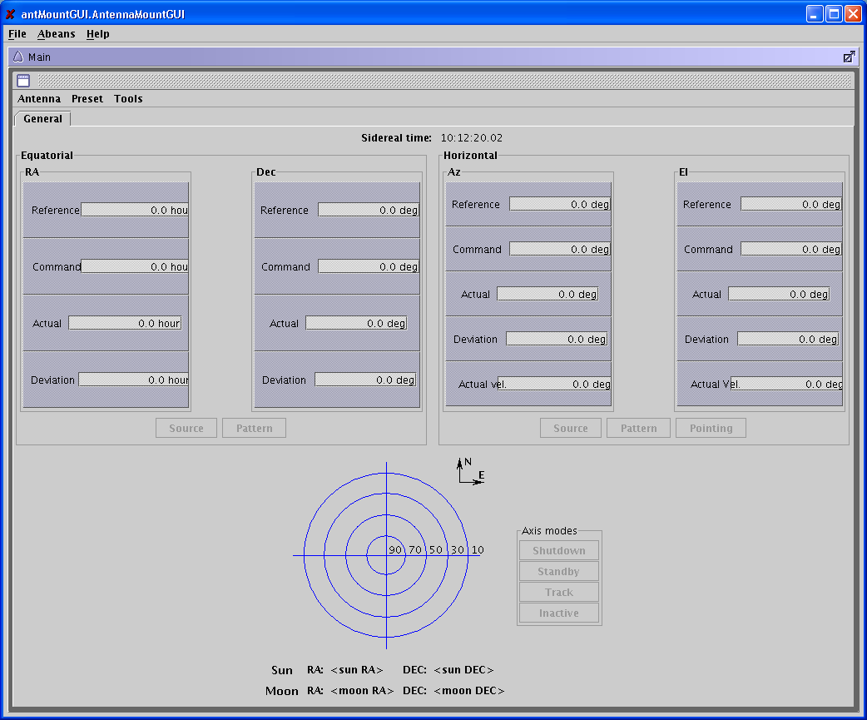
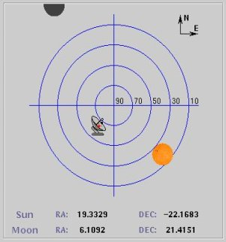
ACS sample Mount Control Panel
Notes:
This picture shows a Mount Control Panel that we are currently developing as a test bed application for TICS.
It is more than 90% built simply by drag and drop from Java NetBeans.
Only a very little amount of Java code needs actually to be “written by hand”.
The Java Beans used for the composition work based on the Component-Property-Characteristic pattern and therefore they configure themselves automatically.

Slide 19
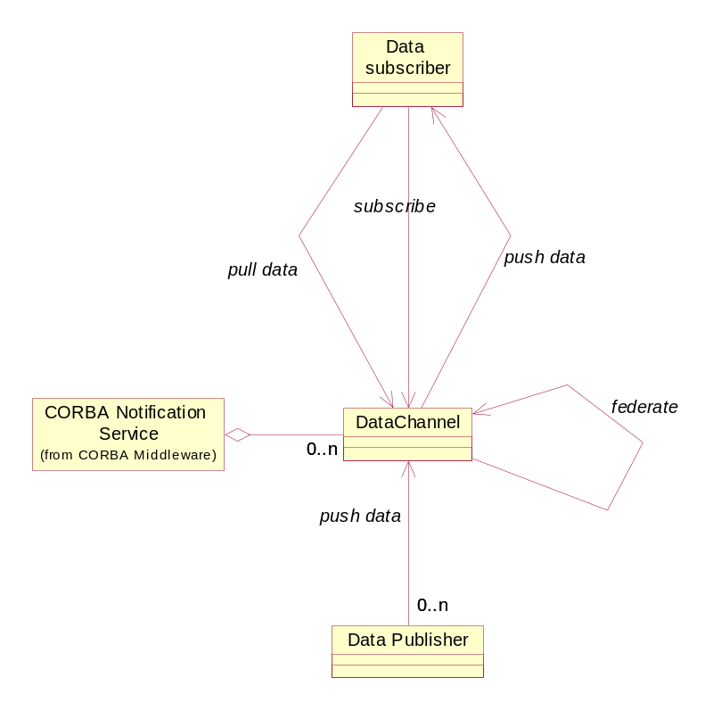
Data Channel
Implementation of Observer Design Pattern
Asynchronously pass information between data suppliers and data consumers in a many-to-many relationship
Based on CORBA Notification Channel
An ACS API provides simplified client and server API

Slide 20
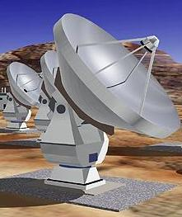
Logging System
To publish any kind of status and diagnostic information for interested clients and archival.
Based on CORBA Telecom Logging Service.
Centralized Logging Host
Web Client
HTTP Server
HTTP request/reply
XSLT
SELECT
Relational Database
SELECT UPDATE
C++ API ⇒ ACE Logging
Database
query
Client
Logger Client
push
Java API -> java.util.logging
XML
Event
push
Client
Parser
Channels
push
ACS Log Service -> IDL
Filtering logic
Centralized Logging
write_records
Logs Publisher
Implements Log interface
Out of scope of this document
XML logs follow
pre-defined schema
Notes:
To publish any kind of status and diagnostic information for interested clients and archival.
Based on CORBA Telecom Logging Service.
Logs are published as XML messages.
Logging for C++, Java and Python is based on standard native APIs.
An ACS Logging IDL interface provides convenient logging capabilities from any CORBA aware application.

Slide 21
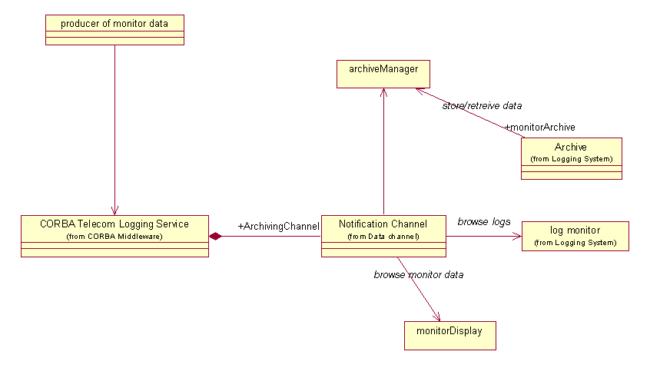
Monitor Archiving system
Notes:
The monitor archiving system provides archiving of monitor point values. ACS provides only the data collection mechanism, but not storing of data (this task is left at the Archive Subsystem). Data are made available from the archiving event channel to clients.
The value of each property in the control system can be archived. Archiving is enabled/disabled and configured on per-property basis. ACS Properties publish their value on a specific ArchivingChannel notification channel as structured events, by using the ACS Logging System.
The parameters for data publishing are defined in the following Property's Characteristics:
archive_priority
archive_max_int
archive_min_int
archive_delta
Whenever the Characteristics of a Property are such that archive values have to be submitted, a BACI Monitor is created to periodically submit the values to the Logging System.

Slide 22
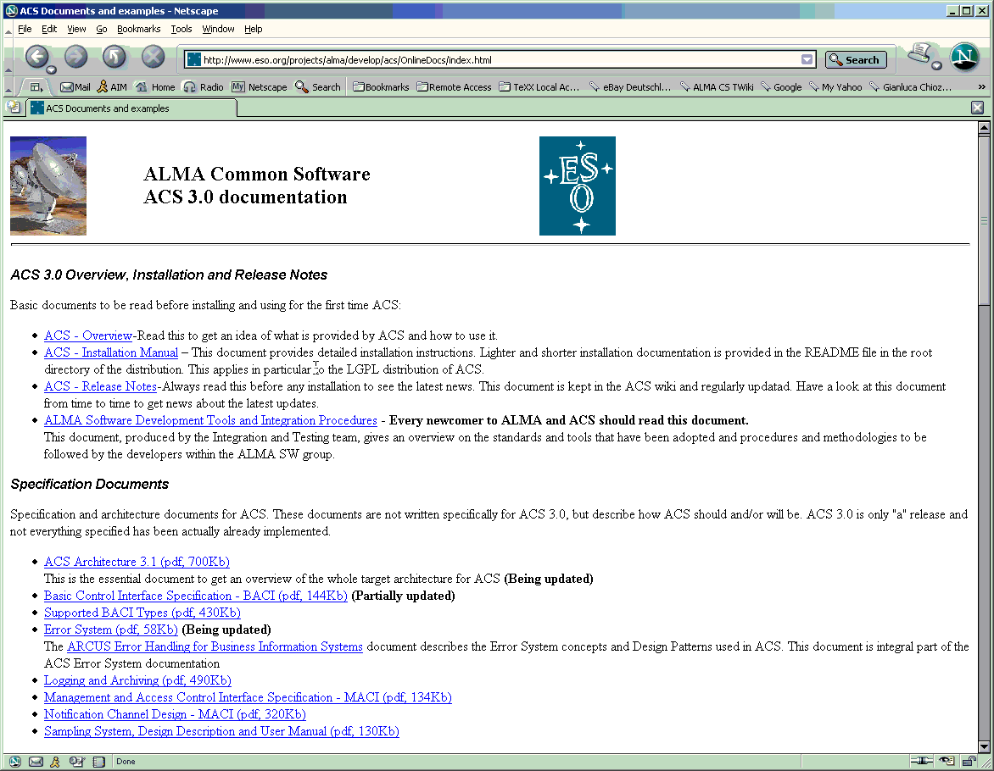
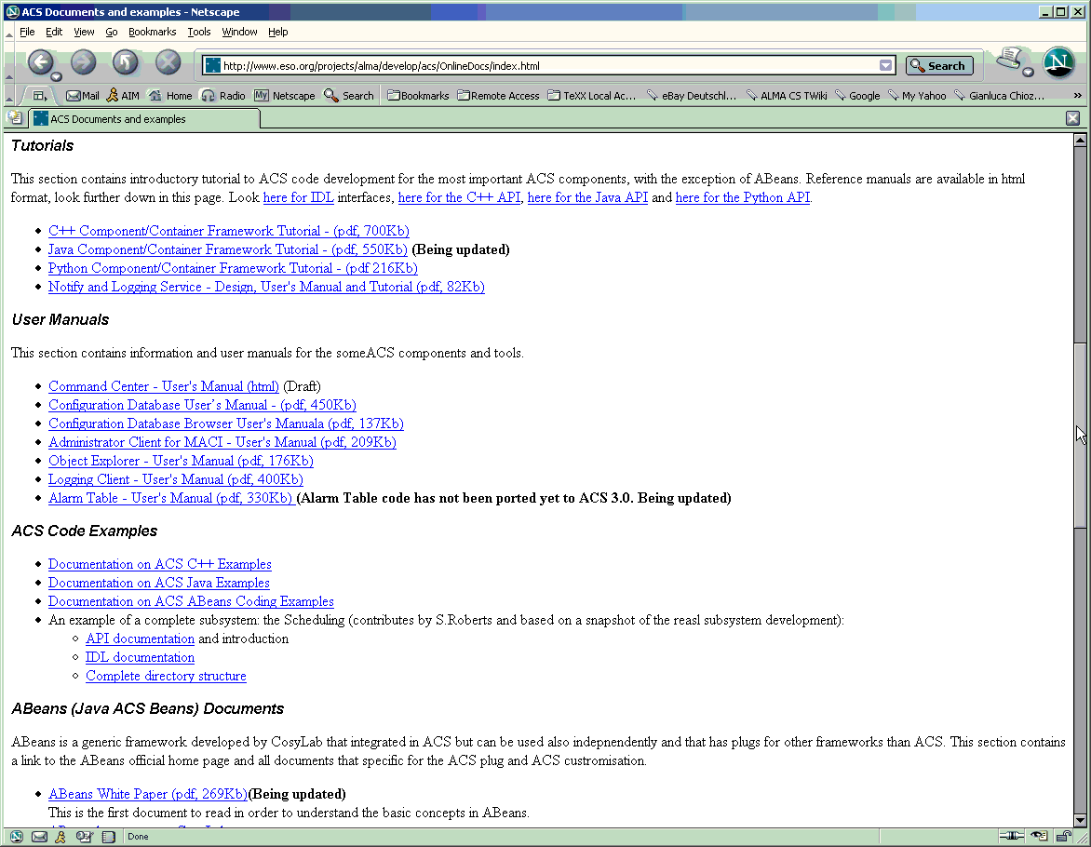
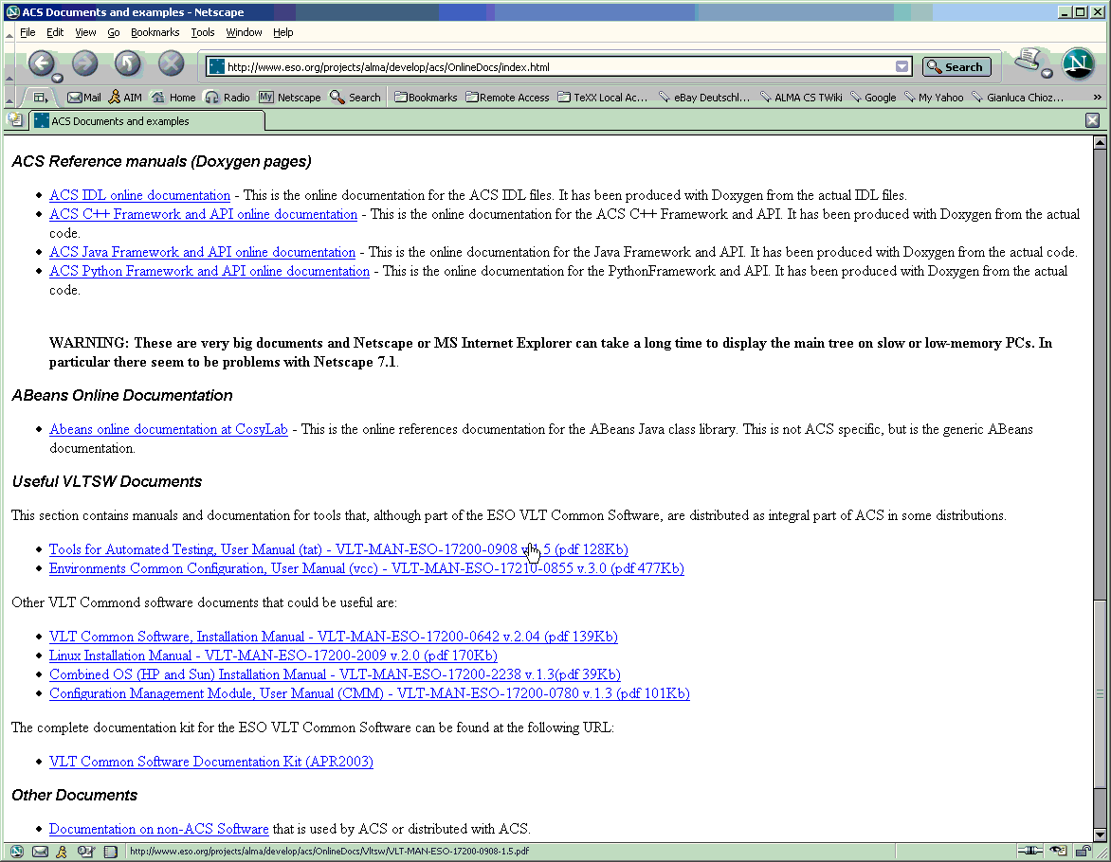
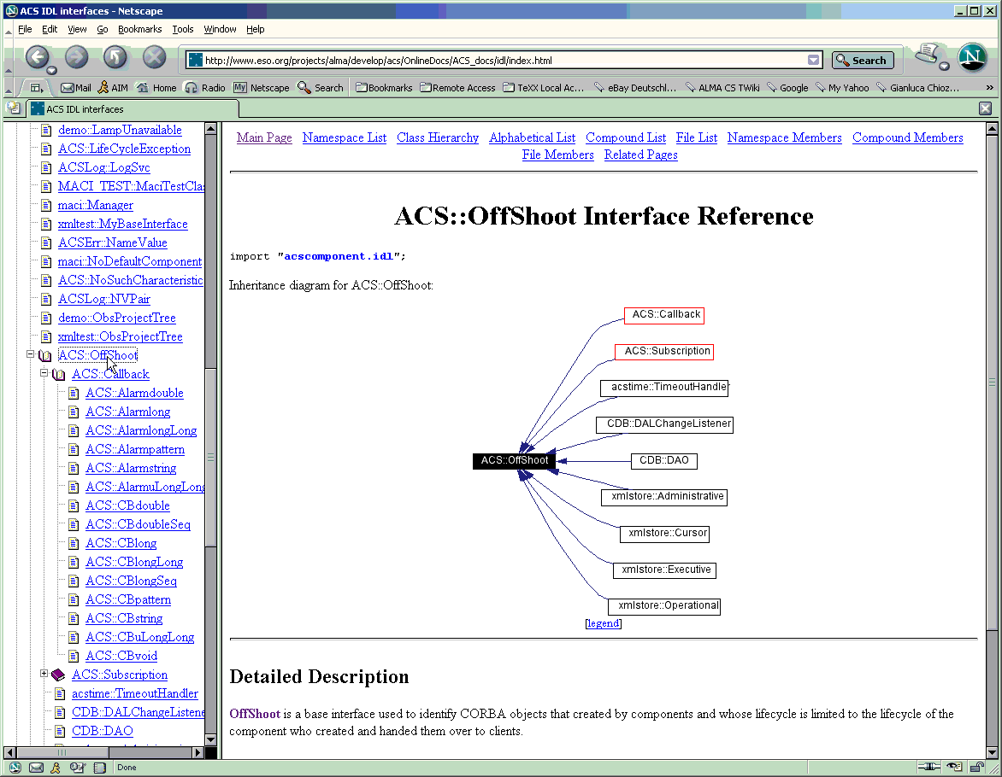
ACS Documentation: http://www.eso.org/projects/alma/develop/acs
Notes:
A major effort has been spent in providing good an comprehensive documentation for ACS.
ACS Overview, Installation and Release Notes
These are the first documents to be read when receiving the package.
The Overview provides a general overview of the distribution and in particular of the processes and executables available.
The Installation Manuals guides step by step in the installation and verification of ACS.
The Release Notes describe the current status of ACS and the backward incompatibilities with. It is an essential reading before porting applications from a previous version of ACS.
Specification Documents
The main document in this section is the ACS Architecture, that describes the final architecture ACS aims to. The other documents detail the most important packages defined/implemented with ACS
User Manuals and Tutorials
The BACI Device Server Tutorial is an introduction to writing C++ code based on ACS and is a must to read. Then there are a few User Manuals for ACS Logging Service and the tools GUIs (Object Explorer, Jlog, Administrator Client).
Abeans (Java ACS Beans) Documents
Tutorials and manuals on writing user interface applications with Abeans. Visual Bean Composition Tutorial is the most useful.
ACS IDL Online Documentation and UML Model
HTML Online reference for the ACS IDL interfaces

Slide 23
Conclusion
Developed based on the experience of both astronomical and accelerator control projects
Can easily run on many platforms
Open source (LGPL license)
Free development tools and ORBs
We think that many other projects can use ACS
A wider user’s base can provide valuable feedback

Slide 24
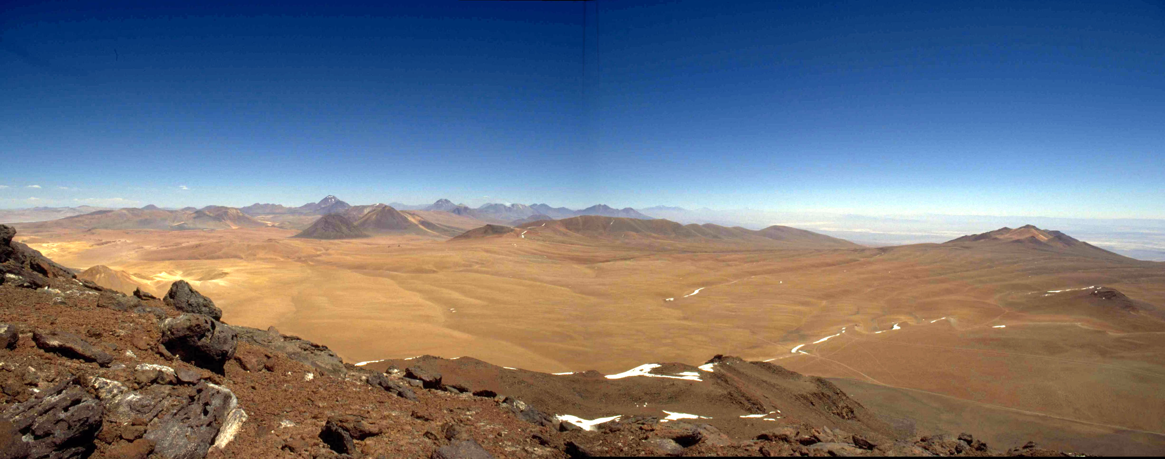
ALMA Sites
Chajnantor
www.eso.org/projects/alma
www.alma.nrao.edu/development/computing
http://www.eso.org/projects/alma/develop/acs
http://kgb.ijs.si/KGB/

Slide 25

Questions (& Answers)
Notes:
20 minutes for discussion (probably some of this time will be spent during the presentation).

