Slide 1

Configuration Database and Deployment of ACS components
Bogdan Jeram, changes by Heiko Sommer
(bjeram@eso.org)
European Southern Observatory
Notes:
A number of papers on the ALMA project and on ACS have been presented in August at the SPIE Conference in Kona, Hawaii:
the ALMA Project has been introduced in the paper 4837-12
ACS in paper 4848-05 (G.Chiozzi et al.)
the overall ALMA software Architecture in 4848-06 (J.Schwarz, G.Raffi).
theALMA Test Interferometer Control Software in paper 4848-07 (R.G..Marson, B.Glendenning).
In this presentation we are going to describe the ALMA Common Software (ACS) that is under development as a set of common software component to be used for the development of any ALMA subsystem.
This work is responsibility of an international team mainly based at ESO and in tight collaboration with the JSI in Ljubljana.
A part from the authors of the paper, we want to thank here the essential contributions to ACS from other members of the ALMA SW community.

Slide 2
CDB: the purpose
The ACS Configuration Database addresses the problems related to defining, accessing and maintaining the configuration of a system.
For each Component on the system, there might be a set of static (or quasi-static) configuration parameters that have to be configured in a persistent store and read when the Component is started up or re-initialized.
CharacteristicComponents MUST have configuration information in the CDB

Slide 3
Configurable deployment
This includes the “structure” of the system, i.e. which statically deployed Components are part of the system and their inter-relationships.
  looking at the CDB only you should be able to see how the Components are distributed among the Containers and on what hosts the Containers are running.
  For Components connected to HW, this would tell you as well what HW you are using and where it is located.
  Changing the CDB you can move Components around and distribute them in a different way in the system.
Deployment for dynamic components is not part of the CDB

Slide 4
Data organization
(directory hierarchy)
CDB (root)
  MACI (system deployment data)
    Managers
    Containers
    Components (just component deployment data)
  alma (component specific data)

Slide 5
CDB/MACI structure
CDB
MACI
Managers
Manager
alma
Components
myComp
yourComp
schemas
anotherComp
Containers
myCont1
yourCont

Slide 6
Components deployment instance – list of components
<Components xmlns="urn:schemas-cosylab-com:Components:1.0" xmlns:cdb="urn:schemas-cosylab-com:CDB:1.0" xmlns:baci="urn:schemas-cosylab-com:BACI:1.0" xmlns:xsi="http://www.w3.org/2001/XMLSchema-instance">
<_ Name="MOUNT1_01"
Code="acscourseMount1Impl"
Type="IDL:alma/ACSCOURSE_MOUNT/Mount1:1.0"
Container="mountContainer“ />
<_ Name="MOUNT_PY_1"
Code="ACSCOURSE_MOUNTImpl.Mount1“
Type="IDL:alma/ACSCOURSE_MOUNT/Mount1:1.0"
Container="mountPython“ />
</Components>

Slide 7
Structure of Components deployment data (Components.xsd)
<xs:schema targetNamespace="urn:schemas-cosylab-com:Components:1.0" xmlns:cdb="urn:schemas-cosylab-com:CDB:1.0" xmlns="urn:schemas-cosylab-com:Components:1.0" xmlns:xs="http://www.w3.org/2001/XMLSchema" elementFormDefault="qualified" attributeFormDefault="unqualified">
<xs:complexType name="ComponentInfo">
<xs:attribute name="Name" type="xs:string" use="required"/>
<xs:attribute name="Code" type="xs:string" use="required"/>
<xs:attribute name="Type" type="xs:string" use="required"/>
<xs:attribute name="Container" type="xs:string" use="required"/>
<xs:attribute name="Default" type="xs:boolean" use="optional" default="false"/>
<xs:attribute name="Autostart" type="xs:boolean" use="optional" default="false"/>
</xs:complexType>
<xs:element name="Components">
<xs:complexType>
<xs:sequence>
<xs:element name="_" type="ComponentInfo" maxOccurs="unbounded"/>
</xs:sequence>
</xs:complexType>
</xs:element>
</xs:schema>

Slide 8
Location of components deployment info (Components.xml)
$ACS_CDB
CDB/MACI/Components/Components.xml

Slide 9
Manager instance example (Manager.xml)
    <Manager xmlns:cdb="urn:schemas-cosylab-com:CDB:1.0"
    xmlns="urn:schemas-cosylab-com:Manager:1.0"
    xmlns:baci="urn:schemas-cosylab-com:BACI:1.0"
    xmlns:xsi="http://www.w3.org/2001/XMLSchema-instance"
    CommandLine=""
    Timeout="50000"
    HeartbeatTimeout="2000"
    CacheSize="10"
    MinCachePriority="0"
    MaxCachePriority="31"
    CentralizedLogger="Log">
    <Startup>
    <cdb:_ string=“MOUNT_1"/>
    </Startup>
    <Execute>
    <cdb:_ string=""/>
    </Execute>
    <ServiceComponents>
    <cdb:_ string="Log"/>
    <cdb:_ string="LogFactory"/>
    <cdb:_ string="NotifyEventChannelFactory"/>
    <cdb:_ string="ArchivingChannel"/>
    <cdb:_ string="LoggingChannel"/>
    <cdb:_ string="InterfaceRepository"/>
    <cdb:_ string="CDB"/>
    <cdb:_ string="ACSLogSvc"/>
    <cdb:_ string="PDB"/>
    </ServiceCOBs>
    </Manager>

Slide 10
Structure of Manager data
(Manager.xsd)
  <xs:schema targetNamespace="urn:schemas-cosylab-com:Manager:1.0"
  xmlns:xs="http://www.w3.org/2001/XMLSchema"
  xmlns="urn:schemas-cosylab-com:Manager:1.0"
  xmlns:cdb="urn:schemas-cosylab-com:CDB:1.0" elementFormDefault="qualified“ attributeFormDefault="unqualified">
  <xs:import namespace="urn:schemas-cosylab-com:CDB:1.0" schemaLocation="CDB.xsd"/>
  <xs:element name="Manager" type="Manager"/>
  <xs:complexType name="Manager">
  <xs:sequence>
  <xs:element name="Startup" type="cdb:Array"/>
  <xs:element name="Execute" type="cdb:Array"/>
  <xs:element name="ServiceComponents" type="cdb:Array"/>
  </xs:sequence>
  <xs:attribute name="CommandLine" type="xs:string" use="optional"/>
  <xs:attribute name="Timeout" type="xs:int" use="optional" default="50000"/>
  <xs:attribute name="HeartbeatTimeout" type="xs:int" use="optional" default="2000"/>
  <xs:attribute name="CacheSize" type="xs:int" use="optional" default="10"/>
  <xs:attribute name="MinCachePriority" type="xs:int" use="optional" default="0"/>
  <xs:attribute name="MaxCachePriority" type="xs:int" use="optional" default="31"/>
  <xs:attribute name="CentralizedLogger" type="xs:string" use="optional" default="Log"/>
  </xs:complexType>
  </xs:schema>

Slide 11
Manager instance file location
$ACS_CDB
CDB/MACI/Managers/Manager/Manager.xml

Slide 12
Container Instance
(XML file)
    <Container xmlns:cdb="urn:schemas-cosylab-com:CDB:1.0"
    xmlns="urn:schemas-cosylab-com:Container:1.0"
    xmlns:baci="urn:schemas-cosylab-com:BACI:1.0"
    xmlns:xsi="http://www.w3.org/2001/XMLSchema-instance"
    CommandLine=""
    Timeout="20000"
    UseIFR="1"
    ManagerRetry="10"
    ManagerReference=""
    CacheSize="0"
    MinCachePriority="0"
    MaxCachePriority="31"
    CentralizedLogger="Log">
    <Autoload>
    <cdb:_ string="baci"/>
    </Autoload>
    </Container>

Slide 13
Structure of Container data
(Container.xsd)
    <xs:schema targetNamespace="urn:schemas-cosylab-com:Container:1.0" xmlns:xs="http://www.w3.org/2001/XMLSchema" xmlns="urn:schemas-cosylab-com:Container:1.0" xmlns:cdb="urn:schemas-cosylab-com:CDB:1.0" elementFormDefault="qualified" attributeFormDefault="unqualified">
    <xs:import namespace="urn:schemas-cosylab-com:CDB:1.0" schemaLocation="CDB.xsd"/>
    <xs:element name=“Container" type=“Container"/>
    <xs:complexType name=“Container">
    <xs:sequence>
    <xs:element name="Autoload" type="cdb:Array"/>
    </xs:sequence>
    <xs:attribute name="CommandLine" type="xs:string" use="optional"/>
    <xs:attribute name="Timeout" type="xs:int" use="optional" default="20000"/>
    <xs:attribute name="UseIFR" type="xs:boolean" use="optional" default="1"/>
    <xs:attribute name="ManagerRetry" type="xs:int" use="optional" default="10"/>
    <xs:attribute name="ManagerReference" type="xs:string" use="optional"/>
    <xs:attribute name="CacheSize" type="xs:int" use="optional" default="10"/>
    <xs:attribute name="MinCachePriority" type="xs:int" use="optional" default="0"/>
    <xs:attribute name="MaxCachePriority" type="xs:int" use="optional" default="31"/>
    <xs:attribute name="CentralizedLogger" type="xs:string" use="optional" default="Log"/>
    <xs:attribute name="DALtype" type="xs:string" use="optional"/>
    </xs:complexType>
    </xs:schema>

Slide 14
Container instance file location
$ACS_CDB
CDB/MACI/Containers/
  <container_ name>/<container_name>.xml
Example:
CDB/MACI/Containers/myContainer/myContainer.xml

Slide 15
Loading Steps
Manager
Container(C++)
“bilboContainer”
Manager.xml
Manager.xml
bilboContainer.xml
Client
X
Components.xml
Container(java)
“frodoContainer”
frodoContainer.xml
Y

Slide 16
CDB Data Retrieval
XML data mapped to Data Access Objects (DAOs)
FILES
NODES
Client (Container
or Component)
parent directory
File1.xml
CDB Data Access
Layer (DAL) Server
child directory1
File2.xml
get “parent”
get “parent/child1”
DAO
“File1”,
“File2”,
“File3”,
“File4”
child directory2
File3.xml
File4.xml
DAO
“File2”

Slide 17
DAL Server
DAL server implements DAL IDL:
interface DAL {
string get_DAO( in string curl )
raises (RecordDoesNotExist,XMLerror);
DAO get_DAO_Servant( in string curl )
raises (RecordDoesNotExist,XMLerror);
oneway void shutdown();
//data change handling
long add_change_listener( in DALChangeListener listener );
void listen_for_changes( in string curl, in long listenerID );
void remove_change_listener( in long listenerID );
// listing
string list_nodes( in string name );
};
XML string for local processing
Remote object for data field retrieval

Slide 18
DAO IDL
interface DAO {
long get_long( in string propertyName ) raises (WrongDataType, FieldDoesNotExist);
double get_double( in string propertyName )
raises (WrongDataType, FieldDoesNotExist);
string get_string( in string propertyName )
raises (WrongDataType, FieldDoesNotExist);
string get_field_data( in string propertyName )
raises (WrongDataType, FieldDoesNotExist);
stringSeq get_string_seq( in string propertyName )
raises (WrongDataType, FieldDoesNotExist);
longSeq get_long_seq( in string propertyName )
raises (WrongDataType, FieldDoesNotExist);
doubleSeq get_double_seq( in string propertyName) raises (WrongDataType, FieldDoesNotExist);
};

Slide 19
Component retrieves data from C++
MyComponent::MyComponent(
ACE_CString _name,
maci::ContainerServices* pCS)
{
try {
CDB::DAL_ptr dal_p = pCS->getCDB();
CDB::DAO_ptr dao_p = dal_p->get_DAO_Servant(curl);
description = dao_p->get_string( "description" );
m_units = dao_p->get_string( "units" );
m_min_step = dao_p->get_double( "minStep" );
}
catch( ... ) {
ReportError( m_name, "Unable to read configuration!" );
return false;
}
}

Slide 20
DAL navigation interface
Retrieve the list of all children of the given node to allow navigation of the CDB hierarchical structure:
interface DAL {
string list_nodes( in string name );
};
This allows an application to discover the CDB structure. Is essential to build a CDB generic browser

Slide 21
Default CDB
jDAL (Java implementation of CDB) started as part of acsStartORBSRVC
$ACS_CDB points to CDB entry point
Default file location: $ACSDATA/config/defaultCDB
Test configuration data:
  test/CDB

Slide 22
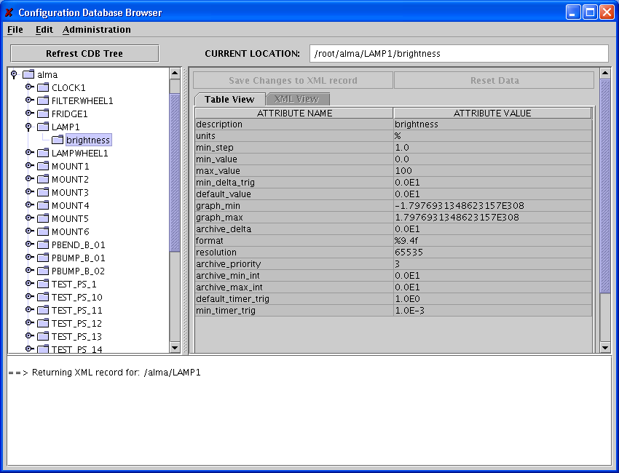
CDB Browser

