Slide 1

ACS Characteristic Components
B. Jeram, …..

Slide 2
Modeling devices
Device model:
  actions
  control/monitor points
  characteristics
Same structure of devices
Ease work of developer
Component-Characteristics-Property pattern

Slide 3
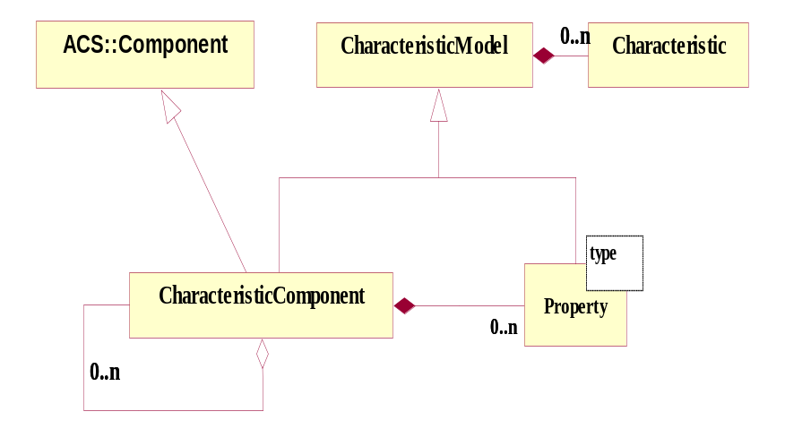
Component-Property-Characteristics
(Characteristic) Component: base class for any physical/logical Device
(e.g. temperature sensor, motor)
Each Component has Properties (e.g. status value, position - control/monitor points)
Characteristics of Components and Properties
(Static data in Configuration DB, e.g. units, ranges, default values)
ABeans
Notes:
The heart of BACI is a distributed object model.
All common telescope components such as antenna mount, antenna control unit, correlator, etc. are Components defined by means of Characteristic Components. Characteristic Components are implemented as CORBA objects that are remotely accessible from any computer through the client-server paradigm.
Each Characteristic Component is further composed of Properties. A Characteristic Component can also contain references to other Characteristic Component s to build hierarchical structures of components.
Both Characteristic Components and Properties have specific Characteristics, e.g. a Property has a minimum, a maximum, units…. The common behavior of Characteristic Component and Property has been factorized in the Characteristic Model common base class. Notice that programmatically characteristics are read-only. For example, all constants related to a Property such as min/max, and description are obtained by clients directly from the Property by means of remote methods - no direct access to the configuration database is necessary.
Values of the Properties are updated asynchronously by means of monitor objects. While there are in principle an infinite number of Characteristic Component types, for example one for each physical controlled device, there are very few different Property types
ACS provides a basic Component implementation (called BACI, standing for Basic Access Control Interface) based on the
Component - Property - Characteristic
paradigm, well established in the world of accelerator control systems.
All common telescope components such as antenna mount, antenna control unit, correlator, etc. are CharacteristicComponents.
Design patterns for synchronous and asynchronous value retrieval/setting, monitoring and archiving or alarms are part of the Property definition

Slide 4
Properties
HL representation of control point/entity
Common functionality => building blocks
Two groups:
  Read-only
  Read-write
Different data types:
  double, long, string, pattern, enum, …
baci: IDLs + implementation (C++, Java, Python)
abeans: beans + gadget beans

Slide 5
Functionality of Properties
Same characteristics: resolution, units, description, …
Get/set value synchronously and asynchronously
Value monitoring:
  Time base
  On-change
  …
history
archiving value
alarms
…

Slide 6
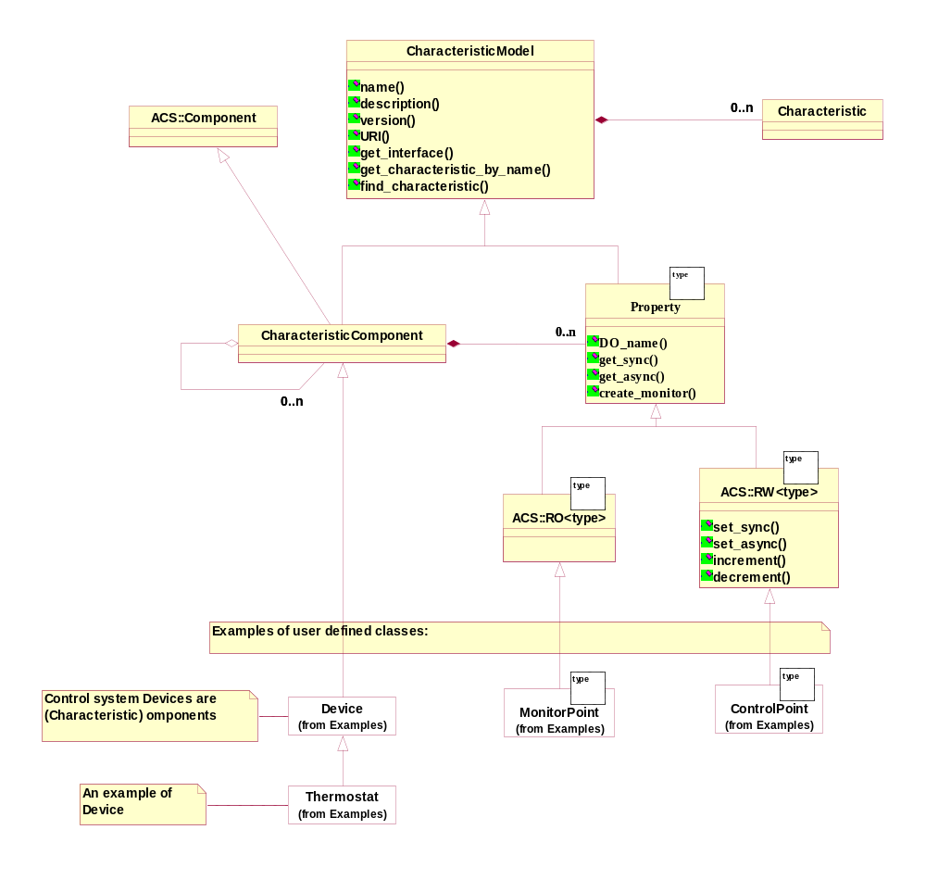
Component-Property-Characteristics full model

Slide 7
Connecting to real control/monitor point
Using idea of bridge design pattern
DevIO:
  read
  write
Pass as parameter to property constructor

Slide 8
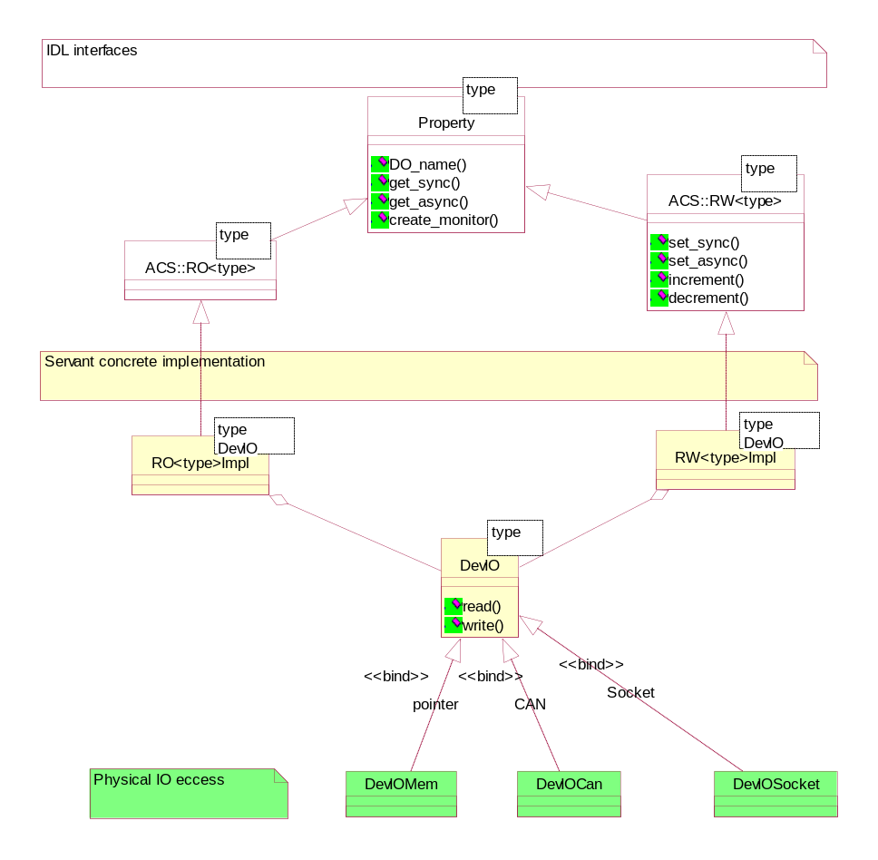
Property Servant implementation
The DevIO bridge pattern decouples Properties from HW.
DevIO implementations available:
Memory location (ACS defaults implementation)
CAN bus access (ALMA)
Socket generic interface (APEX)
RS232 (OAN)
PC Joystick (HPT)
Webcam (HPT)
CCD cameras (FBIG, Finger Lake) (HPT)
Heidenan Encoder board IK220 (HPT)
Motor Control Board (HPT)
CCS Real time database (VLT)
Notes:
This slide show the decoupling between the high level concept of Property and the access to the actual hardware.
While the implementation of Properties is completely general, access to hardware is delegated to a simple DevIO class according to the Bridge design pattern.
The DevIO class needs to implement read and write functions to access the hardware.
When a property is instantiated, it receives a proper DevIO implentation that enable it to retrieve and store (if writable) values in the hardware.
There are already many DevIO implementation available, some developed for ALMA and some developed from other projects:
Memory location (ACS defaults implementation)
CAN bus access (ALMA)
Socket generic interface (APEX)
RS232 (OAN)
PC Joystick (HPT)
Webcam (HPT)
CCD cameras (FBIG, Finger Lake) (HPT)
Heidenan Encoder board IK220 (HPT)
Motor Control Board (HPT)
CCS Real time database (VLT)

Slide 9
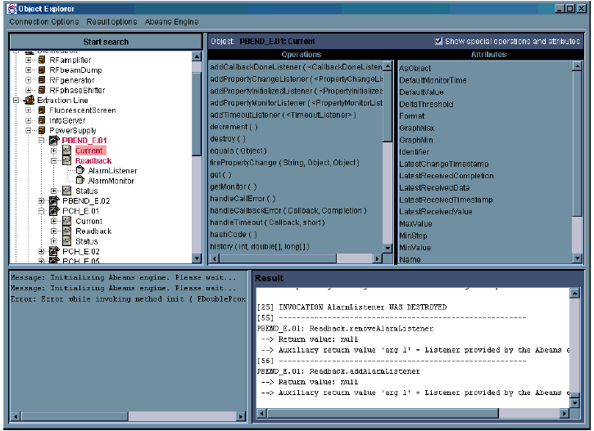
Object Explorer
Notes:
The Object Explorer (OE):
Is a generic tool used for low-level inspection of objects in ACS. It can be used as a debugging or testing tool by the developers and maintainers of a system.
Allows to interact with any CORBA Object known to the system (I.e. whose reference can be retrieved from the Manager - see following slides - and whose IDL interface can be retrieved from the Interface Repository).
Is aware of the design patterns implemented by the DO-Property-Characteristic paradigm - see following slides - and can for example monitor the values of properties and draw trend plots, as will be shown in the demo.
Is a standalone Java program designed using a “plug-in”concept and has been adapted to different systems than ACS.

Slide 10
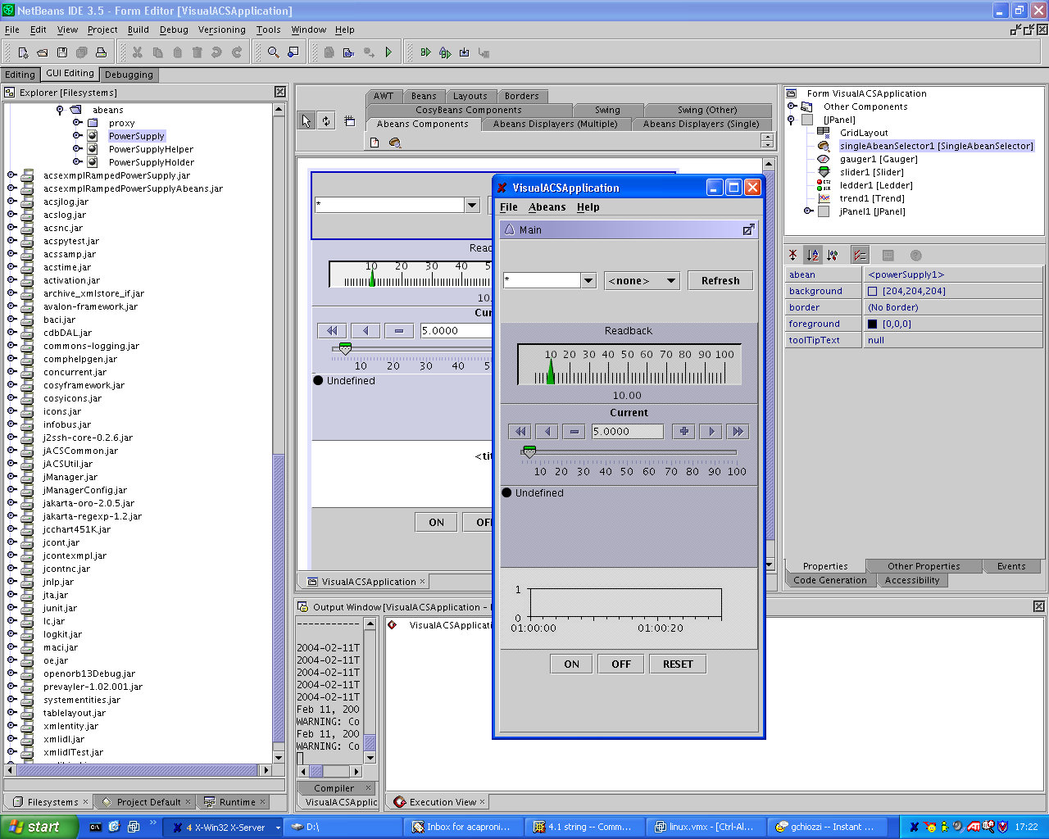
Abeans and visual editing
Notes:
Abeans are Java Beans that are aware of the MACI and BACI paradigms.
In this way it is possible to use any Java Visual Builder (like Sun Java Netbeans, or upcoming Eclipse extensions) to visually build use interfaces for ACS Components.
A set of graphical Java Beans implements the most useful widgets for the development of Control System applications, aware of the concepts of Compoents, Properties and Characteristics.
At the same time a code generator produces Java Beans based on the IDL interface of ACS Components. These Beans are therefore automatically integrated in any Visual Builder.
For example, a Gauge widget can be associated to an ACS Property to display the value, draw trend plots and configure automatically itself based on the Characteristics stored in the Configuration Database.
The suggested Java IDE is Eclipse, because it provides extremely good functionality and performance, but unfortunately there is not yet a usable GUI builder available.
Therefore we currently suggest to use Sun Java Netbeans for GUI layout development. But although the features provided by Netbeans are also extremely good, performance is rather poor.
There are no problems in using at the same time Eclipse for code development and Netbeans ofr GUI layout.

Slide 11
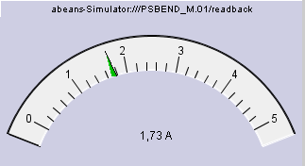
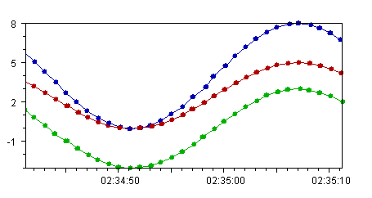
ABeans architecture
ABeans widgets
Abeans Application
Power Supply
Current
Readback
Status
on(), reset(), …
Configuration
Antenna
RA
DEC
Logging
Abeans Model
(e.g. BACI)
Exception handling
…
Abeans Engine
Abeans Plug
(e.g. ACS CORBA)
Notes:
This picture shows the architecture of Abeans.
ABeans “plug-in” architecture allows to use them on top of different Control System architectures (ACS, EPICS, TINE, JADE) and they are therefore used in many different projects independently from ACS.
ABeans have been developed by JSI/Cosylab independently from ACS and are used on different projects.

Slide 12
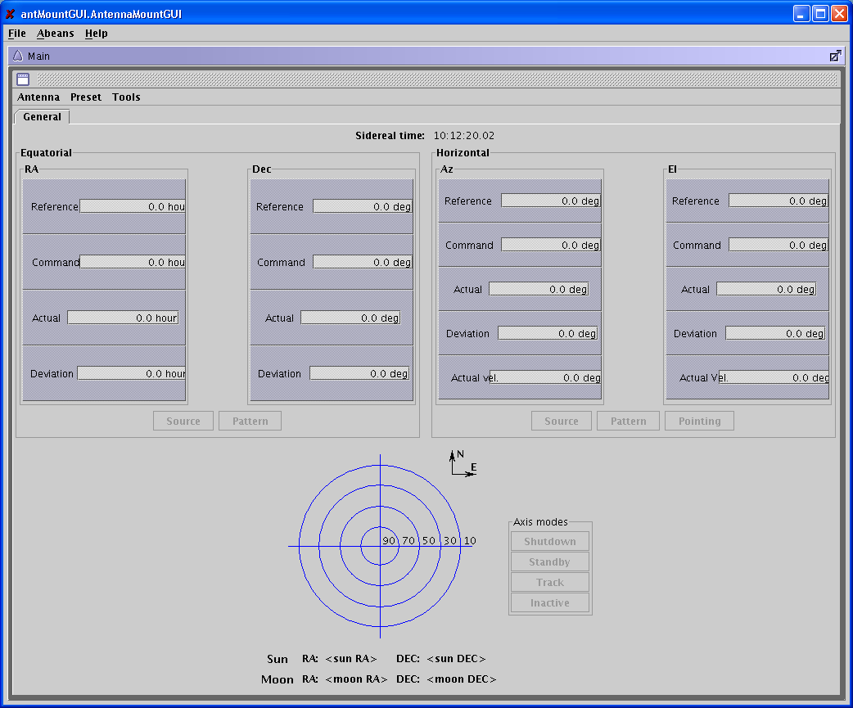
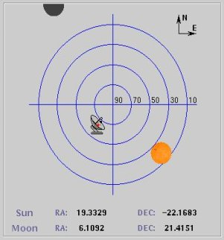
ACS sample Mount Control Panel
Notes:
This picture shows a Mount Control Panel that we are currently developing as a test bed application for TICS.
It is more than 90% built simply by drag and drop from Java NetBeans.
Only a very little amount of Java code needs actually to be “written by hand”.
The Java Beans used for the composition work based on the Component-Property-Characteristic pattern and therefore they configure themselves automatically.

