Slide 1

ACS
Error System APIs: C++
Bogdan Jeram
(bjeram@eso.org)
European Southern Observatory
July 2005
ESO

Slide 2
Summary
Features
Error Trace
Implementation: IDL, C++
Examples
Completion
Representation of errors
Notes:
Firstly I am going to say something about requirements for Error System than I will explain the architecture of the Error System after we’ll take a look at how the error system works through examples

Slide 3
C++ implementation
error handling error in C++ programs
error handling over the network using CORBA from C++ programs (i.e sending to and retrieving errors from C++ programs).

Slide 4
Functionality
creating new completions or exceptions where an error trace is created and filled with run-time and compile-time information
creating new completions or exceptions, adding a previous error trace contained within another completion or exception
sending/receiving completions or exceptions to/from remote process (CORBA)
converting from local helper classes to “remote” structures and vice versa
logging error traces by converting error stack information to strings and XML

Slide 5
Programming framework
- acserr (shared library)
- generated code (helper classes)

Slide 6
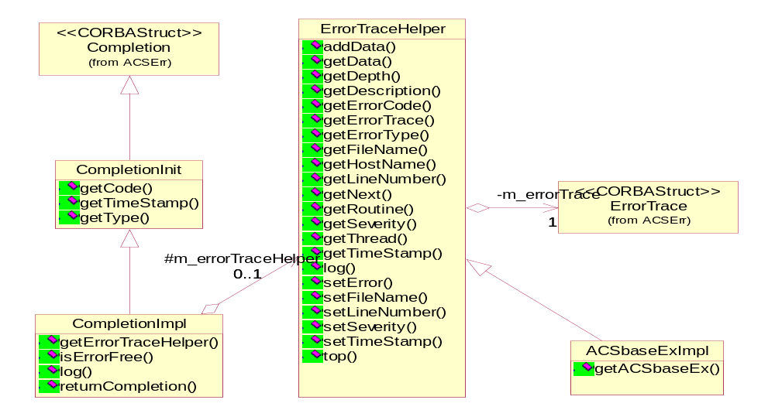
acserr library

Slide 7
Generated code
Input: XML error definition
Output:
  header files: 1 generated file + stubs and skeletons header files from IDL
  library: generated code + stubs and skeletons from IDL

Slide 8
An example of error definition file (XML)
<Type xmlns:xsi="http://www.w3.org/2001/XMLSchema-instance" xsi:noNamespaceSchemaLocation="ACSError.xsd" name="ExmplErrType“ type="900902" _prefix="alma">
<Code name="PointingInProgress" shortDescription="Pointing in progress" description="Pointing in progress"/>
<ErrorCode name="PointingFailure" shortDescription="Pointing Failure“ description="Pointing can not be executed">
<Member name="Azimuth" type="double“
description="Azimuth"/>
<Member name="Elevation" type="double“
description="Elevation"/>
</ErrorCode>
<ErrorCode name="PositionNotObtained" shortDescription="Position not obtained" description="Position of the object can not be obtained"/>
...
</Type>

Slide 9
Completion generation (1/2)
one completion class per completion/error code: <code_name>Completion
derives from CompletionImpl (acserr)
for each member are generated methods:
  get<member_name>
  set<member_name>

Slide 10
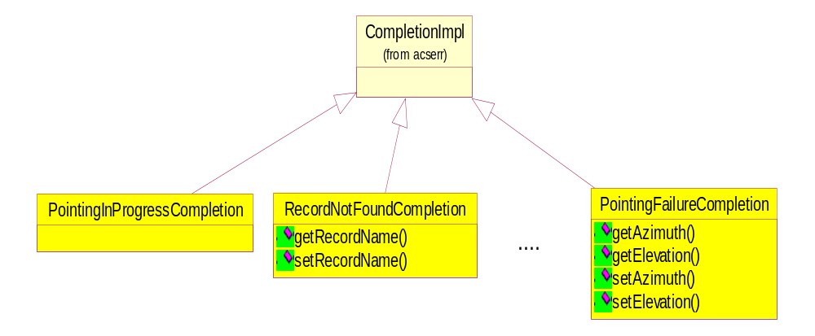
Completion generation (2/2)

Slide 11
Exception Generation (1/2)
one exception class per type: <type_name>ExImpl which derives for common exception class ACSbaseExImpl (acserr)
one exception class per *error code*: <code_name>ExImpl which derives from type exception
for each member are generated methods:
  get<member_name>
  set<member_name>
type exception and base exception can not be instantiated (thrown), but can be caught !

Slide 12
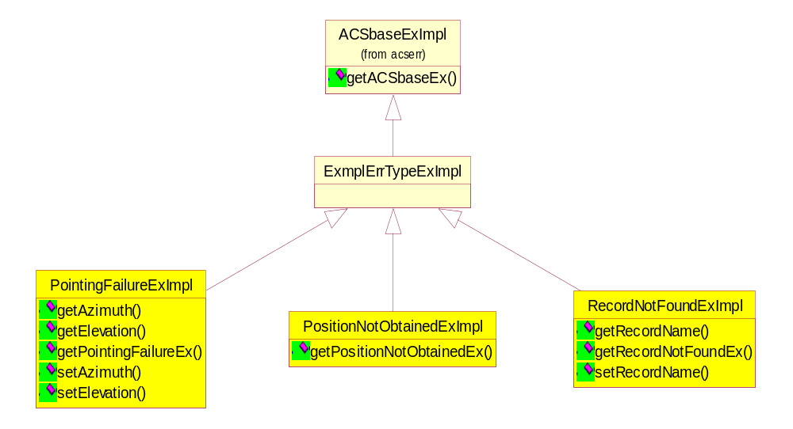
Exception Generation (2/2) – exception hierarchy

Slide 13
Using Generated C++ Classes
include generated header file(s): <type_name>.h
using namespace(s): <type_name>
link generated libraries: <type_name>

Slide 14
Completion
  CompletionImpl* Example::getTarget(char *name)
  {
  CompletionImpl *comp;
  if (error)
  {
  comp = new RecordNotFoundCompletion(__FILE__, __LINE__, “Example::getTarget");
  comp->setRecordName(name);
  }
  else
  comp = new ACSErrOKCompletion();
  return comp;
  }

Slide 15
Remote Completion: IDL
  interface TargetServerSync
  {
  ACSErr::Completion getTarget ();
  …
  };

Slide 16
Remote Completion: implementation
  ACSErr::Completion*
  TargetServerSyncImpl::getTarget()
  {
  CompletionImpl *er;
  if (!error)
  *er = new ACSErrOKCompletion();
  else
  *er = new RecordNotFoundCompletion(__FILE__, __LINE__, “Example::getTarget");
  return er->returnCompletion();
  }

Slide 17
Completion and callbacks
Asynchronous way of notification:
  interface TelescopeServer
  {
  void pointing(in ACS::CBvoid cb);
  …
  };

Slide 18
Callback
  interface CBvoid : Callback
  {
  oneway void working (in Completion c, in CBDescOut desc);
  oneway void done (in Completion c, in CBDescOut desc);
  };

Slide 19
Exception: throwing
…
throw RecordNotFoundExImpl(__FILE__, __LINE__, “TargetServerImpl::getTarget");

Slide 20
Exception: catching
      …
catch (RecordNotFoundExImpl &ex)
{
throw PositionNotObtainedExImpl(ex, __FILE__, __LINE__,
"starServerImpl::getPosition");
}

Slide 21
Remote Exception: IDL
IDL:
void getTarget (…)
raises (RecordNotFoundEx);

Slide 22
Remote exception: implementation
void ….Impl::getTarget (…)
throw ( CORBA::SystemException, RecordNotFoundEx)
{
…
throw RecordNotFoundExImpl (__FILE__, __LINE__, “…ServerImpl::getTarget”).getRecordNotFoundEx();
…
}

Slide 23
Mapping to C++
IDL struct → C++ classes
ErrorTrace → ErrorTraceHelper
Completion → <Code>Completion
IDL exception → C++ class
<Code>Ex → <Code>ExImpl

Slide 24
Documentation
ACS home page documentation (ErrorSystem)
http://www.eso.org/~almamgr/AlmaAcs/Releases/ACS_3_1/Docs/ACS_Error_System.pdf

Slide 25
Exercise(s)
implement error handling in your component:
  device operation(s) should return Completion or exception (change IDL and implementation)
  Define your own type and code (error definition XML file)

