Slide 1
Cosylab Developments
by Mark Plesko

Slide 2
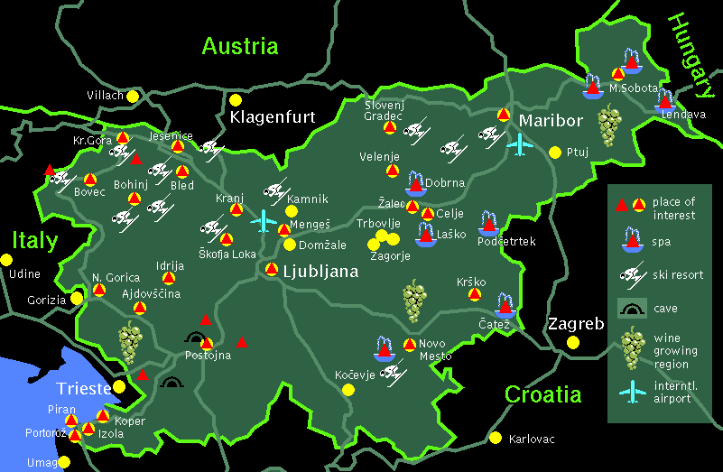

Where is Slovenia
Vienna
Europe
Venice
Notes:
Because Slovenia is very small and is rarely in the news, which is good, let me remind you where it is. It lies in central Europe, at the Souteastern rim of the Alps and the northen Adriatic see, which is part of the Mediteranean see. Slovenia is halfway between two well-known cities, ca. 100km from Venice and 200 km from Vienna. We have many nice skiing resorts, excellent wine, famous underground caves and plenty spas. You are all wellcome to visit the country and enjoy, and I really hope that you will find the opportunity for a visit, if we start a long-term cooperation between our two companies.

Slide 3

Cosylab Facts
Spin-off company from largest Slovenian institute
Recruit top quality team-members
  company loyalty and culture (co-ownership)
  40 man-years experience in control systems
Goal: Best Control System for Installation and Maintenance (lowest Total Cost od Ownership)
From the Detector to the Director™
Notes:
The company Cosylab has been established as a technology spin-off from the largest Slovenian research institute “Josef Stefan”, specialized to build control systems for large physics experimental facilities like accelerators, telescopes, etc.
We are aware that the real asset of value in a software company are its people, therefore we recruit only people of top quality into our team. And not only of programming quality, but also of personal and social integrity. We invest a lot of time and efforts to create a proper company culture and to build employee loyalty for the company, just like it is done in japanese companies.
The team consists of people who have worked on previous projects and comprises a total experience of 40 man-years.
The goal of the company is to make the best control system in the world! Of course, there are many criteria what is the best and we have concentrated on the thing that is most important for the user of a control system: lowest Total Cost of Ownership. This means that the price the user pays over the whole lifetime of the control system should be minimized, not just the purchasing price. We achieve this by optimizing the control system for easy installation, reliable operation and management, trouble-free maintenance and powerful application building tools.

Slide 4
Cosylab Offers
Consulting
Custom development (software, device integration,…)
Develop, install and support complete control systems
Open Source Business Model
  existing software is free to research labs
  we charge only for the adaptation and integration
Notes:
The company Cosylab has been established as a technology spin-off from the largest Slovenian research institute “Josef Stefan”, specialized to build control systems for large physics experimental facilities like accelerators, telescopes, etc.
We are aware that the real asset of value in a software company are its people, therefore we recruit only people of top quality into our team. And not only of programming quality, but also of personal and social integrity. We invest a lot of time and efforts to create a proper company culture and to build employee loyalty for the company, just like it is done in japanese companies.
The team consists of people who have worked on previous projects and comprises a total experience of 40 man-years.
The goal of the company is to make the best control system in the world! Of course, there are many criteria what is the best and we have concentrated on the thing that is most important for the user of a control system: lowest Total Cost of Ownership. This means that the price the user pays over the whole lifetime of the control system should be minimized, not just the purchasing price. We achieve this by optimizing the control system for easy installation, reliable operation and management, trouble-free maintenance and powerful application building tools.

Slide 5
Main References
Elettra high level software 89-95
ANKA control (hard+software): 96-
SLS consulting and software: 99-
Ultra Ltd.: CORBA development 99-01
ESO: ACS development 2000-
SLS, ANL, Daresbury, RAL: VDCT development 2000-
DESY: Java/Abeans applications 2001-
Delta: U55 beamline control (hard+soft) 2002
SNS: Abeans integration with EPICS and XAL 2002
Hitachi-Zosen: Abeans Control Applications 2002
40 conference articles in 6 years
European Physical Society (EPS-EPCS) Award 2001
Isamu Abe Prize 2002
Notes:
We have customers from several European accelerator and astronomy laboratories and are now getting into business also with American laboratories. I will not go through this list, let me just mention that we have published 25 conference articles and had 4 invited lectures in the last 5 years. For my outstanding contributions in the field I have been awarded the biennal experimental physics control system prize of the European Physical Society for the year 2001.

Slide 6
Existing Products
Abeans: Java client library (framework)
CosyBeans: Java powerful GUI components
ACS: CORBA core, developed for ALMA
Visual DCT: EPICS graphic development
LOCO: cheap&precise vacuum measuring
Digital and Analog I/O cards
Notes:
Our main products are Java libraries and a CORBA control system, which we will present today in greater detail:
Abeans, a library to build Java clients (even more than a library, it is really a developing framework); CosyBeans, graphical components for building GUIs; and ACS, a CORBA control system core that we have developed on order from ESO for the ALMA project. I would like to warn those that know Abeans from before that we have now divided the “old” Abeans into three parts:
Running programs like the PSpanel and the table that are called Abeans Applications
GUI components that are called CosyBeans
and the non-graphical core, which is still called Abeans
Other products are a Java library for machine physics, a low-cost control system package including hardware, a hardware that measures low currents from vacuum power supplies and converts it to pressure and the aforementioned Visual DCT, a graphic EPICS database development tool. I can demonstrate it later just to show you our expertise in developing high-performance Java graphical programs.

Slide 7
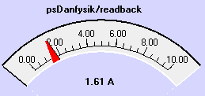
Abeans and ACS
ACS tools
Abeans Application
Management,
ObjectExplorer,
Logging,
Alarms
config
database
plain Java code
CosyBeans
GUI widgets
i
n
t
e
r
f
a
c
e
ACS CORBA server
I/O boards
CORBA
Abeans: libraries, device beans, plugs
implementation
channel access,
CORBA…
replace with any CS, e.g. TINE, EPICS, etc.
Notes:
In order to clarify what we consider as Abeans, CosyBeans and Abeans Applications, please see this picture.
CosyBeans are graphical components, sometimes called widgets, which display values and allow users to enter control data.
Abeans Application is a Java program, which uses CosyBeans for display and the Abeans libraries for services and communication.
Those libraries contain, among others, one Java Bean for each device that we want to control. The Abeans Application contains normal Java code, written by the programmer, which sends commands to the Device Bean. This Device Bean then converts those commands to CORBA and sends them to the server – either ACS CORBA server as in this case or a Riken CORBA server.
I assume that by the expression Abeans customisation, Hitachi-Zosen means changing the plain Java code inside the Abeans Application, adapting the CosyBeans (resizing, positioning, etc.) and making new Device Beans for new types of devices. I am correct? I just want to clarify what you mean.
Our other important product is ACS, which stands for Advanced Control Software. Apart from using CORBA for communication, like Hitachi-Zosen does, ACS also provides standard services for the control system operator: management, name resolution, interface inspection, Logging, Alarm system, Error handling, archiving, etc. I will give a quick demonstration after I show the Abeans. ACS has just been finalized and we want to test it first, before we offer it to others, but I can imagine that in the second half of the year, HZ could connect their CORBA or even device drivers directly to ACS.
Another powerful feature of Abeans is that it can connect to different protocols, by using plugs. So we have made a simple plug for Riken, which we can modify also for Hitachi Zosen IDL. We must change the plug for each new IDL, but it is not so much work. We can even make a plug that connects Abeans directly to EPICS!
In the demonstration that follows, you will see, how Abeans use the simulation plug, so that the applications can be tested and demonstrated without being connected to the real control system.

Slide 8
Conclusions
Cosylab is serious about making the best control system:
  Abeans empower the developer
  CosyBeans display the data
  ACS provides all management features
Notes:
To conclude, we can say that we are getting very close to our goal. The results speak for themselves.
Thank you very much for attention. Dr. Oku-san and I will be glad to answer any questions.

Slide 9
A Generic Simulator of Control Systems
For Application Development and Testing
Dragan Vitas, Mark Plesko, Gasper Tkacik, Ales Pucelj and Igor Kriznar
JSI and Cosylab Limited.

Slide 10
Why simulator
Probing
Testing
Performance evaluation
Problem resolving
Prediction of the application scalability

Slide 11
Design
Not specific to any particular control system software.
Flexible
Easy implementation of new specifics.
Applications have to be tested without being modified.
The user must be able to write extensions in a language and platform of his choice.

Slide 12
Simple
generators
SIN, RND, FIX …
stores
Properties
Simulator Engine
uses
Remote
generators
returns values
create properties
request properties data
Emulators
configure
CORBA
ACS
EPICS
Client applications
Configuration
Clients
&
scripts
Listeners and value generators
in user applications

Slide 13
Implementation
Multi-platform multi-threaded CORBA server
in C++ language
Multi-language, multi-platform clients can be created.
Advantages of the CORBA infrastructure can be exploited.

Slide 14
The Engine
Properties
  Name/value pairs with types and configuration data
Value generators
  Predefined: RANDOM, SINUS, FIXED …
  Remote – user generators
Listeners
  Callback for notification when a value change occurs

Slide 15
Emulators
CORBA
  Object factory
  Dynamic Skeleton Invocation (DSI)
ACS
  All parts of the ACS system are engaged
EPICS in the future?

Slide 16
PowerSupply.PW_SUPPLY_VD
PowerSupply.PW_SUPPLY_HD
PowerSupply.PW_SUPPLY_VU
PowerSupply.PW_SUPPLY_HU
Simulator Engine
Interface Repository
UserPanelInfo. USER_PANEL
InsertionDevice. INSERTION
interface PowerSupply {
long set(in double ampVal);
long get(out double ampVal);
long on();
long off();
long reset();
};
CORBA Emulator
Tao_ifr (IDL load)
ORB
CreateServer client
CC client
IDCPanel
createServer( “PowerSupply”,“PW_SUPPLY_VD” );

Slide 17
Program Generators and Control System Software Development
Klemen Žagar (klemen.zagar@cosylab.com)
Anže Vodovnik (anze.vodovnik@cosylab.com)
Jozef Stefan Institute, Slovenia (http://kgb.ijs.si)
in cooperation with
Cosylab Ltd., Slovenia (http://www.cosylab.com)

Slide 18
Need for program generators
When there is a lot of repetitive code
When there are many artifacts that need to be kept in-sync:
  Device driver code
  Networking protocol
  Configuration database schema
  GUI
Many rules to follow during coding
Errare humanorum est

Slide 19
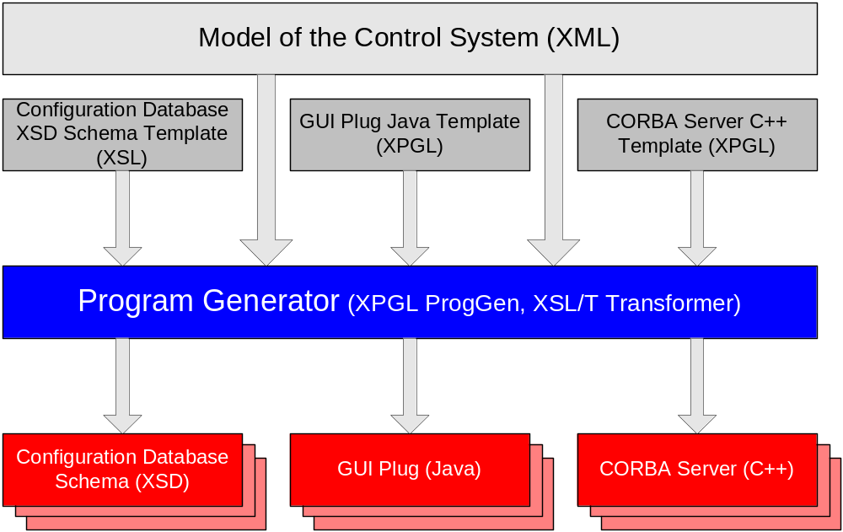
How program generators work?

Slide 20
XML
Extensible Markup Language
  World Wide Web Consortium Standard
XML representation of CSML model:
  Physical representation of the model
  CASE-tool neutral
  Easy to manipulate using widely-available XML tools (parsers)
Extensible Style-sheet Language Transformations
  Standard way to transform XML into another XML or text
  XSL/T files are hard to maintain

Slide 21
Extensible Program Generator Language (XPGL)
XPGL is not an instance of XML
  In XPGL, white spaces are important
  Removes unnecessary verbosity of XML
  Custom parser and transformation tool was needed (ProgGen)
  Only one configurable escape character
XPGL simplifies frequently used constructs of XSL
XPGL allows for several named output streams
XPGL pays a lot of attention to spaces, so that the output can be neatly indented
XPGL has provisions for preserving the output manually inserted by the programmer.

Slide 22
Example: our target
class SomeClass {
private int myVariable;
public int getMyVariable() {
return myVariable;
}
public void setMyVariable(int value) {
myVariable = value;
}
};

Slide 23
Example: describing a class (XML)
<?xml version="1.0"?>
<class name=”some_class”>
<field type=”int” name=”my_variable”/>
</class>

Slide 24
Example: the template (XPGL)
<?xpgl version="1.0"?>
class <”xpgl:naming('UU', /class/@name)”> {
<for-each "/class/field">
private <”@type”> <”xpgl:naming('LU', @name)”>;
public <”@type”> get<”xpgl:naming('UU', @name)”>() {
return <”xpgl:naming('LU', @name)”>;
}
public void set<”xpgl:naming('UU', @name)”>(<”@type”> value) {
<”xpgl:naming('LU', @name)”> = value;
}
</for-each>
};

Slide 25
Conclusion
The entire system is defined in one place
  E.g., the CSML model or XML
  Includes documentation
Other artifacts are kept in-sync with it
  All other artifacts are generated
  Generators are adjustable
Coding effort greatly reduced
Less error prone

Slide 26








eManagement Cycle
Order
Project Web
  Sources
  Manuals
  …
Internal Pages
  open project
  select project manager
  select people included
Scripts
Customer
Request Tracker
  To-Do
  Activity list
Bug report
Actual work
  Code
  XML Docs
Testing
Source Repository
  Sources
  Manuals (in XML)
  Resources
Notes:
Our electronic management is set up around our customer. From the moment he places an order, he has full control over the requests and full insight into the progress of the project. All project documentation, tasks, and even email communication is processed electronically and stored. The results of the work are available to the customer via Web pages.
==========================================================================
When we receive the order, we set up the project documentation pages in our internal Web pages.
All tasks are stored in the request tracker tool, a combination of an electronic to-do list, activity log, bug tracking tool and reminder of tasks. The customer can send his own requests via email or web interface and is automatically informed of any progress or changes. All communcation of the project team members are done via email on an archived mailing list, specially established for this project.
All results of the work, either source code, textual documentation, drawings and other resources, are stored in a versioning source repository so that older versions can be obtain at a later time. The manuals are written in XML structure so that we can make use of the newest standards and tools.
Testing is done by automatic procedures (modular tests) and special tester teams. All errors are reporting in electornic format and go into the request tracker tool. Also customers can send bug reports electronically and follow how theyare being processed.
If the tests prove that the products are functioning to specifications, the automatic scripts build web pages with compiled code, manuals and other resources, even source code, if so defined in the order. The web pages are accessible by the customer and protected with passwords, so that he can always obtain the latest working version.

Slide 27
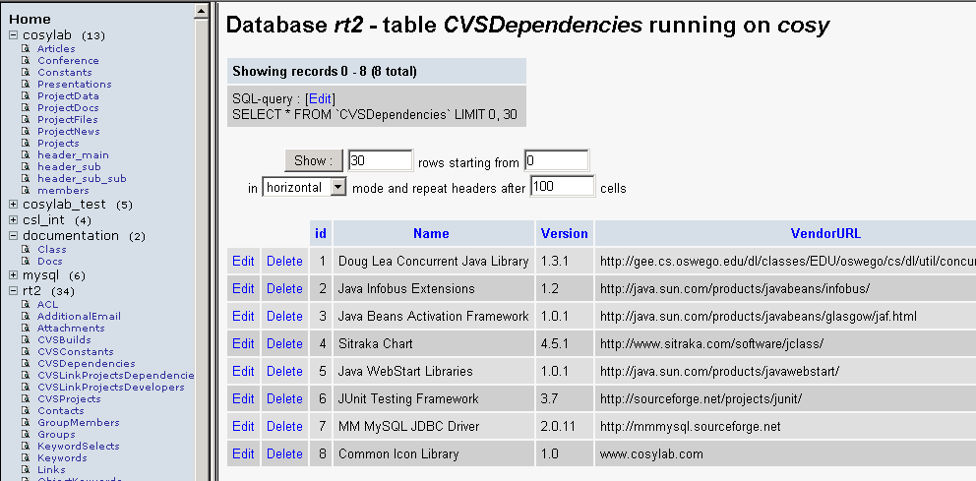
All Data in mySQL

Slide 28
Best of Breed Tools
all open source !
  Apache Web server, PHP scripts
  sympa mailing lists:
    list@<project>.cosylab.com
  eclipse: Java IDE with integrated CVS support
  RT: to-do tickets and support/bug tracking
    Web interface or bug@<project>.cosylab.com
  ant: makefile in Java & XML (nightly build)
  XML source –(XSL)–> html
    CosyXML: no more MS-Word?
    generated project pages
Notes:
KZjev Management/Documentation/XML_Documentation.xml source + drop
mark/doc-test/WIP/XML/*.xml

Slide 29
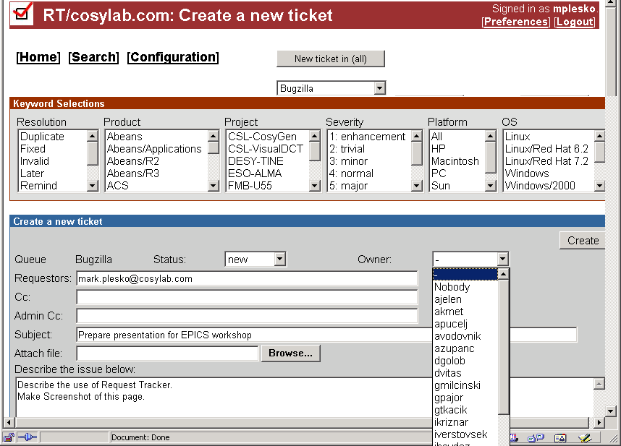
Enter New Ticket

Slide 30
Build Execution
build queries project data
User
user runs the build
SQL
MasterBuild.xml
project-specifc buildfile is generated
Build.xml
CVS
For each project:
Build.xml sets the specific options
Build.xml runs common build routines in CosyBuild.xml
CosyBuild.xml
Project 1
CVS repository checkout
Project 2
Generated
Manually configured
...
Repository

Slide 31
CosyBuild Execution
sources
insert versions
into sources
create javadocs
documents
insert copyrights
transform: CosyXML
→ HTML
compile sources
SQL
check XML correctness
check filenames
synchronize with SQL
run JUnit auto tests
create JAR files
create index.html
digitally sign JAR files
create project Web
Generate distribution ZIP

