Slide 1





ACS Alarm System
A. Caproni^{ac}
a. ESO, European Organization for Astronomical Research in the Southern Hemisphere
b. CERN, European Organization for Nuclear Research
c. INAF-OATs, Osservatorio Astronomico di Trieste
d. COSYLAB, Control System Laboratory

Slide 2
Alarm System
  The AS collects information from the environment and shows to the user what’s happening and possibly how to fix an abnormal situation in a short time.
  shows only the relevant alarms (can show all the active alarms)
  has the concept of authorized users
  doesn’t take any action to fix a problem
  alarm must be acknowledged
  stores the alarms in the database

Slide 3
ACS Alarm system
  2 available implementations:
  ACS
  CERN
  ACS implementation is used if:
  CBD/Alarms folder does not exist
  Implementation property not set to “CERN” in the CDB
  ACS implementation logs a message for each alarm (active/inactive):
  Alarm sent: <AlarmSource,ALARM_SOURCE_MOUNTCPP,1> ACTIVE
  Alarm sent: <AlarmSource,ALARM_SOURCE_MOUNTCPP,1> TERMINATE
  Log level Alert/Emergency

Slide 4
ACS Alarm system
  CERN implementation consists of the alarm system developed at CERN for the LHA collider integrated with ACS.
  We have:
  a working prototype
  an agreement with CERN
  the new version of the source code
  The CERN implementation is part of ACS (need to be explicitly activated)
  Things can change and they’ll do!
  Hopefully not the interfaces.

Slide 5
Large Hadron Collider Alarm Service (LASER)
  LASER is the second generation alarm service developed at CERN for the Large Hadron Collider.
  It is a messaging system: collects, stores, manages and distributes information about abnormal situations: the Fault States.
  Each Fault State (FS) is identified by a triplet:
  FS = <FF,FM,FC>
  the Fault Family (FF) groups elements of the same kind
  the Fault Member (FM) represents the failing instance
  the Fault Code (FC) identifies the particular problem
  A Fault State can be active or inactive

Slide 6


FaultState (triplet) - 1
FS = <FF, FM, FC>
FF groups similar equipments (sw/hw) for example Antenna(s), ACS components
FM identifies which particular equipment in the family is failing (for example Antenna3, MOUNT_3 component)
FC is an integer identifying the particular problem occurring in the failing equipment
It has a status, active ↔ inactive
It has an heartbeat
The FS is a unique identifier! → One triplet per each possible alarm!

Slide 7
FaultState (triplet) - 2
<FaultFamily, FaultMember, FaultCode>
Set of equipments of the same type
Equipment of the set
Specific failure
Examples:
<MOUNT, MOUNT_1, 100> (ACS component)
<ANTENNA, ANTENNA7, 200> (Hardware equipment)
<kernelModule, pcnet32@host, 1> (kernel module)

Slide 8
FaultState (triplet) -3
<Fault Family, Fault Member, Fault Code>
String
String
Integer
The definition of a FS is whatever you prefer!
meaningful (maintenance, readability…)
unique (it is an ID!)
it says who, where and how something is failing

Slide 9
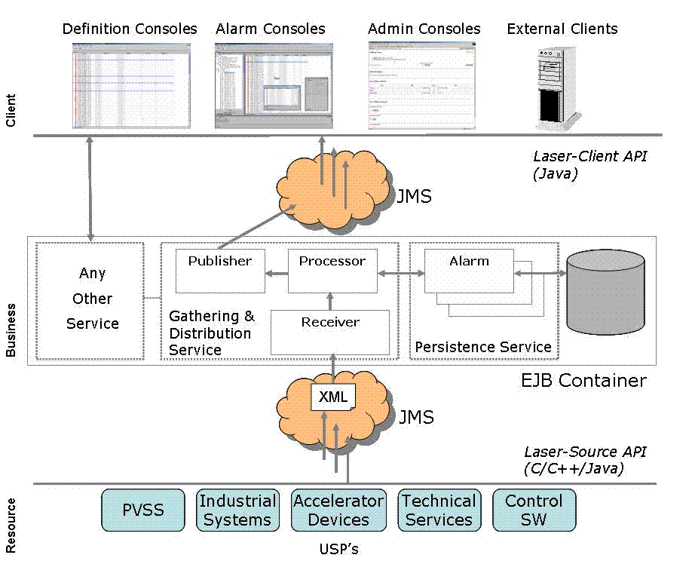
LASER - Overview

Slide 10
LASER – Resource tier
  The resource tier is composed of sources of alarms:
  different programming languages (java, C, C++)
  different platforms
  each source has a definite set of FS whose state can be active/inactive
  each source sends an heartbeat to the service
  categories of alarms
  LASER-source API:
  allows the sources to send alarms to the business tier
  no need of specific knowledge of the alarm service

Slide 11
LASER – An example
  String faultFamily=”PowerSupplies”;
  String faultMember=”PS3”;
  int faultCode=100;
  String faultState=FaultState.ACTIVE;
  AlarmSystemInterface alarmSource =
  AlarmSystemInterfaceFactory.createSource(this.name());
  FaultState fs = AlarmSystemInterfaceFactory.createFaultState(
  faultFamily, faultMember, faultCode);
  fs.setDescriptor(faultState);
  fs.setUserTimestamp(new Timestamp(System.currentTimeMillis()));
  Properties props = new Properties();
  props.setProperty(...);
  ...
  fs.setUserProperties(props);
  alarmSource.push(fs);

Slide 12
LASER- Business tier
  listen for FS changes and heartbeats
  build a complete view of each alarm
  reduces or masks alarms depending of:
  the status of the system
  the knowledge of the environment
  persist the FS
  track and archive the FS changes
  authenticate user of the clients
  allow the management of the FS without stopping the service
  publish alarms to the clients

Slide 13
LASER - Alarm informations
  System name
  Identifier of the system
  Description of the alarm
  The cause of the alarm
  The action to fix the problem
  The consequence of the alarm
  The priority of the alarm (4 priorities)
  The URL with detailed information
  A phone number to call
  The location of the source
  The name/ID of the responsible person

Slide 14
LASER - Reduction rules
The reduction aims to help the user to easily identify the root cause of a cascade of alarms.
The service has a knowledge of the environment by means of a set of reduction rules.
Node reduction (NR)
If a failure in the equipment A triggers a failure in another equipment, B, then the latter is reduced.
Multiplicity reduction (MR)
If the number of alarms of the same type is greater then a given threshold then these alarms are reduced and a new alarm is produced

Slide 15







Node reduction

Slide 16
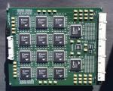
Multiplicity reduction

Slide 17

LASER – Client tier
Composed of java applications that consume the data produced by the business tier.
alarm console
definition console
login and configuration facilities
There is no need to stop the alarm service while administering the system.

Slide 18
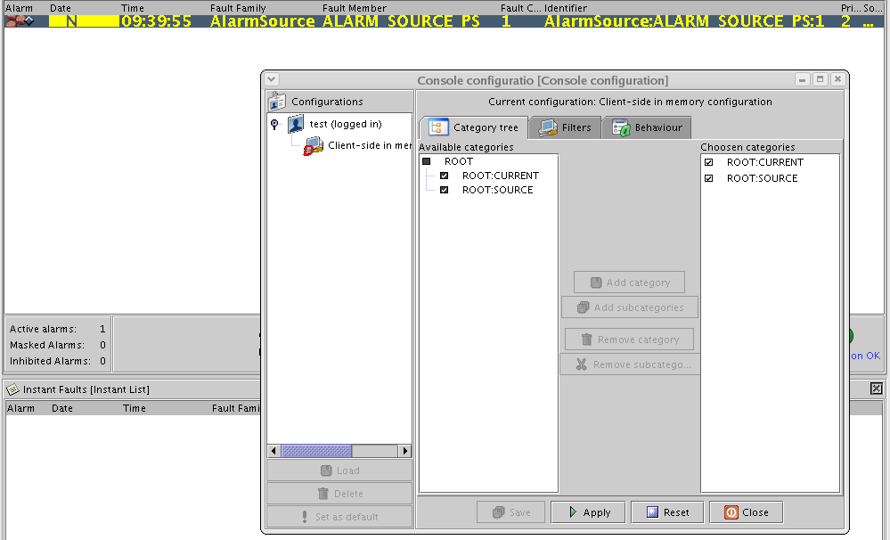
Operator GUI

Slide 19

Communications between the tiers
The communication between the tiers happens by means of JMS.
JMS implementation of ACS sends messages through NCs
It is possible to write clients that listen to the NC and take actions independently of the Alarm Service

Slide 20
ACS LASER structure
E₁
E₂
E₃
E₄
E₅
AS
Client_{ACS}
Source₁
Source₂

Slide 21
BACI properties
< FF=”BACIProperty”, FM=property_name, FC=1 >
This feature must be explicitly enabled by the user changing the value of alarm_timer_trig in the CDB entry of the property.
An alarm is sent when the value of a property become lower then the minimum or higher then the maximum. The min and max possible values of a property are defined in the CDB.
Besides the alarm_timer_trig, the methods startPropertiesMonitoring() and stopPropertiesMonitoring() of CharacteristicComponentImpl allow the developers to enable/disable the monitoring of the properties.
The CDB must be configured in order to see BACI alarms in the GUI.

Slide 22


Sending alarms in C++
C++ API mirrors the Java API
Integrated with BACI (i.e. CharacteristicComponent) properties
Libraries to add to the Makefile:
  acsAlSysSource
  acsErrTypeAlarmSourceFactory

Slide 23

Sending alarms in C++: how to program
// constants we will use when creating the fault
string family = "AlarmSource";
string member = "ALARM_SOURCE_MOUNT";
int code = 1;
// Step 1: create the AlarmSystemInterface using the factory
auto_ptr<AlarmSystemInterface> alarmSource = AlarmSystemInterfaceFactory::createSource();
// Step 2: create the FaultState using the factory
auto_ptr<FaultState> fltstate = AlarmSystemInterfaceFactory::createFaultState(family, member, code);
// Step 3: set the fault state's descriptor
string stateString = faultState::ACTIVE_STRING;
fltstate->setDescriptor(stateString);
// Step 4: create a Timestamp and use it to configure the FaultState
Timestamp * tstampPtr = new Timestamp();
auto_ptr<Timestamp> tstampAutoPtr(tstampPtr);
fltstate->setUserTimestamp(tstampAutoPtr);
// Step 5: create a Properties object and configure it, then assign to the FaultState
Properties * propsPtr = new Properties();
propsPtr->setProperty(faultState::ASI_PREFIX_PROPERTY_STRING, "prefix");
propsPtr->setProperty(faultState::ASI_SUFFIX_PROPERTY_STRING, "suffix");
propsPtr->setProperty("TEST_PROPERTY", "TEST_VALUE");
auto_ptr<Properties> propsAutoPtr(propsPtr);
fltstate->setUserProperties(propsAutoPtr);
// Step 6: push the FaultState to the alarm server
FaultState stateToPush(*fltstate);
alarmSource->push(stateToPush);

Slide 24

Java API - AcsAlarmSystemInterfaceFactory
import alma.alarmsystem.source.ACSFaultState;
import alma.alarmsystem.source.ACSAlarmSystemInterface;
import alma.alarmsystem.source.ACSAlarmSystemInterfaceFactory;
public static ACSAlarmSystemInterface createSource()
throws ACSASFactoryNotInitedEx, SourceCreationErrorEx;
public synchronized static ACSAlarmSystemInterface createSource(
String sourceName)
throws ACSASFactoryNotInitedEx, SourceCreationErrorEx;
public synchronized static ACSFaultState createFaultState()
throws ACSASFactoryNotInitedEx, FaultStateCreationErrorEx;
public static ACSFaultState createFaultState(
String family,
String member,
int code)
throws ACSASFactoryNotInitedEx, FaultStateCreationErrorEx;
...

Slide 25
Java API - AcsAlarmSystemInterface
...
public void push(ACSFaultState state);
public void push(Collection states);
public void pushActiveList(Collection active);
...

Slide 26
Java API - AcsFaultState
public final static String ACTIVE = "ACTIVE";
public final static String TERMINATE = "TERMINATE"
...
public void setDescriptor(String descriptor);
public void setUserProperties(Properties properties);
public void setUserTimestamp(Timestamp timestamp);
...

Slide 27
C++ API - AcsAlarmSystemInterfaceFactory
#include "ACSAlarmSystemInterfaceFactory.h"
#include "AlarmSystemInterface.h"
#include "FaultState.h"
#include "faultStateConstants.h"
static auto_ptr<AlarmSystemInterface> createSource(string sourceName);
static auto_ptr<AlarmSystemInterface> createSource();
static auto_ptr<acsalarm::FaultState>createFaultState(
string family,
string member,
int code);
static auto_ptr<acsalarm::FaultState>createFaultState();

Slide 28
C++ API - AcsAlarmSystem
...
virtual void push(FaultState & state); //raises ASIException = 0;
virtual void push(vector<FaultState> & states); // raises ASIException = 0;
virtual void pushActiveList(vector<FaultState> & activeFaults);
...

Slide 29
C++ API - FaultState
...
void setDescriptor(const string & newDescriptor);
virtual void setUserProperties(auto_ptr<Properties> theProperties);
virtual void setUserTimestamp(auto_ptr<Timestamp> theTimestamp);
...

Slide 30
CDB configuration
CDB
Properties of the AS
MACI
alma
Complete definition of each alarm
(KEY: triplet)
Alarms
List of all the tripletes
AlarmSystemConfiguration
Definition of the categories (NC)
The sources
(only ALARM_SYSTEM_SOURCES)
List
AlarmDefinitions
Assign alarms to category
<Category, triplet>
SourceDefinitions
CategoryDefinitions
Reduction rules
<triplet, triplet>
AlarmCategoryDefinitions
ReductionsDefinitions

Slide 31
CDB population
Write all the triplets
List/List.xml
Write the sources (now only ALARM_SYSTEM_SOURCES)
SourceDefinitions/SourceDefinitions.xml
Write the definition of each alarm: require the triplet and the (only one) source
AlarmDefinitions/<fault_member>/<fault_member>.xml
Write the definition of the categories
CategoryDefinitions/CategoryDefinitions.xml
Assign alarms to categories: require the triplet and the category name
AlarmCategoryDefinitions/AlarmCategoryDefinitions.xml
Define the reduction rules: require the triplets ReductionDefinitions/ReductionDefinitions.xml

Slide 32
CDB - AlarmSystemConfiguration
Alarms/AlarmSystemConfiguration/AlarmSystemConfiguration.xml
<alarm-system-configuration ... >
<configuration-property name="Implementation">
CERN
</configuration-property>
</alarm-system-configuration>

Slide 33
CDB - List
Alarms/List/List.xml
<alarm-definition-list... >
..
<alarm-definition
fault-family="AlarmSource"
fault-member="ALARM_SOURCE_PS"
fault-code="1" />
...
</alarm-definition-list>

Slide 34
CDB - SourceDefinitions
Alarms/SourceDefinitions/SourceDefinitions.xml
<source-definitions ...>
<sources-to-create>
<source-definition name="ALARM_SYSTEM_SOURCES">
<connection-timeout>15</connection-timeout>
<description>The alarm source for all the sources</description>
<responsible-id>1</responsible-id>
</source-definition>
</sources-to-create>
</source-definitions>

Slide 35
CDB - AlarmDefinitions
Alarms/AlarmDefinitions/<FM>/<FM>.xml
<alarm-definition-list ...>
<alarm-definition fault-family="AlarmSource" fault-member="ALARM_SOURCE_MOUNT" fault-code="1">
<visual-fields>
<system-name></system-name>
<identifier></identifier>
<problem-description></problem-description>
</visual-fields>
<instant>false</instant>
<!--cause></cause-->
<!--action></action-->
<!--consequence></consequence-->
<priority>1</priority>
<responsible-id>123</responsible-id>
<!--piquetGSM>12345</piquetGSM-->
<!--help-url></help-url-->
<source-name>ALARM_SYSTEM_SOURCES</source-name>
<!--location>
<building></building>
<floor></floor>
<room></room>
<mnemonic></mnemonic>
<position></position>
</location-->
<!--piquetEmail></piquetEmail-->
</alarm-definition>
</alarm-definition-list>

Slide 36
CDB - CategoryDefinitions
Alarms/CategoryDefinitions/CategoryDefinitions.xml
<category-definitions ...>
<categories-to-create>
...
<category-definition path="ROOT:SOURCE">
<description>
The category for all alarm states.
</description>
</category-definition>
...
</categories-to-create>
</category-definitions>

Slide 37
CDB - AlarmCategoryDefinitions
Alarms/AlarmCategoryDefinitions/AlarmCategoryDefinitions.xml
<alarm-category-definitions
xmlns="urn:schemas-cosylab-com:AcsAlarmSystem:1.0"
xmlns:xsi="http://www.w3.org/2001/XMLSchema-instance">
<category-links-to-create>
...
<alarm-category-link>
<category>
<category-definition path="ROOT:SOURCE"/>
</category>
<alarm>
<alarm-definition
fault-family="AlarmSource"
fault-member="ALARM_SOURCE_A"
fault-code="1"/>
</alarm>
</alarm-category-link>
...
</category-links-to-create>
</alarm-category-definitions>

Slide 38

CDB - ReductionDefinitions
Alarms/ReductionDefinitions/ReductionDefinitions.h
<reduction-definitions ...>
...
<links-to-create>
<reduction-link type="NODE">
<parent>
<alarm-definition fault-family="FF1" fault-member="FM1" fault-code="1"/>
</parent>
<child>
<alarm-definition fault-family="FF2" fault-member="FM2" fault-code="1"/>
</child>
</reduction-link>
...
</links-to-create>
<thresholds>
...
<threshold value="2">
<alarm-definition fault-family="FF3" fault-member="FM3" fault-code="1"/>
</threshold>
...
</thresholds>
</reduction-definitions>

Slide 39

CDB – ReductionDefinitions - NR
Alarms/ReductionDefinitions/ReductionDefinitions.h
<reduction-link type="NODE">
<parent>
<alarm-definition fault-family="AlarmSource" fault-member="ALARM_SOURCE_PS" fault-code="1"/>
</parent>
<child>
<alarm-definition fault-family="AlarmSource"
fault-member="ALARM_SOURCE_MOUNT" fault-code="1"/>
</child>
</reduction-link>
<reduction-link type="NODE">
<parent>
<alarm-definition fault-family="AlarmSource"
fault-member="ALARM_SOURCE_MOUNT" fault-code="1"/>
</parent>
<child>
<alarm-definition fault-family="AlarmSource"
fault-member="ALARM_SOURCE_ANTENNA" fault-code="1"/>
</child>
</reduction-link>

Slide 40

CDB – ReductionDefinitions - MR
Alarms/ReductionDefinitions/ReductionDefinitions.h
<reduction-link type="MULTIPLICITY">
<parent>
<alarm-definition fault-family="AlarmSource" fault-member="MULTIPLE_MF_FAILURES" fault-code="1"/>
</parent>
<child>
<alarm-definition fault-family="AlarmSource" fault-member="ALARM_SOURCE_MF" fault-code="1"/>
</child>
</reduction-link>
<reduction-link type="MULTIPLICITY">
<parent>
<alarm-definition fault-family="AlarmSource" fault-member="MULTIPLE_MF_FAILURES" fault-code="1"/>
</parent>
<child>
<alarm-definition fault-family="AlarmSource" fault-member="ALARM_SOURCE_MF" fault-code="2"/>
</child>
</reduction-link>
...
<thresholds>
<threshold value="3">
<alarm-definition fault-family="AlarmSource" fault-member="MULTIPLE_MF_FAILURES" fault-code="1"/>
</threshold>
</thresholds>

Slide 41

References
http://www.eso.org/projects/alma/develop/acs/OnlineDocs/AlarmSystem.pdf
http://proj-laser.web.cern.ch/proj%2Dlaser/ (Laser documentation)
http://lhc-cp.web.cern.ch/lhc%2Dcp/ (LHC project)
CDB schema:
ACS/LGPL/CommonSoftware/acsalarmidl/ws/config/CDB/schemas/AcsAlarmSystem.xsd
Examples in
ACS/LGPL/CommonSoftware/ACSLaser/demo

Slide 42
ACS alarm system
Questions ?

Slide 43

Exercise
Three components:
PS: composed of three generators
MOUNT
ANTENNA
A failure in PS
generates 3 alarms, one per generator
then triggers a failure in MOUNT that sends another alarm
a failure in MOUNT triggers a failure in ANTENNA that sends the last alarm
The triggering of failure is simulated by means of IDL methods (already implemented)
Define the triplets for the tree generators, the MOUNT and the ANTENNA alarms
Send the alarms (ACTIVE/INACTIVE) and check if they work in ACS implementation (log)
Configure the CDB and check the alarms with the alarm GUI
Define the reduction rule in order to see only the root cause of the problem

Slide 44
A possible solution
<PowerSupplies,ALARM_COURSE_PS,1>
<PowerSupplies,ALARM_COURSE_PS,2>
<PowerSupplies,ALARM_COURSE_PS,3>
<MOUNT,ALARM_COURSE_MOUNT,1>
<ANTENNA,ALARM_COURSE_ANTENNA,1>

