Slide 1

BACI properties
Atacama Large Millimeter Array
Alessandro Caproni
acaproni@eso.org
European Southern Observatory

Slide 2
BACI – Basic Control Interface
Defines interfaces that the user extends
Device model:
  actions
  control/monitor points
  characteristics
Component-Characteristic-Property pattern

Slide 3
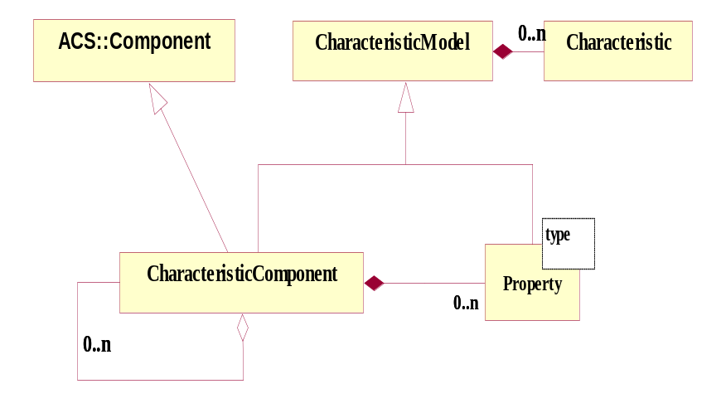
(Characteristic) Component
logical self contained entity
base class for physical and logical devices
managed through CORBA object
accessed through MACI
with a life cycle
each component has
  properties
  (e.g. position, control/monitor points...)
  characteristics
  (static data in CDB, like units, default values...)

Slide 4
BACI Properties
static data item
<name, value>
value is strongly typed
access:
  Read-Only (RO)
  Read-Write (RW)
Different data types
  only basic data types
  double, long, string, pattern, enum, longSeq, ...
ROdouble, RWdouble,....

Slide 5
Functionality of Properties
Same characteristics: resolution, units, description, …
Get/set value synchronously and asynchronously
Value monitoring:
  Time base
  On-change
  …
history
archiving value
alarms
…

Slide 6
BACI Implementation
implementation of RO<type> and RW<type>
  C++ (templates)
  java
  python
IDL: baci.idl

Slide 7
IDL example
#include <baci.idl>
...
module MOUNT_ACS
{
...
interface Mount : ACS::CharacteristicComponent {
…
void objfix (in double az,
in double elev,
in ACS::CBvoid callBack,
in ACS::CBDescIn desc);
readonly attribute ACS::ROdouble cmdAz;
readonly attribute ACS::ROdouble cmdEl;
readonly attribute ACS::ROdouble actAz;
readonly attribute ACS::ROdouble actEl;
…
}
}

Slide 8
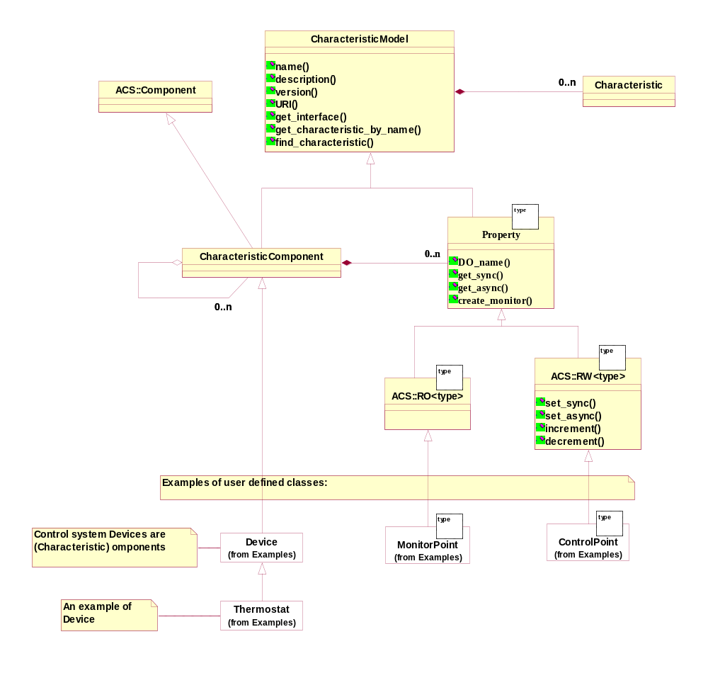
Component-Property-Characteristics full model

Slide 9
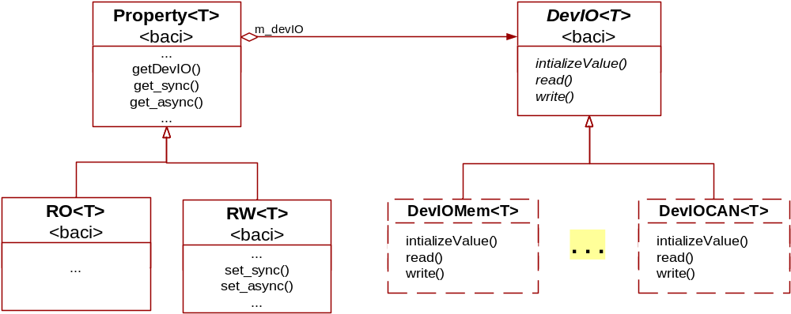
Property and DevIO
Decouple software and hardware
Uses the bridge pattern:
  DevIO read/write/init
  passed in the constructor

Slide 10
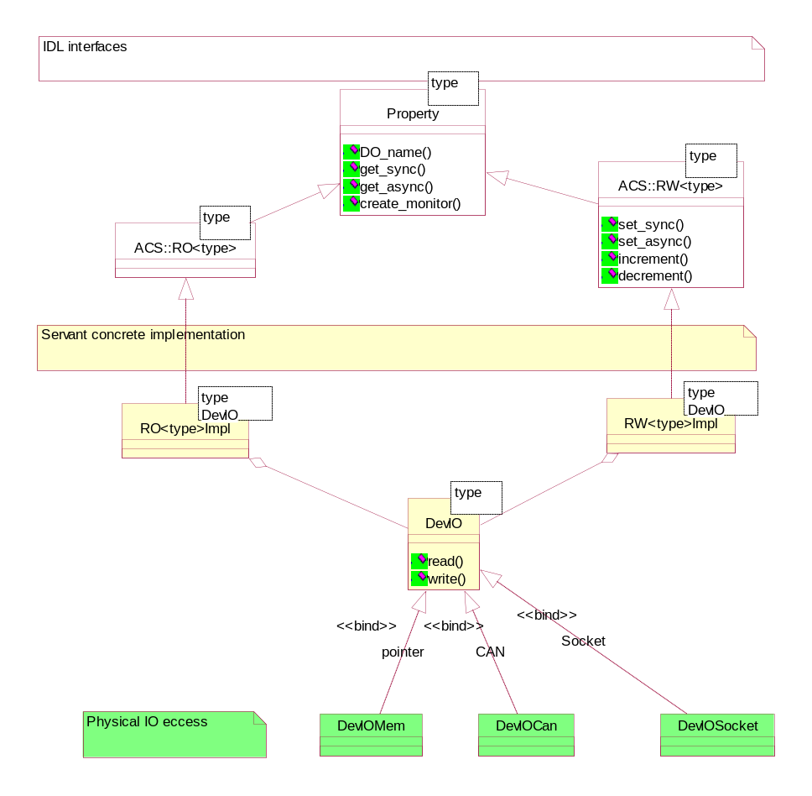
DevIO Implementation
The DevIO bridge pattern decouples Properties from HW.
DevIO implementations available:
Memory location (ACS defaults implementation)
CAN bus access (ALMA)
Socket generic interface (APEX)
RS232 (OAN)
PC Joystick (HPT)
Webcam (HPT)
CCD cameras (FBIG, Finger Lake) (HPT)
Heidenan Encoder board IK220 (HPT)
Motor Control Board (HPT)
CCS Real time database (VLT)
OPC (E-ELT Tdem)
OPCUA (E-ELT instrum. prototype)

Slide 11
CDB
Each Characteristic Component must have:
XML schema (XSD) deriving from baci:CharacteristicComponent XSD (structure of CC + default values/characteristics)
entry in CDB under alma branch for each instance (specific values/characteristics)

Slide 12
XSD example
<xs:schema targetNamespace="urn:schemas-cosylab-com:MOUNT:1.0"
xmlns:xs="http://www.w3.org/2001/XMLSchema"
xmlns="urn:schemas-cosylab-com:MOUNT:1.0"
xmlns:cdb="urn:schemas-cosylab-com:CDB:1.0"
xmlns:baci="urn:schemas-cosylab-com:BACI:1.0" >
<xs:import namespace="urn:schemas-cosylab-com:CDB:1.0" schemaLocation="CDB.xsd"/>
<xs:import namespace="urn:schemas-cosylab-com:BACI:1.0" schemaLocation="BACI.xsd"/>
<xs:complexType name="MOUNT">
<xs:complexContent>
<xs:extension base="baci:CharacteristicComponent">
<xs:sequence>
<xs:element name="cmdAz" type="baci:ROdouble"/>
<xs:element name="cmdEl" type="baci:ROdouble"/>
<xs:element name="actAz" type="baci:ROdouble"/>
<xs:element name="actEl" type="baci:ROdouble"/>
</xs:sequence>
</xs:extension>
</xs:complexContent>
</xs:complexType>
<xs:element name="MOUNT" type="MOUNT"/>
</xs:schema>

Slide 13
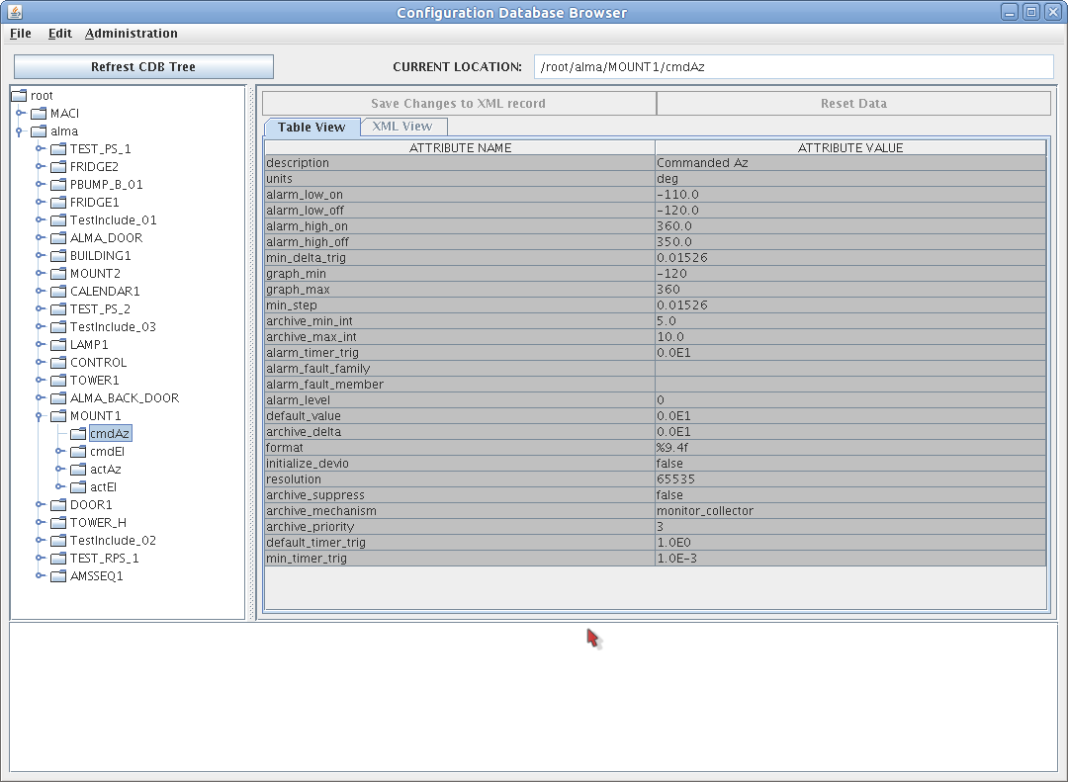
CDB – property entry in “alma”
<?xml version="1.0" encoding="ISO-8859-1"?>
<MOUNT xmlns="urn:schemas-cosylab-com:MOUNT:1.0"
xmlns:baci="urn:schemas-cosylab-com:BACI:1.0"
xmlns:cdb="urn:schemas-cosylab-com:CDB:1.0"
xmlns:xsi="http://www.w3.org/2001/XMLSchema-instance">
...
<cmdAz
description="Commanded Az"
units="deg"
alarm_low_on="-110.0"
alarm_low_off="-120.0"
alarm_high_on="360.0"
alarm_high_off="350.0"
min_delta_trig="0.01526"
graph_min="-120"
graph_max="360"
min_step="0.01526"
archive_min_int="5.0"
archive_max_int="10.0" />
...
</MOUNT>

Slide 14
C++ example – Mount - 1
#include <baciCharacteristicComponentImpl.h>
#include <acsexmplMountS.h>
#include <baciROdouble.h>
<baciSmartPropertyPointer.h>baci::SmartPropertyPointer<baci::ROdouble>
m_cmdAz_sp;
class Mount: public baci::CharacteristicComponentImpl,
public virtual POA_MOUNT_ACS::Mount,
public baci::ActionImplementator
{
. . .
baci::SmartPropertyPointer<baci::ROdouble> m_cmdEl_sp;
baci::SmartPropertyPointer<baci::ROdouble> m_actAz_sp;
baci::SmartPropertyPointer<baci::ROdouble> m_actEl_sp;
. . .
}

Slide 15
C++ example – Mount - 2
. . .
Mount::Mount(
ACE_CString _name,
maci::ContainerServices * containerServices) :
CharacteristicComponentImpl(_name, containerServices),
m_cmdAz_sp(new ROdouble(_name+":cmdAz", getComponent()),this),
m_cmdEl_sp(new ROdouble(_name+":cmdEl", getComponent()),this),
m_actAz_sp(new ROdouble(_name+":actAz", getComponent()),this),
m_actEl_sp(new ROdouble(_name+":actEl", getComponent()),this)
{
…
}
. . .

Slide 16
C++ client example
int main(int argc, char *argv[]) {
SimpleClient client;
client.login();
MOUNT_ACS::Mount_var mount =
client.getComponent<MOUNT_ACS::Mount>(argv[1], 0, true);
ACS::ROdouble_var actAz = mount->actAz();
ACSErr::Completion_var completion;
CORBA::Double val = actAz->get_sync(completion.out());
client.releaseComponent( argv[1]);
client.logout()
}

Slide 17
Python example
from Acspy.Clients.SimpleClient import PySimpleClient
simpleClient = PySimpleClient()
mount = simpleClient.getComponent("MOUNT1")
# get the property
actAzProperty = mount._get_actAz()
# Ask the current value of the property
(azm, compl) = actAzProperty.get_sync()
# Release the component
simpleClient.releaseComponent("MOUNT1")
simpleClient.disconnect()

Slide 18
C++ example – DevIO
#include <baciDevIO.h>
class LongDevIO : public DevIO<CORBA::Long>
{
public:
LongDevIO() {};
virtual ~LongDevIO() {};
virtual bool initializeValue() { return true; }
virtual CORBA::Long read(unsigned long long& timestamp) {
timestamp = getTimeStamp();
// Get value from hw
return . . .;
}
virtual void
write(const CORBA::Long &value, unsigned long long& timestamp) {
timestamp = getTimeStamp();
// Do something with hw
}

Slide 19
C++ – example PS 1
#include <rampedPowerSupplyS.h>
#include <baciROlong.h>
#include <baciRWstring.h>
#include "longDevIO.h"
#include <baciSmartPropertyPointer.h>
class RampedPowerSupply: public PowerSupply
public virtual POA_RampedPS::RampedPowerSupply
{
. . .
baci::SmartPropertyPointer<baci::ROlong> m_rampingStep_sp;
DevIO<CORBA::Long> *m_rampingStep_devio_p;
. . .
}

Slide 20
C++ example – PS 2
. . .
RampedPowerSupply::RampedPowerSupply(
const ACE_CString &name,
maci::ContainerServices * containerServices) :
PowerSupply(name, containerServices),
m_rampingStep_sp(this),
m_rampingStep_devio_p(0),
m_rampingStatus_sp(new RWstring(name+":rampingStatus", getComponent()),this)
{
m_rampingStep_devio_p = new LongDevIO();
m_rampingStep_sp = new ROlong(
name+":rampingStep",
getComponent(),
m_rampingStep_devio_p);
}
. . .

Slide 21
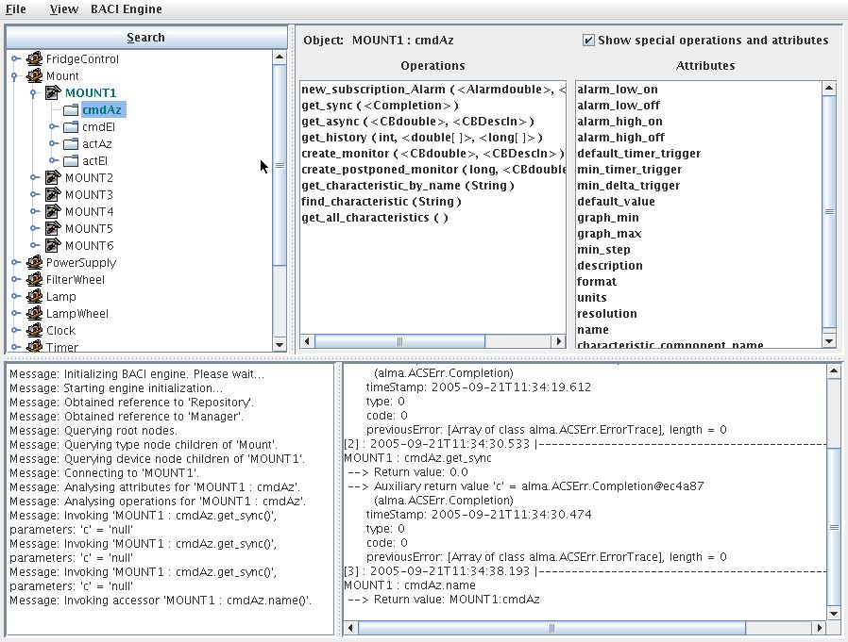
Object Explorer

Slide 22
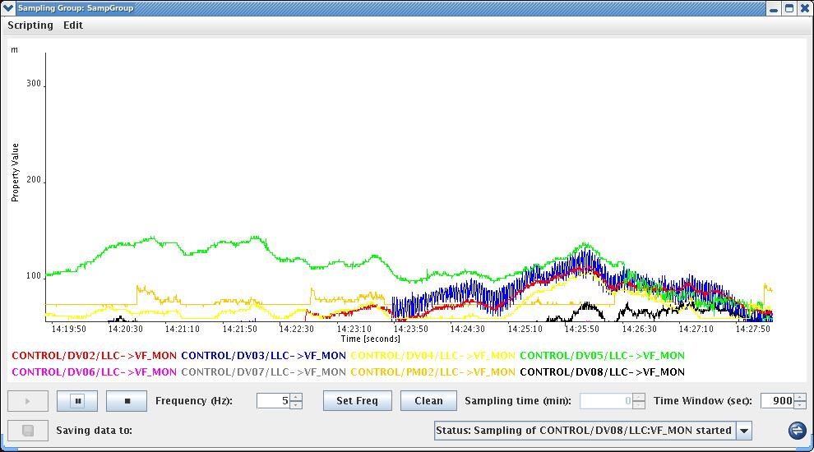
Sampling GUI

Slide 23
GUIs
java
other languages used in other projects
use ACS to
  get/release components
  show and set monitor and control points
  execute actions

Slide 24
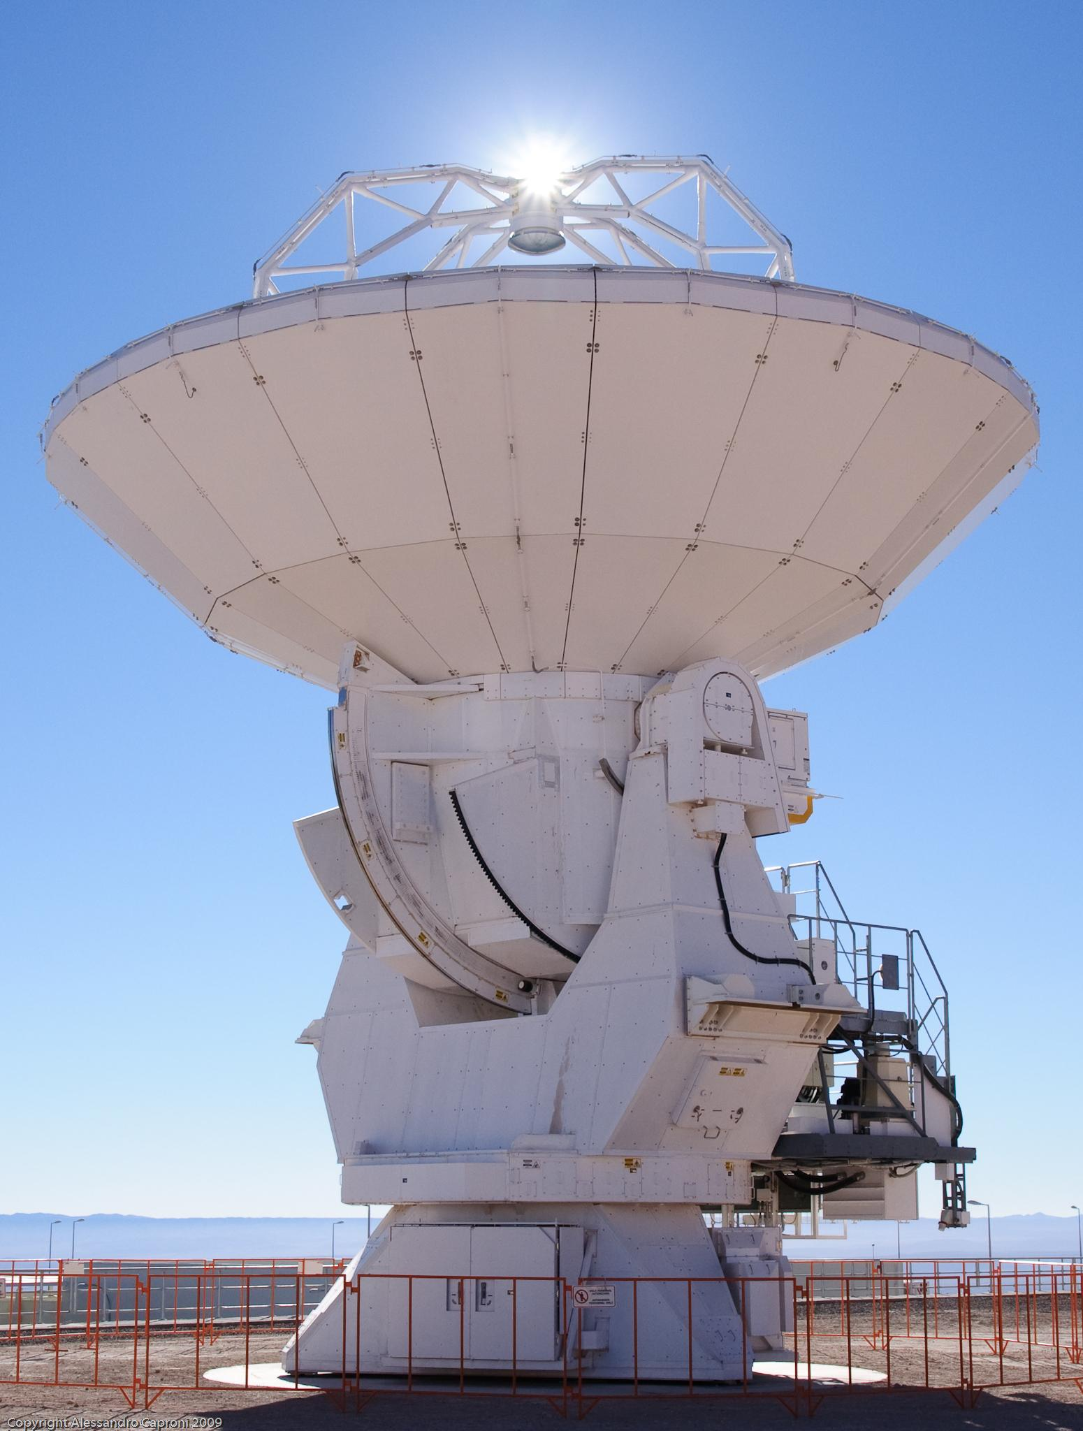
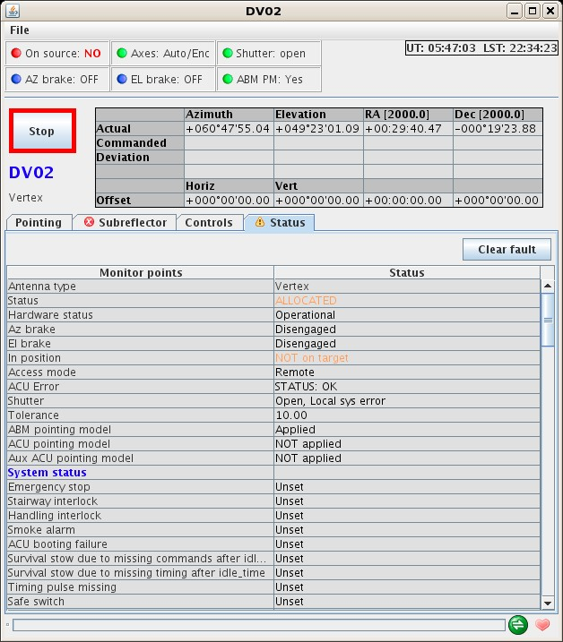
Mount panel

Slide 25
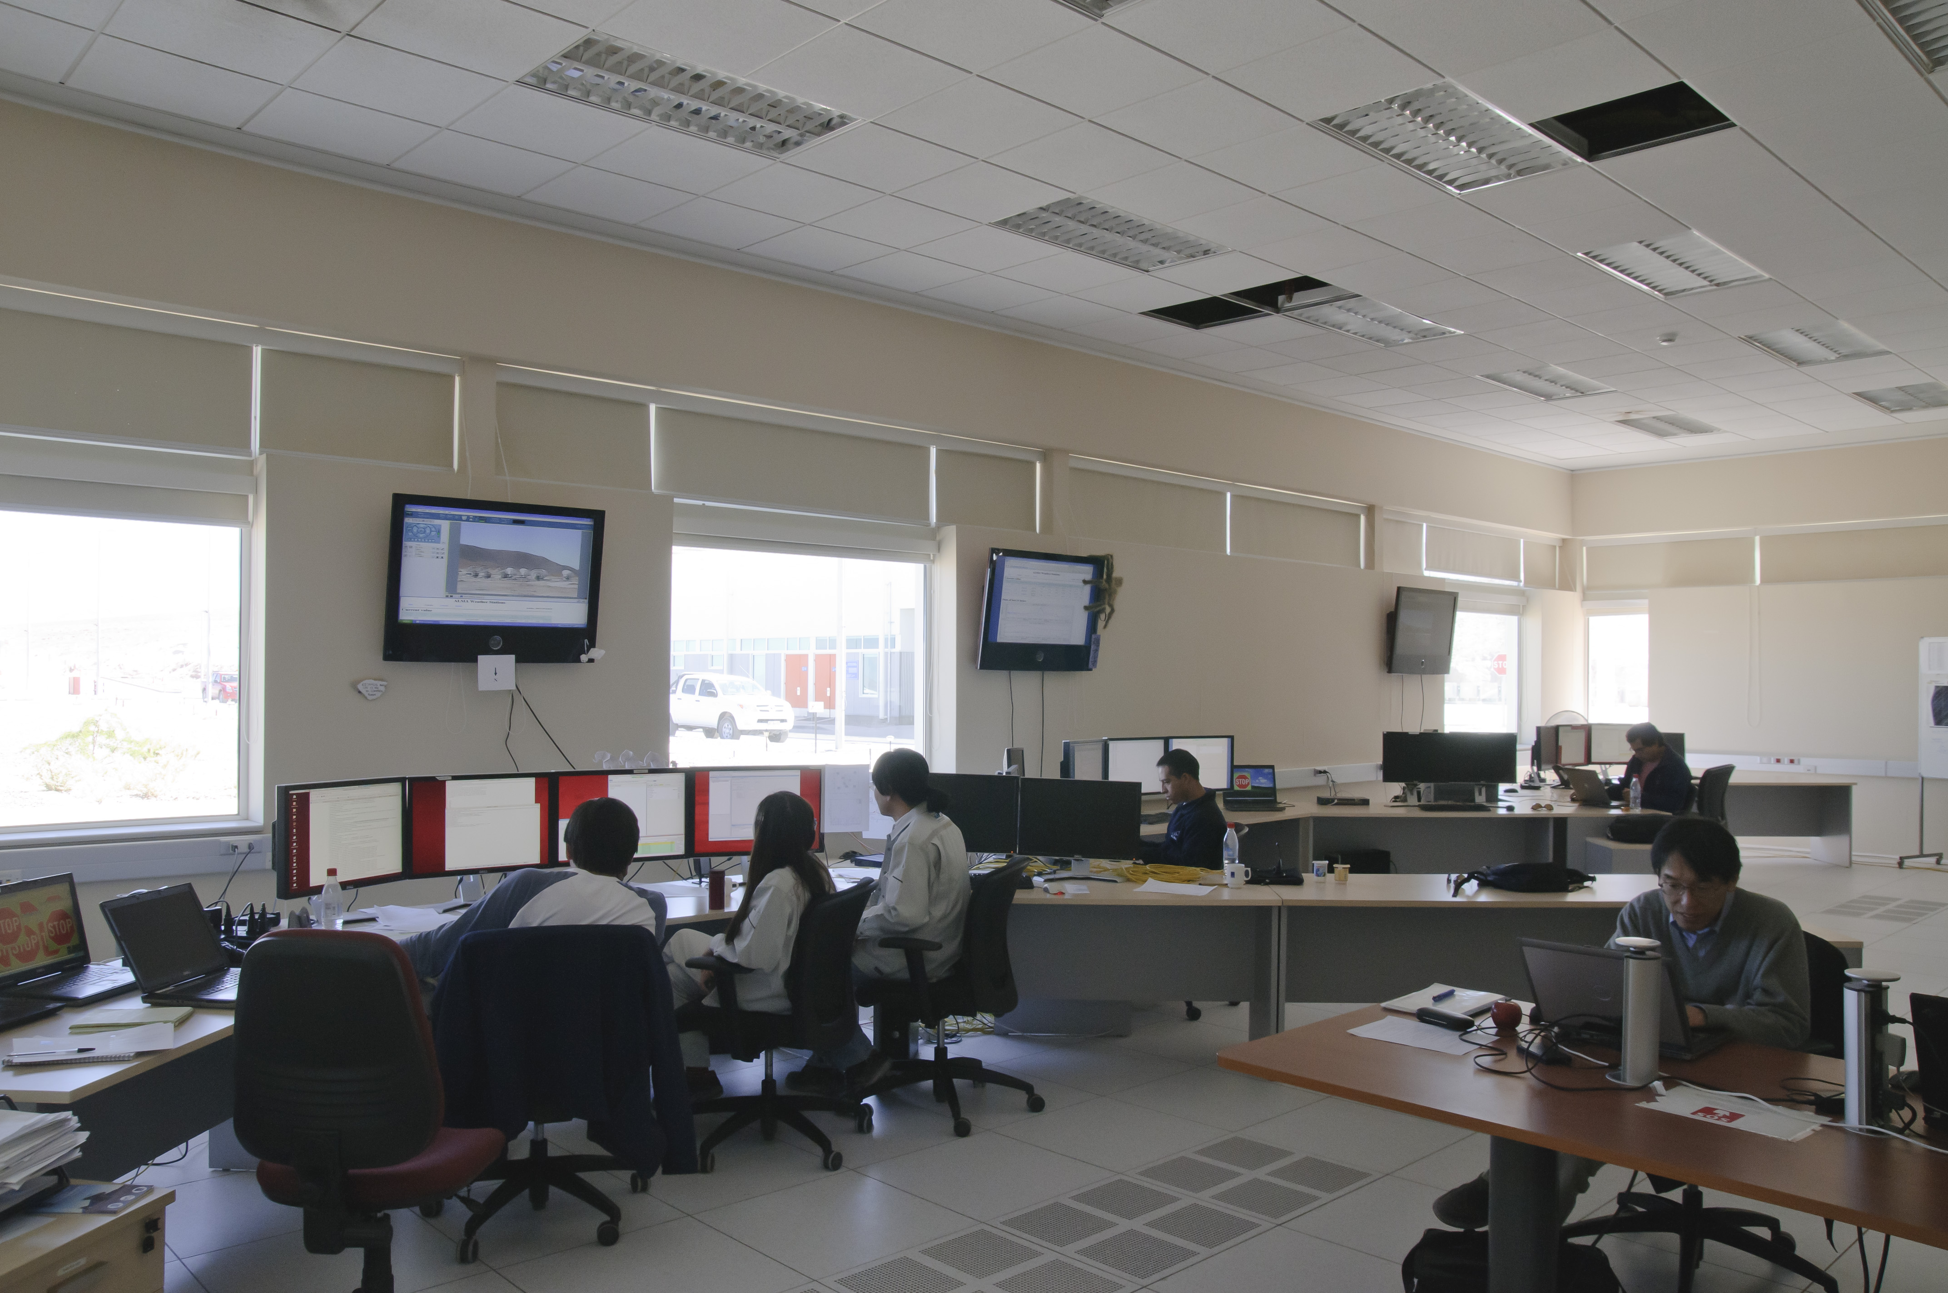
¿ Questions ?

