Slide 1

ALMA
Common Software
Training-Course
Session 1b
Distributed Systems
G.Chiozzi
Notes:
This presentation introduces the basic concepts underlying distributed systems and the architecture of the CORBA Middleware

Slide 2
What is a Distributed System ?
A collection of autonomous computers that are:
  linked by a network
  using software to produce an integrated computing facility
Characteristics:
  Resource Sharing
  Openess
  Concurrency
  Scalability
  Fault Tolerance
  Transparency

Slide 3
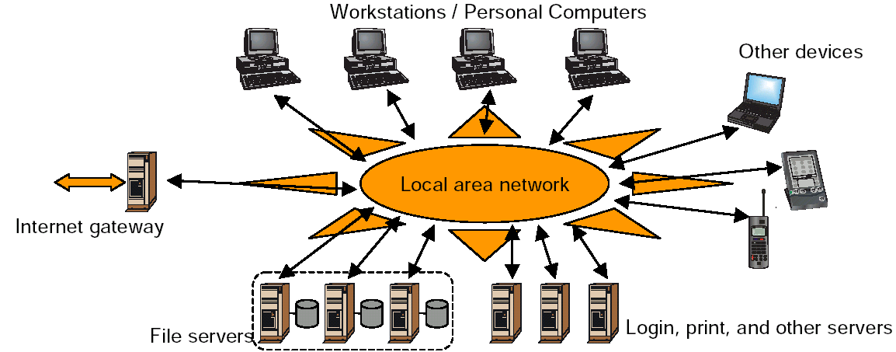
A Distributed System
Source: TU Hamburg

Slide 4
Heterogeneous Distributed Systems
Definition: In heterogeneous distributed systems servers and clients may use different hardware, system software and/or programming languages.
Heterogeneous distributed systems are based on the concept of distributed objects.
A special layer of software between client and server processes is needed to deliver the extra functionality. This software layer is called middleware. It hides the complexity of the extra functionality behind a common set of APIs that client and server processes can invoke.

Slide 5
Required Middleware Functionality
Network protocol functionality only allows data exchange between client and server. More functionality is required for heterogeneous distributed systems, like
translation from name to address,
dynamic invocation of server processes,
load balancing and
security.

Slide 6
Middleware Systems
Common Object Request Broker Architecture (CORBA) from the Object Management Group (OMG)
Java Remote Method Invocation (Java RMI) from Sun Microsystems
Distributed Component Object Model (DCOM) from Microsoft

Slide 7
CORBA design goals/characteristics:
No need to pre-determine:
  The programming language
  The hardware platform
  The operating system
  The specific object request broker
  The degree of object distribution
Open Architecture:
  Language-neutral Interface Definition Language (IDL)
  Language, platform and location transparent
Objects could act as clients, servers or both
The Object Request Broker (ORB) mediates the interaction between client and object

Slide 8
Object Management Architecture (OMA)
Components of CORBA
Interface Definition Language (IDL) Object services (CORBAservices)
Object Request Broker (ORB)
Common facilities (Horizontal CORBAfacilities)
Domain interfaces (Vertical CORBAfacilities)

Slide 9
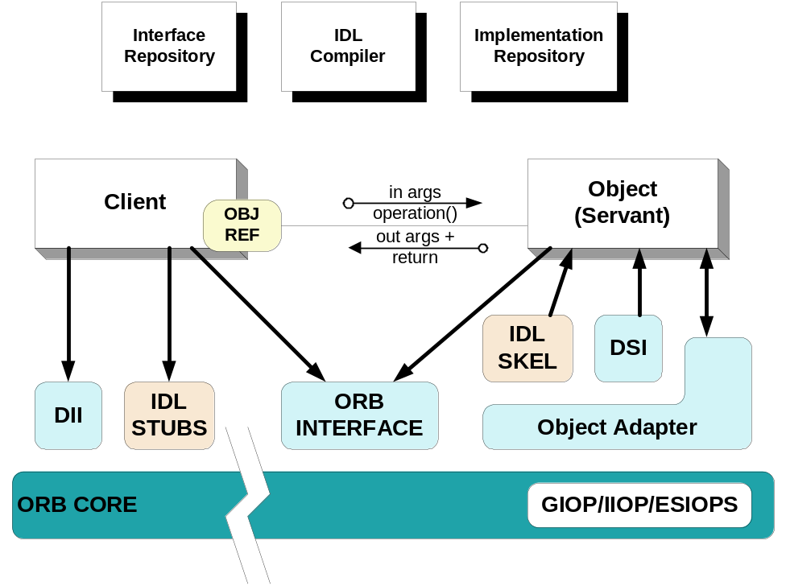
Overview of CORBA
Common Object Request Broker Architecture (CORBA)
  A family of specifications
  OMG is the standards body
  Over 800 companies
CORBA defines interfaces, not implementations
It simplifies development of distributed applications by automating/encapsulating
  Object location
  Connection & memory mgmt
  Parameter (de)marshaling
  Event & request demultiplexing
  Error handling & fault tolerance
  Object/server activation
  Concurrency
  Security
CORBA shields applications from heterogeneous platform dependencies
  e.g., languages, operating systems, networking protocols, hardware
Notes:
CORBA – Common Object Request Broker
Resides between OS, network and application
Simplifies development of distributed applications by making it not much different from stand-alone applications: invocations on remote objects look just like a method call on a local object
The requirements that it meets and make it popular are:
system’s requirement for interoperability, distribution (compatibility of performance), scalability, full tolerance
Its advantages are:
Interface/Implementation separation
Local transparency (hidden object implementation)
Multithreaded library
To be discussed:
CORBA defines one message queue per Component
CORBA does not know anything about the type of the component, Components needs to be casted to the specific type (narrow operation)

Slide 10
CORBA object characteristics
CORBA objects have identity
  A CORBA server can contain multiple instances of multiple interfaces
  An IOR uniquely identifies one object instance
CORBA object references can be persistent
  Some CORBA objects are transient, short-lived and used by only one client
  But CORBA objects can be shared and long-lived
    business rules and policies decide when to “destroy” an object
    IORs can outlive client and even server process life spans
CORBA objects can be relocated
  The fixed object key of an object reference does not include the object’s location
  CORBA objects may be relocated at admin time or runtime
  ORB implementations may support the relocation transparently
CORBA supports replicated objects
  IORs with the same object key but different locations are considered replicas

Slide 11
CORBA server characteristics
When we say “server” we usually mean server process, not server machine
One or more CORBA server processes may be running on a machine
Each CORBA server process may contain one or more CORBA object instances, of one or more CORBA interfaces
A CORBA server process does not have to be “heavyweight”
  e.g., a Java applet can be a CORBA server

Slide 12
Interfaces vs. Implementations
IDL Interface
Object
CORBA Objects are fully encapsulated
Accessed through well-defined interface
Internals not available - users of object have no knowledge of implementation
Interfaces & Implementations totally separate
For one interface, multiple implementations possible
One implementation may be supporting multiple interfaces

Slide 13
Location Transparency
Process A
Process B
Process C
Machine X
Machine Y
A CORBA Object can be local to your process, in another process on the
same machine, or in another process on another machine

Slide 14
Stubs & Skeletons
client program
object
implementation
call
method
language mapping
operation signatures
language mapping entry points
Stub
Skeleton
ORB Operations
Basic Object Adapter
Location Service
ORB
Transport Layer
Multithreading
Stubs and Skeletons are automatically generated from IDL interfaces

Slide 15
Why IDL?
IDL reconciles diverse object models and programming languages
Imposes the same object model on all supported languages
Programming language independent means of describing data types and object interfaces
  purely descriptive - no procedural components
  provides abstraction from implementation
  allows multiple language bindings to be defined
A means for integrating and sharing objects from different object models and languages

Slide 16
IDL simple data types
Basic data types similar to C, C++ or Java
  long, long long, unsigned long, unsigned long long
  short, unsigned short
  float, double, long double
  char, wchar (ISO Unicode)
  boolean
  octet (raw data without conversion)
  any (self-describing variable)

Slide 17
IDL complex data types
string - sequence of characters - bounded or unbounded
  string<256> msg // bounded
  string msg // unbounded
wstring - sequence of Unicode characters - bounded or unbounded
sequence - one dimensional array whose members are all of the same type - bounded or unbounded
  sequence<float, 100> mySeq // bounded
  sequence<float> mySeq // unbounded

Slide 18
IDL user defined data types
Facilities for creating your own types:
  typedef
  enum
  const
  struct
  union
  arrays
  exception
preprocessor directives - #include #define

Slide 19
Operations and parameters
Return type of operations can be any IDL type
each parameter has a direction (in, out, inout) and a name
similar to C/C++ function declarations

Slide 20
CORBA Development Process Using IDL
Client
Implementation
IDL
Definition
Object
Implementation
IDL
Compiler
Client
Program
Source
Object
Implementation
Source
Stub Source
Skeleton Source
Java or C++
Compiler
Java or C++
Compiler
Client Program
Object Implementation

Slide 21
IDL Example: Mount
#ifndef _ACSCOURSE_MOUNT_IDL_
#define _ACSCOURSE_MOUNT_IDL_
#include <baci.idl>
#pragma prefix "alma"
module ACSCOURSE_MOUNT
{
interface Mount2 : ACS::CharacteristicComponent
{
void objfix (in double az,
in double elev);
readonly attribute ACS::RWdouble cmdAz;
readonly attribute ACS::RWdouble cmdEl;
readonly attribute ACS::ROdouble actAz;
readonly attribute ACS::ROdouble actEl;
};
};
#endif

Slide 22
CORBA services
Naming Service
Event Service
Notification Service
Telecom Logging Service
Concurrency Control Service
Externalization Service
Licensing Service
Life Cycle Service
Object Trader Service
Persistent Object Service
Property Service
Query Service
Relationship Service
Security Service
Time Service
Transaction Service

