Slide 1

ALMA
Common Software
Training-Course
Session 4 - ACS Docs
G.Chiozzi, D.Fugate, B.Gustafsson, B.Jeram,
B.Lopez, P.Sivera, M.Zamparelli
Notes:
A number of papers on the ALMA project and on ACS have been presented in August at the SPIE Conference in Kona, Hawaii:
the ALMA Project has been introduced in the paper 4837-12
ACS in paper 4848-05 (G.Chiozzi et al.)
the overall ALMA software Architecture in 4848-06 (J.Schwarz, G.Raffi).
theALMA Test Interferometer Control Software in paper 4848-07 (R.G..Marson, B.Glendenning).
In this presentation we are going to describe the ALMA Common Software (ACS) that is under development as a set of common software component to be used for the development of any ALMA subsystem.
This work is responsibility of an international team mainly based at ESO and in tight collaboration with the JSI in Ljubljana.
A part from the authors of the paper, we want to thank here the essential contributions to ACS from other members of the ALMA SW community.

Slide 2
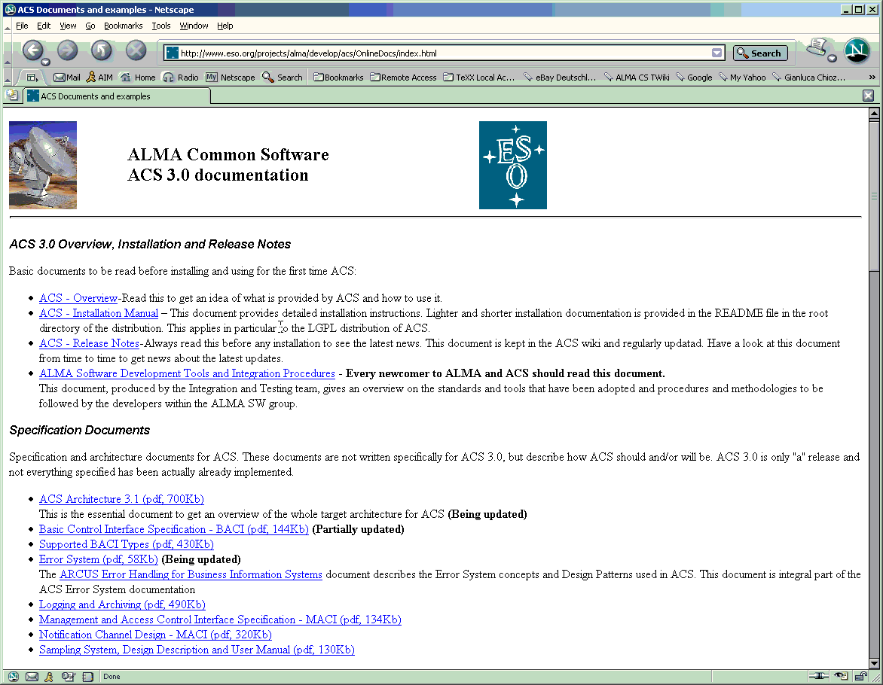
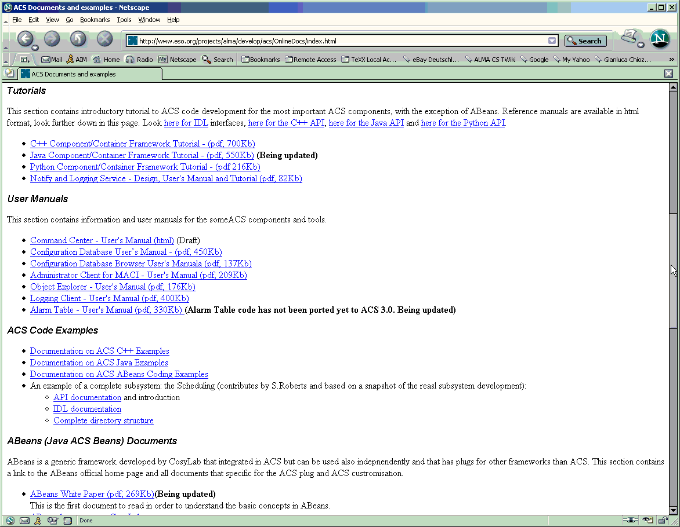
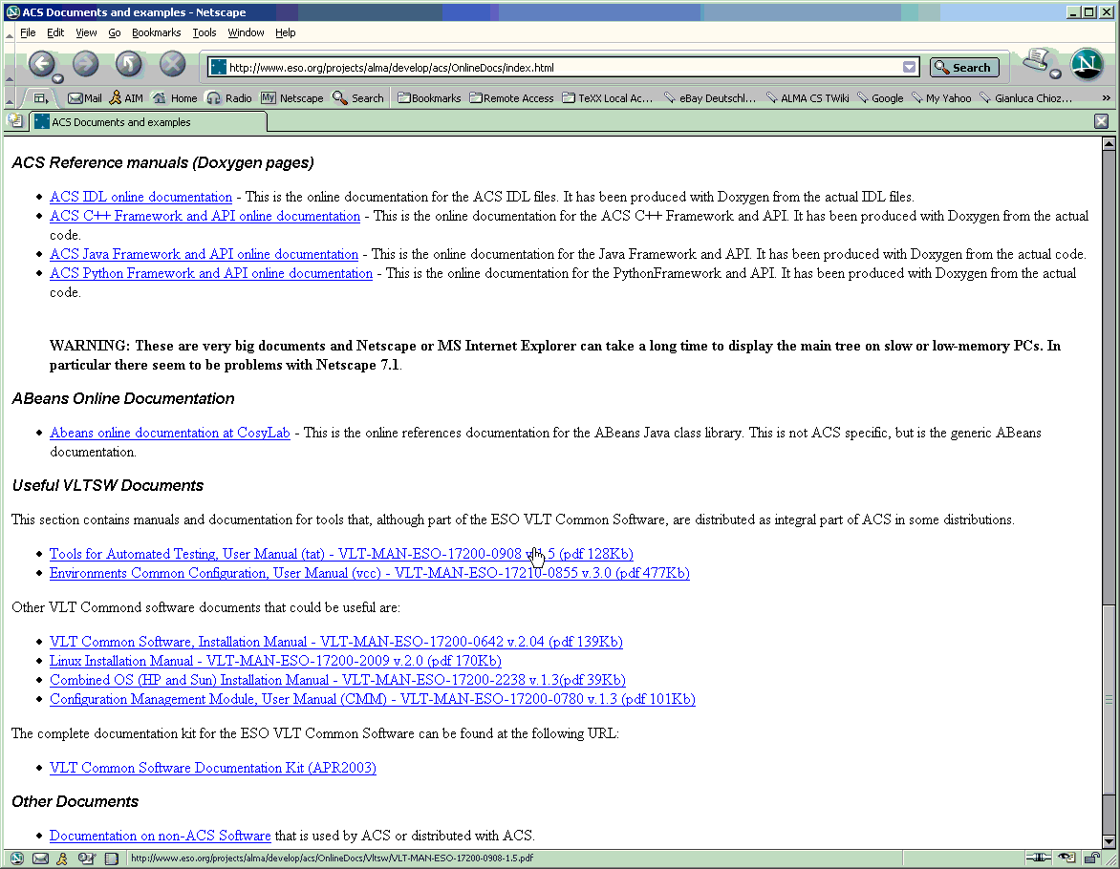
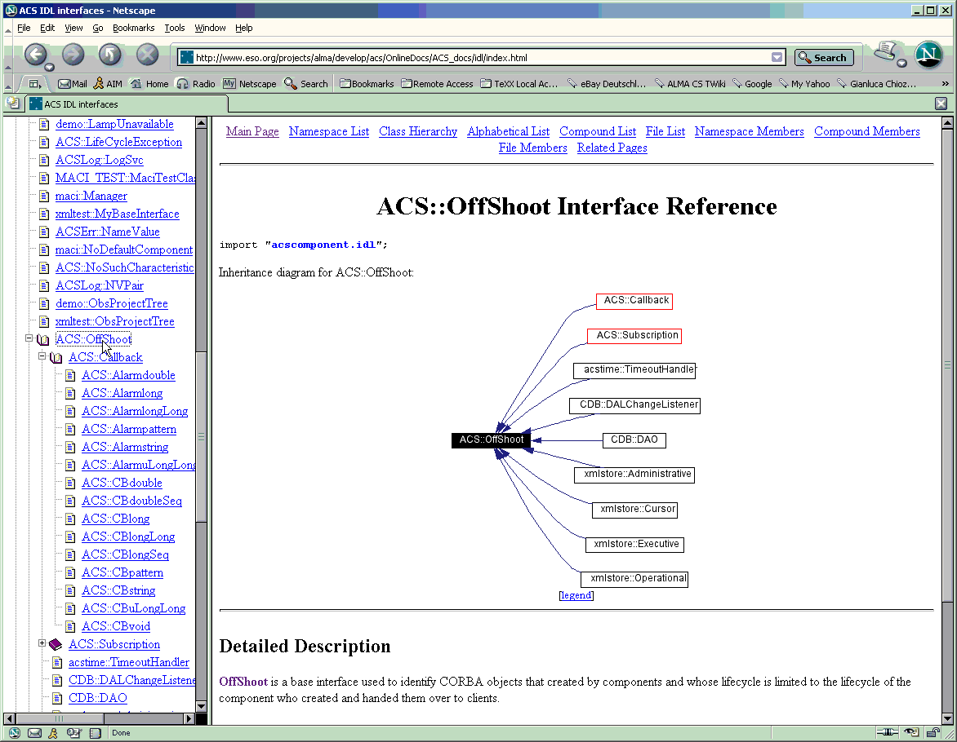
ACS Documentation: http://www.eso.org/projects/alma/develop/acs
Notes:
A major effort has been spent in providing good an comprehensive documentation for ACS.
ACS Overview, Installation and Release Notes
These are the first documents to be read when receiving the package.
The Overview provides a general overview of the distribution and in particular of the processes and executables available.
The Installation Manuals guides step by step in the installation and verification of ACS.
The Release Notes describe the current status of ACS and the backward incompatibilities with. It is an essential reading before porting applications from a previous version of ACS.
Specification Documents
The main document in this section is the ACS Architecture, that describes the final architecture ACS aims to. The other documents detail the most important packages defined/implemented with ACS
User Manuals and Tutorials
The BACI Device Server Tutorial is an introduction to writing C++ code based on ACS and is a must to read. Then there are a few User Manuals for ACS Logging Service and the tools GUIs (Object Explorer, Jlog, Administrator Client).
Abeans (Java ACS Beans) Documents
Tutorials and manuals on writing user interface applications with Abeans. Visual Bean Composition Tutorial is the most useful.
ACS IDL Online Documentation and UML Model
HTML Online reference for the ACS IDL interfaces

Slide 3
ACS Documentation: http://www.eso.org/projects/alma/develop/acs

Slide 4

ALMA Sites
Chajnantor
www.eso.org/projects/alma
www.alma.nrao.edu/development/computing
http://www.eso.org/projects/alma/develop/acs
http://kgb.ijs.si/KGB/

