Slide 1
ACS
Logging System Concepts and Example
J. Avarias & A. Caproni
(Restructured, based on slides from previous years)

Slide 2
Why Logging?
ACS itself, and the software built with ACS, produce logs.
The purpose of logs is to publish any kind of status and diagnostic information for interested clients and archival.
  Logs are essential for post-mortem analysis of hardware or software problems.
  For normal logs, the intended audience are developers.
  Optional “audience” set for individual logs. It can be used for filtering of logs, orthogonal to log levels.
    ENGINEER
    OPERATOR
    SCILOG
Notes:
Examples of ACS logging: container logs in to ACS manager, component throws unexpected exception.
Examples of component logging:
<Info TimeStamp="2009-11-08T12:59:29.057" Routine="HardwareDeviceImpl::logNewState" SourceObject="CONTROL/AOSTiming/LFRD"><![CDATA[Switched hardware state of component CONTROL/AOSTiming/LFRD: undefined -> start]]></Info>
<Trace TimeStamp="2009-11-08T12:59:31.344" File="alma.archive.database.oracle.DatabaseConnectionPool" Line="279" Routine="printLogs" Host="gas01" Process="ARCHIVE/ACC/javaContainer" SourceObject="ARCHIVE_CONNECTION" Thread="RequestProcessor-15" LogId="351"><![CDATA[Open Connections: (3 in total)]]></Trace>
Audience OPERATOR: (Will be) used in Alma to show these logs “live” to the operators, while other logs only get stored in the archive.

Slide 3

Conceptual Overview
ACS Log Service
your Java
stdout:
DEBUG
INFO
ERROR
INFO
ERROR
ACS Java logger
{ ERROR }
ACS C++ logger
Log GUI
(“jlog”)
{ ERROR, INFO, DEBUG }
ERROR
INFO
DEBUG
DEBUG
INFO
ERROR
Log to file
your C++

Slide 4
Log Forwarding
Logs can be output locally on the console.
Logs can be sent to a central Log service, coming from many components / clients in different languages (C++, Java, Py).
From the Log service, all logs can be viewed together and analyzed live in a GUI, or written to file, or to a database and be processed later.

Slide 5
Logger Objects & Filters
Containers, components and some larger tools use separate ACS logger objects.
Logs are prioritized with log levels, which allows filtering, to process only sufficiently important logs.
Filtering can be configured per process or per logger.
Log level filters are applied at the source, before the log is sent to the network.
Log receiver tools have additional throw-away filtering capabilities, which work the same for all logs.
Notes:
C++ also has logger macros

Slide 6
Hidden Benefits
For high performance and robustness, ACS transparently caches logs, and sends them asynchronously in batches.
ACS transparently inserts additional data, such as the host / container names, or the current thread name.
Notes:
The default is to send 100 logs as one batch to the Log service, which is much more efficient than sending them individually or in smaller batches.
Caching is used during process startup, before the connection the central Log service exists. The “early” logs are later sent from the cache to the Log service.
Caching is also important during network problems, and for short bursts when more logs are produced than can be sent off.
Sending logs asynchronously (in a thread separate from where the log is produced) ensures that code which produces logs will not hang for unexpectedly long times.

Slide 7
Special Log types
Domain-specific concepts, e.g. fields for “Antenna” and “Array” in Alma, can be added as parameters w/o affecting other projects.
Optionally, “type-safe logs” can be code-generated from XML configuration files
  To ensure identical messages across files and implementation languages.
  Modify log level or message text centrally.
  Keep a catalog of logs, for system documentation.
Notes:
Examples from Java:
AcsLogger logger = myContainerServices.getLogger();
AntennaContextLogger antennaLogger = new AntennaContextLogger(logger);
antennaLogger.log(Level.WARNING, "Log with audience, array and antenna", alma.log_audience.OPERATOR.value, "Array01", "Antenna01");
Type-safe log XML definition:
<LogDefinition
logName="LOG_NC_SubscriptionConnect_FAIL"
shortDescription="Failed connecting to a notification channel"
description="Failed connecting to a notification channel"
priority="DEBUG"
audience="Developer">
<Member name="ChannelName" type="string" description="Name of the channel not subscribed to." />
<Member name="Service" type="string" description="Name or ID of the notification service that hosts the channel." />
</LogDefinition>
Sending that log with both parameters:
LOG_NC_SubscriptionConnect_FAIL.log(logger, channelName, serviceName);

Slide 8
Log system technology (1)
From the log producers to the Log service, and from there to the receiving clients, logs are transmitted in XML format.
The ACS central Log service
  Receives batches of log records through its IDL interface.
  Is based on the CORBA (“Telecom”) Log service.
  Forwards to a CORBA Notification Channel (NC), to deliver logs to registered clients.
  That NC runs in a separate process, to not interfere with the applications’ notification channels.

Slide 9
Log Repeat Guards
ACS offers “repeat guard” classes that can be used to conveniently reduce the number of executions of some identical activity such as logging.
  Repeat guards are configurable based on the number of skipped executions, or skipping time, or combinations.
  There are both log-specific and generic repeat guards.
Real world example (from the jDAL, skipping logs for the same recordID). Here we use the advanced class MultipleRepeatGuard and wrap the logging of our message with it. This is different from using a RepeatGuardLogger, which does not construct its own log message.
MultipleRepeatGuard recordNotExistLogRepeatGuard = new …;
if (recordNotExistLogRepeatGuard.checkAndIncrement(recordID)) {
String msg = “Record '" + recordID + "' does not exist.“;
int repeatCount = recordNotExistLogRepeatGuard.
counterAtLastExecution(recordID);
if (repeatCount > 1) {
msg += " (" + repeatCount + " identical logs reduced to this log)“;
}
m_logger.log(AcsLogLevel.NOTICE, msg);
}
Notes:
In Java, the other classes are
RepeatGuard: Like MultipleRepeatGuard from this example, but no separate guarding for different IDs.
RepeatGuardLogger: Wraps a Logger, has method like log(Level level, String message, Throwable thr), which internally decide about skipping or logging.

Slide 10
Log system technology (2)
ACS logger objects appear like the “native” APIs
  C++ ACE logging
  Java: java.util.logging
  JDK-inspired Python logging API
Notes:
java.util.logging.Logger logger = myContainerServices.getLogger();
logger.fine(“Fine, this looks like plain JDK logging”);
C++ macro:
ACS_SHORT_LOG((LM_ALERT, "Device %d not responding“ ,devNum))
C++ logger objects:
LoggingProxy m_logger (cacheSize, minCachePrio, maxCachePrio);
LoggingProxy::init (&m_logger);

Slide 11
Log system technology (3)
Plain JDK Logger with ACS behind the scenes
Application code
(component or comp-client)
getLogger
uses
ContainerServices#getLogger()
java.util.logging.Logger
info(String msg)
log(Level, String msg, Throwable)
creates & configures
forwards messages
remote ACS
Log Service
VM-local ACS log handler
forwards
(XML)
Notes:
vollautomatische Ablaufsteuerung
Ueberwachung durch Admin/Operator

Slide 12
Log system technology (4)
XML syntax of a log entry
Log entry type (Debug, Info, Trace...)
Timestamp (ISO format)
Source code info (File, Line, Routine)
Runtime context info (Host, Process, Thread, StackLevel)
Identification (LogId, Uri)
Priority (1-11; default is 2)
Data (<Name, Value>), incl. exceptions
Message
Notes:
10

Slide 13
Example of a log message
<Debug
TimeStamp="2002-10-7T13:44:16.530" Host=“te1.hq.eso.org“
Process="baciTestServer“
Thread="main"
Context="“
File="baciTestClassImpl.cpp“
Line="205" Routine="BaciTestClass::~BaciTestClass
>
Great debug message!
</Debug>
Notes:
10

Slide 14
Log entry type and numerical value
Trace (1)
Delouse (2)
Debug (3)
Info (4)
Notice (5)
Warning (6)
Error (8)
Critical (9)
Alert (10)
Emergency (11)
Off (99)
Notes:
10

Slide 15
Logging Configuration
Overview
Without anything else, an ACS logger is configured to log TRACE and above levels.
Optional environment variables can set per-process default log levels.
The CDB can set per-process log levels and per-logger levels
  For example, loggers for ACS container and for some stable component log only WARNING and higher, but logger for some unstable component should log DEBUG and higher.
  Per-logger levels in the CDB “beat” the env vars, while the env vars override the CDB per-process default
Tools to dynamically change log levels in the running system.
Notes:
10
The idea of using default TRACE is that in any “serious” environment, log levels must always be configured. There is no good or bad default log level for both tests and operational usage.

Slide 16
Logging Configuration Environment Vars
$ACS_LOG_STDOUT sets default values , you can limit which logs are printed to standard out.
  $ACS_LOG_STDOUT must be between 1 and 11. Lesser values imply that more logs get printed / forwarded.
Likewise, $ACS_LOG_CENTRAL sets the default log level for central logging to the ACS Log service.
$ACS_LOG_FILE (or default $ACS_TMP/<hostname>/
acs_local_log_<processname>, when not set) - location and root file name for additional stdout-like ACS log files. Most processes generate a unique file name by appending process name and PID to the root file name.
Notes:
10

Slide 17
Logging Configuration in the CDB
<Container >
<LoggingConfig
minLogLevel=“6”
minLogLevelLocal="8”
immediateDispatchLevel=“5”
dispatchPacketSize=“100”
flushPeriodSeconds="10” >
<log:_ Name="jacorb@silentContainer"
minLogLevel="8" minLogLevelLocal="8" />
</LoggingConfig>
</Container>
Details are described at http://www.eso.org/projects/alma/develop/acs/OnlineDocs/ACS_docs/schemas/urn_schemas-cosylab-com_LoggingConfig_1.0/complexType/LoggingConfig.html
Default log levels
Special levels for a named logger (here: the jacorb logger)
Notes:
10

Slide 18
Logging Configuration
At Runtime (1)
Runtime log level changes override both env var and CDB settings (for both per-process and per-logger settings). They are lost after restarting the process though.
Cmd line tool “maciContainerLogLevel” to get or set log levels. Example:
maciContainerLogLevel frodo get jacorb@frodo
Container: frodo
Log levels for logger 'jacorb@frodo‘:
useDefault : false
minLogLevel : 9
minLogLevelLocal: 6
Notes:
10

Slide 19
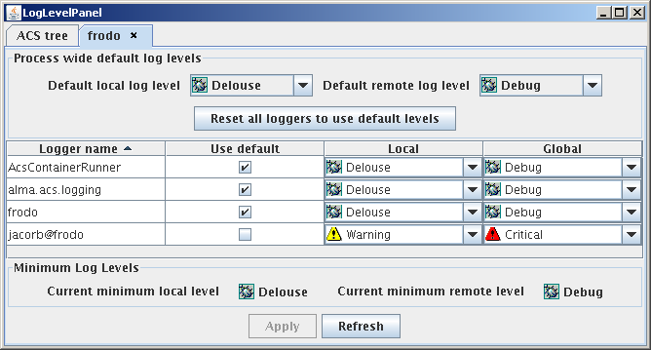
Logging Configuration
At Runtime (2)
GUI “logLevelPanel”
Notes:
10

Slide 20
Logging clients (receivers)
Jlog: A GUI to browse and filter logs.
loggingClient: Command-line tool that dumps all logs to a file
  TAT tests can run it via “acsutilTATPrologue –l”.
Archive logger (from Alma Archive subsystem)
Custom clients can be written. They must subscribe to the logs on the notification channel.
Warning: Every logging client slows down the logging system considerably! Congestions can lead to Log service crashes!
Notes:
10

Slide 21
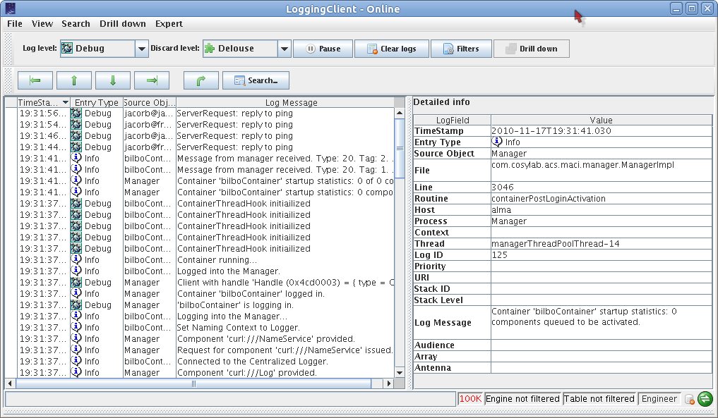
jlog

Slide 22
References
Logging and Archiving:
http://www.eso.org/projects/alma/develop/acs/OnlineDocs/Logging_and_Archiving.pdf
Documentation for the APIs in the online documentation.
Notes:
10

