Slide 1
ACS Configuration Database(s)
ACS workshop presentation
by Heiko Sommer, ESO Garching. Last updated 2010-11-12.
Two alternative implementations in ACS:
CDB
TMCDB
Same purpose:
To centrally maintain and provide structured system configuration data.
Notes:
This presentation supersedes “ACSCourse-CDB-Short.ppt” and “ACSCourse-CDB.ppt”.

Slide 2
What sort of data?
Data used by ACS about system structure and behavior, e.g.
  To run components inside containers.
  Logging config for containers, components, manager.
  Notification channel configuration (deployment, QoS)
  Alarm definitions, reduction rules
  Standard configuration for baci properties (e.g. legal value range, monitoring settings).
Custom data used by components.
[Only with TMCDB extension by Alma]: Structured data about configuration of different hardware, HW startup, pointing model coefficients, SNMP configuration, …
Notes:
Some other configuration data is still kept separately in files:
Other under $ACSDATA/config, e.g.
orb.properties: Read by JacORB from every CORBA aware Java process.
data used by Alma ARCHIVE:
archiveConfig.properties to connect to databases (incl. TMCDB!)
tnsnames.ora read directly by the Oracle driver
The Alma OMC tool still supports some XML config files
NotifyService instances require configuration data (incl. runtime dependent data about NamingService corbaloc and cache for reconnects) in files, which get copied from the template $ACSROOT/config/svc.conf/defaultNotify.svc.conf to $ACS_TMP/ACS_INSTANCE.0/conf/….Notify.svc.conf for the various instances.

Slide 3
Two CDB implementations (1)
CDB (correctly: the "jDAL“ implementation)
  Initial implementation of the CDB’s interface in ACS.
    A future relational variant was always foreseen.
  Data stored as XML files and schemas (XSD) in a directory hierarchy, transparent to users.
  Human-readable and -writable.
  Offline XSD validation catches errors in single XMLs.
  Does not enforce relations between the XML files.
  Best for smaller projects and unit tests (although no performance limits have been reached in Alma yet).
  Configuration control is simple but must be done externally, e.g. by keeping XML files in CVS.
Notes:
When ACS was conceived, we thought that an alternative RDBMS-based implementation of the same “DAL” interface would become necessary for performance reasons as Alma gets bigger. At least with the current emphasis on read-only access to the CDB, the XML implementation has not reached its limits in Alma testing.
Instead, the limit was the lack of history built in, and the need to link hardware and monitoring data to the software configuration data in the CDB.
Application code that uses the CDB can access it independently of the XML storage format, based on the “node with values” concept.
The CDB public interface also offers data as XML, which does not depend on the underlying storage as XML. For example, the TMCDB also returns XML data which it assembles from the relational tables.
For the ACS workshop, we will use the CDB.

Slide 4
Two CDB implementations (2)
TMCDB
  Can do everything the CDB can do:
  “HibernateDAL“ implementation of "DAO / DAL“.
  Data is stored in a relational database (XML import).
  Versioning support (using Oracle's "total recall“).
  Data relation consistency is better, through (cascading) constraints.
  Underlying DB engine: HSQLDB for small testing, Oracle for real-life deployment, or others (hibernate).
  Extensible for other data (direct DB access).
  Needs special tool for data maintenance
  (TMCDB Explorer in Alma).
Notes:
The TMCDB is used by Alma since R8 (ACS 9.0). ACS offers it since ACS 8.2, but it got used by Alma only later because of issues with the hardware extension part and the GUI tool.
The TMCDB functionality is a super-set of the CDB’s. Both implement the same Corba interfaces.
Using a relational database does not give performance advantages over XML storage, because both CDB implementations read all data into memory.
The XML import is an additional feature of the HibernateDAL process, allowing us to import old XML CDB data into the TMCDB tables. Of course the tables can also be filled from scratch.
Will talk of the additional features of the TMCDB later.

Slide 5
CDB runtime access
Notes:
When ACS was conceived, we thought that an alternative RDBMS-based implementation of the same “DAL” interface would become necessary for performance reasons as Alma gets bigger. At least with the current emphasis on read-only access to the CDB, the XML implementation has not reached its limits in Alma testing.
Instead, the limit was the lack of history built in, and the need to link hardware and monitoring data to the software configuration data in the CDB.
For the ACS workshop, we will use the CDB.

Slide 6
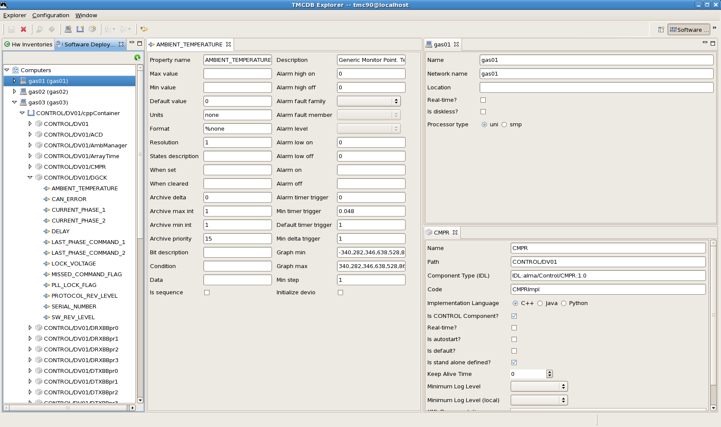
TMCDB Explorer

