Slide 1

ACS Error System
J. Avarias & A. Caproni

Slide 2
Summary
Features
Completions/Errors
Architecture
Error representation/structures/propagation
Error Trace
Code generation
Defining new errors
Programming language support
Remote error handling
Notes:
Firstly I am going to say something about requirements for Error System than I will explain the architecture of the Error System after we’ll take a look at how the error system works through examples

Slide 3
Features
support for distributed and heterogeneous system
support synchronous and asynchronous calls
Errors traceability
support different programming language (eg. C++, Java, Python)
easy to use within all programming languages supported by ACS
Notes:
We can talk about two types of requirements for the error system:
First, explicit requirements that are written in the document: ALMA Common Technical Requirements (tracing of error, severity, …)
and than we can talk about
implicit requirements that come out from ACS architecture:
- Error handling can be used in local and remote invocations
- support for asynchronous and synchronous calls
- it has to support (at least) all ACS supported programming languages
and finally the error system should be compact and simple to use. That’s mean that ES API has to be simple. The ES will be used on a lot of places. The ES will be widely used (among the all SW: inside the ACS and in the SW that use ACS)

Slide 4
Completions and Errors
reporting how an action has completed
an action can complete:
  erroneous (different ways)
  successful (different ways)
completion for reporting:
  errors
  different success completion
  intermediate status of an action
completions are superset of errors

Slide 5
Architecture
GUI
Completion & Error
definition
(XML)
CDB
(Archive)
Error Log Browser
(GUI)
Code generators (XSLT)
error library
IDL
Java
Python
C++
Logging system
Application
not part of error system
not yet available

Slide 6
Error representation
each completion/error is defined with two numbers:
  type (group)
  code
OO mapping:
  type -> namespace / IDL module
  code -> completion class/ exception class

Slide 7
Error structures
error trace (can not exist standalone)
  type+code
  severity: Error, Critical, Alert, Emergency
  timestamp
  source code info: line, file, routine
  run-time info: process name, thread ID, host name
  arbitrary data in name-value format (generic) or members
exception classes (contain error trace)
completion classes:
  non-error
  error (contain error trace)

Slide 8
Arbitrary data
generic way: name-value pairs
members:
  defined together with error: name, type and description (documentation)
  generated getter/setter methods
  stored in name-value pairs (accessed in a generic way)

Slide 9
Error Trace
linked list of objects/structures/exceptions
chain of calls create an error trace: at each level error information can be added
It is contained inside:
  an exception
  a completion

Slide 10
Error Trace
length of error trace
error(n-1)
error(n-2)
depth of calls
error1
error0

Slide 11
Example of error trace
ACSErr::Completion* Ex::op(){
  er2 = new RecordNotFoundCompletion(“getRecord”);
  er1 = new PositionNotObtainedCompletion(er2,“getPosition”)
  er1->returnCompletion();
}
ACSErr::Completion *c = …->op();
er = new PointingFailureCompletion(c, “routine”);
er->log();
er2
er1
er2
er1
er2
er
er1
er2
Notes:
First we create an error object (begin of error stack) using ACS_ERROR_BEGIN like in previous examples and after that create new error object and adding previous one using macro ACS_ERROR.

Slide 12
Example of Error Trace
f1(…)
f2(…)
f3(…)
f4(…)
er2
er1
er0
er2
er1
er0
er1
er0
er0

Slide 13
Error propagation
throwing exception:
  just for reporting errors
returning/sending completion structure:
  asynchronous actions/communications (callback mechanism)
  reporting different success statuses of the operation
  where exceptions are not supported e.g. old C++ compilers

Slide 14
Error Definition (XML)
<Type xmlns:xsi="http://www.w3.org/2001/XMLSchema-instance" xsi:noNamespaceSchemaLocation="ACSError.xsd" name="ExmplErrType“ type="900902" _prefix="alma">
<Code name="PointingInProgress" shortDescription="Pointing in progress" description="Pointing in progress"/>
<ErrorCode name="PointingFailure" shortDescription="Pointing Failure“ description="Pointing can not be executed">
<Member name="Azimuth" type="double“
description="Azimuth"/>
<Member name="Elevation" type="double“
description="Elevation"/>
</ErrorCode>
<ErrorCode name="PositionNotObtained" shortDescription="Position not obtained" description="Position of the object can not be obtained"/>
...
</Type>

Slide 15
Code generation
Completion &
error definition XML file
XSLT for
IDL
XSLT for
C++
XSLT for
Java
XSLT for Python
IDL
C++
Java
Python

Slide 16
Adding new types to the system
obtain an unique type number. For examples are reserved types from 900000 to 909999.
http://almasw.hq.eso.org/almasw/bin/view/HLA/CompletionErrorTypes
create a new XML file according to the schema rules in the idl directory of the module
specifying the XML file’s name (without extension) in ACSERRDEF tag in the Makefile

Slide 17
Programming language support
Supported languages:
  IDL (remote)
  C++
  Java
  Python
Generated code + library

Slide 18
CORBA (remote) error handling
Common IDL structures:
  error trace
  completion
+
Generated IDL code:
  exception

Slide 19
Class diagram of IDL

Slide 20
IDL: Error Trace (1/2)
IDL structure to hold error trace information: ACSErr::ErrorTrace
  error: type & code , severity (Error, Critical, Alert, Emergency)
  timestamp
  runtime information: process, thread, host
  source information: file name, line number, routine name
  additional info: pairs of name-value
  “pointer” to the previous error
Error trace is not used standalone, but as a part of:
  completion structure
  exceptions
Notes:
Since that not all implementation of CORBA that we use support OBV we have decided that error information (stack) is sent from process to process (that can be written in different programming languages) using structure and than have locally wrapper class(es). We could say that we simulate OBV stuff.
IDL structure Completion contains several group of information:
- information about error itself like: error code (for time being we are using any to represent the error), its description (string), severity of the error (TBD).
- time information: the time when the error occurred (dependency on time system)
- run time information like: process ID (or its name), thread ID (or its name), host
- source information like: file name, routine name, file number and name
- and we can add arbitrary number of additional information (data) about error
- previous error(s)
Error information can be send around (remotely as locally) also using exceptions. For this purpose the ACSException IDL exception was introduced.

Slide 21
IDL: Error Trace (2/2)
  struct ErrorTrace {
  string file;
  long lineNum;
  string routine;
  string host;
  string process;
  string thread;
  TimeStamp timeStamp;
  string shortDescription;
  ACSErr::ACSErrType errorType;
  ACSErr::ErrorCode errorCode;
  ACSErr::Severity severity;
  NameValueSeq data;
  sequence<ErrorTrace, 1> previousError;
  };

Slide 22
IDL: Completion
can contain ACSErr::ErrorTrace
struct Completion {
TimeStamp timeStamp;
ACSErr::ACSErrType type;
ACSErr::ErrorCode code;
sequence<ACSErr::ErrorTrace, 1> previousError;
};

Slide 23
Example (remote) _{IDL}
error is sent around as return value or (in)out parameter of IDL structure (ACSErr::Completion):
#include <acserr.idl>
interface Ex {
ACSErr::Completion op(…);
}
Notes:
In remote case error is send around as return value or (in)out parameter of IDL Completion structure.
Here is an example of IDL where error stack is sent as return value.

Slide 24
IDL: Exceptions
there is no exception hierarchy in IDL!
generated from XML error definition file
containers for ACSErr::ErrorTrace
module <type_name> {
  exception <code_name>Ex {
  ErrorTrace error;
  };
};

Slide 25
Example exception (remote) _{IDL}
error is send around as IDL exception (ACSErrTypeACSCourse::TargetNotFoundEx):
#include <ACSErrTypeACSCourse.idl>
interface Ex {
void readFile(…) raises (ACSErrTypeACSCourse::TargetNotFoundEx);
}
Notes:
Here is shown how to use exception in IDL.

Slide 26
ACS – Alarm system
notify operators of abnormal situations
explains what is the root cause of a set of problems
4 level of alarms
reduce alarms

Slide 27
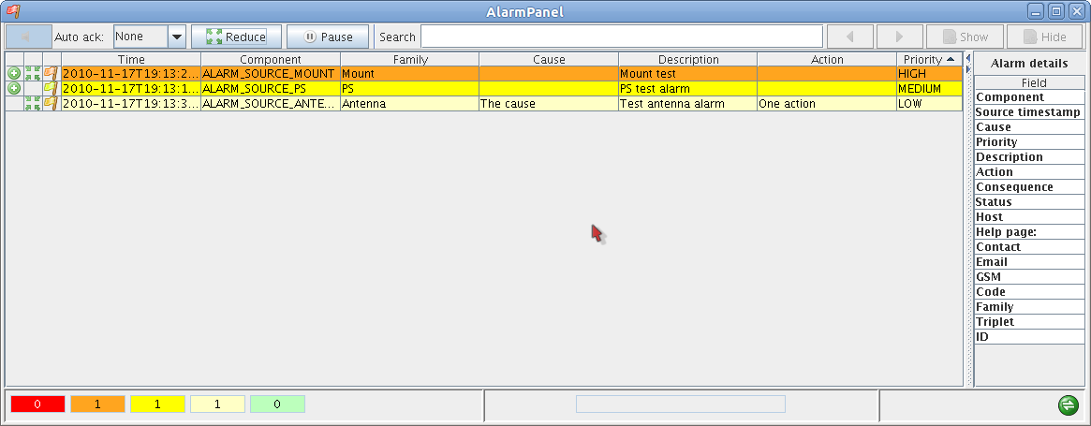
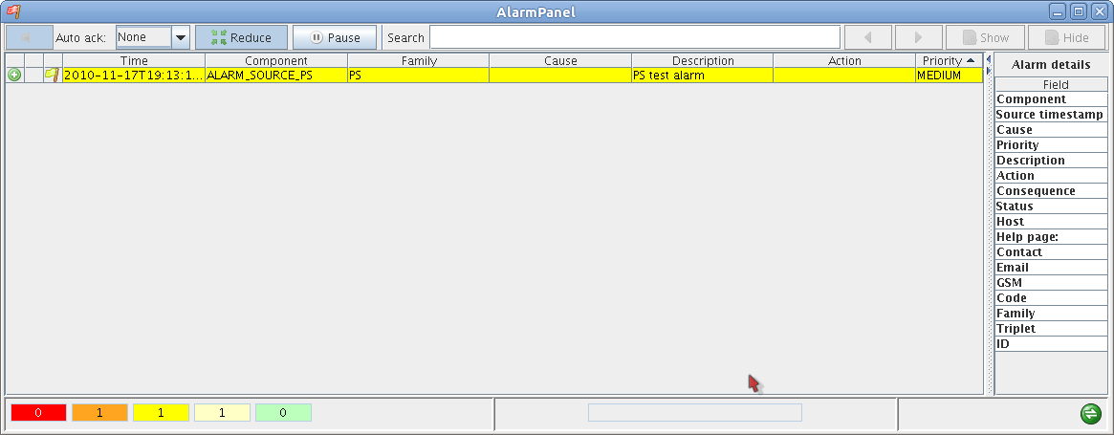
Alarm system GUI

Slide 28
References
Doxygen documentation:
$ACSROOT/man/api/html/acserr_8h.html
OCI, TAO Developers Guide version 1.1a Chapter x: Error Handling

