Slide 1

ACS Training
IDL Simulator

Slide 2
Overview
Shortly before the release of ACS 3.0, it was decided there was a need for a dynamic component (derived from ACSComponent) capable of implementing its IDL interface at run-time. For those unfamiliar with ACS terminology, ACSComponent is an IDL interface defined in the acscomponent module and it is the base interface for all components within ALMA software. Editor’s note: as of ACS 4.0, the simulator framework also supports components derived from the BACI CharacteristicComponent IDL interface.
A dynamic, “simulated” component becomes especially useful when a developer wants to test Components against an IDL interface that has no concrete implementation yet. This simulator will either generate return values, exceptions, etc. on the fly or accept these parameters from the user in some form or another (i.e., command-line, GUI, configuration database, etc.). Also, the simulator takes advantage of ACS helper classes where applicable (i.e., ComponentLifecycle, ACSComponentImpl, etc.).

Slide 3
Requirements
Must be able to generate complete implementations of all IDL methods and attributes of an interface on the fly.
Regarding exceptions for a given method, end-users should be capable of giving the exception one of three states: ‘ALWAYS’, ‘NEVER’, or ‘RANDOM’. Not yet implemented.
If an interface defines a CORBA object attribute or a method that returns a reference to another CORBA object, the simulator should create the CORBA object.
A simulated component should behave in the same manner as a real component. That is, simulated components shall be derived from the ComponentLifecyle class and other utility classes where applicable.
Users will have the option to specify a timeout value for methods. When the method is invoked it will sleep for a period of time defined by the timeout and then return.
Capability of reading method implementations from the CDB.

Slide 4
Requirements (continued)
An entire method can be set to a ‘RANDOM’ state meaning that the timeout value is random, all the exceptions the method throws enter the ‘RANDOM’ state, and return values become random. Not yet implemented.
Read/write attributes should have some form of “memory” to store the value if it is being set. If the attribute is being read and it is not in the ‘RANDOM’ state, the “memory” value will be returned. Not yet implemented.
A GUI shall be implemented allowing developers to set return values, timeouts, etc. Furthermore, the GUI will accept as a parameter a Python package and a function name which can substitute for a simulated attribute or method.
The GUI will be a dumb client for all intensive purposes. In other words, the intelligence of the simulation will reside in an API available to developers and the GUI will just make requests of the API.

Slide 5
CDB XML Defining Components
  Predefining simulated component behavior can be very useful. For example, perhaps the end-user wants to find out what happens when the return value of some method is fixed, but other methods are not. Productivity may be hampered because of the time spent changing return value(s) each time the simulated component is activated from the GUI or command-line. For reasons like this, the characteristics of a simulated component should be retrieved from the ACS configuration database if the user does not explicitly set them by some other means. The CDB entries will be placed in $ACS_CDB/alma/simulated/* in a similar fashion to BACI CharacteristicComponents. Simulated components must validate against the SimulatedComponent.xsd schema defined in the next slide:

Slide 6
SimulatedComponent.xsd
<xs:schema targetNamespace="urn:schemas-cosylab-com:SimulatedComponent:1.0"
xmlns:xs="http://www.w3.org/2001/XMLSchema"
xmlns="urn:schemas-cosylab-com:SimulatedComponent:1.0"
elementFormDefault="qualified"
attributeFormDefault="unqualified">
<xs:complexType name="corbaAttribute">
<xs:attribute name="Name" type="xs:string" use="required"/>
<xs:attribute name="Value" type="xs:string" use="optional" default="None"/>
<xs:attribute name="Timeout" type="xs:int" use="optional" default="1"/>
</xs:complexType>
<xs:complexType name="method">
<xs:attribute name="Name" type="xs:string" use="required"/>
<xs:attribute name="Value" type="xs:string" use="optional" default="None"/>
<xs:attribute name="Timeout" type="xs:int" use="optional" default="5"/>
<xs:attribute name="Random" type="xs:boolean" use="optional" default="false"/>
</xs:complexType>

Slide 7
SimulatedComponent.xsd (cont.)
<xs:element name="SimulatedComponent">
<xs:complexType>
<xs:sequence>
<xs:element name="_method" type="method" minOccurs="0" maxOccurs="unbounded"/>
<xs:element name="_attribute" type="corbaAttribute" minOccurs="0" maxOccurs="unbounded"/>
</xs:sequence>
</xs:complexType>
</xs:element>
</xs:schema>

Slide 8
Present Status of the IDL Simulator
The simulator has been written in Python.
It’s capable of dynamically implementing most methods and attributes of IDL interfaces.
A Python BACI prototype has been released and the IDL simulator uses this to it’s advantage (e.g., BACI properties of simulated IDLs behave rationally as opposed to returning nonsense values).
Most of the requirements listed in the previous slides have been met excluding the ‘RANDOM’ state goals.

Slide 9
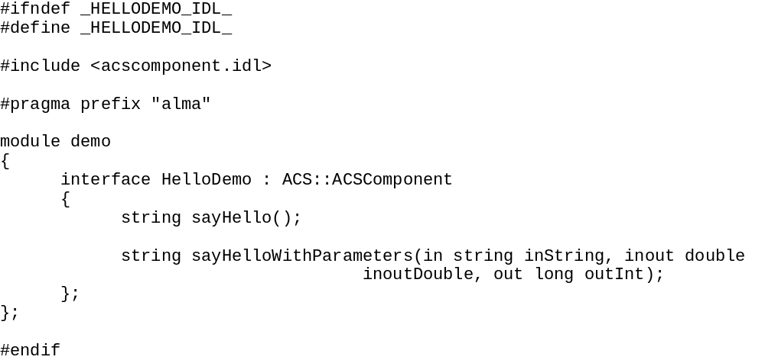
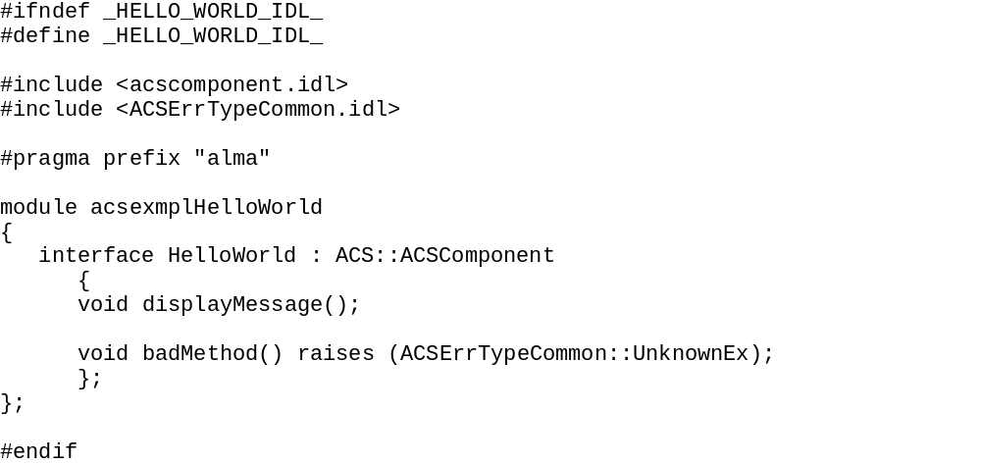
Guide – Creating an IDL

Slide 10
Guide – Components.xml
Just like all other components in ALMA software, your simulated component will need at least one entry in the CDB. Specifically, $ACS_CDB/CDB/MACI/Components/Components.xml must be modified to tell the Python container to activate the component using a special Python package developed by ACS.
<_ Name="HELLODEMO1“ Code="alma.demo.HelloDemoImpl.HelloDemoHelper"
Type="IDL:alma/demo/HelloDemo:1.0" Container="frodoContainer"/>
becomes:
<_ Name="HELLODEMO1" Code="Acssim.Servants.Simulator"
Type="IDL:alma/demo/HelloDemo:1.0“ Container="somePythonContainer"/>

Slide 11
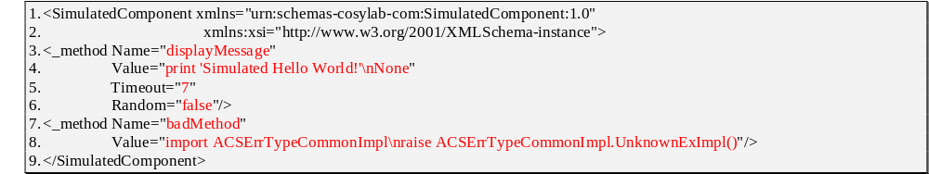
Guide – $ACS_CDB/CDB/alma/simulated/*

Slide 12
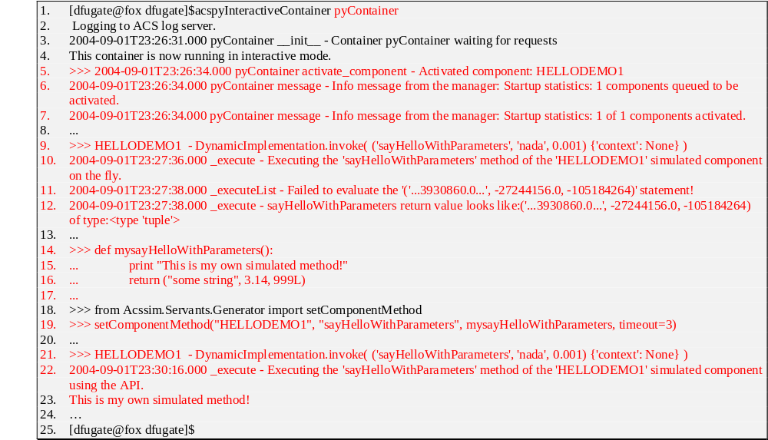
Guide – Using the API

Slide 13
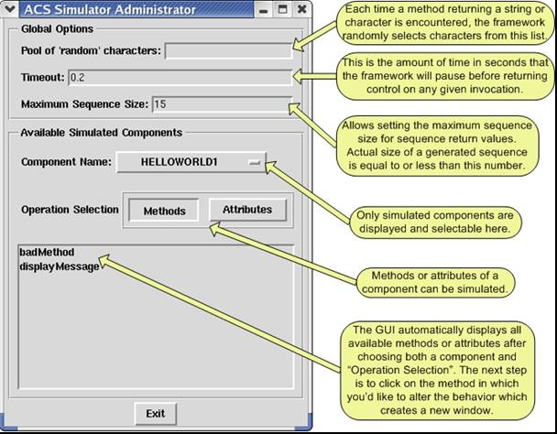
Guide - GUI

Slide 14
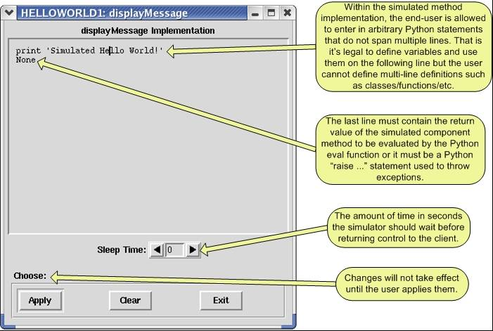
Guide – GUI (cont.)

Slide 15
Demo(s)

Slide 16
Questions and Feedback

