Slide 1


ALMA/ACS Software Engineering
M. Zamparelli
European Southern Observatory
ACS Course Japan, July 2005
Notes:
Abstract:
Write here you abstract.

Slide 2
Software Engineering
Software Engineering and Quality Assurance activities:
  Software Process
  Document Reviews, Format, Templates
  Development Environment
  Integration Procedure
  Coding Standards
  Code Inspection
  Configuration Management
  Testing framework and assessment
  Change Management
Notes:
The principles and ideas governing SE activities

Slide 3
Major SE deliverables to ALMA
the tool to build the software with (Makefile) - in maintenance
the version controlled storage area where the software is (CVS) – in maintenance
the problem tracking system (Action Remedy) we use to track faults and change requests - pending replacement/upgrade
the system you document your software with (both inline and online – doxygen, TWiki) – in maintenance
The automated Night Reporting Infrastructure (NRI) which checks standards compliance– in maintenance
generic CASE tools (UML Modeling, Editors, Quality Control) – being updated, reviewed
standards for mostly all the process phases and deliverables
Notes:
And what they translate into for practical usage

Slide 4
Directory Structure
<module>/ws/src
<module>/ws/object
<module>/ws/include
<module>/ws/lib
<module>/ws/test
<module>/ws/man
<module>/lcu/src
<module>/lcu/include
<module>/lcu/man
…….
Separation of WS from LCU code
Separation of source from headers (for C,C++)
Separation of application code from test code
ownership assignment, homogeneity
Notes:
What a module is: a measure against proliferation of different solutions to the same problem

Slide 5
esoMakefile
a project wide set of rules, centrally stored and managed.
every developer has to add only the module specific part: the name of the files to be treated!
allows exceptions (it is a normal Makefile)
Based on the features of GNUmake and strictly correlated with the environment variable set up and the directory and Software Module standards.

Slide 6
<modName>/src/Makefile
For every software modules:
defines what has to be build as a list of variables
includes the project-wide rules ($ACSROOT/include/acsMakefile)
defines the standard targets: all, man, install, clean (if necessary, they can be customized)
Notes:
This could be ovious, but you never know

Slide 7
esoMakefile example
USER_CFLAGS =
USER_LIB = -lACE -lTAO -lTAO_DsLogAdmin -lTAO_CosNaming -lTAO_IORTable -lTAO_PortableServer -lTAO_Svc_Utils -lTAO_CosTrading -lTAO_DynamicAny -lTAO_CosProperty -lTAO_IFR_Client -lacsutil -lcdb -llogging -lCCS -lrecovery -lacserr
INCLUDES = baciDevIO.h baciDevIOMem.h baciExport.h ….
LIBRARIES = baci
baci_OBJECTS = baciDevIOMem baciError \
baci baciTime baciThread baciValue baciDB \
baciRecovery baciCORBA baciDLL baciC baciS ……
DBL_CLASSES = acsDefine acsDistributedObject acsProperty
IDL_FILES = baci
USER_IDL = -I$(ACE_ROOT)/TAO/orbsvcs/orbsvcs/
EXECUTABLES = maciActivate maciManager maciManagerShutdown maciActivatorShutdown \
nslist nsadd
maciActivate_OBJECTS = maciActivate
maciActivate_LIBS = maci
maciManager_OBJECTS = maciManager
maciManager_LIBS = maci
JARFILES = abeansgen
abeansgen_DIRS = si/ijs/kgb/generators
Notes:
An ugly example of Makefile, can be briefly overflown or used if there are questions. The main point is the declarative nature.

Slide 8
ACSERRDEF
XML_IDL
ACS XmlIdl compiler
IDL_FILES
ACE/TAO
JacORB
Omniorb
C++ Stubs
Java Stubs
Python Stubs
Java Component Wrappers for Container
C++
Java
Python
Real Time Linux Kernel Modules
XSDBIND (XSDBIND_INCLUDE)
Java Entity Classes
RTAI_MODULES
COMPONENT_HELPERS
Java Component Helper Classes
ABEANS
Abeans Support Classes
Hierarchical Include directories
BACK
Notes:
In blue are the Makefile tags which users are supposed to fill in. In green the stuff which is generated. In light gray are things which were added last year.

Slide 9
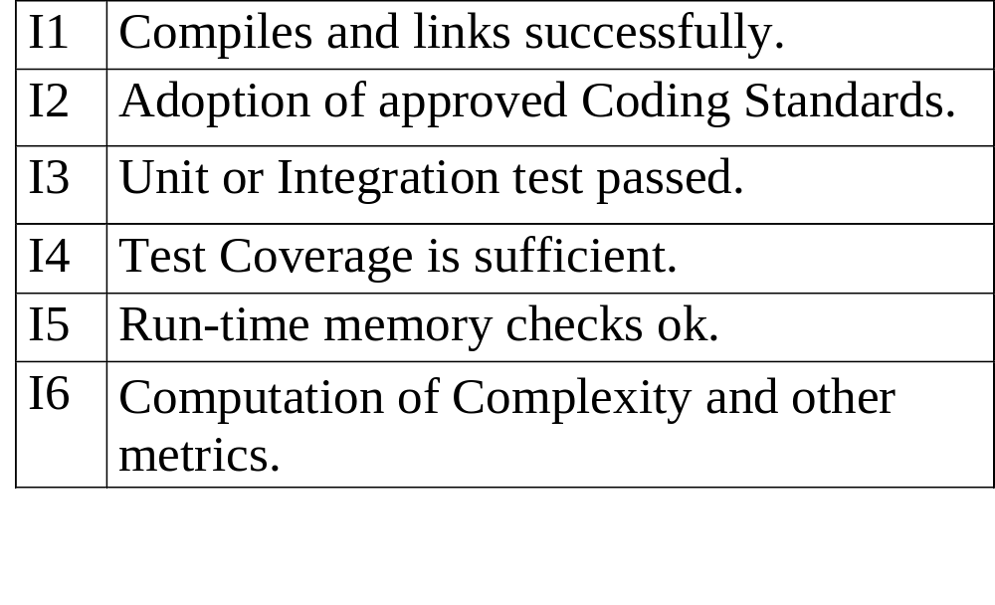
Integration Layers :
Notes:
This nomenclature is only introduced to explain the next slide

Slide 10
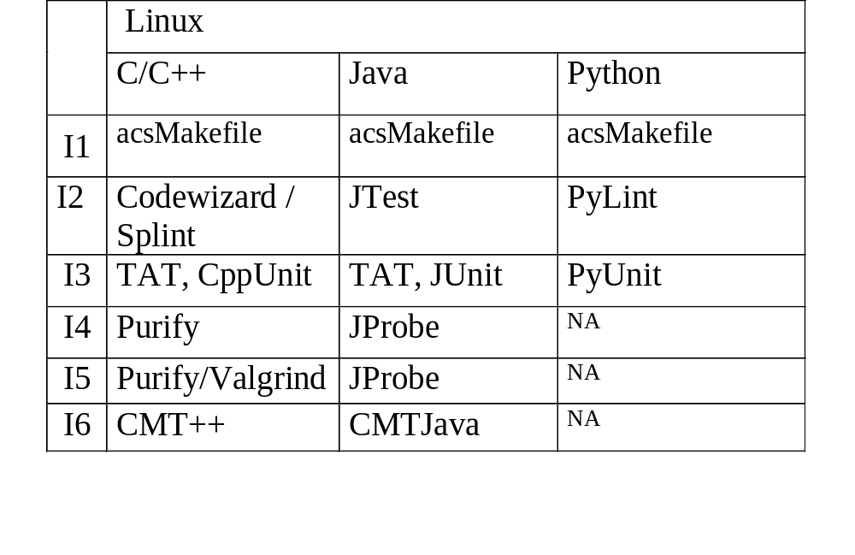
Quality Assurance Tools
Notes:
For each category and programming language the corresponding tool is shown

Slide 11
Automated Inspections (NRI)
Build reports (GO/NO-GO)
Tests (availability, execution results GO/NO-GO, coverage, memory behaviour)
Coding Standards (ALMA, MISRA, Motorola, Scott Meyers, Sun)
Inline documentation sufficiency
lines of code (total, per language, per module, production vs test code)
Algorithmic Complexity (McCabe)
module dependency diagrams
SPR statistics, number of commits, number of unused files
Java duplicate classes verification
Events and Channels in use
metrics on design quality (Robert C. Martin, for Java)
Notes:
Introducing NRI: what does it bring

Slide 12
Configuration Management
NRI
source
reports
Codewizard
JTest
sloccount
cmt/cmtjava
JDepend
doxygen
graphviz
Purify
splint
JContract
Database
WebServer
Static Inspection
(dynamic inspection machines)
host₁
host₂
host₃
Notes:
Generic layout of NRI. Dynamic NRI in particular is to be considered as an early warning system. NRI is also the glue which holds together all the tools mentioned above (and probably more)

Slide 13
TEST OUTCOME DETERMINATION
Purify
Compiled
Test DIR
Makefile
Purify
Make all
UNDETERMINED
UNDETERMINED
TAT
test target
TAT
Purify
make test
test output
success
failure
FAILED
PASSED
Notes:
For each and every blue box there may be an outcome of success or failure. The specific path followed determines whether the TEST will be considered FAILED, PASSED or UNDETERMINED.

Slide 14
Data archival for trend analysis
NRI
 | ACS | ARCHIVE | CONTROL | CORR | EXEC | ICD | OBSPREP | PIPELINE | SCHEDULING | TELCAL
Total Modules | 56 | 6 | 34 | 49 | 3 | 8 | 3 | 2 | 2 | 9
Build FAILED | 1 | 0 | 13 | 8 | 0 | 0 | 0 | 0 | 0 | 0
Test FAILED | 2 | 3 | 0 | 3 | 0 | 0 | 2 | 2 | 1 | 0
Instrumentation Failed | 11 | 1 | 2 | 1 | 0 | 0 | 1 | 0 | 1 | 0
Test UNDETERMINED | 7 | 1 | 16 | 12 | 0 | 0 | 1 | 0 | 0 | 0
No Makefile | 0 | 0 | 0 | 0 | 0 | 0 | 0 | 0 | 0 | 0
Missing Test Directory | 6 | 1 | 14 | 30 | 0 | 8 | 0 | 0 | 0 | 3
Test TIMED OUT | 0 | 0 | 0 | 0 | 0 | 0 | 2 | 0 | 0 | 0
Test CORE DUMPED | 0 | 0 | 0 | 0 | 0 | 0 | 0 | 0 | 0 | 0
Test PASSED | 41 | 1 | 0 | 3 | 3 | 0 | 0 | 0 | 1 | 6
Notes:
To make the point clearer, this is a snapshot from a moment in time last year.

Slide 15
LINKS
http://websqa.hq.eso.org/alma/snapshot/ main entry page
http://websqa.hq.eso.org/alma/snapshotSL//ACS-Reports/TestCoverage-Linux/ to see memory inspection for C/C++ and coverage for some modules
Notes:
At this stage the reports on the web should be shown and, in particular for the dynamic analysis their results briefly explained
Since we are in a permanent status of modification, some of the reports will be missing or inaccurate.

