Slide 1
ACS Component Simulation
Arturo A. Hoffstadt Urrutia
<ahoffsta@inf.utfsm.cl>
ALMA Scheduling Developer
UTFSM Research Collaborator
(Presentation based on Jorge Ibsen, David Fugate and Arne Grimstrup work)

Slide 2
Introduction

Slide 3
Why?
Complex and HUGE software systems.
Not all parts are available for testing.
Teams get delayed, expected planning changes.
Need to be able to integrate and test before everything if completed.

Slide 4
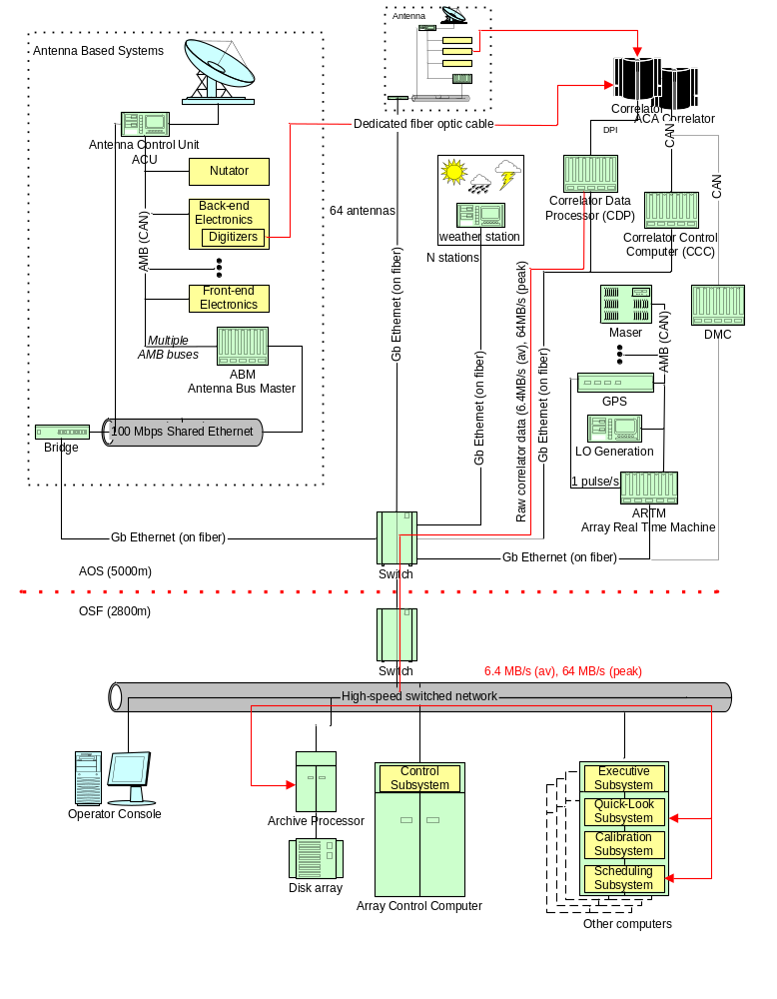
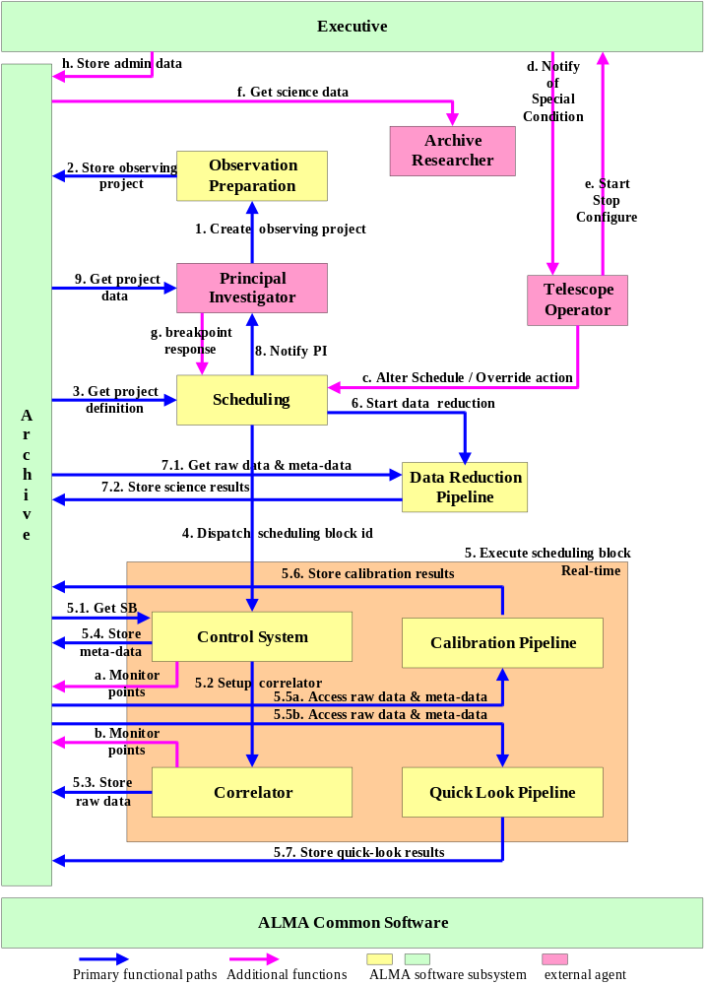
Example of complex systems and SW...

Slide 5
Simulation?
Integral part of Integration Testing.
If you want to test your software BEFORE everything is done, you need a simulation of the missing pieces of the puzzle.
IT team provides a simple simulation of the expected behaviour
Note: SIMPLE simulation. We don't want to do things twice.

Slide 6
How?
IDL provides perfect interfaces for simulations.
Each component has an IDL.
ACS Component Simulator uses the IDL to provide a quick implementation of the methods.
Coded, or in runtime.
Using a simple language: Python.

Slide 7
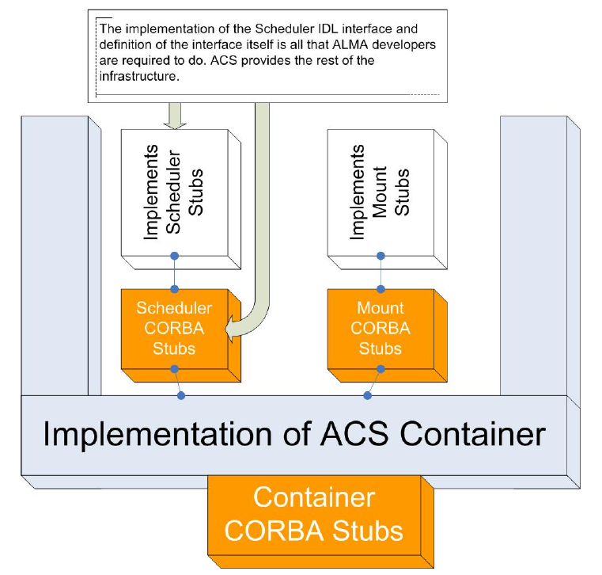

Slide 8
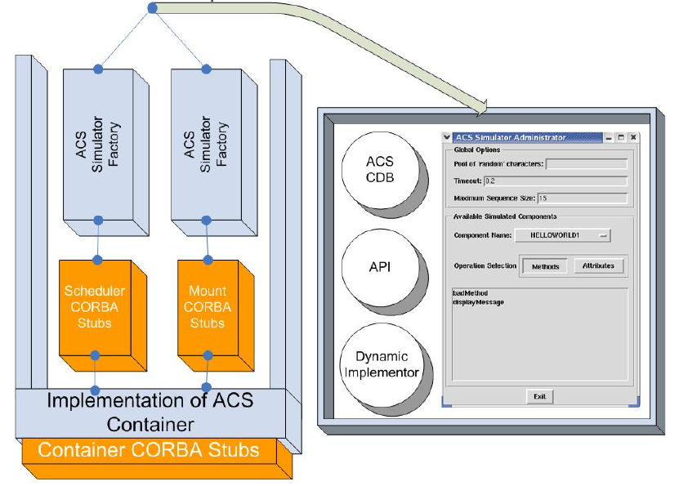

Slide 9
ACS Component Simulator

Slide 10
Characteristics
Capable of:
  Implementing IDLs on runtime.
  ... but also coded.
  Behaves as a real component (lifecycle, ...)
  Uses CDB for configuration

Slide 11
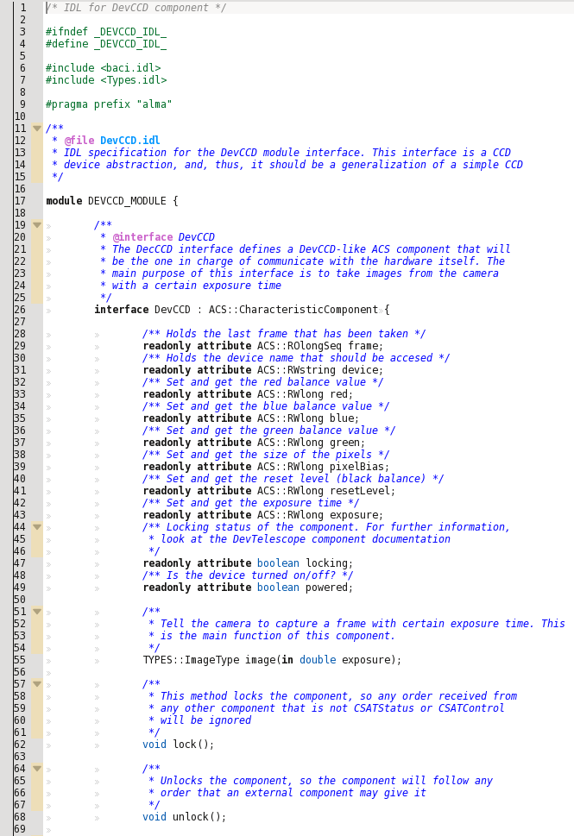

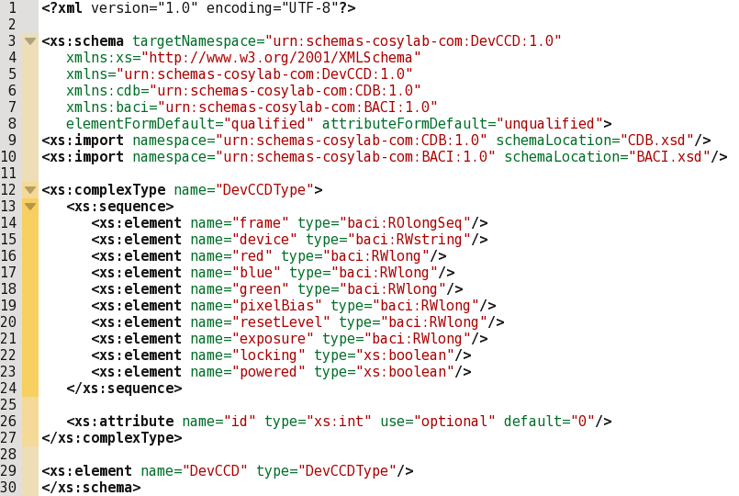
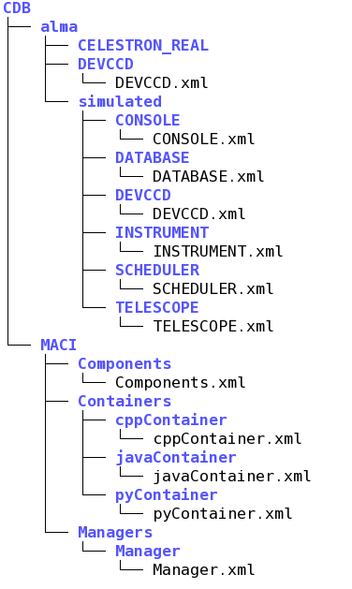
What do we need?
Brand new IDL (and schema if we have a characteristic component)
Runtime environment (i.e. CDB suitable to stat ACS and containers)

Slide 12
CDB changes
Add component to:
CDB/MACI/Components.xml
ONLY for characteristic components,
add entry to:
CDB/alma/<Name>/<Name>.xml
Add entry to:
CDB/alma/simulated/<Name>/<Name>.xml

Slide 13
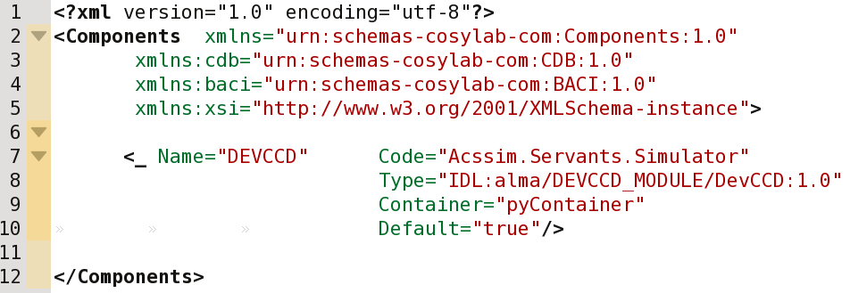
CDB/MACI/Components/Components.xml

Slide 14
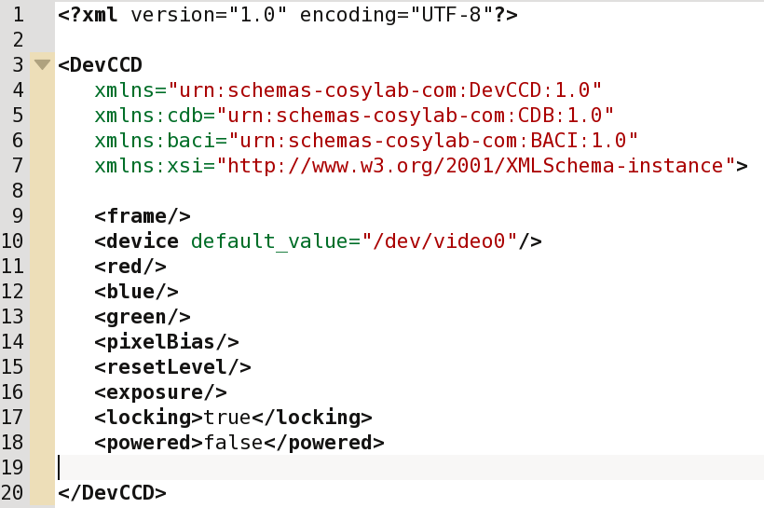
CDB/alma/<Name>/<Name>.xml
(only for characteristic components)

Slide 15
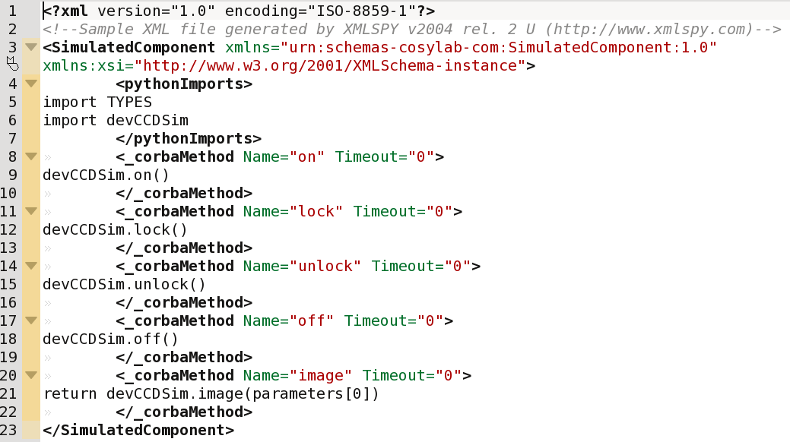
CDB/alma/simulated/<Name>/<Name>.xml

Slide 16
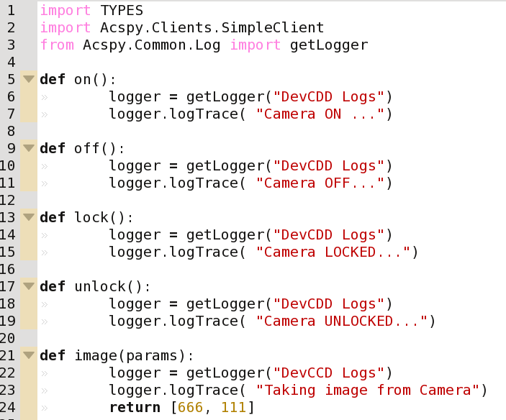
src/<name>Sim/__init__.py

Slide 17
Examples

Slide 18
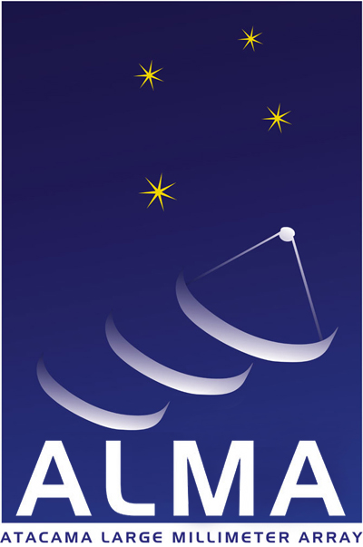
www.almaobservatory.org
The Atacama Large Millimeter/submillimeter Array (ALMA), an international astronomy facility, is a partnership of Europe, North America and East Asia in cooperation with the Republic of Chile. ALMA is funded in Europe by the European Organization for Astronomical Research in the Southern Hemisphere (ESO), in North America by the U.S. National Science Foundation (NSF) in cooperation with the National Research Council of Canada (NRC) and the National Science Council of Taiwan (NSC) and in East Asia by the National Institutes of Natural Sciences (NINS) of Japan in cooperation with the Academia Sinica (AS) in Taiwan. ALMA construction and operations are led on behalf of Europe by ESO, on behalf of North America by the National Radio Astronomy Observatory (NRAO), which is managed by Associated Universities, Inc. (AUI) and on behalf of East Asia by the National Astronomical Observatory of Japan (NAOJ). The Joint ALMA Observatory (JAO) provides the unified leadership and management of the construction, commissioning and operation of ALMA.

