Slide 1
ACS 7th Workshop
A trip through ACS functionalities
G.Chiozzi
Antofagasta – 15th to 19th November 2010

Slide 2
ACS Services
Every application needs a set of Core Integration Infrastructure services, like for example:
  messaging (request/response and publisher/subscriber)
  logging,
  error management,
  alarms
  configuration.
For ACS we have identified the services essential for our application domain.
These have been implemented mostly on top of standard CORBA Services (but DDS is replacing CORBA in several of them)
The ACS work consists in wrapping the implementation to make it easier to use for our purposes.
We will briefly see here some of services provided by ACS
Antofagasta,
15th to 19th November 2010
7th ALMA Common Software Workshop
Notes:
Until now we have defined an infrastructure to build distributed applications.
We can define interfaces, implement Components, deploy them on Containers and have them interact with each other.
But there are also a number of very important general services that almost every application will need and that are essential to allow integrating the different parts of a system, in particular if they are going to be developed by different teams.
In the E-ELT studies we have identified 5 Core Integration Infrastructure services:
A messaging system (request/response and publisher/subscriber)
A centralized logging system
An error system capable of propagate errors/exceptions across the network
A distributed alarm system
A configuration system
ACS implements all these services, plus some additional ones that we think are very important for our application domain.
Whenever possible we have based our implementation on an existing equivalent (CORBA) service. Our work has been in this case to identify and implement on top of the standard services the design patterns most interesting for the development of our applications.
In this way we want to make as easy as possible the access to the services for the functional application developer.
New services or new ways of using already integrated services can be added whenever their need becomes apparent.
It is also very important to notice that many services are defined in CORBA in order to warranty vendor interoperability, so that we can easily replace the underlying implementation.

Slide 3
Messaging
Messaging enables the communication between system Components
supports both request-response and publish-subscribe message patterns
anonymous publish/subscribe data transfer is seen more and more as a key need for the messaging system.
In ACS:
  CORBA messaging provides request-response
  CORBA Notify Service provides publish-subscribe
  DDS can replace the Notify Service and offers many advantages
Antofagasta,
15th to 19th November 2010
7th ALMA Common Software Workshop
Notes:
The messaging system is the core functionality that emables the communication between system Components.
It must support both the publish-subscribe and request-response message patterns.
These functions are available to external users via an API developed as part of the Core Integration Framework. Every effort should be made to ensure that the API encapsulates the underlying communications technology.
To promote a loosely-coupled distributed system, and hence aid future maintainability, anonymous publish/subscribe data transfer is seen as a key need for the messaging system. In this situation, components publishing data have no knowledge of who is going to use the published data and subscribers have no knowledge of who published the data comes from.
In ACS, CORBA naturally provides the request-response implementation, just by calling CORBA methods.
Publisher/subscriber is instead now provided by the CORBA Notify Service.
On the other hand, DDS seems a very promising replacement, with several advantages.
We have therefore developed in the last years several prototypes and benchmarks to evaluate replacing CORBA Notify with DDS.
The requirements of the ALMA are currently satisfied by the CORBA Notify and therefore ALMA (in the critical commissioning phase) has no interest in replacing the core publisher/subscriber mechanism.
But this is very interesting for new projects and we are therefore working on integrating the DDS prototypes in the core ACS distribution as a replacement for the Notify Service.

Slide 4
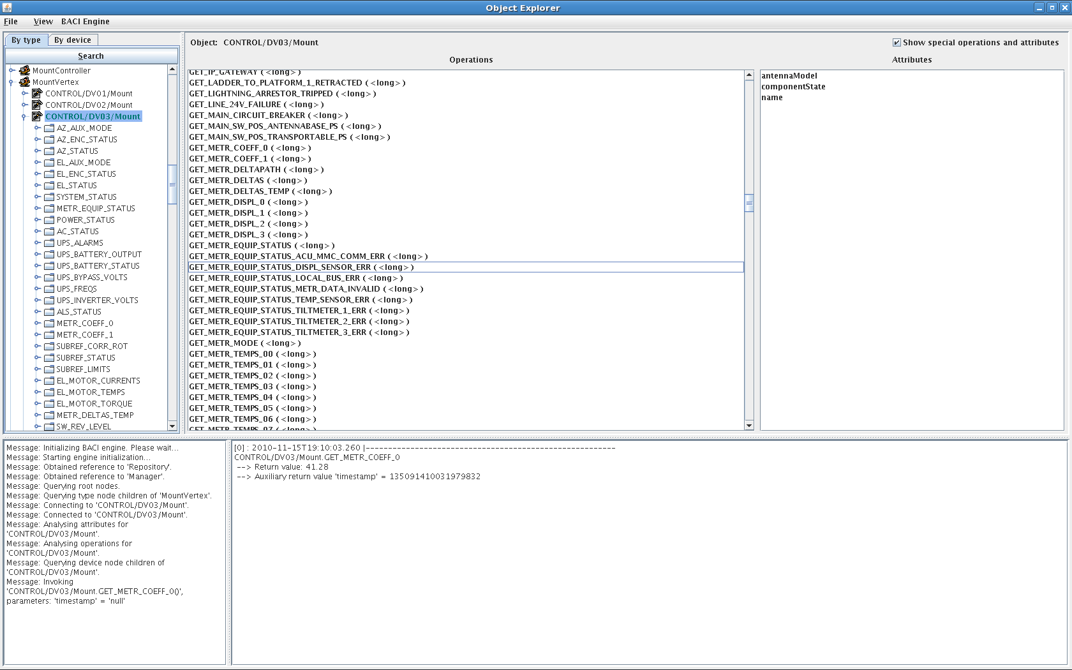
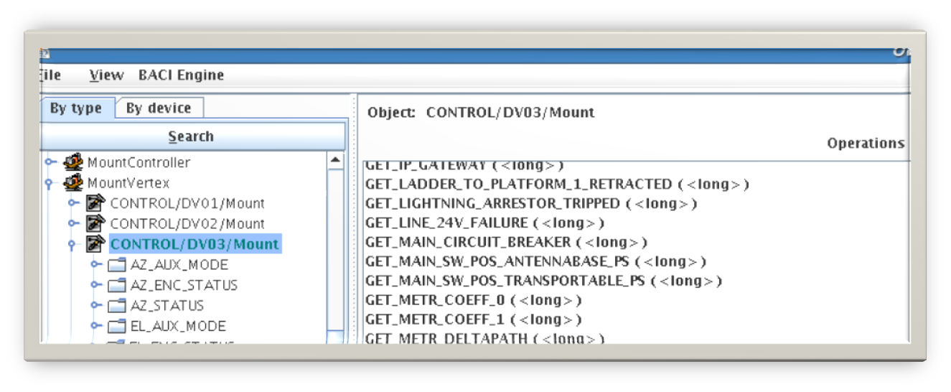
ACS Object Explorer
Antofagasta,
15th to 19th November 2010
7th ALMA Common Software Workshop
Notes:
The Object Explorer (OE):
Is a generic tool used for low-level inspection of Components in ACS. It can be used as a debugging or testing tool by the developers and maintainers of a system.
Allows to interact with any Component or, more in general, any object whose reference can be retrieved from the Manager and whose IDL interface can be retrieved from the Interface Repository.

Slide 5
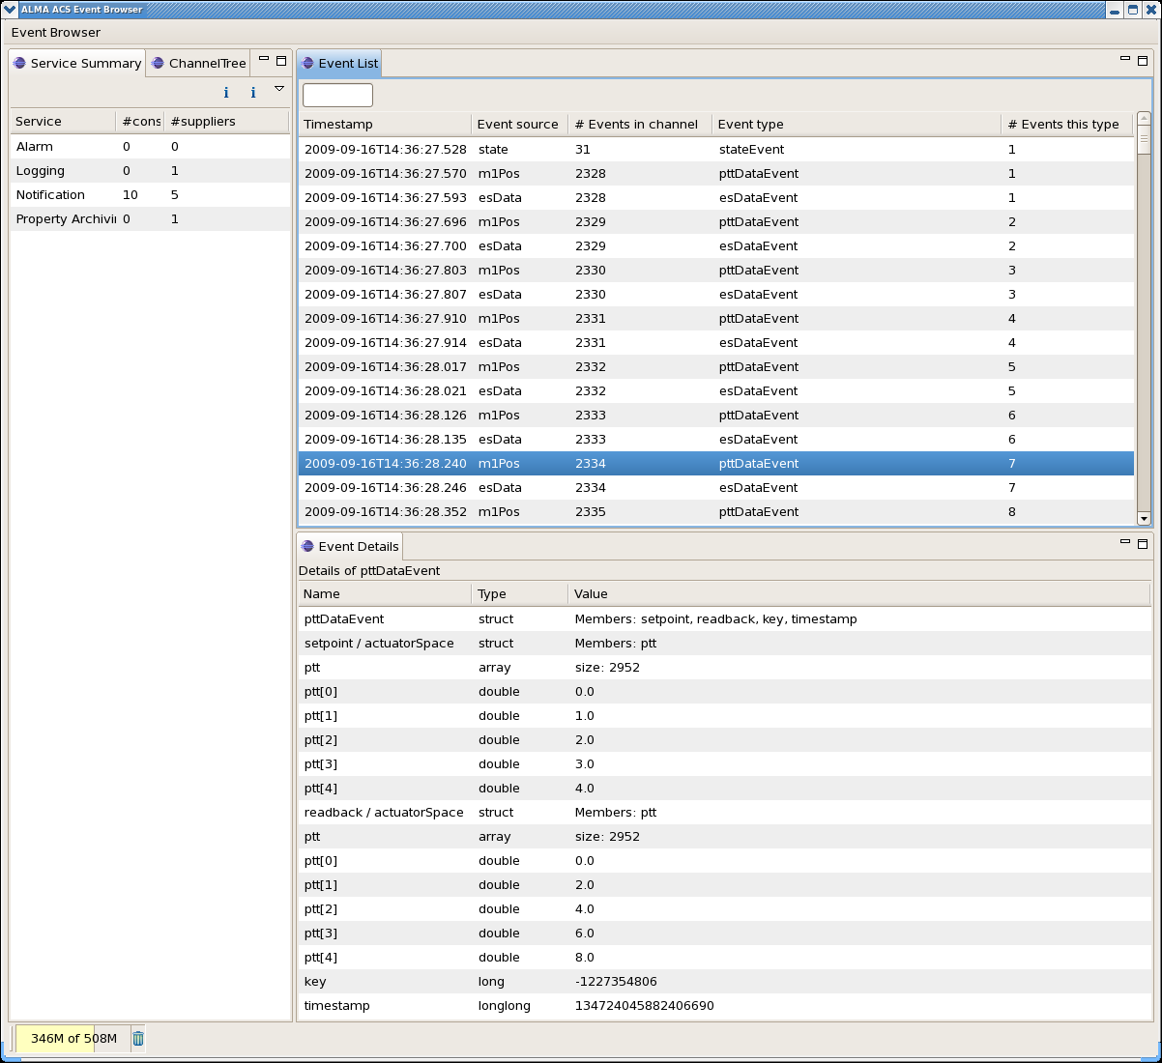
Event Browser
Antofagasta,
15th to 19th November 2010
7th ALMA Common Software Workshop
Notes:
The Event Browser is a generic client for the Notification Channel.
It is capable of subscribing to any publisher and display any kind of event published on the Notification Channel.
It is therefore an extremely valuable debugging tool.

Slide 6
Logging system
Logging is fundamental for the operation of distributed systems, in order to understand and keep track of what happens between concurrent components.
Logging is used to publish any kind of status and diagnostic information for interested clients and for archival.
The current implementation is based on the Notification Service.
We have now a prototype implementation based on DDS.
Antofagasta,
15th to 19th November 2010
7th ALMA Common Software Workshop
Notes:
A centralized logging system is the most essential service for the operation of a distributed system.
It is also probably the most important debugging tool for a distributed and concurrent system.
Using a source code debugger, it is in fact impossible to debug concurrent issues, because break points and function stepping heavily affect concurrency.
The standard CORBA Logging Service provides a very powerful and scalable logging infrastructure.
But this infrastructure is still too generic for our purpose.
In particular it does not provide any guideline on how to structure the contents of the messages.
In ACS we have therefore decided to structure messages using XML and we have defined an XML schema for the contents of logs.
Then we have implemented wrapper APIs in the supported languages and a generic server for other clients that make trivial to use the logging system and generate messages properly formatted according to the schema.
Doing this we have taken into account that Java has a native logging API and that therefore Java developers should have been very happy of being able to use this standard API.
The driving forces in designing the ACS layer on top of the standard CORBA logging service have been:
Define how the flexible and generic CORBA logging system shall be used:
Make the usage as simple as possible
Hide native CORBA and make it look like APIs the developers are already comfortable with.
Quality of Service specifications and a thoroughly defined Administration Interface take care of the reliability requirements.
We have now implemented a prototype that uses DDS instead of CORBA Notify, with much better performance. The prototype is presented at this conference: “Introducing high performance distributed logging service for ACS”, J.Avarias

Slide 7
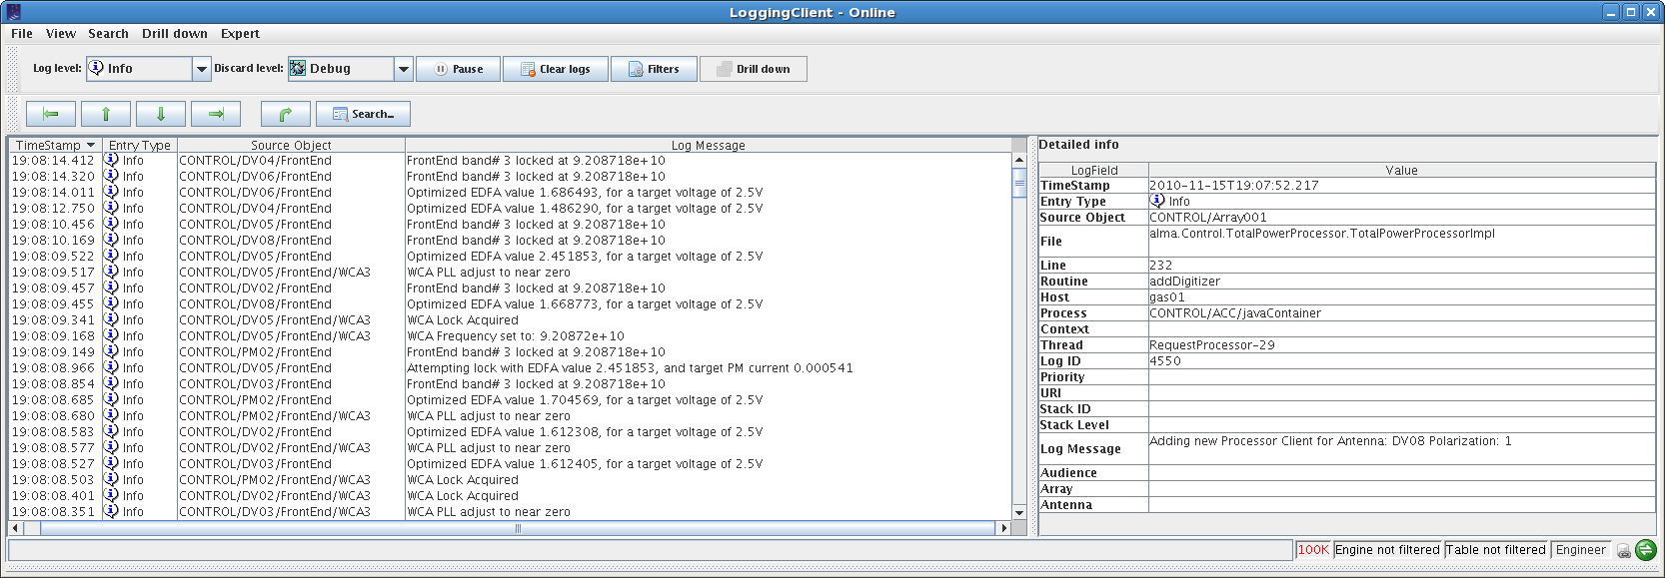
Logging client, jlog
Antofagasta,
15th to 19th November 2010
7th ALMA Common Software Workshop
Notes:
An API allows to write clients of the logging system.
In this way any application can retrieve logs while they are published.
We have two clients of uttermost importance:
A GUI client that allows operators to display and monitor logs.
An Archive Client that receives logs with the purpose of storing them in a persistent archive for later analysis and retrieval.
ACS itself does not provide any archive, but the responsibility of providing one is left to applications.

Slide 8
Error System
We need a unified way of dealing with errors through the system
CORBA supports “distributed” exceptions
We need more:
  Error format standardisation
  Error handling design patterns
  Error trace
  Error logging
  Synchronous and asynchronous error handling
  Error browsing and definition tools
  The ACS Error System provides these features
Notes:
It is extremely important to have a coherent and complete way of handling error conditions all over the system.
This involves handling errors:
in different programming languages:
an error in a C++ Component has to be propagated and understood by a Java Component
distributed over the network:
an error in a Component in one host has to be propagated over the network to a client component on another host, possibly with a different operating system and architecture
CORBA allows defining exceptions in IDL (with some limitations due to the need of supporting non exception-aware programming languages) and throwing exceptions over the call to IDL operations. This means that a remote call can throw an exception that goes back over the wire to the caller and looks the same as a local exception. The exception’s data is handled by CORBA and marshalling is therefore transparent.
The possibility of treating local and remote exceptions in the same way is extremely important in order to build transparency in the distribution of Components, but it is not sufficient.
There are many other issues that we need to solve to allow treating efficiently error conditions in Components:
Error format standardisation
A part from the exception “name”, we often profit significantly from additional context information in the data coming with the exception. But to be able to interpret this information the data structure shall be standardized in the format and contents.
Error handling design patterns
There are a number of well proven error handling design patterns (see ARCUS Error Handling for Business Information Systems: http://www.eso.org/projects/alma/develop/acs/Releases/ACS_3_1/Docs/ARCUSErrorHandling.pdf). Providing a standard implementation for these patterns helps a lot in writing solid applications.
….continues

Slide 9
Alarm System
Deals with abnormal situations
  Fault states (FS)
  Range from severe alarms to warning states
Provides
  FS collection, analysis and distribution, definition and archiving
  FS reduction
  Dedicated alarm consoles
Porting of CERN LASER system to ACS technology
Antofagasta,
15th to 19th November 2010
7th ALMA Common Software Workshop
Notes:
An alarm system is a cornerstone service in every computer controlled environment.
Its purpose is the notification of exceptional conditions (fault states) in the system requiring an intervention from the staff.
The specifications for the alarm system in the Alma Common Software (ACS) require not only that each alarm has to be shown to operators in a short time, but also that correlated alarms must be "reduced" and presented in compact form in such a way that operators are able to easily identify the root cause for an abnormal condition.
In the development of ACS we always investigate the availability of adequate implementations before writing a service from scratch. Such an implementation, the CERN LASER Alarm System, developed for the Large Hadron Collider, was fulfilling and exceeding our requirements.
We have therefore started a collaboration with the CERN LASER team to integrate it with ACS.
The Laser implementation uses an architecture similar to ACS but a different set of underlying technologies.
The porting work has consisted therefore in identifying how to replace the original technologies with ACS and refactor when convenient the code to keep the biggest possible common code base, isolating the access to specific technologies in separate interfaces.
LASER is a messaging system; it collects, stores, manages and distributes information regarding abnormal situations called Fault States (FS). A FS is identified by a triplet: the Fault Family (FF), the Fault Member (FM) and the Fault Code (FC). The FF represents a set of elements with the same kind of problems, like power supplies. The FM specifies the particular instance of an object in the FF, for example a specific power supply. The FC is a code representing a particular problem occurring in the FM.
From an operational point of view, the alarm service receives FS from alarm sources. Each FS is made persistent and correlated with other FS previously received. Each FS is defined in the database together with other information, like for example the exact position of the failing component as well as the name and telephone number of the responsible person for that particular alarm. The alarm system uses the FS as a key to retrieve such information from the database and build a new, more complete snapshot of the specific FS. Finally, the alarm service sends this snapshot to the clients, one of which is the operator GUI that presents the alarms to the operators that can take the more appropriate action to fix the problem.
When the system is complex, the cascade of alarms produced as the consequence of just a single failure can be huge. LASER correlates active alarms in order to show to the operators only the root cause of a specific alarm. We call this phase reduction and it is a key process to help users in finding and fixing quickly each problem.

Slide 10
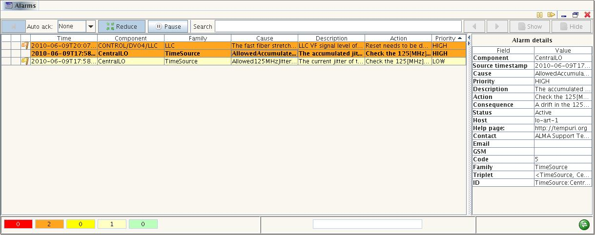
Alarm System console
SPIE 2010 – SC-644, G.Chiozzi
An Introduction to Scalable Frameworks for Observatory Software Infrastructure
Notes:
Probably the most important element in an Alarm System is the operator’s console.
This graphical user interface shall enable the operators to quickly and efficiently analyze the fault states occurring to identify the ultimate cause and take appropriate actions.
It is therefore necessary to allow a large degree of configurability and good filtering capabilities.
The development of such a GUI is very expensive and therefore the possibility of sharing one implementation across different projects is very appealing.
Whenever the alarm consol receives an alarm, it shows a line in the table with the label N that means “new”. When the operator presses the mouse button over the alarm, the N changes to the date when the alarm was issued by the source. If an active alarm becomes terminate, its entry remains in the main panel until the operator explicitly acknowledges the alarm by adding a comment.

Slide 11
Configuration Database
The ACS Configuration Database addresses the problems related to defining, accessing and maintaining the configuration of a system.
For each Component in the system, there might be a set of static (or quasi-static) configuration parameters that have to be configured in a persistent store and read when the Component is started up or re-initialized.
This includes the “deployment structure” of the system, i.e. which statically deployed Components are part of the system and their inter-relationships.
This information is used by the Component/Container infrastructure.
SPIE 2010 – SC-644, G.Chiozzi
An Introduction to Scalable Frameworks for Observatory Software Infrastructure
Notes:
The ACS Configuration Database addresses the problems related to defining, accessing and maintaining the
configuration of a system based on ACS.
Typically, Components in the system have an associated set of configuration parameters.
For example, Components representing devices need to define device characteristics, calibration parameters or limit values.
If we consider for example the Component representing a motor we normally need to be able to configure information like the brand, the serial number, the limit positions and so on.
There is clearly no point in hard coding this information in the code, because devices are replaced and recalibrated.
We need to put the configuration in a persistent store, keep it under configuration control and be able to read it whenever
the Component needs it, for example at startup or initialization time.
The information that needs to be stored in this Configuration Database includes the structure and deployment of the system, i.e. which Components are part of the system and their inter-relationships. For what concerns system deployment, looking at the CDB only you should be able to see how the Components are distributed among the Containers and on what hosts the Containers are running.
For Components connected to HW, this would tell you as well what HW you are using and where it is located.
Changing the CDB you can move Components around and distribute them in a different way in the system.

Slide 12
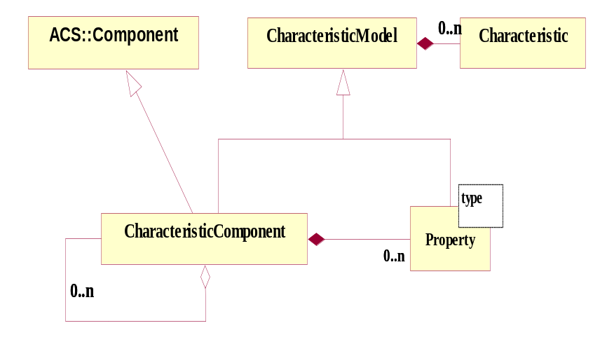
Pattern for devices:
Component-Property-Characteristics
(Characteristic) Component: base class for any physical/logical Device
(e.g. temperature sensor, motor)
Each Component has Properties (e.g. status value, position - control/monitor points)
Characteristics of Components and Properties
(Static data in Configuration DB, e.g. units, ranges, default values)
GUIs
What about Data Distribution (ACS Events and/or DDS)?
Antofagasta,
15th to 19th November 2010
7th ALMA Common Software Workshop
Notes:
On the Control System side the concept of a Software Device representing physical or logical devices of the system such as antenna mount, antenna control unit, correlator, etc is very common. It is therefore useful to take a formal design pattern for this model and implement it.
We have taken the Characteristic Component-Property-Characteristics pattern. The Device itself is mapped on a Component in our Component/Container model.
Each Characteristic Component implements operations and is further composed of Properties (representing monitor and control pointes).
A Characteristic Component can also contain references to other Components to build hierarchies.
Both Characteristic Components and Properties have specific Characteristics, e.g. a Property has a minimum, a maximum, units…. The common behaviour of Characteristic Component and Property has been factorized in the Characteristic Model common base class. Values of the Properties are updated asynchronously by means of monitor objects.
While there are in principle an infinite number of Component types, for example one for each physical controlled device, there are very few different Property types
Underneath this high level pattern, design patterns for synchronous and asynchronous value retrieval/setting, monitoring and archiving or alarms are part of the Property definition
The implementation of this pattern provides once more a clear path for the Technical Architecture of the Control System.
The developers responsible for the implementation of the control system have to:
Identify the hierarchy of logical and physical devices
Identify the operations allowed on each device and the monitor and control points. This is the IDL interface of the devices.
Implement the code for the operations.
Implement the hardware access layer (using the Bridge pattern) to connect the properties with the actual hardware
The framework provides them with standardized configuration and deployment means, automatic monitoring for telemetry and many other facilities.
In our on-going evaluation of DDS we see that very similar concepts could be conveniently applied also for values published in a data distribution model.
In this case the role of the property would be taken by the data “topic”. “Topic properties” would be in general de-coupled from components representing devices, but still we would have general facilities to analyze the characteristics of such properties, monitor them (for example to make trend plots or attach callbacks) and interact with them (for example publishing values).

Slide 13
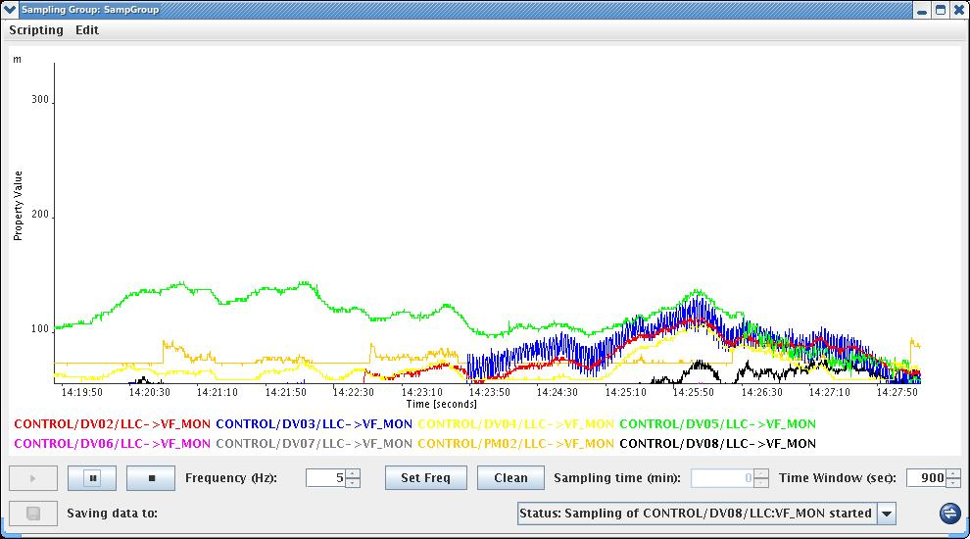
Sampling System
Sampling of any Property
High sustained frequency
Optimized data transport
Simultaneous sampling
Plotting GUI
Antofagasta,
15th to 19th November 2010
7th ALMA Common Software Workshop

Slide 14
Code generation
Code generation in ACS is widely used:
  uniform framework throughout different modules
  reduction of routine tasks
  avoiding typing errors
  better focusing on functionality of application
Model Driven Architecture?
  creation of an application (skeleton) from IDL-file or, better, UML
Antofagasta,
15th to 19th November 2010
7th ALMA Common Software Workshop
Notes:
In ACS many repetitive tasks are handled with the help of code generation tools.
For example:
error system interfaces and implementation classes are generated from an XML specification
XML binding classes
documentation
state machines
Still it has been pointed out several times, in particular by new users, that implementing ACS components requires editing of several files and that this work could be drastically simplified by code generation with a noticeable improvement in the slope of the ACS learning curve.
Together with the ALMA High Level Analysis team we think that code generation from UML will be able to relieve the programmers from a lot of code editing, since a big part of the Component’s code can be easily generated. This is an important step toward Model Driven Architecture.
More over there are now powerful tools to implement efficiently code generation solutions.
In particular we rely a lot on the openArchitectureware code generation framework: http://www.openarchitectureware.org/

Slide 15
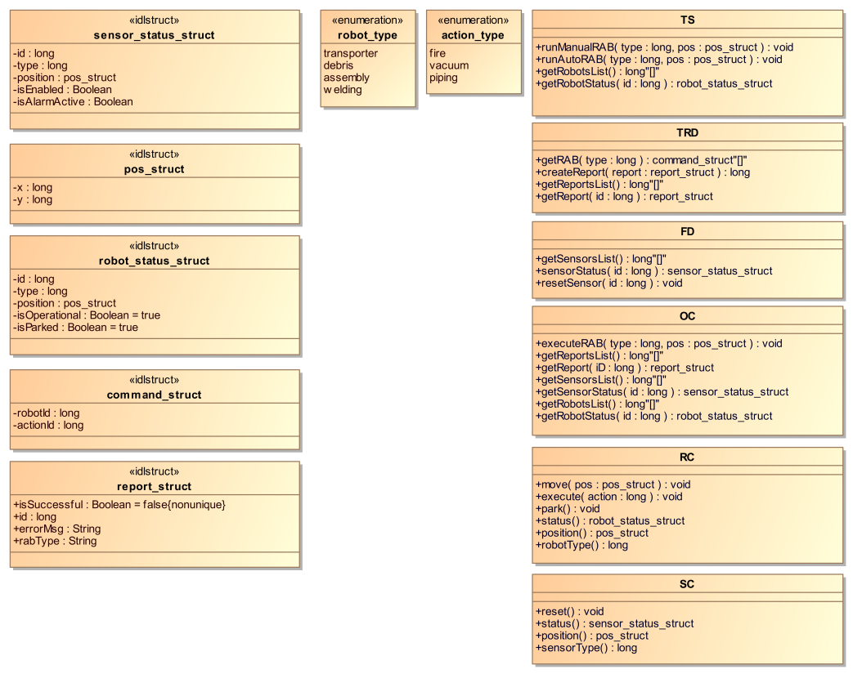
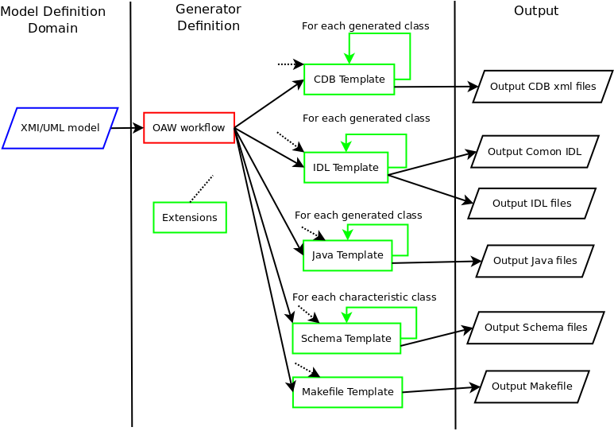
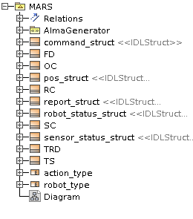
Model Driven Code Generation
UML model
Generator process
Antofagasta,
15th to 19th November 2010
7th ALMA Common Software Workshop
Notes:
We are now exploiting, in collaboration with UTFSM in Chile, the more comprehensive approach of Model Driven code generation to transform directly an UML Model into a full implementation in the ACS framework.
This approach makes it easier for newcomers to grasp the principles of the framework. Moreover, a lower handcrafted LOC reduces the error rate. Additional benefits achieved by model driven code generation are: software reuse, implicit application of design patterns and automatic tests generation. A model driven approach to design makes it also possible using the same model with different frameworks, by generating for different targets.
The generation framework, presented in a paper in this conference, uses openArchitectureWare as the model to text translator.
OpenArchitectureWare provides a powerful functional language that makes this easier to implement the correct mapping of data types, the main difficulty encountered in the translation process. The output is an ACS application readily usable by the developer, including the necessary deployment configuration, thus minimizing any configuration burden during testing.
The specific application code is implemented by extending generated classes. Therefore, generated and manually crafted code are kept apart, simplifying the code generation process and aiding the developers by keeping a clean logical separation between the two.

Slide 16
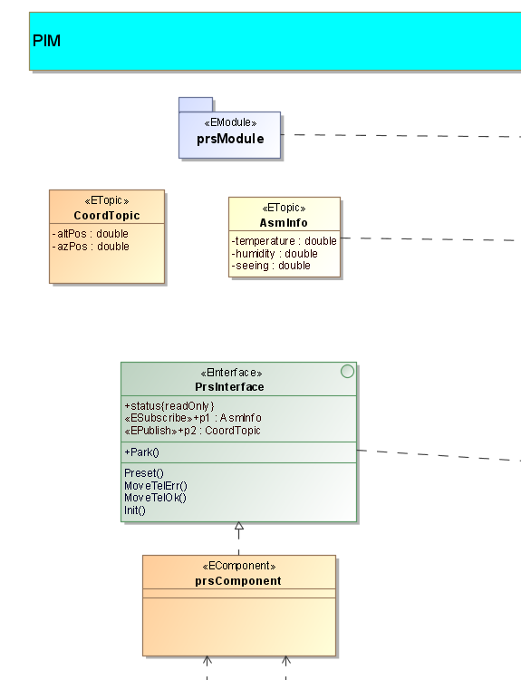
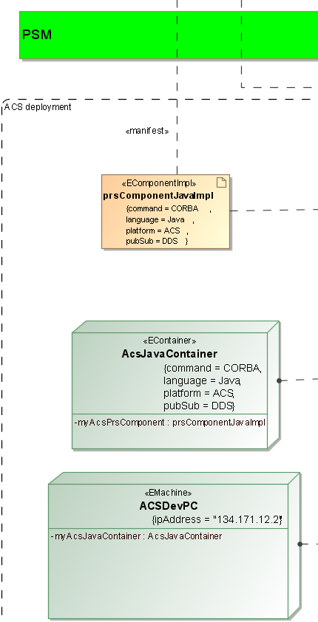
Model Driven Code Generation
Integration with the whole control system model
Define a metamodel and a profile
Separate Platform Independent (PIM) and Platform Specific (PSM) Models
Separate and handle both definition and deployment
Antofagasta,
15th to 19th November 2010
7th ALMA Common Software Workshop
Notes:
We are now exploiting, in collaboration with UTFSM in Chile, the more comprehensive approach of Model Driven code generation to transform directly an UML Model into a full implementation in the ACS framework.
This approach makes it easier for newcomers to grasp the principles of the framework. Moreover, a lower handcrafted LOC reduces the error rate. Additional benefits achieved by model driven code generation are: software reuse, implicit application of design patterns and automatic tests generation. A model driven approach to design makes it also possible using the same model with different frameworks, by generating for different targets.
The generation framework, presented in a paper in this conference, uses openArchitectureWare as the model to text translator.
OpenArchitectureWare provides a powerful functional language that makes this easier to implement the correct mapping of data types, the main difficulty encountered in the translation process. The output is an ACS application readily usable by the developer, including the necessary deployment configuration, thus minimizing any configuration burden during testing.
The specific application code is implemented by extending generated classes. Therefore, generated and manually crafted code are kept apart, simplifying the code generation process and aiding the developers by keeping a clean logical separation between the two.

Slide 17
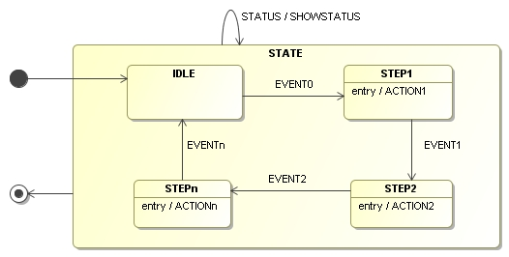
State Machines
… generate FSM from model
Control applications are very naturally mapped into state machines
Implementation and maintenance of state machines by hand is expensive
Modeling tools are good in helping defining state machines
Therefore…..
Executable
Antofagasta,
15th to 19th November 2010
7th ALMA Common Software Workshop
Notes:
Control applications are in principle very naturally mapped into state machines.
Clearly the direct control of physical devices needs to be modeled using finite states machines, but also the high level coordination between the subsystems of a telescope or the sequencing of observations would be very conveniently described using state machines.
Unfortunately in our community (at least according to my experience) we have often designed state machines for the description of devices but we have very seldom implemented real state machines explicitly. In most of the cases we have implemented them implicitly using flags and if switches.
This is probably due to the fact that there is no long tradition of FSM frameworks and to the fact that maintaining FSM implementations based on state/transition tables is normally quite difficult.
In the last few years the situation has improved and there is now, for example, a very good open source FSM engine that is part of the Boost C++ library: Boost Statecharts.
But the best approach seems to be in any case that of being able to model the state machines in a UML modeling tool and generate from that the skeleton of a complete application where only the specific code for actions and transitions needs to be implemented.
This can clearly only work if it is possible to go back to the model, modify the states and generate a new version without losing the previously implemented actions and transition functions.

Slide 18
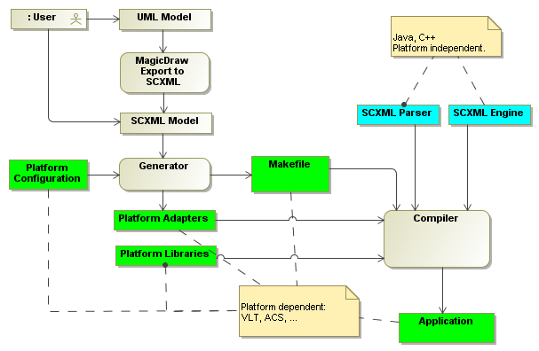
Generic State Machine engine
Data Flow
Antofagasta,
15th to 19th November 2010
7th ALMA Common Software Workshop

Slide 19
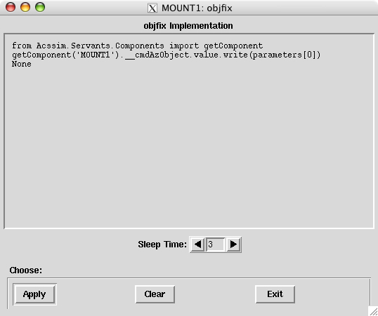
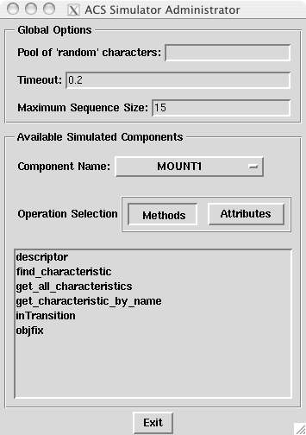
Component simulation framework
Why simulation?
  Distributed development
  Features or entire subsystems not yet available
  Test a subsystem in isolation
Simulation of Components from IDL interface spec.
Dumb default or “intelligent” simulation
Antofagasta,
15th to 19th November 2010
7th ALMA Common Software Workshop
Notes:
The functional entities collaborating in an ACS application are the Components.
The interaction between components is based on the IDL interfaces and/or on the notification channel.
No client is ever aware of the actual implementation of a component it interacts with.
There are very good reasons to be able to simulate a complete component:
In a distributed development the code base cannot be all the time synchronized. Therefore a subsystem team can desire to have a stable simulation of components developed by other subsystems.
At any intermediate time between releases, some pieces of code contributed by the various subsystems are only partially implemented. Another subsystem might need functionality that is not available yet.
It also happens that the intermediate code does not perform according to specifications. This might confuse the developer of a subsystem using it. When running tests or when implementing modular regression tests, who is at fault in case of problems?
It is therefore very difficult to get the integrated (but partial) system working.
It is also very difficult to identify the subsystems responsible for bugs and work around them to proceed with the integration tests.
It is therefore much quicker to get the complete system exercised if the capability to fake the missing software functionality is available.
If possible, modular regression tests should only rely on internal code and simulation for external Components.
Due to the fact that only IDL interfaces can be seen by clients of Components and not the actual implementations, the most effective means of simulation for ALMA is at the Component level. That is, it should be possible to specify to the Container that the implementation for a given Component is a simulated Component factory. Also, because of the very nature of IDL interfaces, clients using the Component will never know they are not using the real one or a surrogate. Component implementations are hot-swappable within the ACS framework.
The ACS Component simulator allows developers to configure the behavior of simulated Components in four different ways – completely self-implementing components, configuration files found in the ACS CDB, a GUI, and an API.
The ACS Component Simulator has the following characteristics:
• It is implemented in Python
Uses the CORBA IDL Interface Repository (IFR), a CORBA service which stores and retrieves IDL, it is possible to accurately create method return values for the developer without their input.
Can be executed from an interactive Python session. This implies that the developer can swap out entire method/attribute implementations with ease.
Instead of simulating components at the interface level where all component instances of a given IDL type behave identically, we simulate the named component at instance level. This means that each simulated component of a given type can be configured to behave uniquely.
Using native Python methods, it is possible to dynamically create the implementation of any IDL interface.
Using native Python methods, it’s possible to read method/attribute return values in the form of XML strings from the ACS CDB.

Slide 20

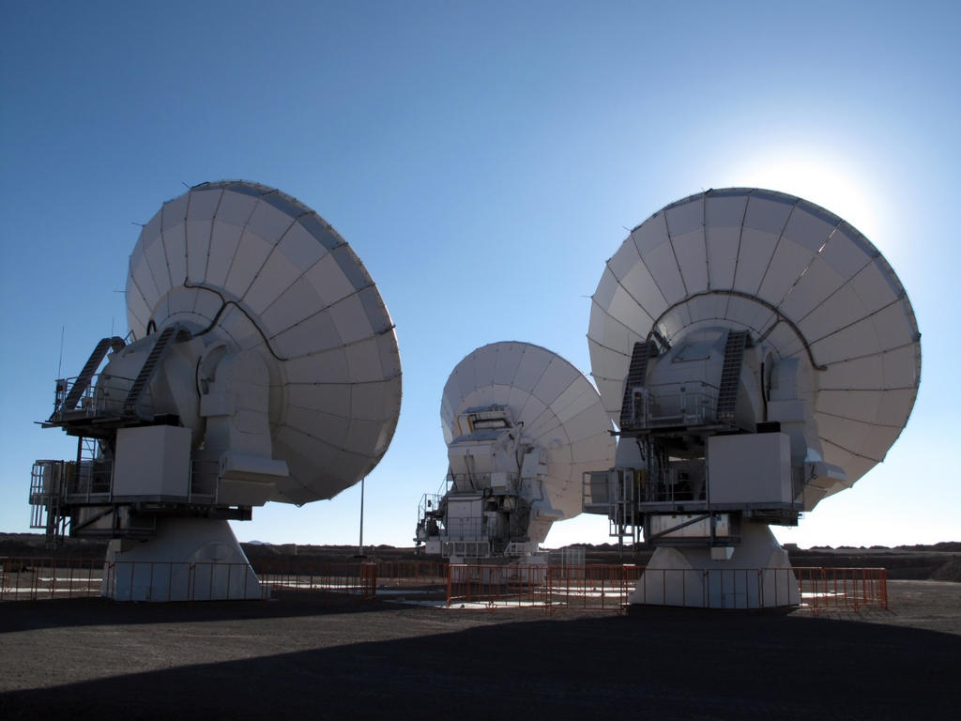
Questions (& Answers)
Antofagasta,
15th to 19th November 2010
7th ALMA Common Software Workshop

