Slide 1





ACS Alarm System
A. Caproni^{ac}
a. ESO, European Organization for Astronomical Research in the Southern Hemisphere
b. CERN, European Organization for Nuclear Research
c. INAF-OATs, Osservatorio Astronomico di Trieste
d. COSYLAB, Control System Laboratory
ACS alarm system
UTFSM, Valparaiso, Nov 2009

Slide 2
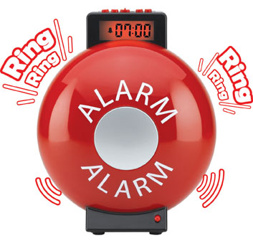
Alarm System
The Alarm System deals with abnormal situations by means of Fault States (FS):
FS collection
FS analysis and distribution
Alarm definition
Alarm archiving
ACS alarm system
UTFSM, Valparaiso, Nov 2009

Slide 3
Alarm System
The AS collects information from the environment and shows to the user what’s happening and possibly how to fix an abnormal situation in a short time.
shows only the relevant alarms (can show all the active alarms)
has the concept of authorized users
doesn’t take any action to fix a problem
alarm must be acknowledged
stores the alarms in the database
ACS alarm system
UTFSM, Valparaiso, Nov 2009

Slide 4
ACS Alarm system
2 available implementations:
ACS
CERN
ACS implementation is used if:
CBD/Alarms folder does not exist
Implementation property not set to “CERN” in the CDB
ACS implementation logs a message for each alarm:
Alarm sent: <AlarmSource,ALARM_SOURCE_MOUNTCPP,1> ACTIVE
Alarm sent: <AlarmSource,ALARM_SOURCE_MOUNTCPP,1> TERMINATE
Log level Alert
jlog (with filters)
ACS alarm system
UTFSM, Valparaiso, Nov 2009

Slide 5
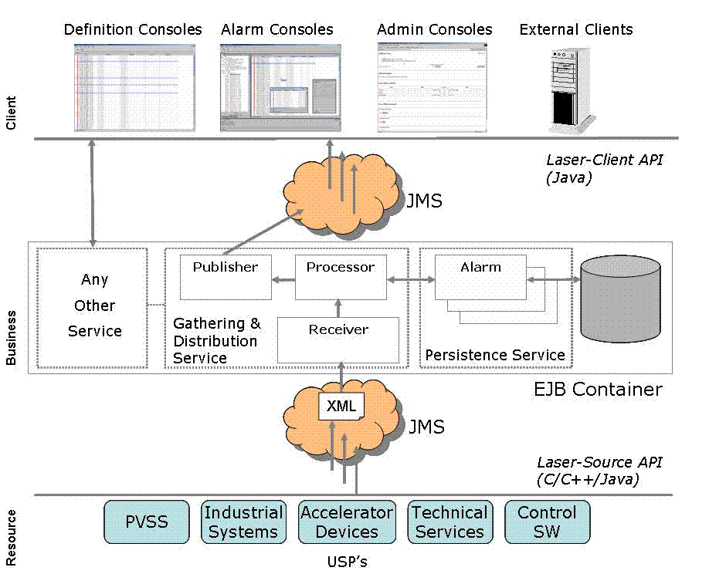
LASER - Overview
CERN implementation consists of the alarm system developed at CERN for the LHA collider (LASER) integrated within ACS.
ACS alarm system
UTFSM, Valparaiso, Nov 2009

Slide 6
CERN Implementation
Alarm panel
Java clients
Client tier
ACS wrapper
CDB
Business tier
LASER
ARCHIVE
Source tier
Components
SimpleClient
C++, java, python
ACS alarm system
UTFSM, Valparaiso, Nov 2009

Slide 7
Large Hadron Collider Alarm Service (LASER)
LASER is the second generation alarm service developed at CERN for the Large Hadron Collider.
It is a messaging system: collects, stores, manages and distributes information about abnormal situations: the Fault States.
Each Fault State (FS) is identified by a triplet:
FS = <FF,FM,FC>
the Fault Family (FF) groups elements of the same kind
the Fault Member (FM) represents the failing instance
the Fault Code (FC) identifies the particular problem
A Fault State has a boolean state: active or inactive
ACS alarm system
UTFSM, Valparaiso, Nov 2009

Slide 8

FaultState
FS = <FF, FM, FC>
FF groups similar equipments (sw/hw) for example Antenna(s), ACS components
FM identifies which particular equipment in the family is failing (for example Antenna3, MOUNT_3 component)
FC is an integer identifying the particular problem occurring in the failing equipment
It has a status, active ↔ inactive
It has an heartbeat
The FS is a unique identifier! → One triplet for each possible alarm!
ACS alarm system
UTFSM, Valparaiso, Nov 2009

Slide 9
Triplet - 1
<FaultFamily, FaultMember, FaultCode>
Group equipments of the same type
Failing instance
Specific failure
Examples:
<MOUNT, MOUNT_1, 100> (ACS component)
<ANTENNA, ANTENNA7, 200> (Hardware equipment)
<kernelModule, pcnet32@host, 1> (kernel module)
ACS alarm system
UTFSM, Valparaiso, Nov 2009

Slide 10
Triplet - 2
<Fault Family, Fault Member, Fault Code>
String
String
integer
The definition of a triplet is whatever you like!
meaningful (maintenance, readability…)
unique (it is an ID!)
it says who, where and how something is failing
ACS alarm system
UTFSM, Valparaiso, Nov 2009

Slide 11
Source tier
The resource tier is composed of sources of alarms:
different programming languages (java, C++, python)
ACS components, simple clients, tests...
each source has a definite set of FS whose state can be active/inactive
each source sends an heartbeat to the service
Source API:
allows the sources to send alarms to the business tier
no need of specific knowledge of the alarm service
Independent of the implementation (ACS/CERN)
ACS alarm system
UTFSM, Valparaiso, Nov 2009

Slide 12
Java example
String faultFamily=”PowerSupplies”;
String faultMember=”PS3”;
int faultCode=100;
AlarmSystemInterface alarmSource =
AlarmSystemInterfaceFactory.createSource(this.name());
FaultState fs = AlarmSystemInterfaceFactory.createFaultState(
faultFamily, faultMember, faultCode);
fs.setDescriptor(FaultState.ACTIVE);
fs.setUserTimestamp(new Timestamp(System.currentTimeMillis()));
Properties props = new Properties();
props.setProperty(...);
...
fs.setUserProperties(props);
alarmSource.push(fs);
ACS alarm system
UTFSM, Valparaiso, Nov 2009

Slide 13
C++ example
string family = "AlarmSource";
string member = "ALARM_SOURCE_MOUNT";
int code = 1;
AlarmSystemInterface* alarmSource = AlarmSystemInterfaceFactory::createSource();
auto_ptr<FaultState> fltstate = AlarmSystemInterfaceFactory::createFaultState(family, member, code);
fltstate->setDescriptor(faultState::ACTIVE_STRING);
Timestamp * tstampPtr = new Timestamp();
auto_ptr<Timestamp> tstampAutoPtr(tstampPtr);
fltstate->setUserTimestamp(tstampAutoPtr);
Properties * propsPtr = new Properties();
propsPtr->setProperty(...);
auto_ptr<Properties> propsAutoPtr(propsPtr);
fltstate->setUserProperties(propsAutoPtr);
alarmSource->push(*fltstate);
ACS alarm system
UTFSM, Valparaiso, Nov 2009

Slide 14
Python example
family = "AlarmSource"
member = "ALARM_SOURCE_MOUNT
code = 1
Acsalarmpy.AlarmSystemInterfaceFactory.init()
alarmSource = Acsalarmpy.AlarmSystemInterfaceFactory.createSource("ALARM_SYSTEM_SOURCES")
fltstate=Acsalarmpy.AlarmSystemInterfaceFactory.createFaultState(family,member, code)
fltstate.descriptor = FaultState.ACTIVE_STRING
fltstate.userTimestamp = Timestamp.Timestamp()
fltstate.userProperties["TEST_PROPERTY"] = "TEST_VALUE"
alarmSource.push(fltstate)
Acsalarmpy.AlarmSystemInterfaceFactory.done()
ACS alarm system
UTFSM, Valparaiso, Nov 2009

Slide 15
LASER- Business tier
listen for FS changes and heartbeats
build a complete view of each alarm
reduces or masks alarms depending of:
  the status of the system
  the knowledge of the environment
persist the FS*
track and archive the FS changes
authenticate user of the clients*
allow the management of the FS without stopping the service*
publish alarms to the clients
ACS alarm system
UTFSM, Valparaiso, Nov 2009

Slide 16
LASER - Alarm informations
System name
Identifier of the system
Description of the alarm
The cause of the alarm
The action to fix the problem
The consequence of the alarm
The priority of the alarm (4 priorities)
The URL with detailed information
A phone number to call
The location of the source
The name/ID of the responsible person
ACS alarm system
UTFSM, Valparaiso, Nov 2009

Slide 17
Alarm service core engine
Source tier
Fault state
Build internal view of FS
CDB
Persist FS
ARCHIVE
Reduce
Enrich alarm
Publish alarm
Client tier
Client
ACS alarm system
UTFSM, Valparaiso, Nov 2009

Slide 18
LASER - Reduction rules
The reduction aims to help the user to easily identify the root cause of a cascade of alarms.
The service has a knowledge of the environment by means of a set of reduction rules.
Node reduction (NR)
If a failure in the equipment A triggers a failure in another equipment, B, then the latter is reduced.
Multiplicity reduction (MR)
If the number of alarms of the same type is greater then a given threshold then these alarms are reduced and a new alarm is produced
ACS alarm system
UTFSM, Valparaiso, Nov 2009

Slide 19







Node reduction
ACS alarm system
UTFSM, Valparaiso, Nov 2009

Slide 20

Multiplicity reduction
ACS alarm system
UTFSM, Valparaiso, Nov 2009

Slide 21
Client tier
Composed of java applications that consume the data produced by the business tier.
alarm panel
definition console*
login and configuration facilities*
ACS alarm system
UTFSM, Valparaiso, Nov 2009

Slide 22
Categories
The AS sends each alarm to one or more categories
Each client listen for alarms from one or more categories
Categories are hierarchically organized
View of alarms
Example of views:
Operators views
Engineers views
Subsystems views
…
ACS alarm system
UTFSM, Valparaiso, Nov 2009

Slide 23

Communications between the tiers
The communication between the tiers happens by means of JMS.
JMS implementation of ACS sends XML messages through NCs
The alarm service does not take any action!
It is possible to write clients that listen to the NC and take actions independently of the Alarm Service
ACS alarm system
UTFSM, Valparaiso, Nov 2009

Slide 24
ACS LASER structure
C₁
C₂
C₃
C₄
AS
CDB
Client_{ACS}
ARCHIVE
Source₁
Source₂
ACS alarm system
UTFSM, Valparaiso, Nov 2009

Slide 25
IDL interface
getAlarmByID (..)
getAlarmByTriplet (..)
getNodeChildreen(..)
getMultiplicityChildreen(…)
…
submitAlarm(…)
allow to send alarms without passing through the source NC
must not be used when the notify service is available
used for special cases only i.e. the ACS daemons
ACS alarm system
UTFSM, Valparaiso, Nov 2009

Slide 26
BACI properties monitoring
< FF=”BACIProperty”, FM=Comp#name, FC=1 >
This feature must be explicitly enabled by the user changing the value of alarm_timer_trig in the CDB entry of the property.
An alarm is sent when the value of a property become lower then the minimum or higher then the maximum. The min and max possible values of a property are defined in the CDB.
The methods startPropertiesMonitoring() and stopPropertiesMonitoring() of CharacteristicComponentImpl allow the developers to enable/disable the monitoring of the properties.
setAlarmFaultFamily(...) and setAlarmFaultMember(...) allow to set the FF and FM programmatically
Different FC for different failures (too low FC=2, too high FC=3)
customizable priority
The actual value and the property description are visible in the alarmPanel
ACS alarm system
UTFSM, Valparaiso, Nov 2009

Slide 27
BACI properties - CDB
<doubleVar description=“Property description”
alarm_low_on="-110.0"
alarm_low_off="-100.0"
alarm_high_on="360.0"
alarm_high_off="350.0"
…
alarm_timer_trig="1.0" />
<patternVar
alarm_mask="2"
alarm_trigger="2"
alarm_timer_trig="1.0" />
<enumVar
alarm_on="1, 3"
alarm_off="0, 2"
alarm_timer_trig="1.0" />
ACS alarm system
UTFSM, Valparaiso, Nov 2009

Slide 28
CDB configuration
CDB
MACI
alma
Alarms
Administrative
AlarmSystemConfiguration
Categories
ReductionDefinitions
AlarmDefinitions
ACS alarm system
UTFSM, Valparaiso, Nov 2009

Slide 29
CDB - AlarmDefinitions
Alarms/AlarmDefinitions/<FF>/<FF>.xml
<fault-family name=<FF> ...>
<alarm-source>ALARM_SYSTEM_SOURCES</alarm-source>
<help-url>http://tempuri.org</help-url>
<contact email="" gsm="" name="" />
<fault-code value="1">
<priority>3</priority>
<cause>The cause of the alarm</cause>
<action>The action to fix</action>
<consequence>A cascade of failures</consequence>
<problem-description>The descritpion</problem-description>
</fault-code>
<fault-code value=“2”>
....
</fault-code>
<fault-member name=“FM name">
<location>
  <building>building</building>
  <floor>floor</floor>
  <room>room</room>
  <position>The position</position>
  </location>
</fault-member>
<fault-member-default>
</fault-member-default>
</fault-family>
ACS alarm system
UTFSM, Valparaiso, Nov 2009

Slide 30
CDB - AlarmSystemConfiguration
Alarms/AlarmSystemConfiguration/AlarmSystemConfiguration.xml
<alarm-system-configuration …>
<configuration-property name="Implementation">
CERN
</configuration-property>
</alarm-system-configuration>
ACS alarm system
UTFSM, Valparaiso, Nov 2009

Slide 31
CDB - CategoryDefinitions
Alarms/CategoryDefinitions/CategoryDefinitions.xml
<categories …>
<category is-default="true" path=“ACS_CATEGORY">
<description>ACS alarms category</description>
<alarms>
<FaultFamily>AS</FaultFamily>
</alarms>
</category>
<category is-default=“false" path="CATEGORY1">
<description>CONTROL alarms category</description>
<alarms>
<FaultFamily>PS</FaultFamily>
<FaultFamily>MOUNT</FaultFamily>
</alarms>
</category>
</categories>
ACS alarm system
UTFSM, Valparaiso, Nov 2009

Slide 32
CDB - ReductionDefinitions
Alarms/ReductionDefinitions/ReductionDefinitions.h
<reduction-definitions ...>
...
<links-to-create>
<reduction-link type=“...">
</reduction-link>
<reduction-link type=“...">
</reduction-link>
...
</links-to-create>
<thresholds>
...
<threshold value=“...">
...
</threshold>
...
</thresholds>
</reduction-definitions>
ACS alarm system
UTFSM, Valparaiso, Nov 2009

Slide 33
CDB – ReductionDefinitions - NR
Alarms/ReductionDefinitions/ReductionDefinitions.h
<reduction-link type="NODE">
<parent>
<alarm-definition fault-family="PS" fault-member="ALARM_SOURCE_PS" fault-code="1" />
</parent>
<child>
<alarm-definition fault-family="Mount" fault-member="ALARM_SOURCE_MOUNT" fault-code="1”/>
</child>
</reduction-link>
<reduction-link type="NODE">
<parent>
<alarm-definition fault-family="Mount" fault-member="ALARM_SOURCE_MOUNT" fault-code="1"/>
</parent>
<child>
<alarm-definition
fault-family="Antenna"
fault-member="ALARM_SOURCE_ANTENNA"
fault-code="1”/>
</child>
</reduction-link>
ACS alarm system
UTFSM, Valparaiso, Nov 2009

Slide 34
CDB – ReductionDefinitions - MR
<reduction-link type="MULTIPLICITY">
<parent>
<alarm-definition fault-family="AlarmSource“ fault-member="MULTIPLE_MF_FAILURES"
fault-code="1"/>
</parent>
<child>
<alarm-definition fault-family="AlarmSource“ fault-member="ALARM_SOURCE_MF“
fault-code="1"/>
</child>
</reduction-link>
<reduction-link type="MULTIPLICITY">
<parent>
<alarm-definition fault-family="AlarmSource" fault-member="MULTIPLE_MF_FAILURES"
fault-code="1"/>
</parent>
<child>
<alarm-definition fault-family="AlarmSource" fault-member="ALARM_SOURCE_MF" fault-code="2"/>
</child>
</reduction-link>
<thresholds>
<threshold value="3">
<alarm-definition fault-family="AlarmSource" fault-member="MULTIPLE_MF_FAILURES"
fault-code="1"/>
</threshold>
</thresholds>
ACS alarm system
UTFSM, Valparaiso, Nov 2009

Slide 35
Java source client
Notified for each alarm published in the source NC.
import alma.alarmsystem.clients.SourceClient;
import alma.alarmsystem.clients.source.SourceListener;
SourceClient client = new SourceClient(containerServices);
client.addListener(this);
client.connect();
. . .
client.close();
public void sourceXMLMsgReceived(String msg) {
…
}
public void faultStateReceived(FaultState faultState) {
…
}
ACS alarm system
UTFSM, Valparaiso, Nov 2009

Slide 36
Java categories client
Notified for each alarm published in the subscribed categories.
import alma.alarmsystem.clients.CategoryClient;
import alma.alarmsystem.clients.CategoryClient;
import cern.laser.client.services.selection.AlarmSelectionListener;
CategoryClient categoryClient = new CategoryClient(containerServices);
categoryClient.connect(listener);
//categoryClient.connect(listener, categories)
. . .
categoryClient.close();
public void onAlarm(Alarm alarm) {
. . .
}
public void onException(LaserSelectionException e) {
. . .
}
ACS alarm system
UTFSM, Valparaiso, Nov 2009

Slide 37
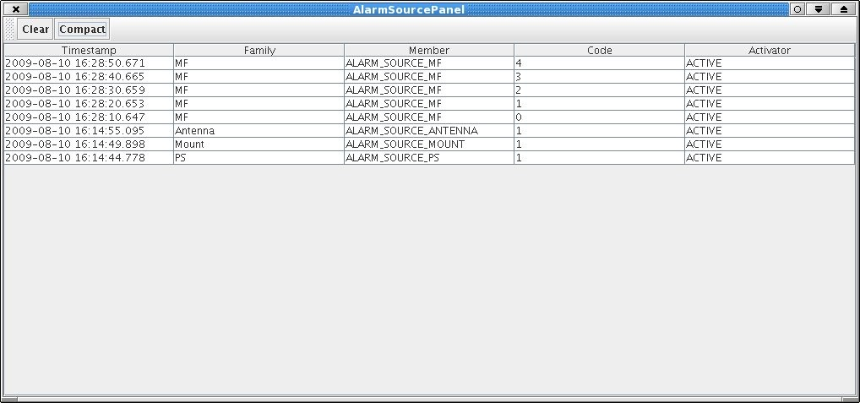
alarmSourcePanel
It is a debugging tool that listen from alarms published by sources.
ACS alarm system
UTFSM, Valparaiso, Nov 2009

Slide 38
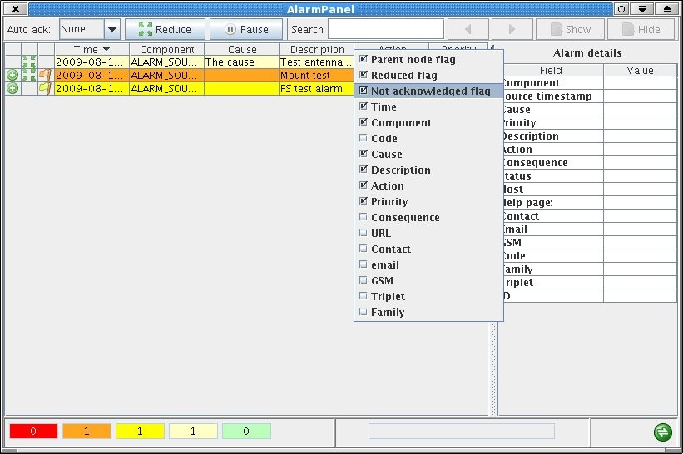
Alarm panel
ACS alarm system
UTFSM, Valparaiso, Nov 2009

Slide 39

Demo
NR demo
A (simulated) chain of alarms generated by 3 components:
PowerSupply
Mount
Antenna
MR demo:
MF component fires 5 alarms with a threshold of 3
ACS alarm system
UTFSM, Valparaiso, Nov 2009

Slide 40

References
http://www.eso.org/projects/alma/develop/acs/OnlineDocs/AlarmSystem.pdf
http://proj-laser.web.cern.ch/proj%2Dlaser/ (Laser documentation)
http://lhc-cp.web.cern.ch/lhc%2Dcp/ (LHC project)
Examples in
ACS/LGPL/CommonSoftware/ACSLaser/demo
ACS/LGPL/CommonSoftware/ACSLaser/baciPropsTest
ACS alarm system
UTFSM, Valparaiso, Nov 2009

Slide 41

ACS alarm system
Questions ?
Questions ?
acaproni@eso.org
ACS alarm system
UTFSM, Valparaiso, Nov 2009

