Slide 1





ACS Alarm System
A. Caproni^{ac}
a. ESO, European Organization for Astronomical Research in the Southern Hemisphere
b. CERN, European Organization for Nuclear Research
c. INAF-OATs, Osservatorio Astronomico di Trieste
d. COSYLAB, Control System Laboratory
ACS alarm system
UTFSM, Valparaiso, Nov 2009

Slide 2
Alarm System
The Alarm System is a messaging system that deals with abnormal situations by means of Fault States (FS):
FS collection
FS analysis and distribution
Alarm definition
Alarm archiving
The AS collects information from the environment and shows to the user what’s happening and possibly how to fix an abnormal situation in a short time.
ACS alarm system
UTFSM, Valparaiso, Nov 2009

Slide 3
ACS Alarm system
ACS comes with 2 implementations:
ACS (default)
CERN (explicitly set in the CDB)
ACS implementation logs a Alert message for each alarm (active/inactive):
Alarm sent: <AlarmSource,ALARM_SOURCE_MOUNTCPP,1> ACTIVE
Alarm sent: <AlarmSource,ALARM_SOURCE_MOUNTCPP,1> TERMINATE
jlog (with filters) shows the alarms
ACS alarm system
UTFSM, Valparaiso, Nov 2009

Slide 4
CERN Implementation
Alarms are injected into LASER, the alarm system developed at CERN for the LHA collider.
It is a messaging system: collects, stores, manages and distributes information about abnormal situations: the Fault States.
Three tiers architecture:
sources of alarms
alarm service (LASER)
alarm clients
ACS alarm system
UTFSM, Valparaiso, Nov 2009

Slide 5
CERN implementation features
sources trigger FS changes
shows only the relevant alarms (can show all the active alarms)
has the concept of authorized users
alarm must be acknowledged
stores the alarms in the database
API for different languages: C++, java, python
hierarchy of alarms to build different views
doesn’t take any action to fix a problem
ACS alarm system
UTFSM, Valparaiso, Nov 2009

Slide 6
Fault state
Each Fault State (FS) is identified by a triplet:
FS = <FF,FM,FC>
the Fault Family (FF) groups elements of the same kind
the Fault Member (FM) represents the failing instance
the Fault Code (FC) identifies the particular problem
A Fault State can be active or inactive.
Sources send fault states to the alarm service.
ACS alarm system
UTFSM, Valparaiso, Nov 2009

Slide 7
Alarm system – java API example
String faultFamily=”PowerSupplies”;
String faultMember=”PS3”;
int faultCode=100;
AlarmSystemInterface alarmSource =
AlarmSystemInterfaceFactory.createSource(this.name());
FaultState fs = AlarmSystemInterfaceFactory.createFaultState(
faultFamily, faultMember, faultCode);
fs.setDescriptor(ACSFaultState.ACTIVE);
fs.setUserTimestamp(new Timestamp(System.currentTimeMillis()));
Properties props = new Properties();
props.setProperty(...);
...
fs.setUserProperties(props);
alarmSource.push(fs);
ACS alarm system
UTFSM, Valparaiso, Nov 2009

Slide 8
C++ example
// constants we will use when creating the fault
string family = "AlarmSource";
string member = "ALARM_SOURCE_MOUNT";
int code = 1;
// Step 1: create the AlarmSystemInterface using the factory
AlarmSystemInterface* alarmSource = AlarmSystemInterfaceFactory::createSource();
// Step 2: create the FaultState using the factory
auto_ptr<FaultState> fltstate = AlarmSystemInterfaceFactory::createFaultState(family, member, code);
// Step 3: set the fault state's descriptor
string stateString = faultState::ACTIVE_STRING;
fltstate->setDescriptor(stateString);
// Step 4: create a Timestamp and use it to configure the FaultState
Timestamp * tstampPtr = new Timestamp();
auto_ptr<Timestamp> tstampAutoPtr(tstampPtr);
fltstate->setUserTimestamp(tstampAutoPtr);
// Step 5: create a Properties object and configure it, then assign to the FaultState
Properties * propsPtr = new Properties();
propsPtr->setProperty("TEST_PROPERTY", "TEST_VALUE");
auto_ptr<Properties> propsAutoPtr(propsPtr);
fltstate->setUserProperties(propsAutoPtr);
// Step 6: push the FaultState to the alarm server
alarmSource->push (*fltstate);
ACS alarm system
UTFSM, Valparaiso, Nov 2009

Slide 9
Python example
family = "AlarmSource"
member = "ALARM_SOURCE_MOUNT
code = 1
Acsalarmpy.AlarmSystemInterfaceFactory.init()
alarmSource = Acsalarmpy.AlarmSystemInterfaceFactory.createSource("ALARM_SYSTEM_SOURCES")
fltstate=Acsalarmpy.AlarmSystemInterfaceFactory.createFaultState(family,member, code)
fltstate.descriptor = FaultState.ACTIVE_STRING
fltstate.userTimestamp = Timestamp.Timestamp()
fltstate.userProperties["TEST_PROPERTY"] = "TEST_VALUE"
alarmSource.push(fltstate)
Acsalarmpy.AlarmSystemInterfaceFactory.done()
ACS alarm system
UTFSM, Valparaiso, Nov 2009

Slide 10
LASER- Business tier
asynchronously and sequentially listen for FS changes
build a complete view of each alarm
persist FS*
track and archive the FS changes
authenticate user of the clients*
reduces or masks alarms depending of:
  the status of the system
  the knowledge of the environment
FS’s are distributed into a hierarchy of domains of interest
allow the management of the FS without stopping the service*
Distribute alarms to the clients
ACS alarm system
UTFSM, Valparaiso, Nov 2009

Slide 11
Alarm details
System name
Description of the alarm
The cause of the alarm
The action to fix the problem
The consequence of the alarm
The priority of the alarm (4 priorities)
The URL with detailed information
A phone number to call
The location of the source
The name/ID of the responsible person
. . .
ACS alarm system
UTFSM, Valparaiso, Nov 2009

Slide 12
LASER - Reduction rules
The reduction rules aim to help the user to easily identify the root cause of a cascade of alarms.
The service has a knowledge of the environment by means of a set of reduction rules (CDB).
Node reduction (NR)
If a failure in the equipment A triggers a failure in another equipment, B, then the latter is reduced.
Multiplicity reduction (MR)
If the number of alarms of the same type is greater then a given threshold then these alarms are reduced and a new alarm is produced
ACS alarm system
UTFSM, Valparaiso, Nov 2009

Slide 13

Communications between the tiers
The communication between the tiers happens by means of JMS.
JMS implementation of ACS sends messages through NCs
It is possible to write clients that listen to the NC and take actions independently of the Alarm Service
ACS alarm system
UTFSM, Valparaiso, Nov 2009

Slide 14
ACS LASER structure
E₁
E₂
E₃
E₄
E₅
AS
Client_{ACS}
Source₁
Source₂
ACS alarm system
UTFSM, Valparaiso, Nov 2009

Slide 15
Categories
The AS sends each alarm to one or more categories
Each client listen for alarms from one or more categories
Categories are hierarchically organized
View of alarms
Example of views:
Operators views
Engineers views
Subsystems views
…
ACS alarm system
UTFSM, Valparaiso, Nov 2009

Slide 16
BACI properties
< FF=”BACIProperty”, FM=property_name, FC=1 >
This feature must be explicitly enabled.
An alarm is sent when the value of a property becomes lower then the minimum or higher then the maximum.
Alarm monitoring can be enabled/disabled programmatically.
A dedicated API allows to set programmatically the FF and FM of a property
The GUI shows the value of the property and its description
ACS alarm system
UTFSM, Valparaiso, Nov 2009

Slide 17
CDB configuration
CDB
MACI
alma
Alarms
Administrative
AlarmSystemConfiguration
Categories
ReductionDefinitions
AlarmsDefinitions
Default values help reducing the entries in the CDB
ACS alarm system
UTFSM, Valparaiso, Nov 2009

Slide 18
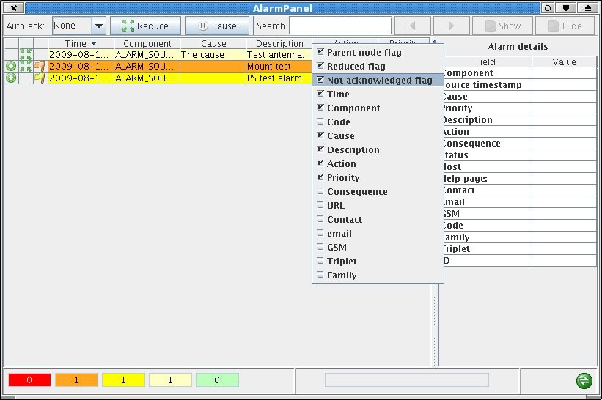
Alarm panel
ACS alarm system
UTFSM, Valparaiso, Nov 2009

Slide 19

ACS alarm system
References:
ACS Alarm system documentation
ACSLaser/demo
Questions ?
acaproni@eso.org
ACS alarm system
UTFSM, Valparaiso, Nov 2009

