Slide 1
Phishing email detection
Viviana - Ștefania Pantazică
Mihai-Alexandru Filișanu
Universitatea Politehnică București
05.11.2024

Slide 2
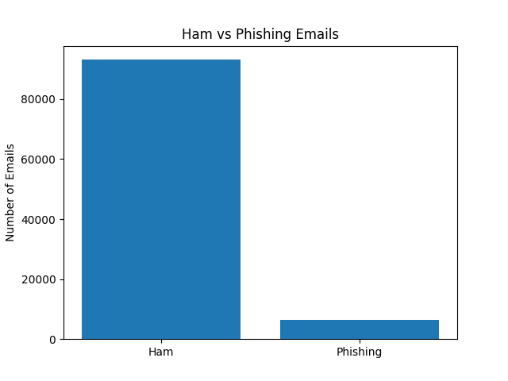
Dataset formatting
Enron Dataset
Spam Assassin Dataset
Nazario Dataset
Nigerian Frauds Dataset
Phishing
HAM

Slide 3
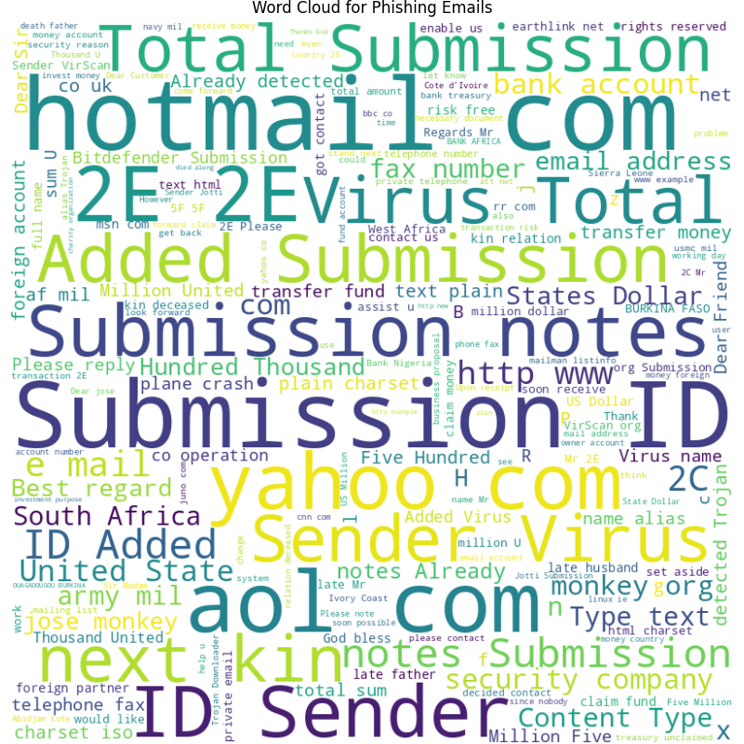
WordCloud Representation
for Phishing

Slide 4
Load & preprocess data
stopWords elimination
(nlkt.corpus + custom ones)
for email’s body
TfidfVectorizer
(from sklearn.feature_extraction.text)
LabelEncoder()
- optional - StandardScaler()
(both from sklearn.preprocessing)

Slide 5
Logistic Regression
import from sklearn.linear_model
data needs scaling beforehand
LogisticRegression(
solver='liblinear’,
max_iter=1000,
class_weight='balanced’)
Accuracy: 0.984
F1-Score: 0.868

Slide 6
2. Random Forest Classifier
import from sklearn.ensemble
data doesn’t need scaling beforehand
RandomForestClassifier(n_estimators=100, random_state=42, class_weight='balanced', max_depth=10)
Accuracy: 0.979
F1-Score:0.812

Slide 7
3. Support Vector Machine
import from sklearn.svm
data needs scaling beforehand
SVC(
kernel='linear’,
C=1.0,
random_state=42)
Accuracy: 0.981
F1-Score:0.820

Slide 8
4. CNN
auxiliary functions imported from keras
data needs label encoding
sequential:
2 Conv1D layers with ‘relu’ activation
2 Dense layers (
1 – ‘relu’ activation for 128 filters;
2 – ‘sigmoid’ activation for binary classification)
Adam Optimizer
early stopping
training for 4 epochs
Accuracy: 0.989
F1-Score: 0.921

Slide 9
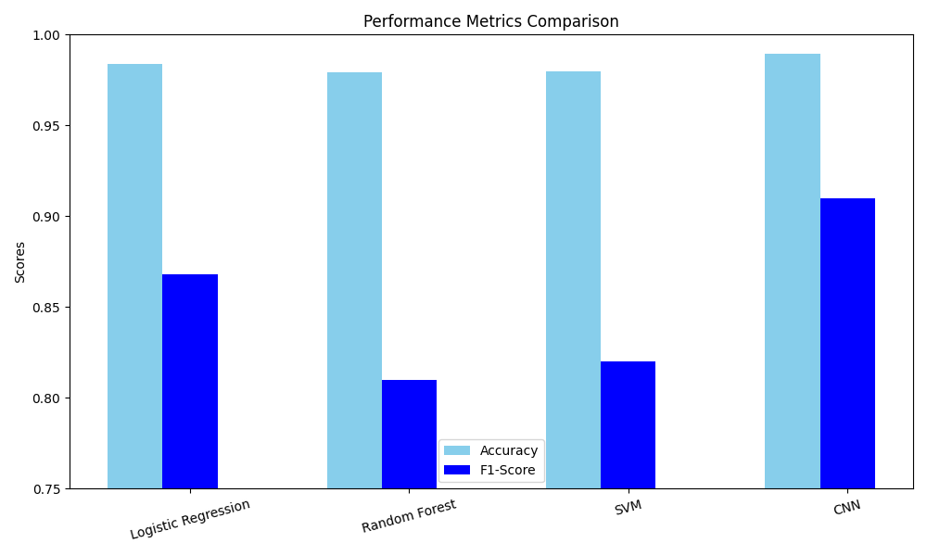
Performance Metrics

Slide 10
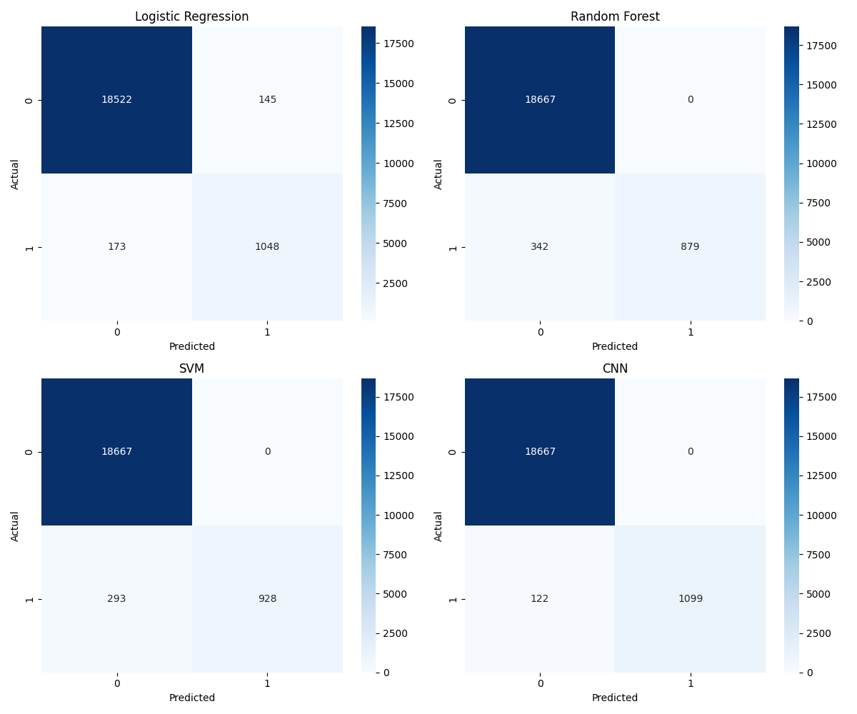
Heatmap for Confusion Matrix

Slide 11
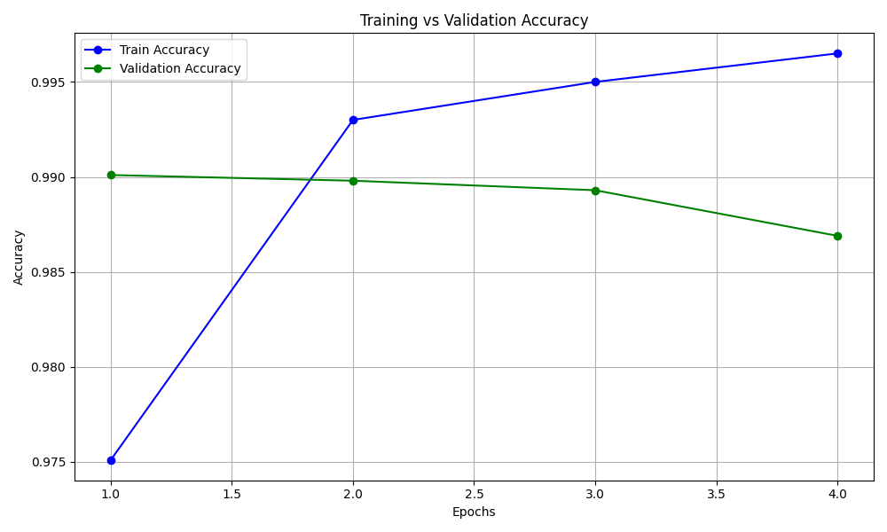
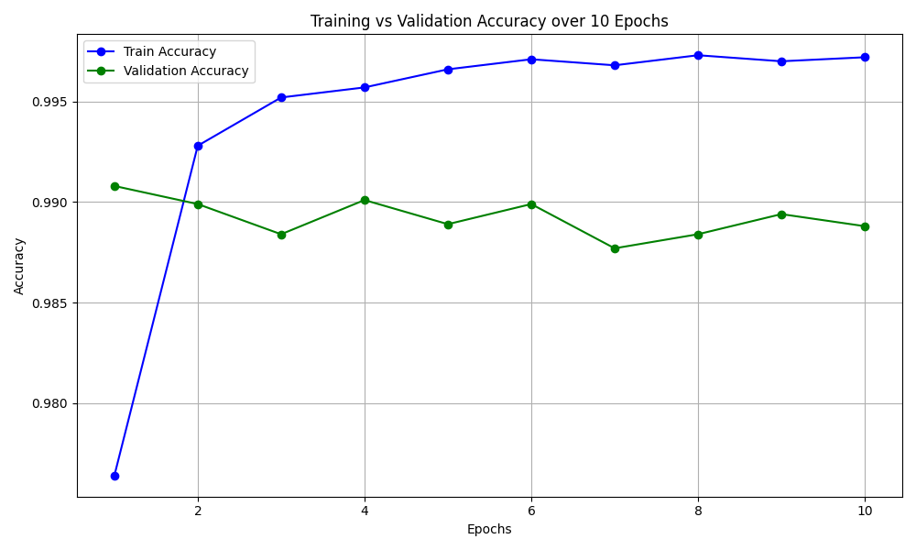
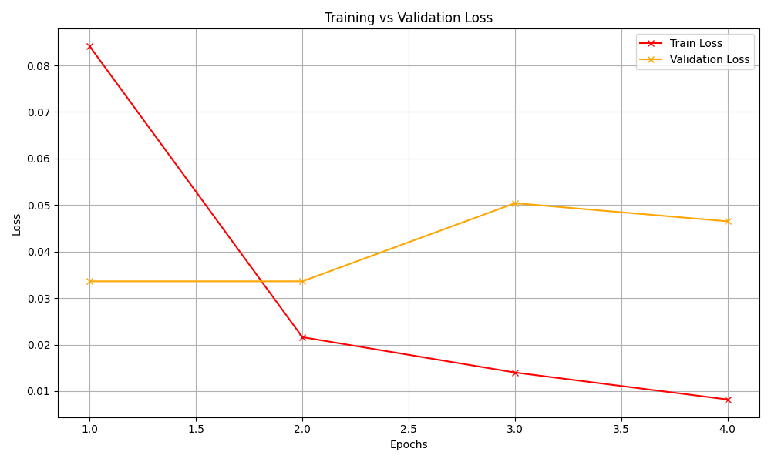
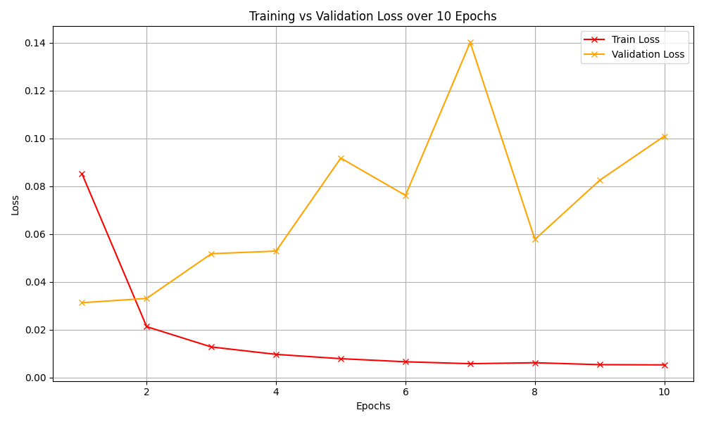
Training vs Validation Accuracy & Loss
with early stoppping
over 10 epochs

Slide 12
Conclusion
Why CNN is the Best:
Highest recall (87%)
ensures it catches the most phishing emails.
High precision (93%)
means it rarely misclassifies ham as phishing.
- Highest F1-score (92%)
balances precision and recall effectively.
Fewest false negatives (122),
which is critical in this domain.

Slide 13
Mulțumim pentru atenție!
viviana.pantazica@stud.upb.acs.ro
mihai.filisanu@stud.acs.upb.ro

