Slide 1
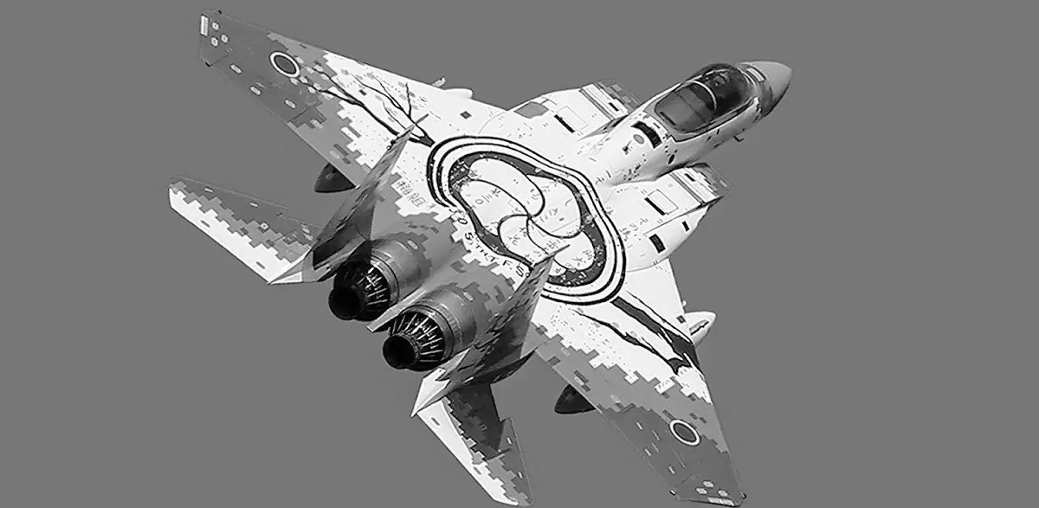
Chat gpt
Chat GPT
Coding project
Group 3

Slide 2
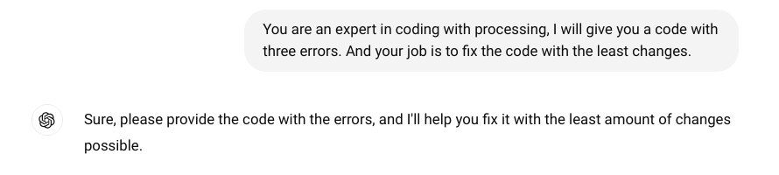
First step
In this project we used chat for coding, gave him broken code and he had to fix it.
First of all we gave him an explanation:

Slide 3
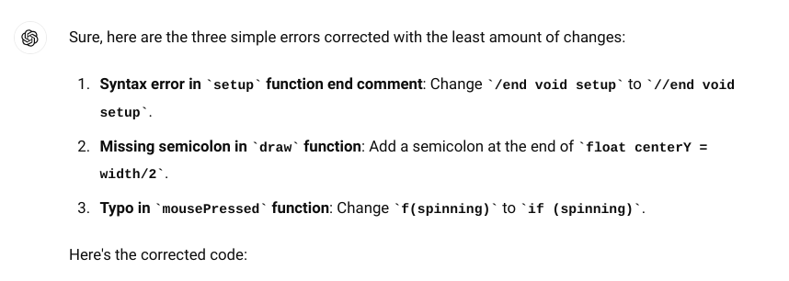
Second step
We took a roulette code as a base for an experiment and broke it a little bit.After sending code to chat gpt,he sent us this response:

Slide 4
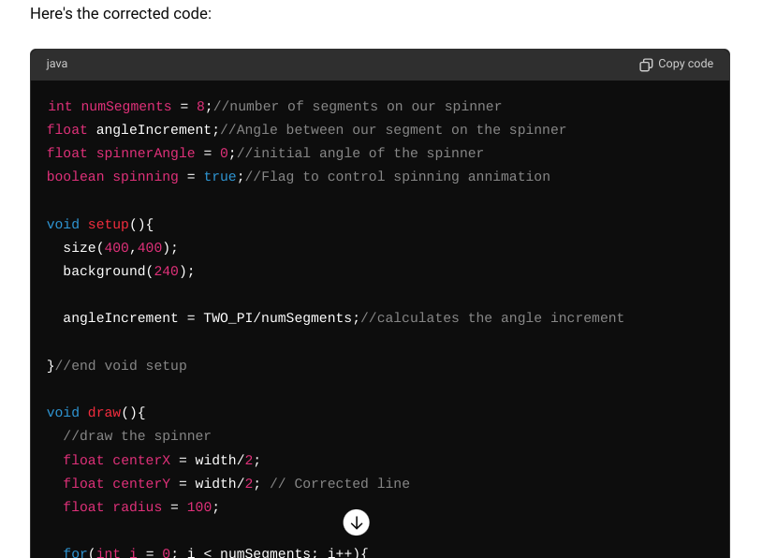
The gpt chat did an excellent job. He gave us an explanation of our errors and a fully working code.

