Slide 1

Learning Java
by Ram Etwaroo
Listen

Slide 2
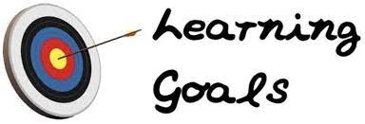
Learning Goals
Java
I will be talking about:
Why Java?
Choosing an IDE for Java
Differences between Python
and Java code
OOP in Java
Conclusion (overall)

Slide 3
Source code to machine code
Machines cannot understand source code
Compiler: a tool/program that converts source code into machine code
All programs of coding (Scratch, C, C++, Python, Java, etc.) will output the same thing even though the source code looks different
Example: Hello World!
Notes:
Recall that machines only understand machine code. We as programmers write source code in a language understandable by humans.
Therefore we need tools to convert the source to machine code. So we start by talking about the tools needed to convert source code to machine code.
So, for example, I want to do “Hello, World!”. I could do it in Scratch, C, C++, Python or Java and the output will be the same.
All programs of coding (Scratch, C, C++, Python, Java, etc.) will output the same thing even though the source code looks different.
Basically, we can write our program in any language. Let’s choose Java. Why Java? Why do I want to learn Java?

Slide 4
Why Java?
Notes:
Let’s choose Java. Why Java?

Slide 5
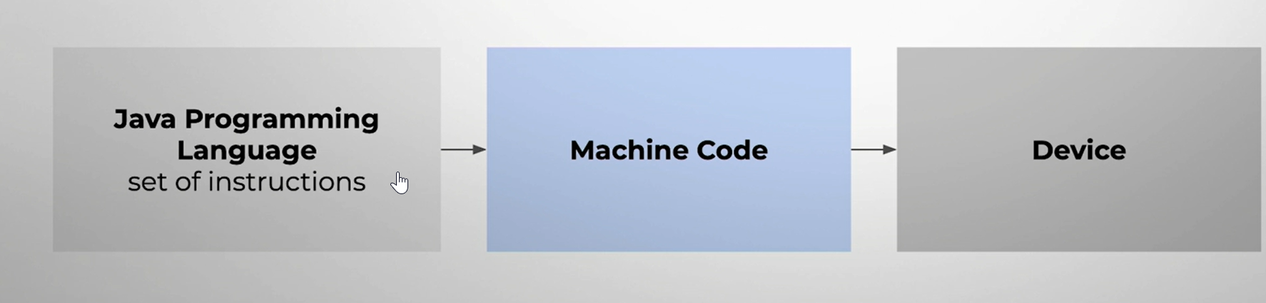
“Write once, run anywhere”
Java is an OO programming language.
Java is multiplatform: all platforms (including Microsoft and Windows) with a Java Virtual Machine (JVM) can run Java.
Notes:
Why Java?
“Write once, run anywhere”.
Java is a pure OO language.

Slide 6
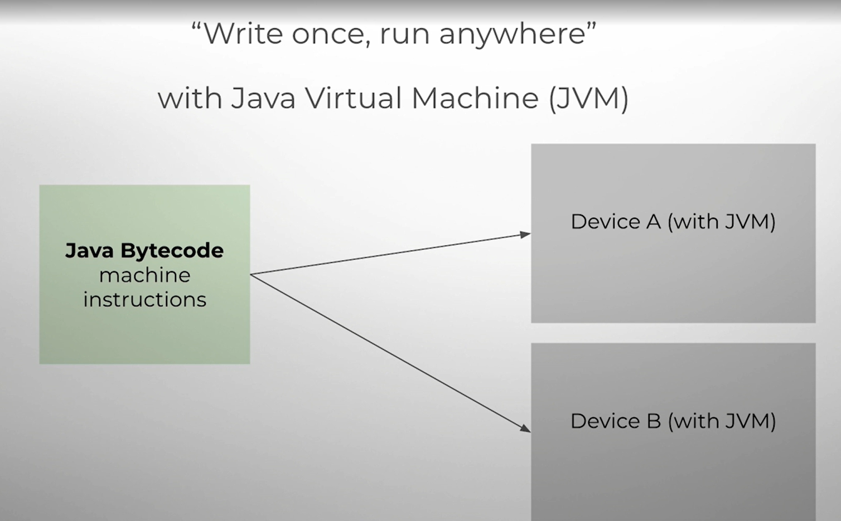
Java
You can write a source code in Java and expect it to run everywhere!
This is why Java is one of the most preferred programs to use.
Notes:
Why Java?
“Write once, run anywhere”.
Java is a pure OO language.

Slide 7
Difference between Java code and bytecode

Slide 8
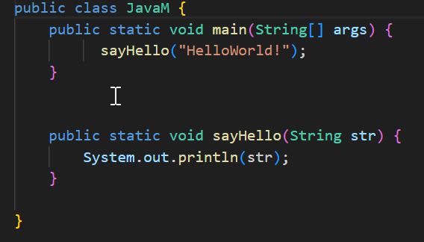
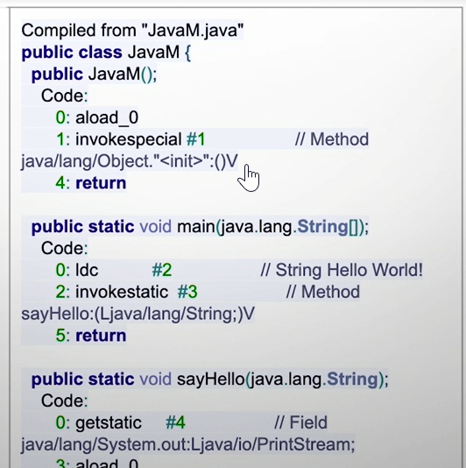
Java code vs bytecode
Bytecode is between source code and machine code and will need an interpreter to convert to machine code
Notes:
On the left is Java code. On the right is what the bytecode looks like. Obviously, we will not explain any of this. What we are doing here is simply showing what bytecode looks like. Notice that bytecode is not machine code, that is, not binary code. Bytecode is human readable.

Slide 9
Choosing an IDE for Java

Slide 10
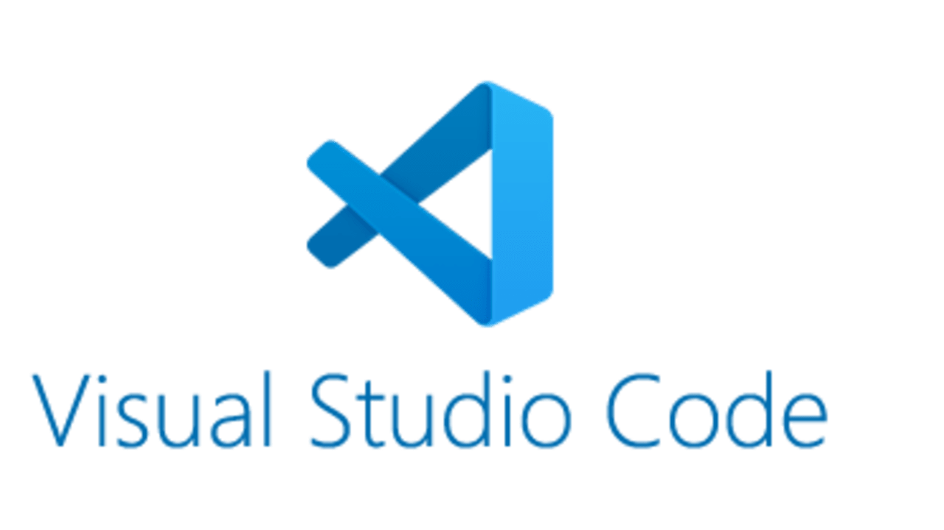
Choose an IDE
An IDE (integrated development environment) is a software application that helps a programmer to efficiently develop software codes
Notes:
Gotcha! Does it include the JDK (Java Development Kit)? When choosing an IDE to do Java programming, you need to be aware of whether the JDK is included or not. Or simply choose an IDE that you are familiar with, such as Visual Studio Code

Slide 11
Differences between Python and Java code

Slide 12

Hello, World!
Notes:
So let’s see “Hello, World!” in Python. We did this program in course so you know how it works and you know this Python code.

Slide 13
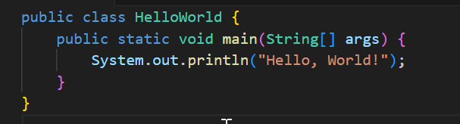
Hello, World!
Notes:
So let’s see “Hello, World!” in Java

Slide 14
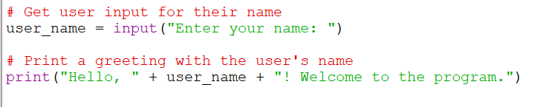
What is your name?
Notes:
Let’s see a simple program “What is your name?” in Python. We have written Python programs like this in this course so there is no need for any explanations of this code. You know it already.

Slide 15
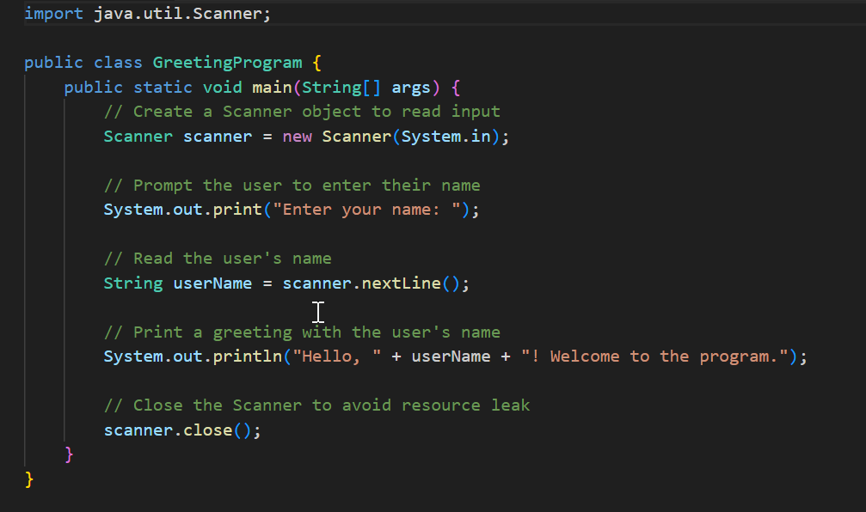
What is your name?
Notes:
Let’s see “What is your name?” in Java.
See the difference between Python code and Java code? What are the differences that you see?

Slide 16
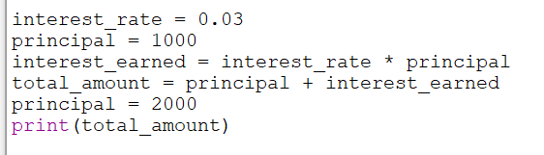
Variables: Operations and Input/Output
Notes:
Here is the slide from our lessons showing how variables are written in Python. This is a slide from our lessons, you know this slide so it needs no explanations. As you may recall from the lectures in our course, Python does dynamic typing of variables. As you can see here, we do not need to specify the type of variable. Python dynamically assigns the type of variable based on the value assigned to it.

Slide 17
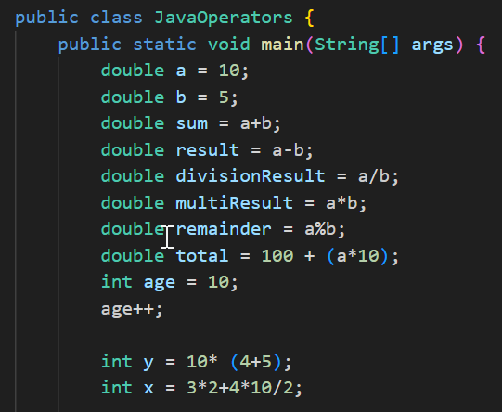
Variables: Operations and Input/Output
Notes:
Here is a slide that shows how variables are written in Java. In Java the type of the variable must be declared before a value can be assigned to it. Contrast this with Python which does dynamic typing of variables, as we saw previously.
The examples we see here is how variables are declared in Java. The type of the variable must be specified first then the variable is given a name. Here we see the variables declared and initialized at the same time. So the variable is declared and defined here at the same time.

Slide 18
Data types
Python: primitive and compound data types
Java: primitive data types only
Python: dynamic typing
Java: static typing
Notes:
Python has primitive and compound data types. We learn this in this course. List is a compound data type that we learnt in this course. Do you remember what are the primitive data types in Python? (Answer: int, float, bool)
Java has primitive data types only. Everything else exist as classes. So lists are a compound type in Python. In Java lists are not a part of the language. Instead lists must be implemented as a class, the same as every other class.
We already explained that Python has dynamic typing of variables, meaning that Python dynamically assigns the type of variable based on the value assigned to it. In contrast, In Java the type of the variable must be declared before a value can be assigned to it. The type of the variable must be specified first then the variable is given a name. So the type of the variable must be known when the code is first compiled. So that the compiler can check the type of the variable. This is what static typing of variables mean.
This means that in Java the compiler can check for errors or bad code at compile time before the code is compiled and run. This results in more robust and error free code but it takes more time and work to write Java code. Python dynamically assigns the type of the variable for the programmer so that writing Python code can take less time and require less work but it is also easier to have bugs in Python code, unless the programmer is diligent. Java forces the programmer to be diligent about the type of the variable when writing code.

Slide 19
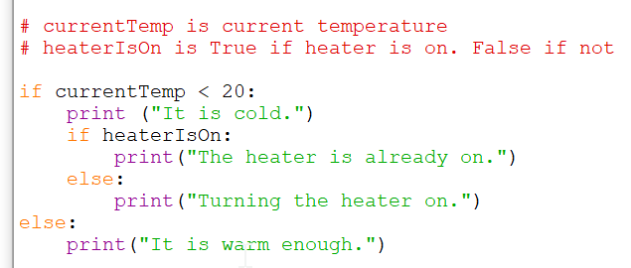
Conditional statements
Notes:
Here we see conditional statements in Python. This is a slide from the lessons in this course so we need no explanations for this.

Slide 20
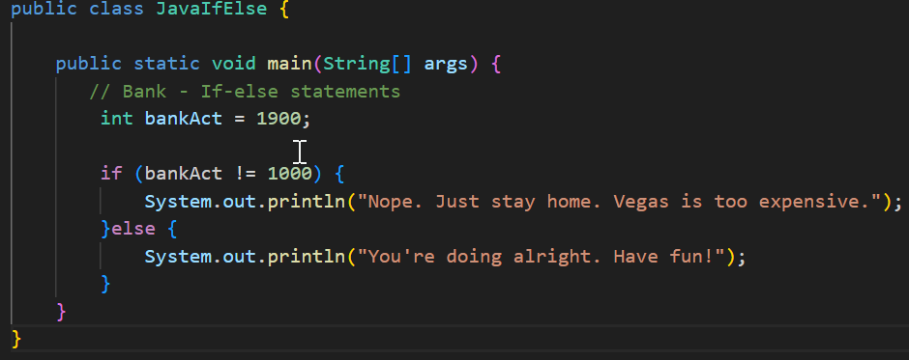
Conditional statements
Notes:
Here we see conditional statements in Java. Notice that how we write conditional statements in Java is similar to how we write conditional statements in Python. But notice unlike Python, all statements must be a part of a method. Statements in Java must be a part a class, unlike the statements in Python we saw earlier.
This is an example of how some of things we learn about writing Python code is useful when we are learning to write Java code.
This is also an example of how some of programming skills you learn can be transferred to learning another programming language.

Slide 21
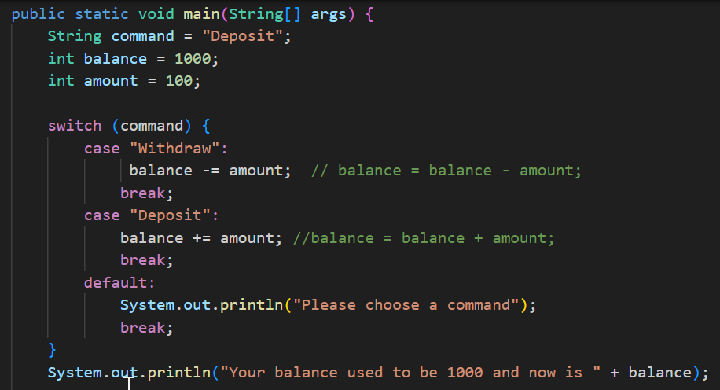
Conditional statements
Notes:
Here is a switch statement in Java. Python does not have a switch statement. This is an example of when one language can have features that another languages does not have.

Slide 22
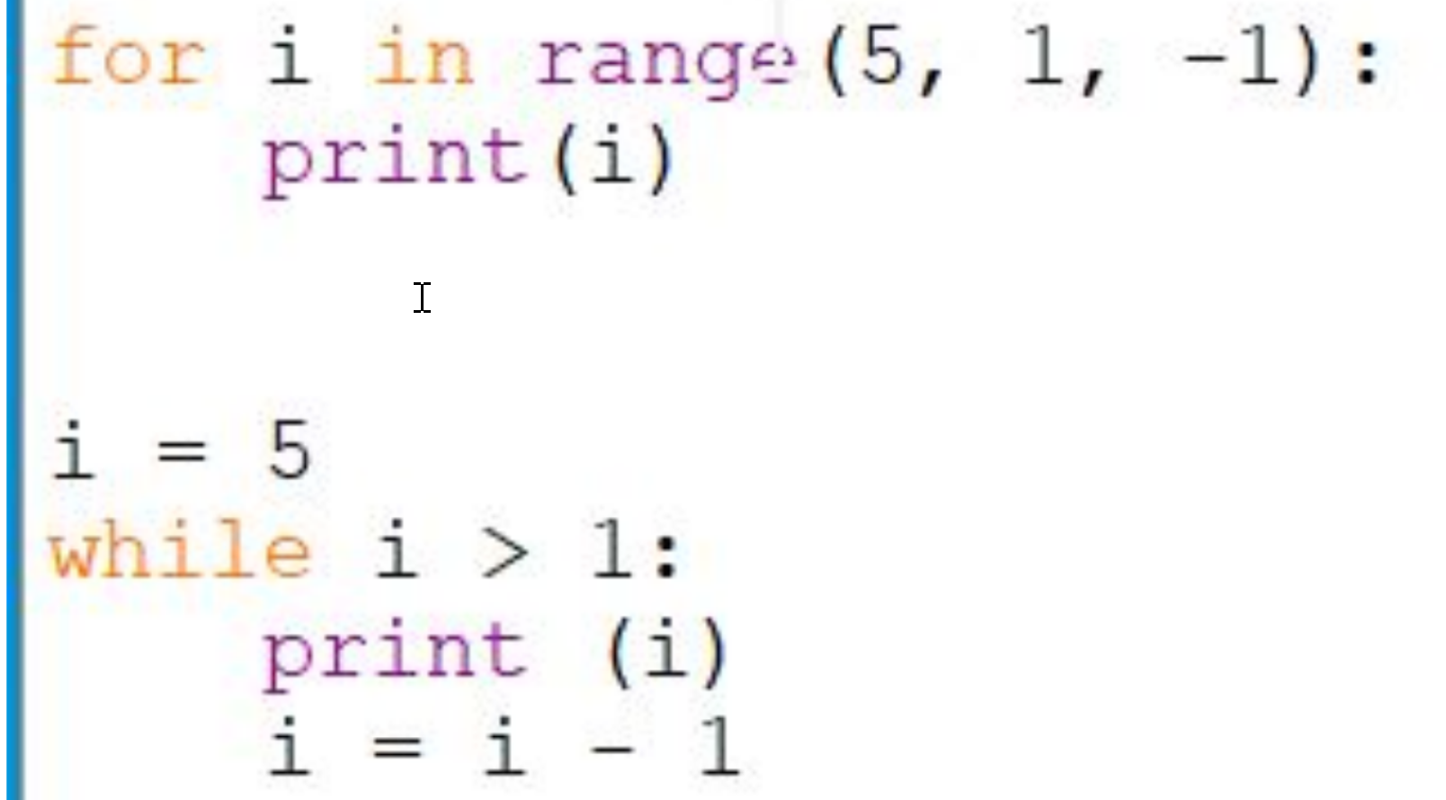
Loops and Iterations
Notes:
We learned about loops and iterations in this course so this needs no explanations. We have examples here on Mr.Ram’s chalkboard in the classroom.

Slide 23
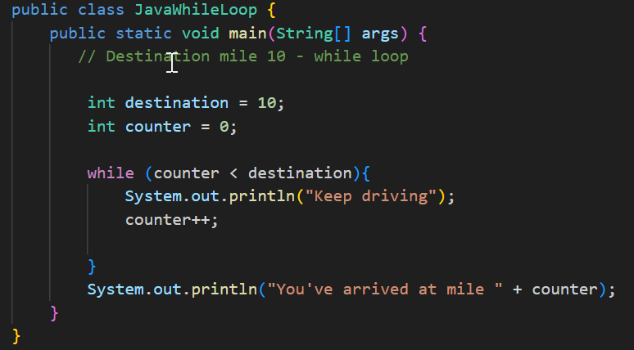
Loops and Iterations
Notes:
Obviously, Java has loops and iterations similar to Python.
Here we see an example of a while loop in Java. Notice that how we write while loops in Java is similar to how we write loops in Python. But notice unlike Python, all statements must be a part of a method. Statements in Java must be a part a class, unlike the statements in Python we saw earlier.
This is an example of how some of things we learn about writing Python code is useful when we are learning to write Java code.
This is also an example of how some of programming skills you learn can be transferred to learning another programming language.

Slide 24
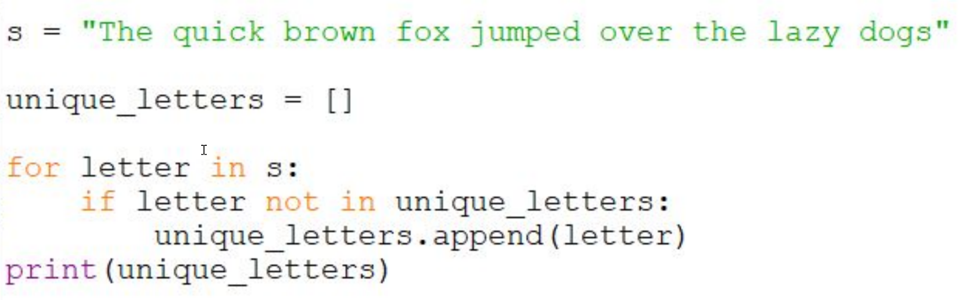
Lists in Python, Arrays in Java
Notes:
We learned about lists in Python so this needs no explanation.
We learned that lists are one of the programming features that Python supports particularly well. Python makes it very easy to create lists and do all sorts of things with them.

Slide 25
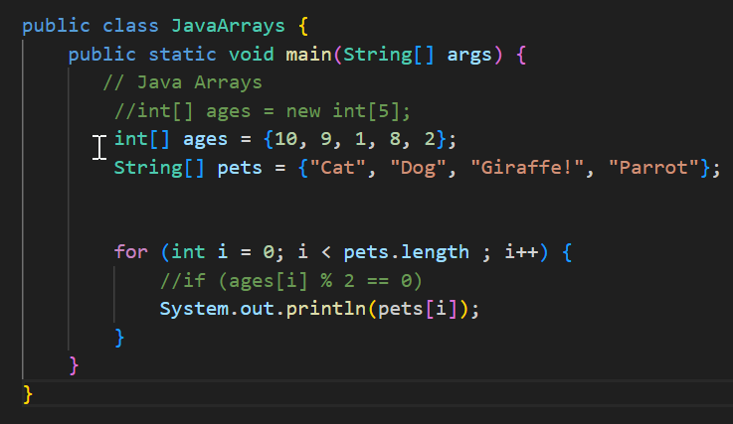
Lists in Python, Arrays in Java
Notes:
Here is an example of an array in Java. In Java, arrays are more commonly used, in contrast to lists being more common in Python.
As we learned in this class, Python has a more generalized list, with “array” being used to refer to only one specific type
of memory-efficient list.

Slide 26
OOP - Java

Slide 27
OOP - Java
Java is a pure OOP language.
C++ an OOP language but C++ is also procedural to allow backward compatibility to C.
Python is a procedural language that has OOP features.
Notes:
Java is a pure OOP language. C++ an OOP language but C++ is also procedural to allow backward compatibility to C. Python is a procedural language that has OOP features.

Slide 28
Standard Library
Standard Library - C and C++
Standard Library - Python
Java Class Library - Java
Notes:
C and C++ has a standard library, Python has a standard library whereas Java has a Class Library. This again show that Java is a pure OOP language whereas the other languages are not pure OOP language.
In fact, we know that C is a pure procedural language, C++ is OOP language but is also a procedural language and so is not a pure OOP language. Python is a procedural language that has OOP features.

Slide 29
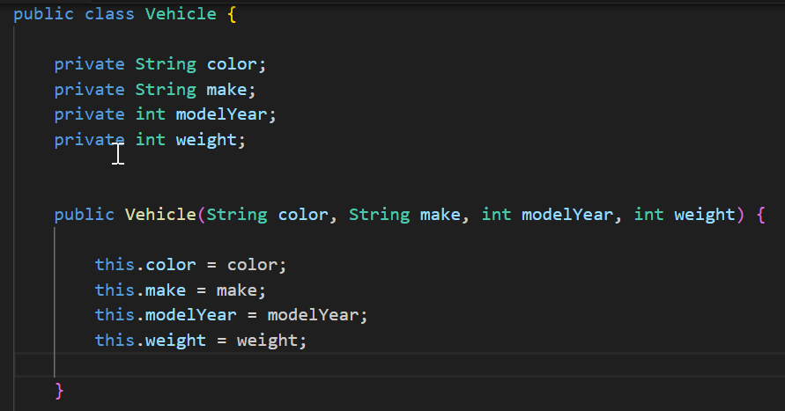
Classes
Notes:
Similar to Python, we use the keyword class to define a class in Java. And everything is encapsulated in the class: the attributes and methods. In Java, these are called fields and methods. In Python, everything in the class definition is indented. In Java, everything in the class definition is within curly braces.
As we learned from our lessons, we use indentation in Python code. As we can see here, we use curly braces and semicolons in Java code.
Next, notice that the fields in the Java class definition must have a type specified in the same manner as variables. Similar to attributes in a class definition in Python, fields in a class definition are like variables. In C++, these are called member variables. Do you see the connection?
Next, notice that in Python we use the keyword self to refer to the self object, that is, the current instance of the class, or this object. In Java and C++ we use the keyword this.
Next, notice the keywords public and private. The use of the keywords public and private in the definitions of the fields and methods in Java is how encapsulation works in Java.
Related to this is the concept of information hiding. The use of the private keyword in the definition of the fields and methods means that they are not accessible from outside the class, that is, they are hidden and private to the class. The use of the public keyword public in the definition of the methods makes the methods public and so they can be called from outside the class.
Related to this is the concept of visibility. The keyword private means that it is not visible from the outside of the class, public means visible from the outside.
Notice the constructor method in Java. The constructor is the method with the same name as the class.
In Python, we write an __init__(self) method that initialize the object and the use of the keyword self.
(We do not talk about constructors in Python).

Slide 30
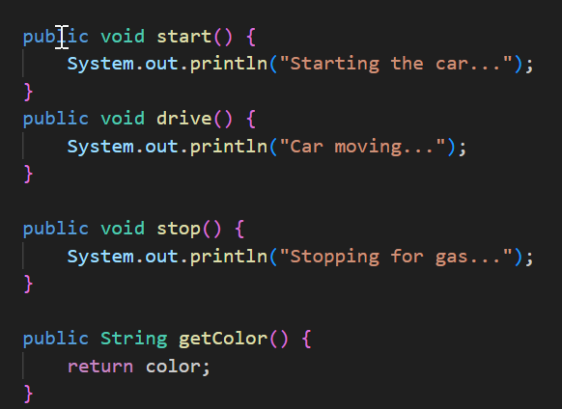
Methods
Notes:
Next, notice how methods are defined in Java.
Notice that the methods must have a return type specified in the method definition.
Notice that the methods must have the visibility of the method specified. Here we see the methods are defined as public. Methods are usually public since the methods must be called on the object. So as we see here, in the class definition, the method is defined as public.

Slide 31
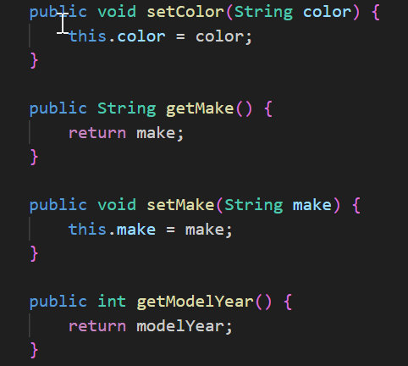
Encapsulation
Notes:
Next, notice the use of setter and getter methods in Java in these next slides.
We learned about setter and getter methods in this course. As we learned in this course, the use of setter and getter methods is not required in Python. Why is that? Because Python does not do encapsulation and information hiding the way Java does.
Java is a pure OOP language. Java enforces information hiding and encapsulation through the use of the private and protected and public keywords. And therefore as we see here, getter and setter methods are required in Java.
(We did not talk about the protected keyword and we will not talk about it).

Slide 32
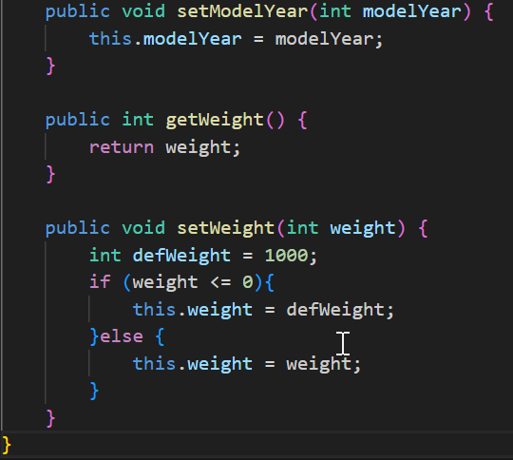
Encapsulation
Notes:
No notes here - as said on the previous slide.

Slide 33
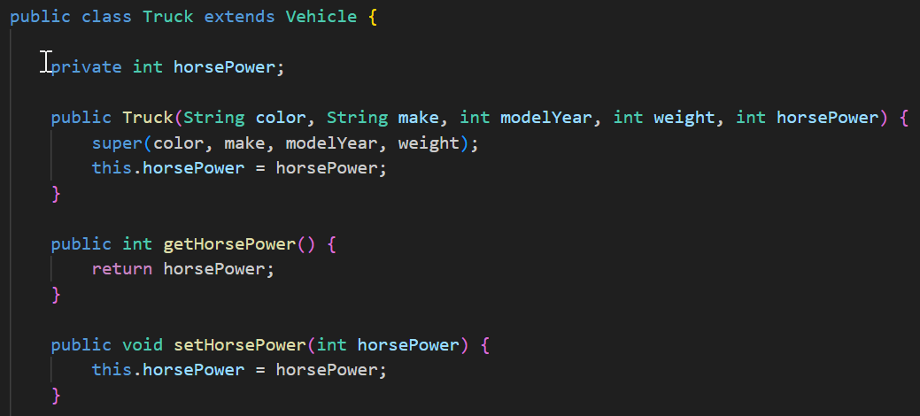
Inheritance
Notes:
Here we see inheritance in Java.
As we learned in the lessons on Python, inheritance in Python is specified by writing the name of the parent class in parenthesis in the definition of the child class.
Notice the way it is done in Java, by the use of the keyword extends as we see here. So Truck extends Vehicle means that Vehicle is the parent class of Truck. So Truck is a child of the class Vehicle.
Notice the constructor method in Java. The constructor is the method with the same name as the class.
Notice the call to the parent constructor by calling super.
In Java, the super keyword is used to refer to the immediate parent class object.
In Python, we write an __init__(self) method that initialize the object and the use of the keyword self.
(We do not talk about constructors in Python).
Similarly in Python, we do super().__init__(self) to call the init method of the parent class.
Notice again the use of the keyword this in Java. Worth repeating, we learned about the keyword self in Python, equivalent to this in Java and C++.

Slide 34
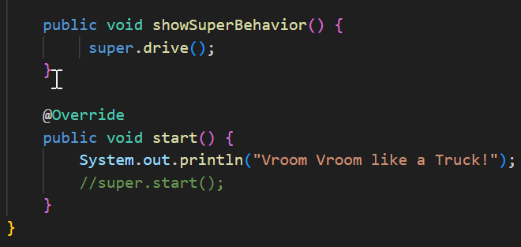
Polymorphism
Notes:
Notice how polymorphism is done in Java. The method start in the child class Truck has the same name start as in the parent class Vehicle. So the start method in the child class Truck overrides the start method in the parent class Vehicle. This is polymorphism. The word polymorphism means the same form. As we see here, the two methods have the same name but different behaviour. The behaviour of the start method in the parent class is different from the start method in the child class.
~~~~~~~~~~~we will not be talking about this, only if someone asks the question ~~~~~~~~~~~~~~~~~~~~~~~~~~~~~~~~~~~~~~~~~~~~~~~~
In Java, the @Override annotation is used to indicate that a method in a subclass is intended to override a method declared in its superclass. When a method is marked with @Override, it informs the compiler that you expect the method in the subclass to override a method with a similar signature in the superclass.
The @Override annotation is optional, but it helps catch errors during compilation. If there's a mistake in the method signature (e.g., a typo or incorrect parameter types), the compiler will generate an error, letting you know that the method in the subclass is not correctly overriding a method in the superclass.
Using @Override is considered good practice because it enhances code readability and helps prevent accidental errors when dealing with method overriding.

Slide 35
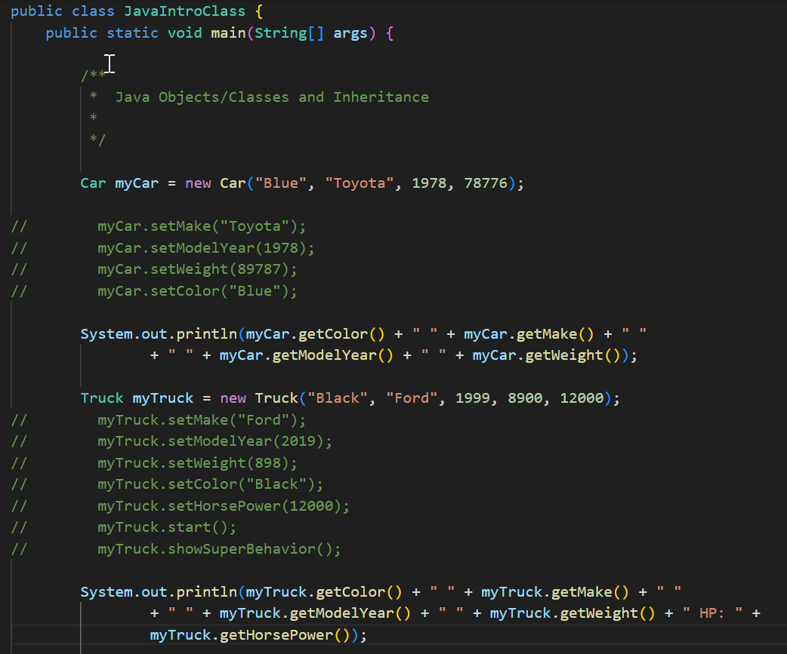
Objects
Notes:
Finally, similar to how it is done in Python, here we see how we create objects in Java, call the methods of those objects and set the values of the fields of those objects in Java.
This is similar to how we create objects in Python, call the methods of those objects and set the values of the attributes of those objects in Python.

Slide 36
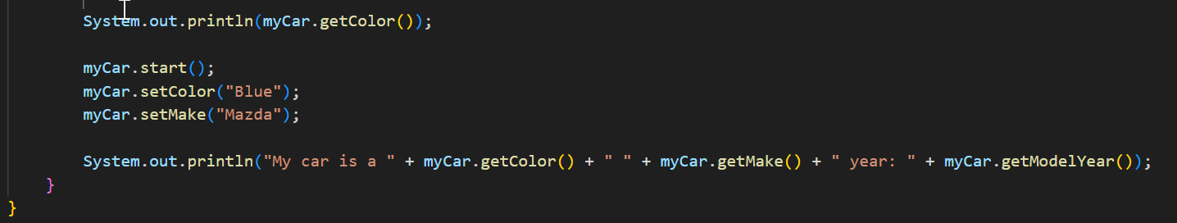
Objects
Notes:
No notes here - as said on the previous slide.

Slide 37
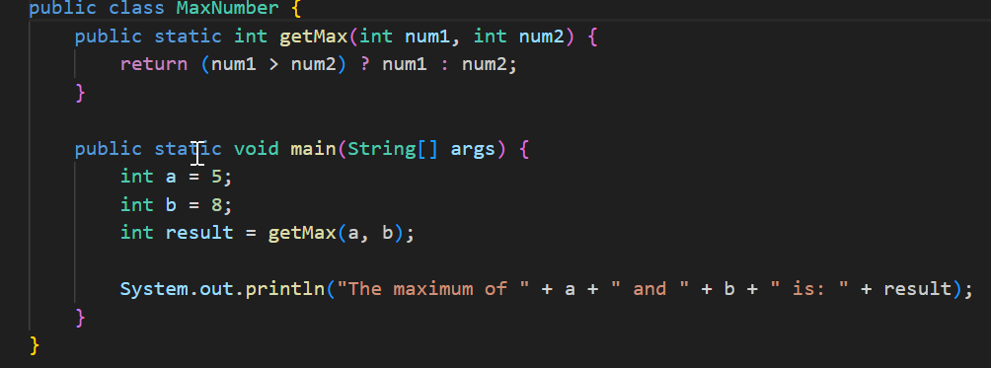
Functions in Java?
Notes:
We saw functions in Python. What about functions in Java? No, Java does not have functions. Java only has methods. Recall that Java is a pure OO language. What we see here is a static method in Java. Static methods in Java behave like functions in the sense that we do not need to create an object to call the method. Yet notice that even a static method must be contained in a class.

Slide 38
Conclusion
Java: pure OOP program
Python and Java are different programs
Notes:
Java is a pure OOP programming language that can run on any platform with a JVM.
Python is a dynamic programming language, making things more simple and easier to understand for humans
Java is a static programming language, making things more complicated looking but easier to access from most platforms as it is a multiplatform program

Slide 39
END of SECTION
END of SECTION

