Slide 1
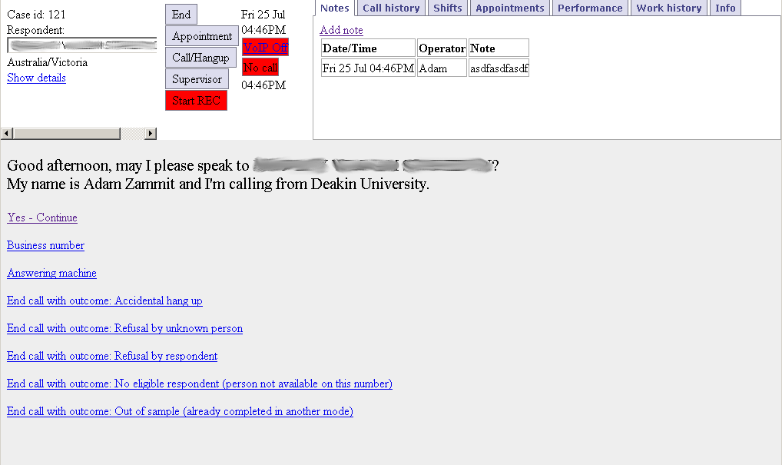
queXS

Slide 2
queXS: 5 sections

Slide 3
Respondent section

Slide 4
Respondent section
Respondents' name
Respondents' time zone
Click for details about the respondent

Slide 5
Action section

Slide 6
Action section
Click END to end the case or end work
  End case: close this case and bring the next one
  End work: close this case and stop work or take a break
Appointment
  Schedule an appointment
Call/Hangup
Supervisor
  Calls the supervisor on your current call
Start REC (record this call)

Slide 7
Status section

Slide 8
Status section
Displays time and date in facility time
VoIP (headset) status
  If red, click to turn on VoIP
Call Status
  (No call, requesting, ringing, answered)
APPT
  On an appointment
MISSED
  Missed a previous appointment
Time at the bottom is time for the respondent

Slide 9
Information section

Slide 10
Information section
Notes
  Leave and read notes about this case
Call history
  A list of all calls made for this case
Shifts
  A list of shifts in the future for this project
Appointments
  A list of future appointments for this case
Performance
  All interviewers performance (completions p/h)
Work history
  A list of all the cases you have called in the past
Info
  Information about this project

Slide 11
Questionnaire section

Slide 12
Questionnaire section
Displays respondent selection script
Displays links for common outcomes from the current script
When respondent accepts interview, displays the questionnaire script

Slide 13
Placing a call: Example
Click on the “Call/Hangup” button

Slide 14
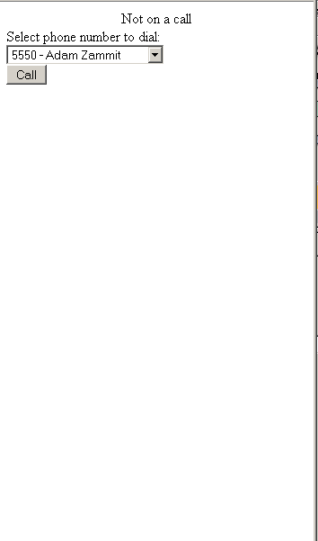
Placing a call: Example
The call screen will appear.
Select a number and click the “Call” button.

Slide 15
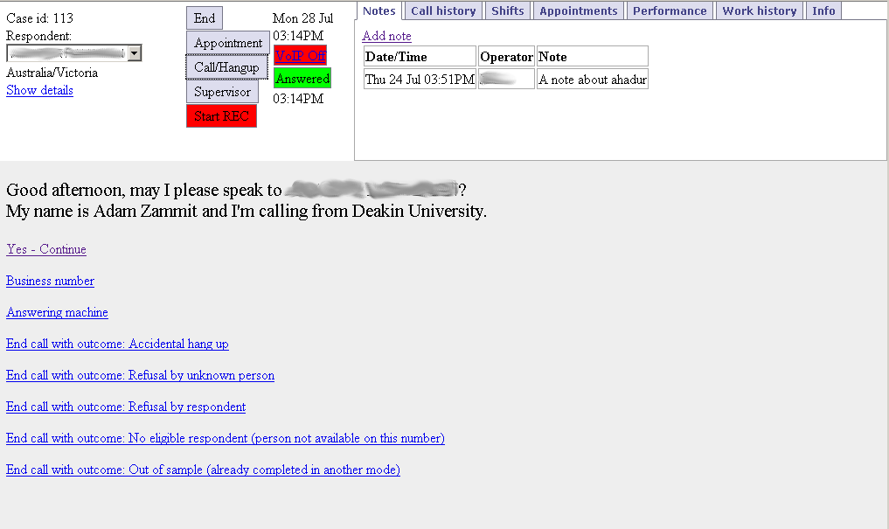
Placing a call: Example
Notice the status will change to “Requesting” then
Ringing” then “Answered” if someone picks up
Once answered and the script read out, click on “Yes – Continue” if the person is the one you are after

Slide 16
Placing a call: Example
If the respondent agrees to continue, click on “Yes – continue” to see the questionnaire
If the respondent refuses, click on the outcome on the list here, or on the “Call/Hangup” box

Slide 17
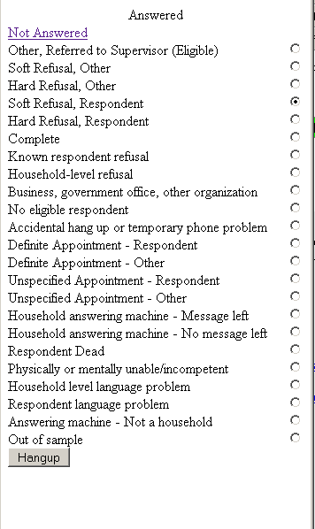
Placing a call: Example
The call screen will appear.
Select the relevant outcome if not already selected from the list, then press “Hangup” to end the call

Slide 18
Placing a call: Example
You will now be back at the main screen – select “Call/Hangup” to see if there are any numbers left to call

Slide 19
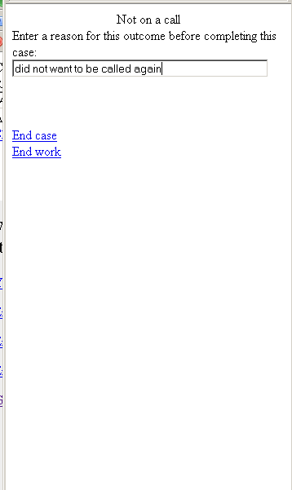
Placing a call: Example
As we had set the outcome to be a “Refusal” we will not call this case again. Therefore this screen will appear. You will need to enter a reason for the refusal. Once this is done, select “End case” to move on to the next case, or “End work” if you need to finish work or take a break

Slide 20
Schedule an appointment: Example
When on a call and an appointment needs to be scheduled. Click on the appointment button

Slide 21
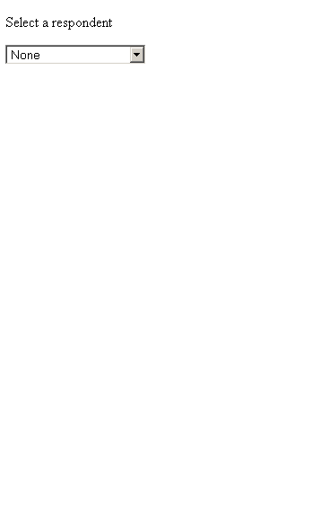
Schedule an appointment: Example
The appointment screen will appear. Select a respondent from the list of available respondents

Slide 22
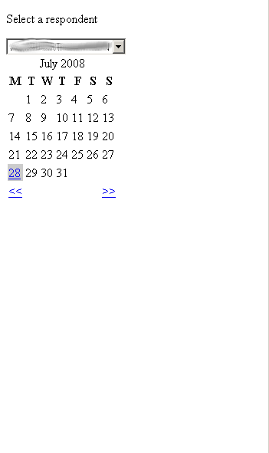
Schedule an appointment: Example
Now select a date by clicking on an available day of the month. You can use the arrow links to change months.

Slide 23
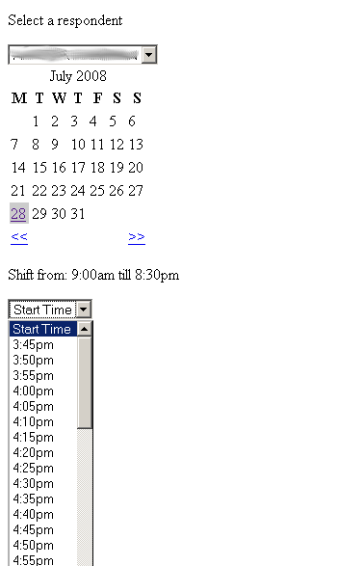
Schedule an appointment: Example
The shift times for this day will appear
Now select a start time for the appointment, then an end time

Slide 24
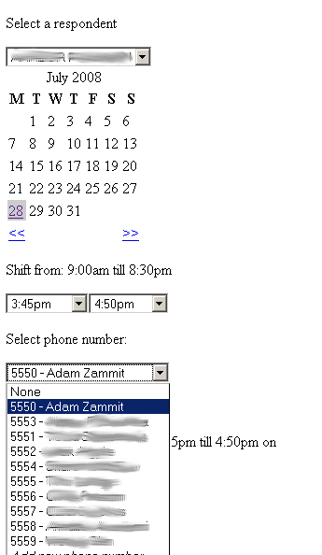
Schedule an appointment: Example
Now select a telephone number for this appointment, or select “Add new number” to add a new number to call the respondent on for this appointment

Slide 25
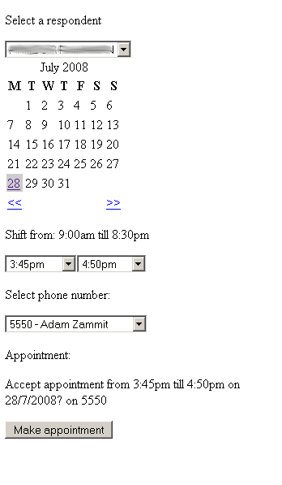
Schedule an appointment: Example
Once the appropriate time and number have been selected, press “Make appointment” to make the appointment in the system. You will be returned to the main screen

