Slide 1
CARDAT IT overview
by Christy Geromboux

Slide 2
CARDAT technology overview
Centre for Air pollution, energy and health Research (CAR) Data Analysis Technology (DAT) is a collection of IT infrastructure that enables easy data sharing and reuse, and reproducible data analysis.
the CAR Data Inventory (a catalogue of available datasets and their associated metadata records,
a cloud based file store (CloudStor) which enables shared access to datasets, and the ability to sync data automatically
an online platform for data analysis (CoESRA) which provides a secure environment for reproducible, collaborative data analysis.
CAR is an NHMRC funded Centre of Research Excellence (CRE) funded from 2017 to 2021.

Slide 3
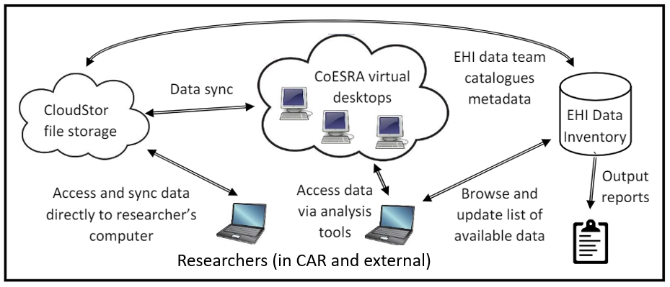
An overview of the technology

Slide 4

Data discovery and acquisition
Data analysis
Outputs
Cloudstor
Restricted and general datasets
CoESRA data analysis platform
Output
Restricted?
No
Yes
OR
Request permission from data owner
Data Inventory of available datasets
Analysis done on work /personal computer
Policy
Researcher
Collaborator

Slide 5
Why use CoESRA
No need to synchronise or download large dataset locally.
Your analysis environment can be configured.
It provides an easy way to work collaboratively on the same files, even across organisations.
There are a range of pre-installed technologies for manipulating data (preventing issues with versions and software dependencies).
Data analysis can be done in a reproducible and transparent way.

