Slide 1
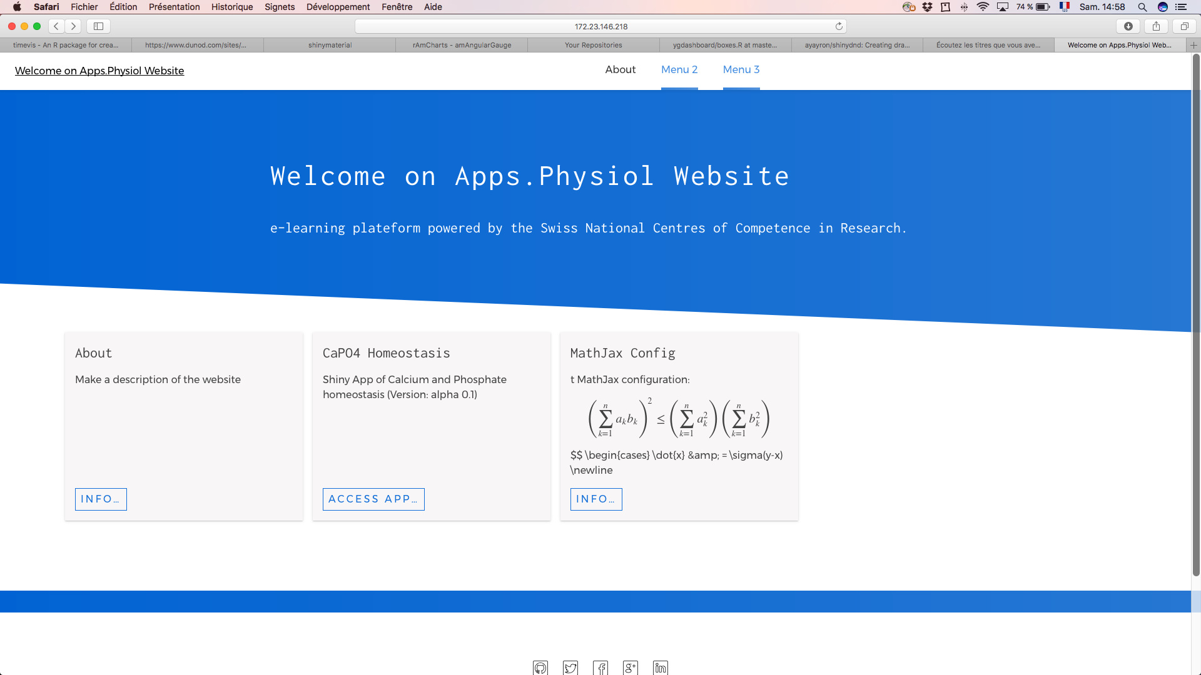
Create menus here
Each App will be accessible in this part
Click here to launch the CaPO4 App
Add NCCR Logo, UZH logo, …

