Slide 1
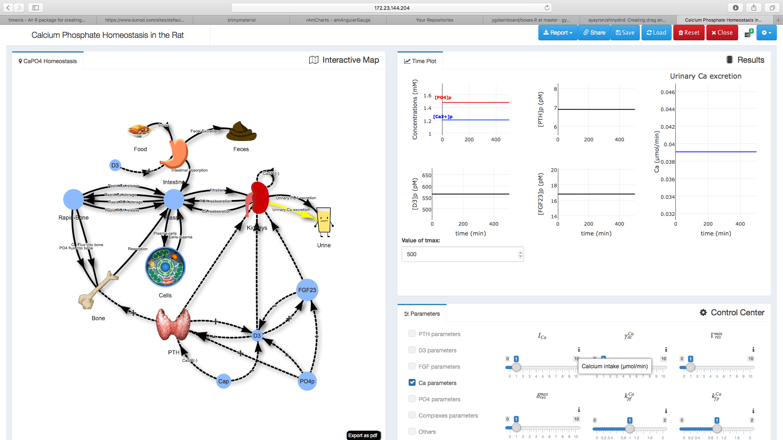
(4) Application
(2) Graph Display
(1) Main Area: interactive diagram
Change the maximum time of simulation (only for alpha version)
(3) Parameter control
-Click on edge to display the related flux in the results part (if available)
-Click on a node to display the related concentration or quantities

