Slide 1
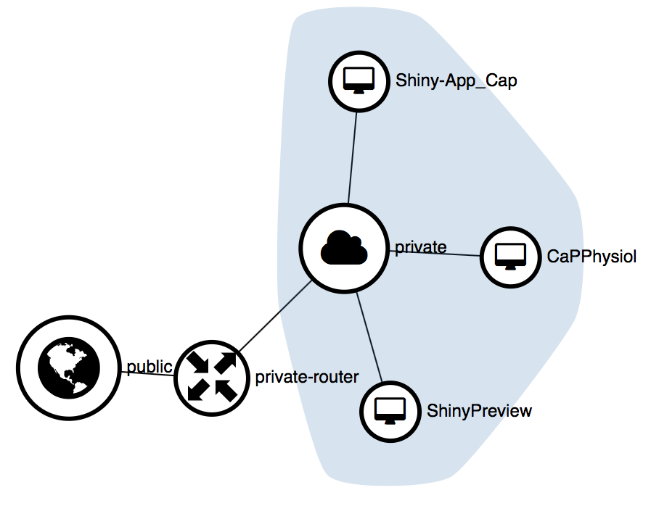
Server running all shiny apps
Web server containing all apps but not the latest development version
130.60.24.78
Latest development version
130.60.24.77:3838/global_app_V2.1
url to enter in the web browser

