Slide 1

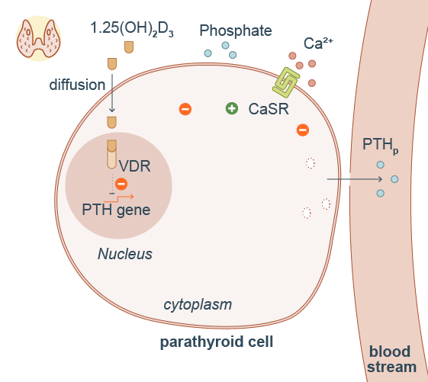
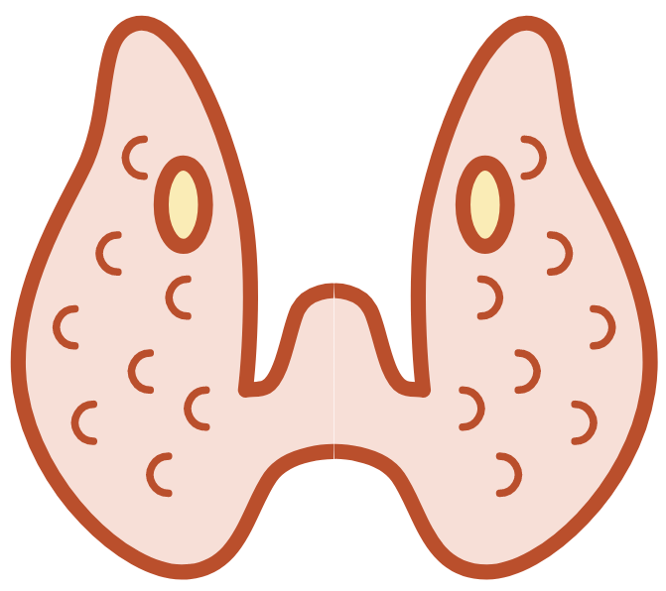


Parathyroid hormone is synthetized in parathyroid glands
parathyroid gland
PTH exocytosis is modulated by the calcium sensing receptor (CaSR)
PTHg
exocytosis
synthesis
degradation
Thyroid gland
Parathyroid hormone synthesis is regulated by 1,25 vitamin D3 and phosphate
A part of PTH is degraded inside the cell

