Slide 1










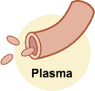





50%
98%
50%
2%

