Slide 1
Introduction to Factory IO
Designing and arranging a factory

Slide 2
Content
Introduction
Arranging a factory
Adding machines and further parts
Moving parts

Slide 3
Introduction
This chapter will guide you through the elemental steps that you will use while designing your virtual factory
This means you will add and move different machines and sensors around
Designing your factory does not mean you will automate it using PLC programming – this is done in later steps

Slide 4
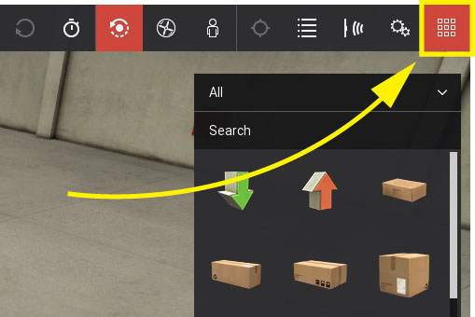
Arranging a factory: Adding machines and sensors
In order to add new machines, we first need to pop up our palette of available parts and machines
This is done by clicking on the most right symbol in the menu bar:

Slide 5
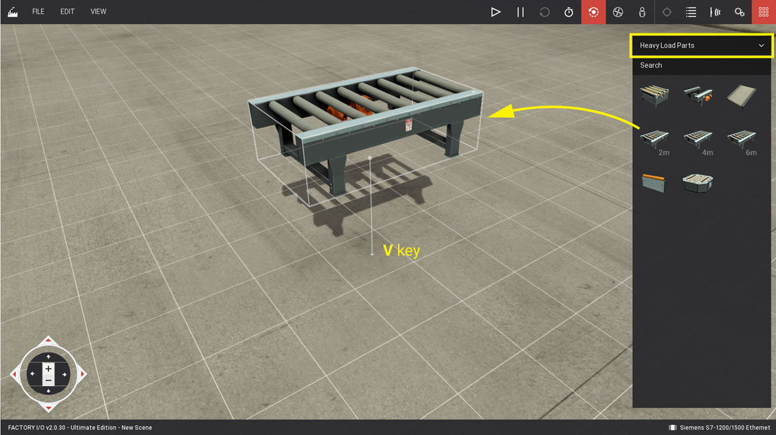
Arranging a factory: Adding machines and sensors
Having the palette of machines and parts accessible, you can search for your desired parts using the search function at the upper end of the palette window
You can also search manually. Be sure to first filter out undesired parts by choosing the right category right above the search function.
When you have found the part you need, simply drag and drop it into the scene:
You can also duplicate existing parts using the context menu (right click)!

Slide 6
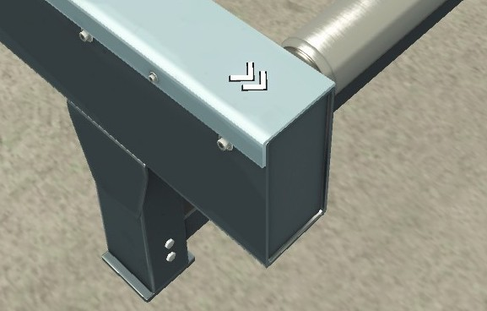
Arranging a factory: Moving parts
In order to move parts that were already added to the scene, simply drag and drop it to the desired place
You can select multiple parts and move them at once. To do this, simply draw a box around the desired parts as if you wanted to select multiple folders and files on your desktop.
If you do not want to select multiple parts repeatedly, you can group a selection by hitting CTRL+G. Ungroup a group using the same combination.
Some parts of your factory have a fixed direction of flow. This is normaly indicated by white arrows:

Slide 7
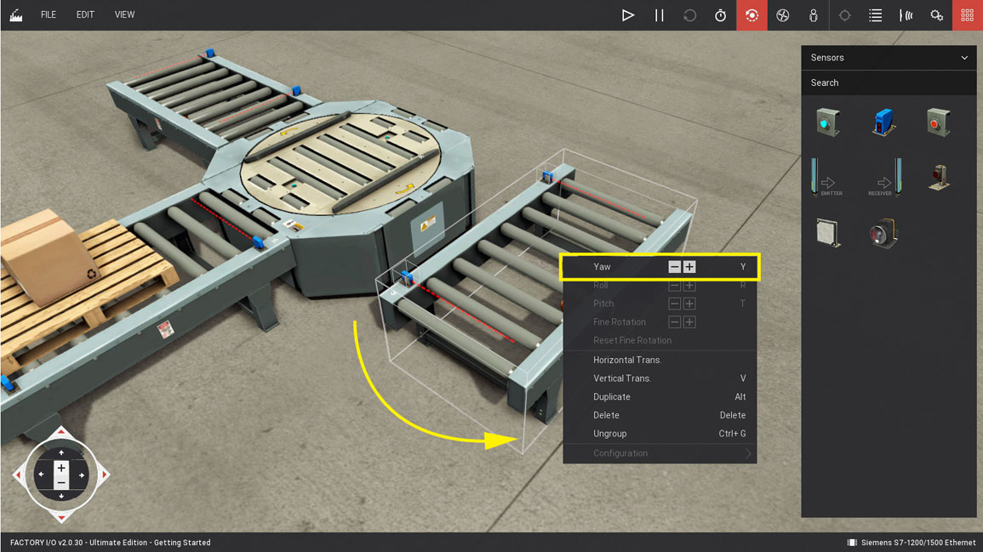
Arranging a factory: Moving parts
If the direction of flow does not meet your arrangement, you can also rotate parts.
To do this, select the part in question. Selected parts or groups have a white box surrounding them.
When you have selected a machine, simply hit Y in order to rotate it for 90 degrees. Hit Y multiple times in order to rotate furher.

Slide 8
Further reading
If you need further help or want to dive deeper into Factory IO, please relate to the official documentation: https://docs.factory.io
This part of the introduction is based upon part 1 (“Navigating”) of the “Getting started” section.
Disclaimer: All pictures that show a yellow arrow where taken from https://docs.factory.io

Slide 9





Contact
9
Ing. Maarten Luyts BSc
Ing. Geert Vanhulle BSc - MBA
Ing. Dirk Van Merode MSc
AP University of Applied Sciences and Arts
maarten.luyts@ap.be
dirk.vanmerode@ap.be
Florian Eichel
FH Dortmund
sascha.pampus@fh-dortmund.de
N.K Kumar
Jimma University
rajeshtripathi63@gmail.com
Mr. Adhena Nigus
Mekelle University
nigusadhena11@gmail.com
Ms. Salama Asikuru
Muni University
s.asikuru@muni.ac.ug

