Slide 1
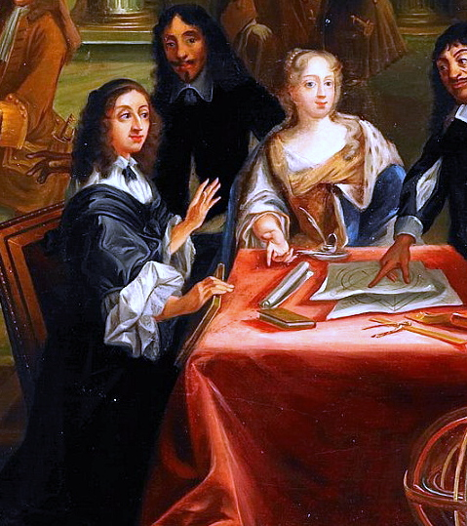
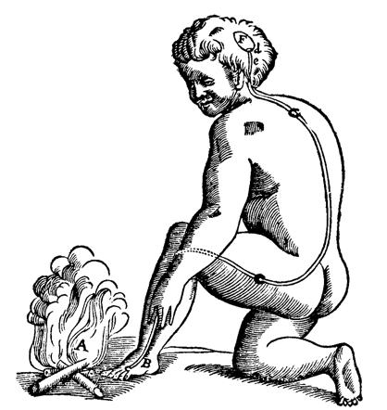
Applying Computational Thinking in the Humanities: Python, Data and Beyond – the project
Dr. Bruno Sartini
b.sartini@lmu.de

Slide 2
Cultural Heritage Analytics

Slide 3
Objective
Build a modular Python system that models, processes, and enriches data about cultural artifacts using real museum datasets, linked open data, NLP, and machine learning.
You can have specific goals for your project depending on your choices on the data (see more in next slides) and methods/attributes you choose!

Slide 4
Datasets you will use
MET Museum Open Access Format: CSV — includes fields like Object ID, Title, Artist Display Name, Culture, Object Date, Medium, Dimensions, Department, Image URL, etc. Full dataset available at https://github.com/metmuseum/openaccess
Art Institute of Chicago API. Docs https://api.artic.edu/docs/#quick-start
Cleveland Museum of Art API. Docs openaccess-api.clevelandart.org
You can decide to focus only on specific types of objects or not (you should explore the data and look into the APIs before starting with the project!)

Slide 5
Required Classes (with freedom on design)
Your project can have a potentially infinite amount of classes and methods, but it must include the following three classes:
Artifact (abstract/base class)
Represents a generic cultural artifact.
Required methods:
to_rdf(self): returns an rdflib.Graph representation of the object (simplistic, does not need to have all the attributes represented in RDF)
wikidata_enrich(self): enriches artifact metadata by querying Wikidata with SPARQL
similar_artworks(self): queries both Chicago API or Cleveland Museum API to look for similar artworks (maybe they share the creator, place of creation, date of creation – up to you)
Attributes are up to you — choose fields from the MET dataset that will support your research goals.
You should create subclasses of this for specific types of artifacts

Slide 6
Required Classes (with freedom on design)
Your project can have a potentially infinite amount of classes and methods, but it must include the following three classes:
Artist Represents a person who created one or more artifacts.
You choose what attributes to store (e.g., name, lifespan, nationality, movement), and how to structure artist-artifact relationships.
Required methods:
to_rdf(self): returns an rdflib.Graph representation of the artist (simplistic, does not have to have all the attributes represented in RDF, just a proof of concept)
wikidata_enrichment: queries wikidata to obtain more information about the artist
You can create subclasses of artists for specific types (i.e., human vs organization)

Slide 7
Required Classes (with freedom on design)
Your project can have a potentially infinite amount of classes and methods, but it must include the following three classes:
Collection group of Artifact instances.
Required methods:
add_artifact(self, artifact)
add_artist(self,artist)
to_rdf(self): returns an rdflib.Graph with all RDF triples from the collection – artifacts and their creators must be linked! **Not every single attribute needs to be represented in RDF, keep it simple as a proof of concept**
visualize_metadata(self): generates visualizations from the raw dataset (e.g. pie charts, bar charts) up to you which ones
visualize_rdf(self): generates RDF visualizations
cross_api_enrich(self): finds additional works by the artists in the collection from the AIC or Cleveland API, adds the items to the collection (with the metadata that they have from the APIs, so you should consider about their metadata as well when you create attributes. Remember you can put default attributes as None for things that are not shared between the APIs

Slide 8
Required project features
MET Data Cleaning
Handle columns with multiple values (e.g., split on |)
Normalize the gender field
Other issues that might arise during the project

Slide 9
Required project features
Visualizations
Metadata from CSV (e.g. culture distribution, periods, materials)
ML results (e.g. clusters of artworks, topic plots)
RDF (Graph visualization)

Slide 10
Required project features
Machine Learning
Image-based
Use images from AIC API (extract around 5000 with the API) – maintain the link between artworks and their images
Cluster them with ML methods (simple methods)
Visualize results
Text-Based
Apply ML to analyze titles or other fields (e.g., topic modeling, clustering, classification) (on the whole MET data)
Apply ML to analyse descriptions or other fields from 5000 extracted artworks from Chicago and 5000 extracted artworks from Cleveland
Visualize outputs (e.g. word clouds, topic charts)

Slide 11
Final deliverable
Each group must submit a GitHub repository with the following structure:
final-project-groupname/
|── Notebooks/
│ └── main.ipynb # Jupyter notebook(s) with full code and documentation
│
|── Diagram/
│ └── uml_diagram.png # UML class diagram generated with Graphviz
│
|── RDF_outputs/
│ └── collection.ttl # RDF Turtle file containing a collection with at least 50 artifacts/artists
│
└── README.md # Project summary, design choices, and division of group work

Slide 12
Deadline
You must send me via emails the links to your GitHub repositories by July 22nd

Slide 13
Presentation
On July 23°, each group will present their project, clearly stating how they divided the work.
I will ask questions about the code to make sure you did it, including (i) explanations of what is happening line by line and (ii) small changes live to verify how you can navigate and edit your own code

Slide 14
Evaluation Criteria
Completeness: 1 to 10 -> depending on whether you were able to do all the required tasks
Code correctness 1 to 10 -> depending on whether everything works or if there are bugs
Clarity of the documentation and the readme 1 to 10 -> how you documented your code and explained the project in the readme
Indvidual contribution -30 to 30 -> how each student contributed to the project, whether they are able to explain the code and to slightly change it (the score will depend on the previous criteria if the student is able to demonstrate they did the code, if not, it will be -30)
Total max score: 60
Notes:
Contribution must be balanced and clearly stated (you can of course help each other, but every student should be responsible for their own code)

Slide 15
Grading
57-60 -> 1
52-56 -> 1.3
48-51 -> 1.7
44-47 -> 2
41-43 -> 2.3
38-40 -> 2.7
35-37 -> 3
32-34 -> 3.3
31 -> 3.7
30 -> 4
< 30 = fail (which means having at least 15 points in the first three criteria and confirming it)

Slide 16
Example
Group: The coders
Scores:
Completeness: 10
Code correctness: 7
Clarity of the documentation: 6
Total = 23
Mary confirms she did the code, score = (23+23) = 46 -> 2
Andy struggles a bit explaining some lines, score (23+18) = 41 -> 2.3
Lukas is not able to recognize his alleged code, fails to answer questions, score (23-23) = 0 -> fail

