Slide 1
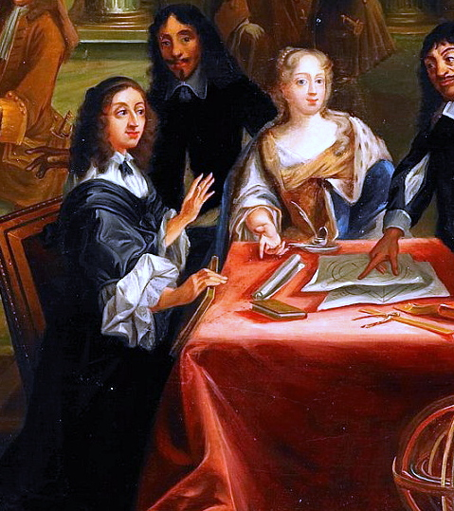
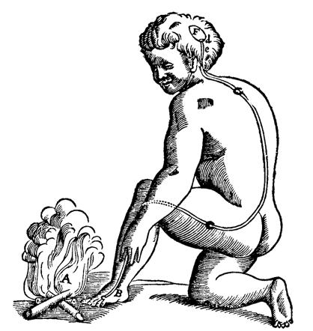
Applying Computational Thinking in the Humanities: Python, Data and Beyond - intro
Dr. Bruno Sartini
b.sartini@lmu.de

Slide 2


Who am I?
Bruno Sartini
Akademischer Rat (Postdoc)
Bruno
Dr. Sartini Mr. Sartini
Digital Humanities and Semantic Web Technologies

Slide 3
Who are you?
Name
What are you studying?
Why did you choose to join this course?

Slide 4
We are here to
Gain practical knowledge on the application of Computational Thinking via Python
Become familiar with object oriented programming
Become familiar with the use of Application Portable Interfaces, (graph-)databases and their implementation, creation and analysis with Python
Develop a Python project based on data from the Humanities domain

Slide 5
FYI: There is also an additional practical course in this semester
https://lsf.verwaltung.uni-muenchen.de/qisserver/rds?state=verpublish&status=init&vmfile=no&publishid=1080431&moduleCall=webInfo&publishConfFile=webInfo&publishSubDir=veranstaltung
Web App development for Digital Cultural Heritage
Learn how to develop web applications on the humanities combining knowledge from web design and programming – extremely recommended (takes place at the end of the semester as a block course)
Let me know if you are interested in it

Slide 6
Class structure: general information
Class Starts: 14:15
5-min Break: 15:00 please remind me
Class Ends: 15:45-50

Slide 7
Course structure (tentative)
Class #1 to #8 – Explanation of new concepts and practical sessions
Materials will be posted in the GitHub repository of the course:
https://shorturl.at/yDQvF
If you do not have a GitHub account, create it
After every class you will have some exercises to be completed every week and submitted via GitHub Issues (will see more of this today)

Slide 8
Course structure (tentative) - 2
Class #9 to #13 will be dedicated to the development of a group project of programming (more details of the project will be revealed in class #6)
Class #14 will be dedicated to the presentations of the projects, where I will ask questions to verify the individual work and the knowledge of the code

Slide 9
Tentative Calendar
# | Date | Topic
1 | 23.04 | Introduction to the course + python recap + exercises
2 | 30.04 | Pandas + exercises
3 | 07.05 | Recursion, divide and conquer and dynamic programming + exercises
4 | 14.05 | Object oriented programming + exercises
5 | 21.05 | Graph Databases + exercises
6 | 28.05 | Project presentations + more graph databases + exercises
7 | 04.06 | NO CLASS
# | Date | Topic
7 | 11.06 | Data Visualization – 3H – 14:00-17:00 + exercises
9 | 18.06 | Machine Learning – 3H – 14:00-17:00 + exercises
10 | 25.06 | Project Support + questions, additional materials and recap
11 | 02.07 | Project Support + questions, additional materials and recap
12 | 09.07 | Project Support + questions, additional materials and recap
13 | 16.07 | Project Support + questions, additional materials and recap
14 | 23.07 | Project Presentation

Slide 10
The exam
Depending on your study program *and* if you are following the Seminar as well
I will evaluate the projects and the individual contributions of each one of you
The projects will be developed in GitHub, with a documentation of the code. (You have to create the repositories and contribute to them in your group)
Groups can be maximum of 3 people.
You can do the project alone as well, if you prefer.

Slide 11
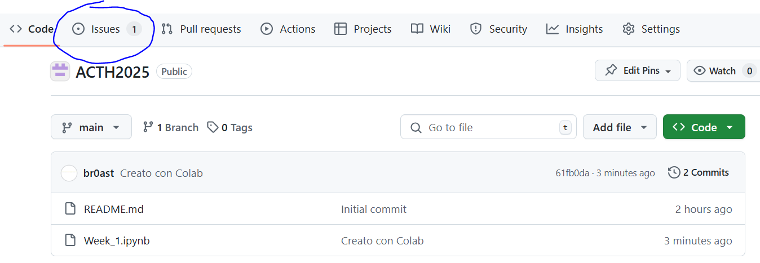
GitHub issues for exercises
If you go to the github repository of the course, you will see "issues" tagged with the "exercise". You can comment on the issue to provide the solution to the exercise.

Slide 12
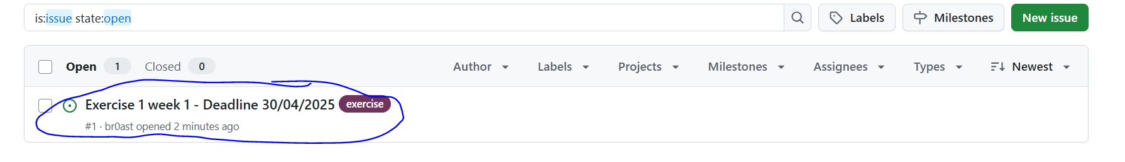
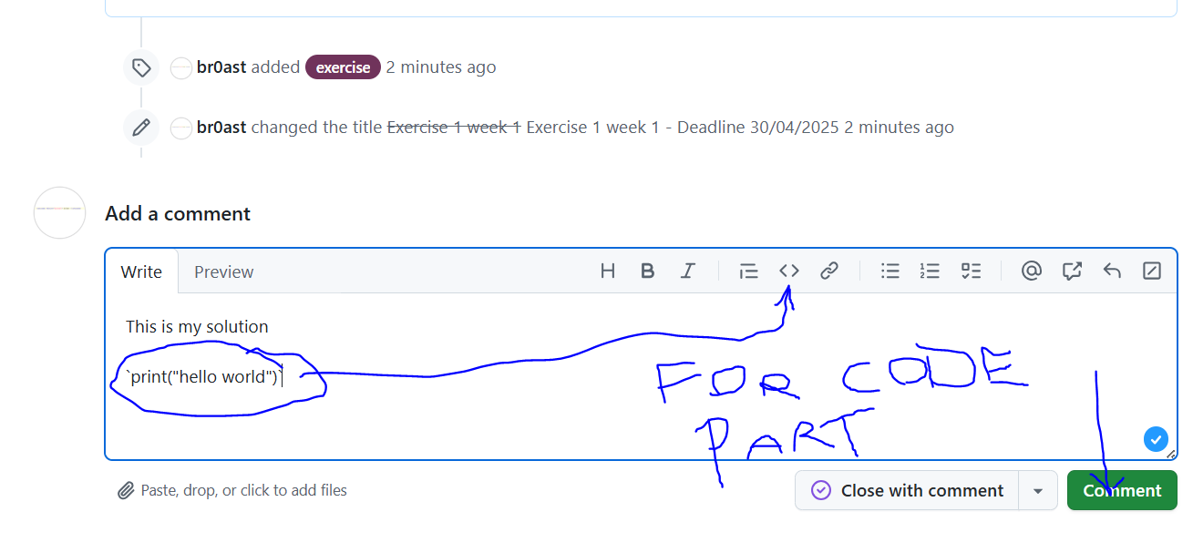
How to paste the solution

Slide 13
Questions?

