Slide 1



Wavelet Augmented Regression Profiling (WARP): improved long-term estimation of travel time series with recurrent congestion
Alvaro Cabrejas-Egea, Colm P. Connaughton
Notes:
Hello everyone.
In this presentation I will be introducing the contents of the paper : Wavelet Augmented Regression Profiling or WARP, improved long-term estimation of travel time series with recurrent congestion.
The authors of these paper are Colm Connaughton and myself, Alvaro Cabrejas Egea,.
Colm is affiliated with the Warwick Mathematics Institute and I am finishing my PhD at the University of and collaborate with the Alan Turing Institute, all of them in the UK.

Slide 2
Long term forecast and Profile Estimation
Aims:
Long term estimation of Highway Travel Time from Historical Data
Reach best estimate of the underlying true temporal distribution of travel times
Use these estimates to forecast a week ahead
Challenges:
Need to classify non-recurrent congestion as noise
Need to extract all seasonality
Automatically ignore rare events
Notes:
From a user perspective, vehicle travel times are the most relevant measure of the state of the traffic flow on a section of road.
In this project, we used historical data publicly available in the UK to achieve a successful long term estimation of travel times.
We will be using the previous 8 weeks of travel times, to predict one entire week ahead with a resolution of 1 minute and a precision of 1 second.
Since we are looking only at the long term estimate, rare events involving bad weather, football games and so on should be ignored.
By this I don’t mean they should be dropped from the data-set during pre-processing, but that they should be filtered out of the predictions by the algorithm itself, being resilient to them.
Equally, all exceptional congestion should be classified as noise, and thus, filtered out from the final profiles (which I will also introduce shortly) and forecasts..
OK, now we have a goal and a list of requirements, but how do we get there?
Let me give a bit of extra background: [[NEXT SLIDE]]

Slide 3
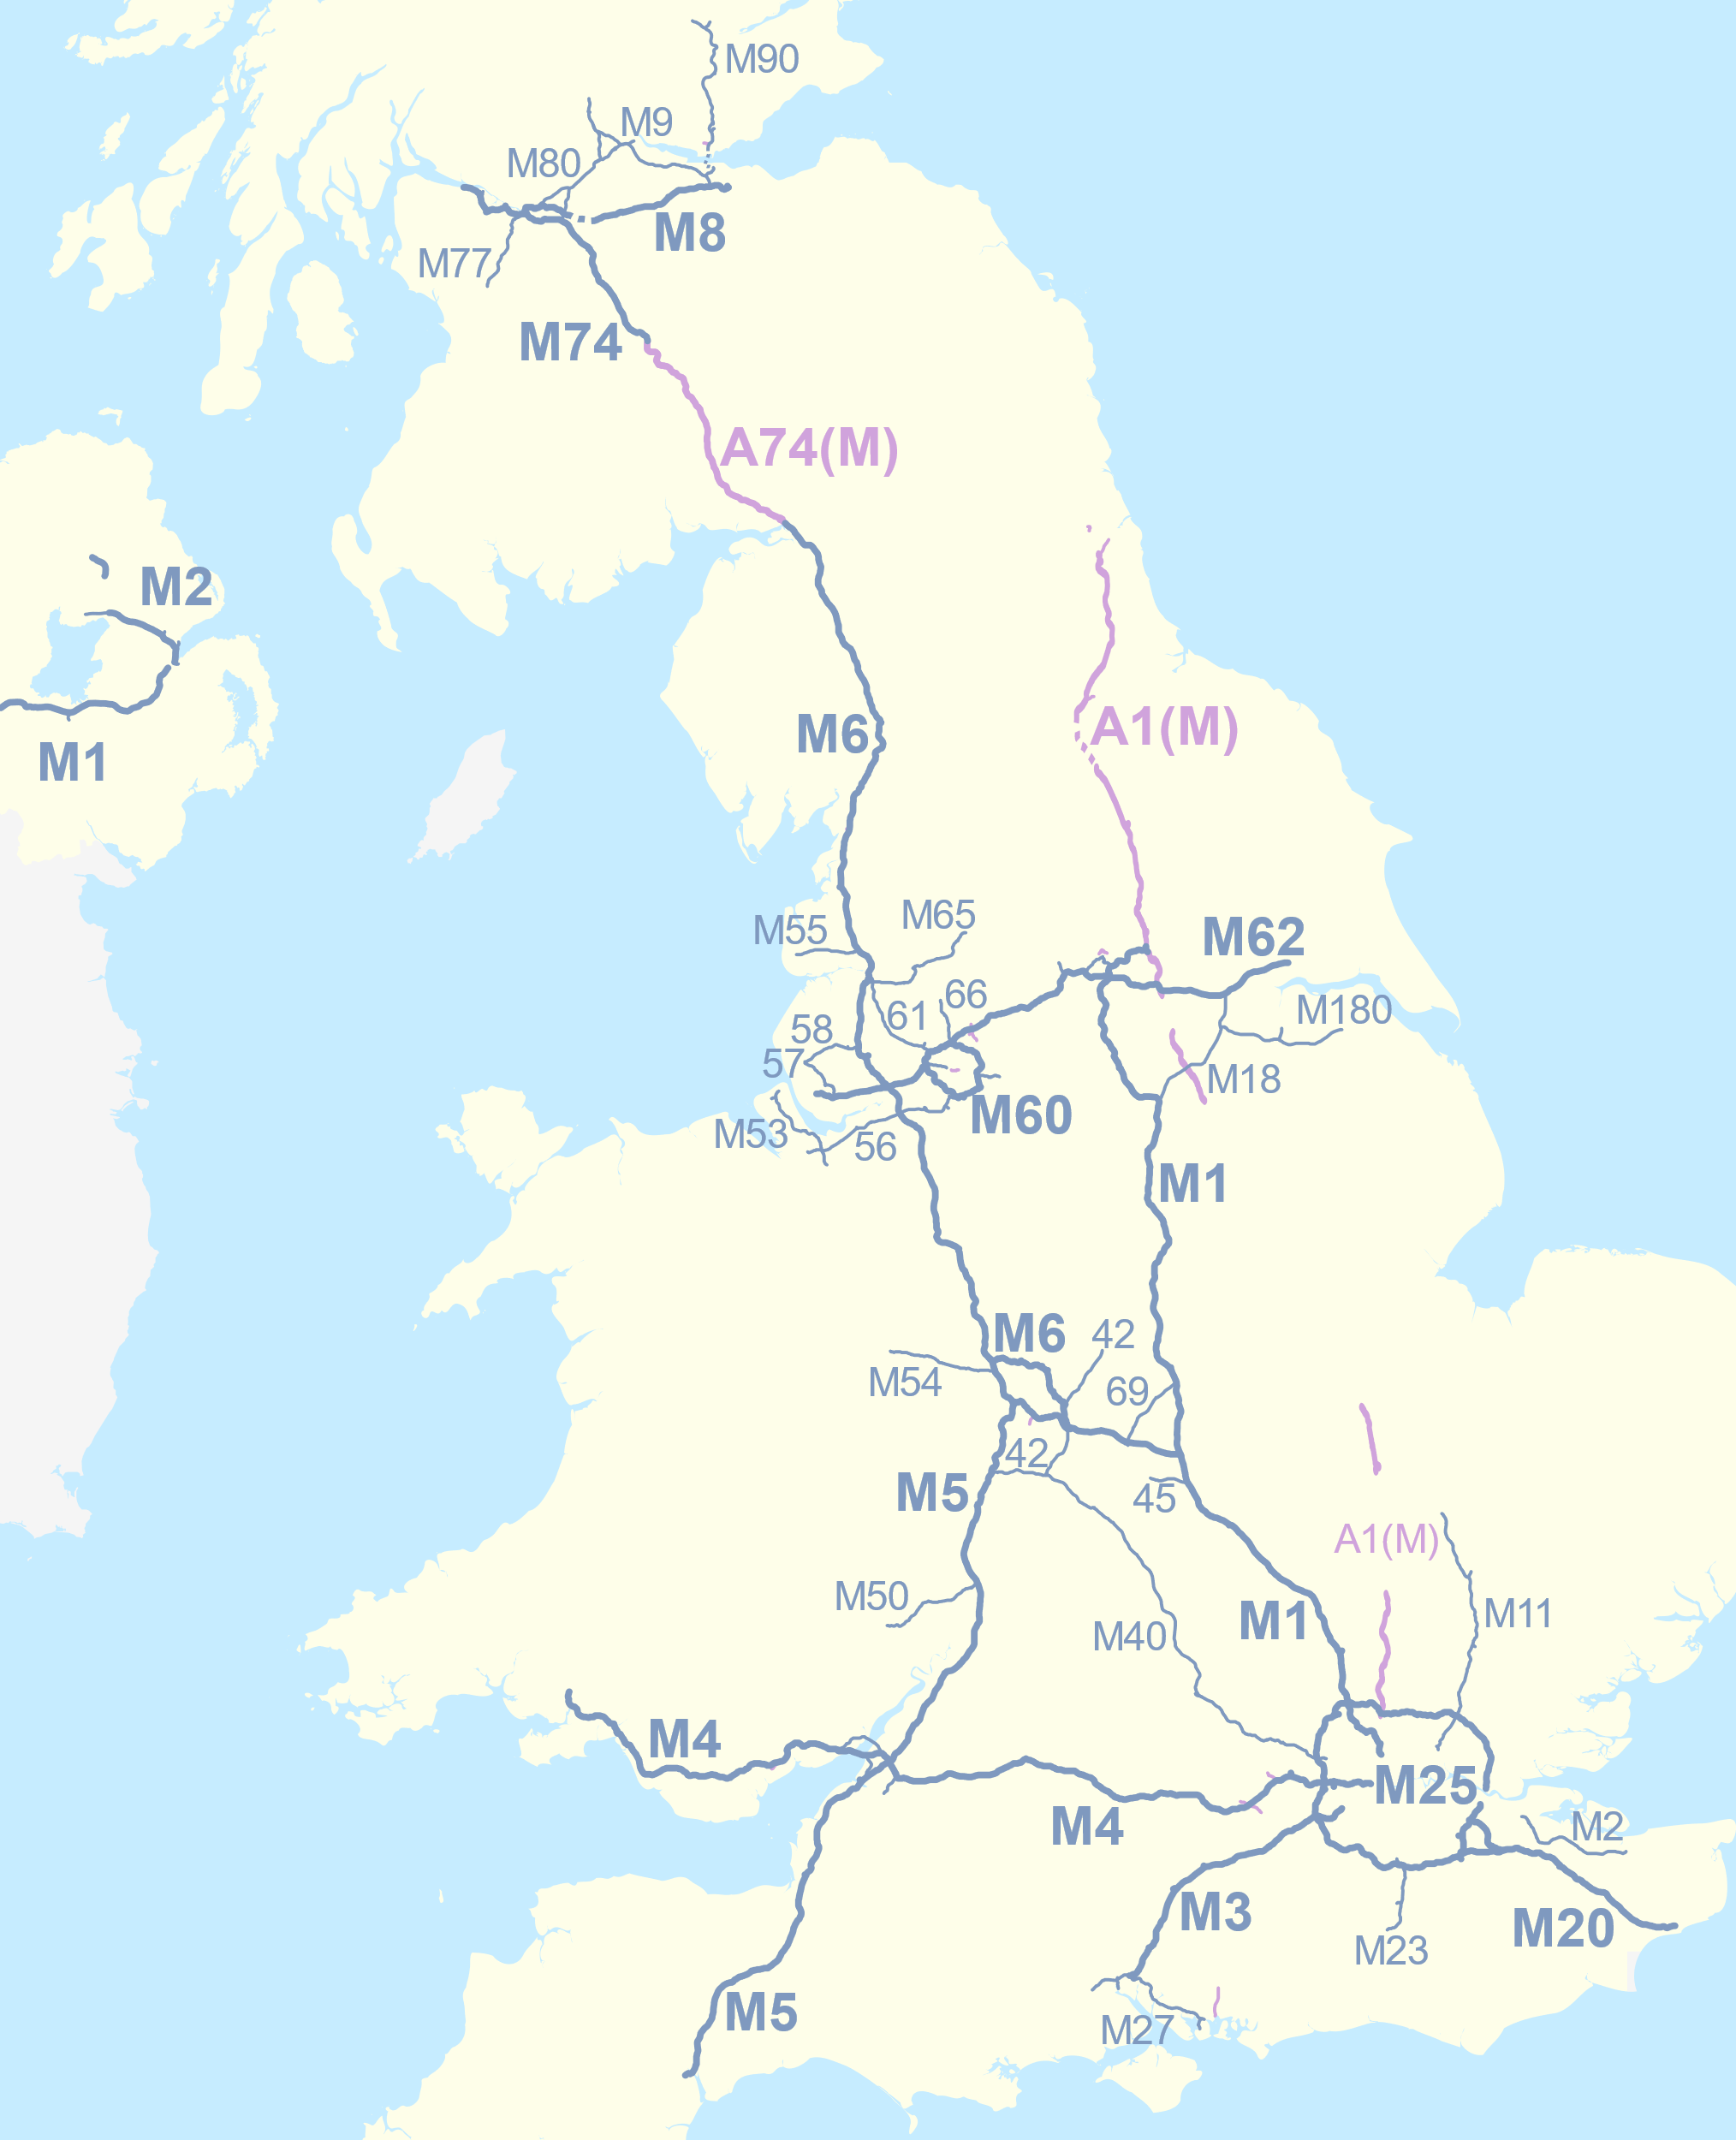
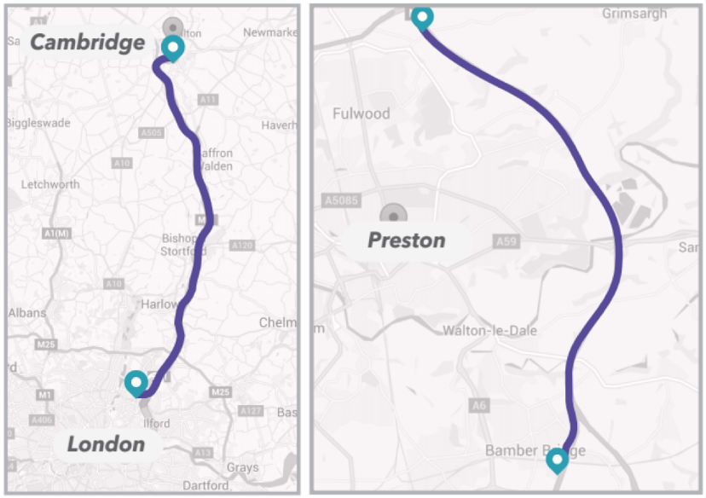
Site Selection and Rationale
Notes:
First we will go over a bit of background:
The Strategic Road Network covers all the motorways and A roads in England, with each road being partitioned in Links measuring between 500meters and 20 km in length.
These are fitted with induction loop sensors, CCTV cameras and other sensors that monitor the state of traffic.
All of this data is managed and published by the National Traffic Information System or NTIS.
In this context, the traffic profile of a link is a series containing Expected Travel Time at that location over time.
A given profile value should be understood as the expected travel time for the location at that time of the day, independent from travel conditions such as congestion, weather or any other event.
Within the Strategic Road Network, we selected 2 different motorways from which to gather data:
-The M6 around Preston.
-The M11, between London and Cambridge
These 2 motorways are characterised by their high recurring congestion, typically being a bit of a nightmare to commuters.
We set up a subscription to the NTIS system and gathered 12 weeks (about 3 months) of travel time and profile data created by the operators under their current methodology. [[NEXT SLIDE]]

Slide 4
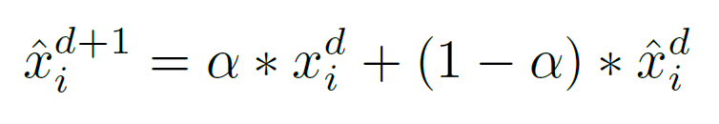
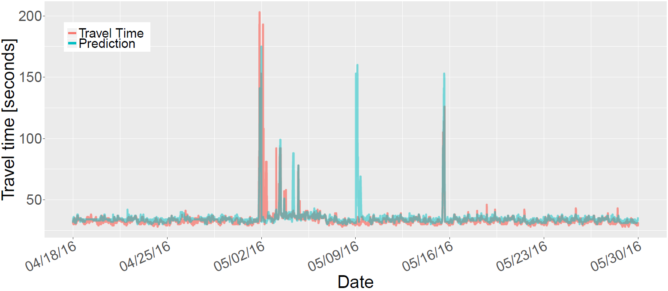
Current Profile Estimates
Uses EWMA + Segmentation
Can lead to overestimation or repetition of events
Notes:
The current methodology to calculate profiles involves heavy use of time-based segmentation and combines it with an exponentially decaying moving average.
This time segmentation implies that the data will placed in different categories and these will be assessed independently (one category for Mondays, a different one for Sundays, a special one for Christmas day….you get the idea).
Once this is done, the Exponentially Weighted Moving Average can be applied on a minute by minute basis.
This means that to generate an estimation of the 10:15 AM today, I will look into the travel times at 10:15 AM over previous days that fall in the same category as today, and apply this weighted moving average over them.
The most obvious and immediate downside of this approach is that it can easily be led into overestimation by any single non-recurring event that is not filtered out, as you can see in the plot on the screen.
In this case we find a great peak around the 2nd of May. An algorithm using this approach, will replicate this spike on the exactly one week later, but as you can see, it was nowhere to be found.
In this context, we need to generate an algorithm capable of accounting for seasonal changes, without the need of segmentation, and in a way that is resilient to large deviations in the data.

Slide 5
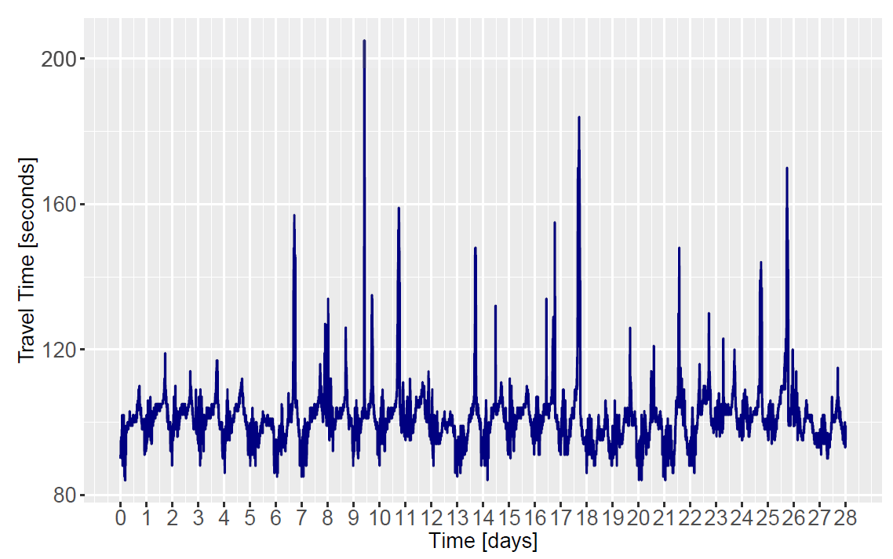
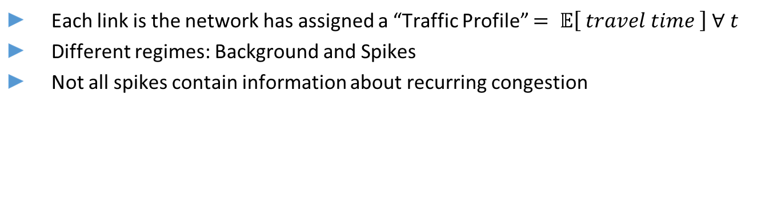
Examples of Travel Times
Each link is the network has assigned a “Traffic Profile” $= 𝔼\left[ travel time \right] ∀ t$
Different regimes: Background and Spikes
Not all spikes contain information about recurring congestion
$$Travel Time= Background+Spikes+Noise$$
Notes:
Below, you can see a 4-week slice of the travel time in one of these roads.
What we see in the plot, and this will come into play later on, is that for most of the series, travel times oscillates around a mostly stable mean value, with occasional quick large deviations from this.
We will refer to these deviations as spikes in travel time.
Some of them will carry valuable information about recurring congestion experienced at the link, while others will be isolated rare events that should be classified as noise.
The rest of the series, will be referred to as the background.
[[NEXT SLIDE]]

Slide 6
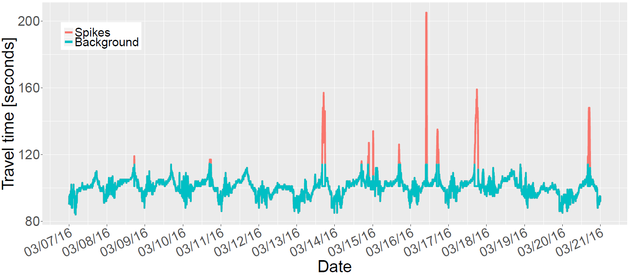
Travel Time: Components
Background
Stable Around Mean
High Frequency – Low Amplitude
Suitable for Spectral Filtering
Spikes
Zero most of the time
Low Frequency – High Amplitude
Suitable for Seasonal Analysis
Notes:
As we were saying, the background comprises a relatively stable series that suffers high frequency oscillations around a mean value, making it Suitable for Spectral Filtering.
The spikes on the other hand are not there most of the time, and while they are rare enough to not have intra day patterns, the congestion do have patterns in lengthier periods, making it necessary to look at their seasonality.
Let’s first look at the structure of the time series over time.
[[[[SLIDE]]]]

Slide 7
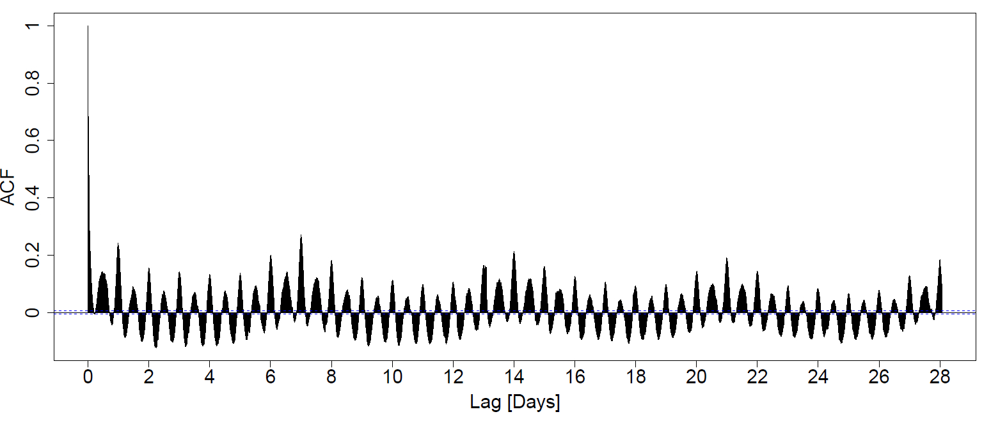
Autocorrelation of travel time series
Notes:
To do this, it seems reasonable to look at the autocorrelation function for the travel time.
And what we can see here, as far as autocorrelation functions go, is quite interesting.
First, the patterns are much clearer than usual.
On top of that, we can see how we have a pattern going on with a period of a day, and at the same time another overarching patter with a period of a complete week.
This leads us to believe, that we will be dealing with a heavy double seasonality (daily and weekly), which otherwise makes sense from what we intuitively know about how we humans operate in terms of time.
So summarizing, so far we have, oscillations around a mean (as we said earlier), quick large deviations and various seasonalities.
Since we have a series that has exhibits seasonal dynamics strongly focused around certain timescales, we can use the Continuous Wavelet Transform to look more deeply into the temporal structure of the series and make use of its additive properties to select a rule that allows us separate both components.
[[[NEXT SLIDE]]]

Slide 8
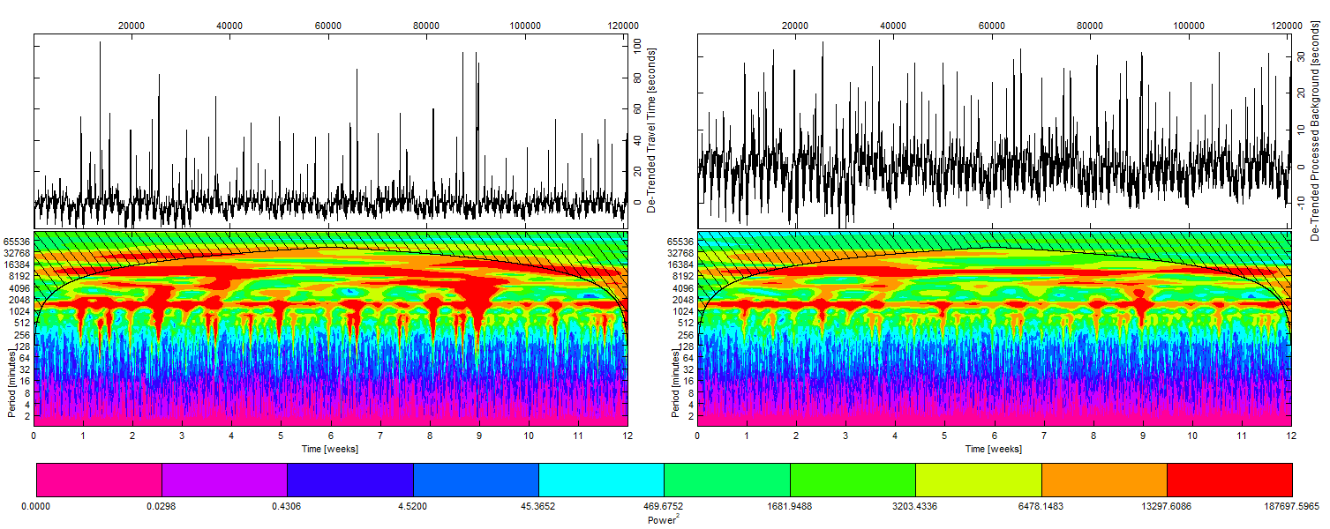
Algorithm: Wavelet based decomposition
Notes:
Wavelet transforms are similar to Fourier transforms, but localised both in time and frequency, providing information about where the different oscillation frequencies are located in time, as well as allowing the identification of sparse events.
In order to use the Wavelet Transform, first we need to take our series and make it zero mean by subtracting the mean of the series.
Then it can be used for input for a Continuous Wavelet Transform, using a Morlet Wavelet and 140 timescale levels.
This generates a complex matrix of dimensions: number of levels times length of the original series, in which each element gives information about the influence of that given timescale at that point in time.
The output is what you see on the left, with the original input series on the top.
It is a heatmap of the squared power of each complex element of the complex matrix.
Here we can observe that the most influential dynamics (in red) occurring during the series length, represented by the x axis, happen at the timescales (represented by the y axis) corresponding to a day (or 1440 minutes) and a week (10080 minutes), following what we saw in the autocorrelation function.
In the figure, we also observe that surges in power across different wavelet timescales occur at the same time as the non-recurring congestion, since in order to approximate this signal, the CWT algorithm needs to combine several wavelets with smaller periods than those dominating the recurring part of the series.
In order to isolate this non-recurring component, the series is sequentially assessed over all the time domain by taking a horizontal slice for a single timescale level.
In each timescale, the median and interquartile range are calculated, to identify outliers, representing points at which the power in the given timescale is not behaving as expected in the series.
In this case, anything outside 1 interquartile range was deemed as outlier, but this is a tunable parameter of the model, which sets how aggressively spikes are targeted.
Anything found within this limit is passed to the container of the Background series, while elements above the limit are split.
The fraction up to the limit is still passed on to the Background, while the part over it is classified as a spike.
The background fraction can be observed in the right, still dominated by dynamics in the timescales of a day and a week, while mostly removing the surges across timescales.

Slide 9
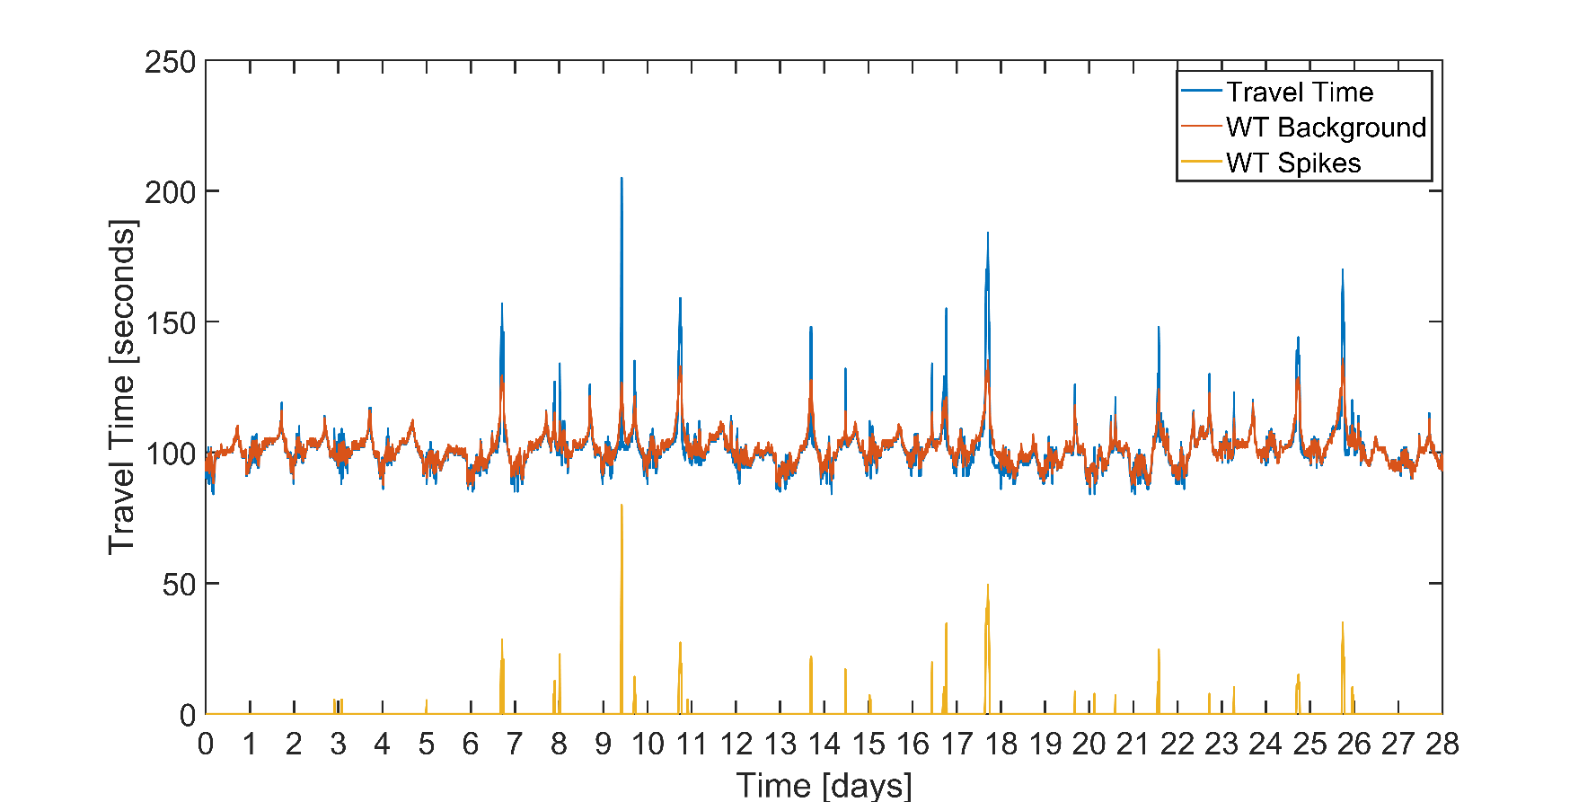
Algorithm: Decomposition
Notes:
The now separated Background and Spikes, are then passed through the Inverse Wavelet Transform in order to reconstruct them in the time domain.
As we can observe in the figure on screen, the additive properties of Wavelet Transform are rather useful in this case, allowing us to perform this decomposition as an superposition of two now independent series.
This demonstrates the ability to process a time series showing multiple seasonalities and punctuated by large deviations from the normal dynamics of the process into two separate series, one of which will exclusively contain the baseline dynamics of the process, respecting its structure and natural variability, and the other, which will only contain those large events that occur outside of the smooth operational region.
Further than this, we define an indicator function that will tell us whether a spike is present at all points in the series.
This indicator function will come in handy later on.

Slide 10
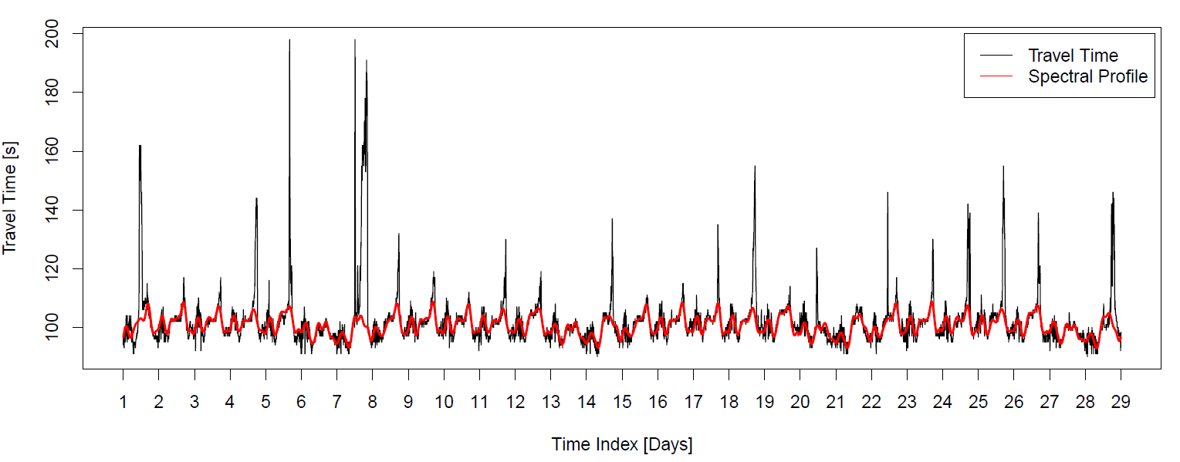
Algorithm: Background Analysis
Notes:
In the case of the background, after separating it from the rest of the series, and we apply a frequency filter.
With this filter we get rid of all frequencies under 4 hours and over a week to obtain what we called the spectral profile.
This way, we aim at eliminating the influence that a short term event and random oscillations may have over the normal functioning of the highway and obtaining a highly smooth series that accurately follows the actual travel times without being dragged into the large deviations. Mind that in this plot, besides containing a few specially bad days, the red line represents forecasts made one week in advance. So it is by itself a good approximation of the “normal” operation of a motorway. THIS WORKS EVEN WITHOUT REMOVING THE SPIKES SINCE THEIR EFFECTS USUALLY OPERATE ON SMALL TIMESCALES.
However, we can do better since we also aim to capture the recurrent component of the congestion, so we turn to seasonal analysis. [[SLIDE]]

Slide 11
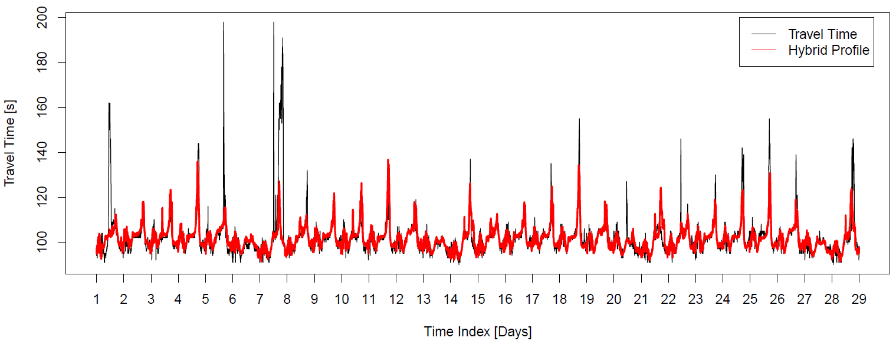

Algorithm: Seasonal Analysis
Notes:
We begin by isolating the daily seasonality from the entire background training series using STL.
Then we do the same thing with the weekly seasonality.
By adding the two of them together while discarding the noise, we obtain a seasonal approximation to the original time series.
This series, unlike that obtained via spectral filtering, can accurately forecast the part of the spikes that is indeed recurrent.
However, this approach makes the forecast less smooth and more prone to error in the least spiky areas of the series.
While the approximation is good, and the lack of smoothness is expected on a minutely seasonal forecast, with a resolution of a second made a week in advance, we can do better than this.

Slide 12
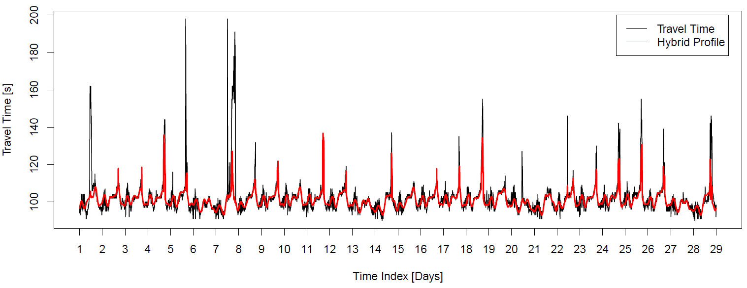
Algorithm: Recombination
Notes:
The best predictive power is obtained when we combine these 2 previous results, using the Background whenever the spikes are not present and switching to seasonal analysis when they are (we would use the indicator function we defined previously). In this manner we obtain a system that has the best of both worlds, smooth prediction over long periods of time, being capable of switching to a different mode when density and travel times start to grow.

Slide 13
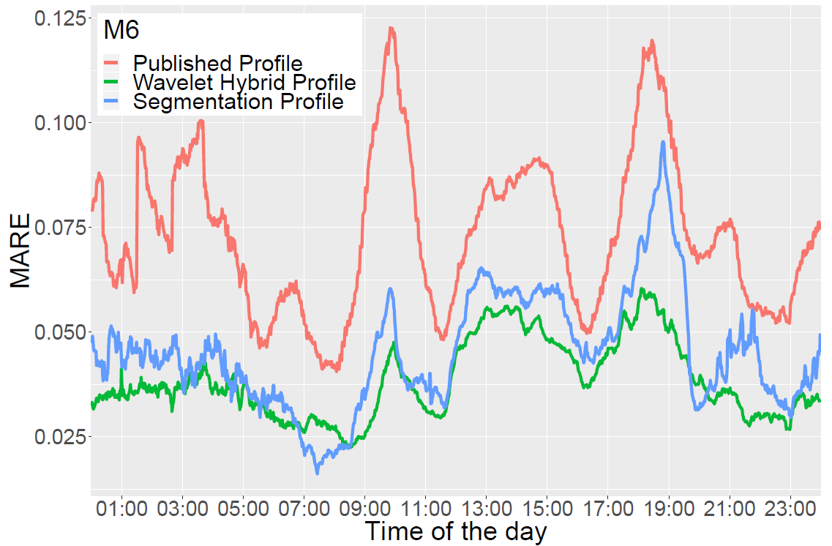
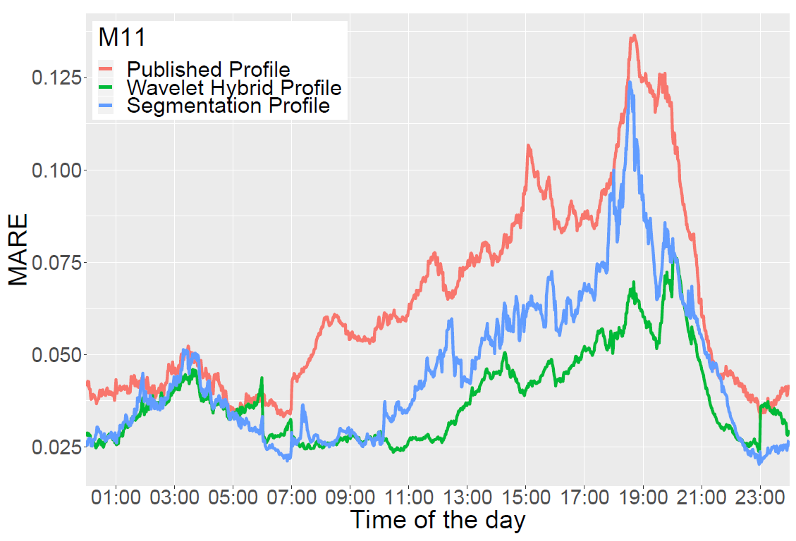
Results – Time of the Day (M6 & M11)
Notes:
Now let’s look at the results comparing our newly obtained profile with the published one and a reference profile using EWMA and segmentation.
If we aggregate all predictions per motorway and time of the day, in the case of the M6, we obtain the figure above.
We can observe how the currently published profile generates large absolute relative errors reaching around 12% of the actual travel time values during the peak hours.
By contrast the forecast using Wavelets is not so sensitive to the time and volume of vehicles present in the motorway, peaking at around 6% error during the evening rush hour.
If we do the same thing for the M11, we find the error of the published profile to be around 13% during the evening rush hour, with the reference segmentation profile obtaining slightly better results.
Once again, the profile and forecasts obtained with Wavelets obtain a vastly superior performance, keeping the error below 7.5% during the rush hour.

Slide 14
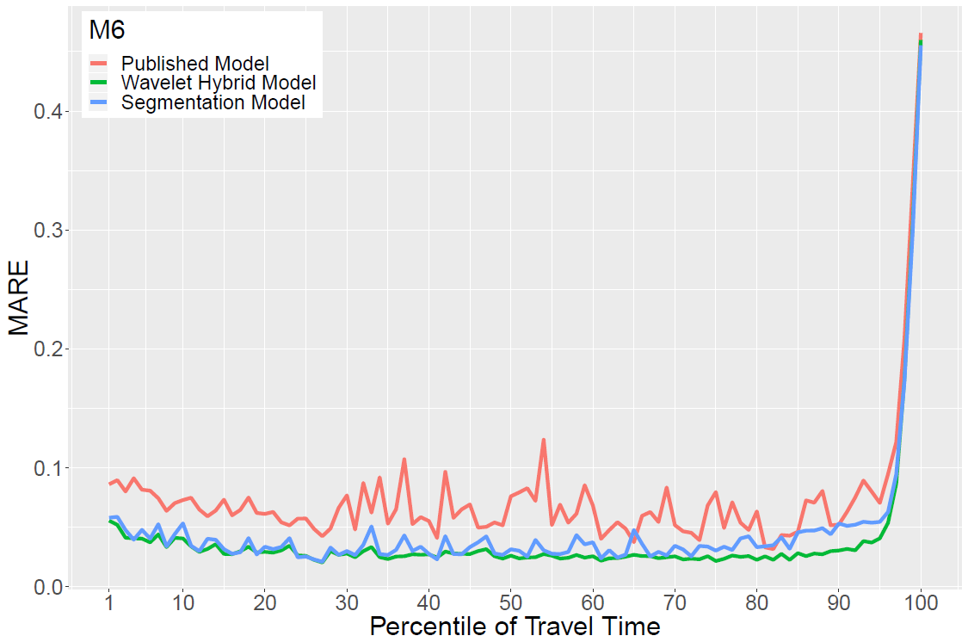
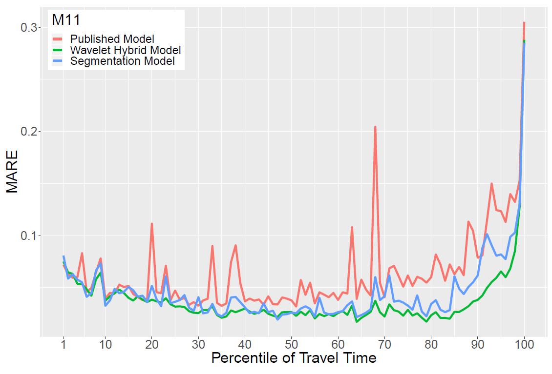
Results – Percentile of Travel Times (M6 & M11)
Notes:
This you know by heart. GO.

Slide 15
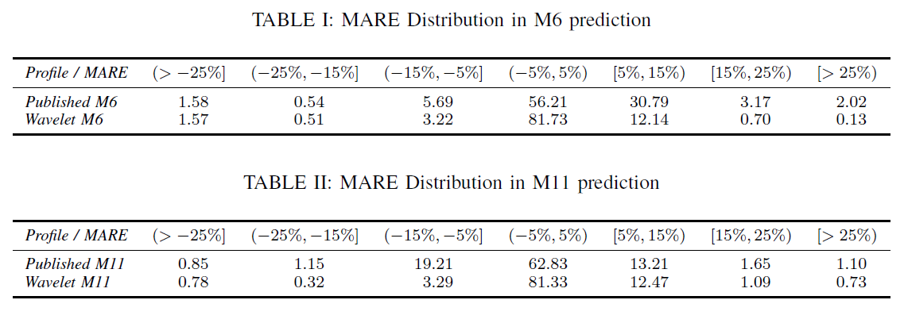
Results – Mean Absolute Relative Error Distribution
Notes:
If we look at the distribution of Mean Absolute Relative Errors in the Wavelet profile and compare it with the currently published profiles we find that:
In the M6, the percentage of predictions that resulted within 5% of the true value is 81.73%, compared with the original 56.21%.
In the case of the M11. we obtain an 81% of predictions within 5% of the true value, up from an original 62.83%.
Take into account that the predictions are issued with a resolution of a minute and have individual precision of 1 second.

Slide 16
Conclusion and Way Forward
Achieved:
Presented an Algorithm for Profile Generation and Forecasting
Based on seasonal variation, frequency smoother and filtering of rare events
Much better accuracy than existing estimation methods
Ability to distinguish between recurrent and outstanding congestion
Way Forward:
More sophisticated analysis in the Frequency Space
Extensions for incident detection
Data-guided automatization of the filtering parameter
Notes:
This paper has presented a new methodology for creating long term travel-time forecasts from historical data.
The method uses the wavelet transform to separate background and spikes and then process them by studying their seasonal variation and using a frequency smoother.
The method obtains much better accuracy than other comparable methods, being able to distinguish between recurrent and outstanding congestions.
Potential improvements for the method could involve deeper analysis in the frequency space, automatization of the separation parameter and could be extended for incident detection.

Slide 17

Thank you!
If you have any questions, please do not hesitate to email:
alvaro.cabrejas-egea[at]warwick.ac.uk
Notes:
Thank you very much for watching and if you have….

