Slide 1



Wavelet Augmented Regression Profiling (WARP): improved long-term estimation of travel time series with recurrent congestion
Alvaro Cabrejas-Egea, Colm P. Connaughton

Slide 2
Index
MathSys Traffic Research Group
Prediction versus Estimation
NTIS & UK Strategic Road Network
Data Selection and Contents
Algorithm
Results
Limitations and way forward

Slide 3






MathSys Traffic Research Group
MathSys Centre for Doctoral Training, University of Warwick
Kieran
Kalair
Charlotte
Roman
Andrew
Hilditch
Steve
Bennet
Notes:
We have a small traffic research group at the university of Warwick.
Here you can see the collaborators for this paper: Peter and Colm.
And below you can find other members of our group, including Kieran Kalair who will be presenting the biggest experimental validation of the Lighthill – Whitman –Richards model to date, as far as we know, by at least an order of magnitude, this will be on Wednesday.
[[[[NEXT SLIDE]]]]

Slide 4
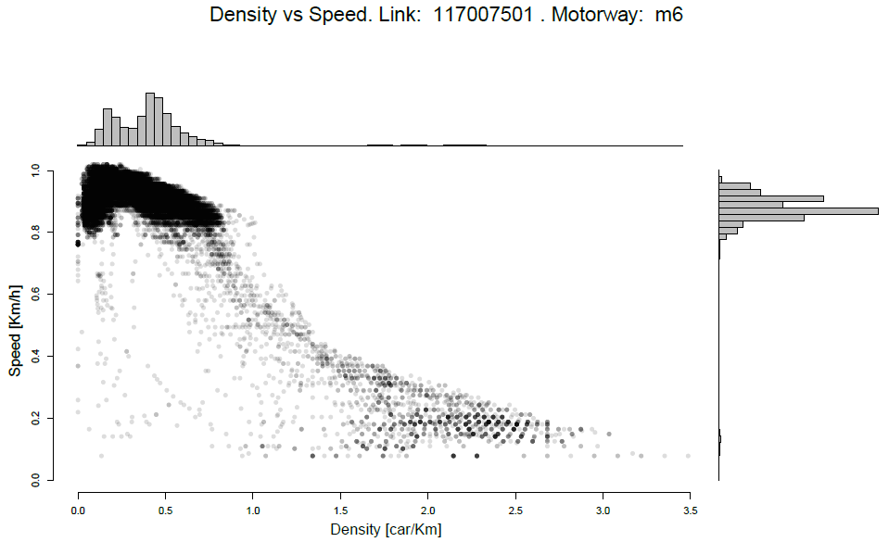
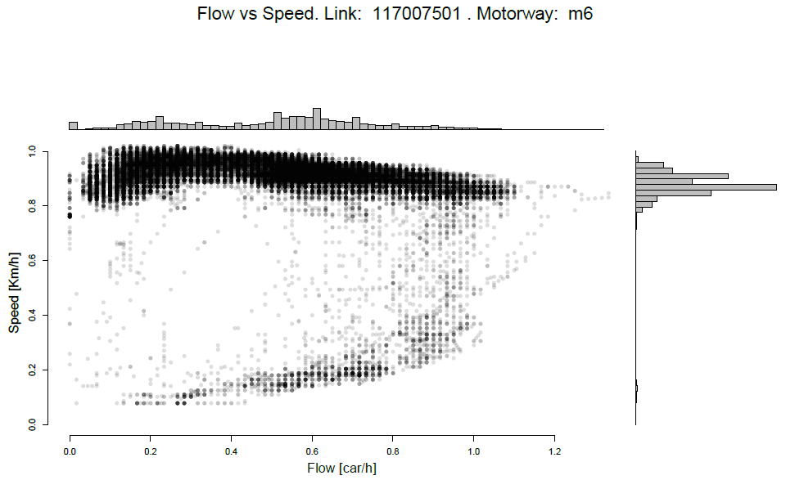
Short term forecast vs Profile Estimation
Most literature focuses on short time prediction
We focus on the long term estimation
Obtain the baseline of expected travel times during normal operation
Notes:
Unlike most literature, here, we will be focusing on the Profile estimation rather than on the short term forecasting.
In this context, the profile is the Expected Travel Time in a particular location.
A given profile value should be understood as the typical travel time for the location at that time, independent from travel conditions such as congestion, weather or any other event.
So in terms of the plots below, we will be in this general area rather than on the hysteretical excursions that go this way.
[[NEXT SLIDE]]

Slide 5
Short term forecast vs Profile Estimation
Aims:
Long term estimation of Highway Travel Time from Historical Data
Reach best estimate of the underlying true temporal distribution of travel times
Requirements:
Need to extract ALL seasonality
Need to classify non-recurrent congestion as noise
Ignore rare events
Notes:
To achieve a successful long term estimation of these travel times, we used historical data publicly available through the NTIS system, which I will introduce in a moment.
Using these, we tried to extract all seasonality in the time series.
Since we are looking only at the long term estimate, rare events involving bad weather, football games and so on should be ignored (not data-wise, but by the algorithm).
Equally, all exceptional congestion should be classified as noise, and thus, filtered out from the final profiles.
OK, now we have a goal and a list of requirements, but what is our data and how do we get there?
Let me give a bit of extra background: [[NEXT SLIDE]]

Slide 6
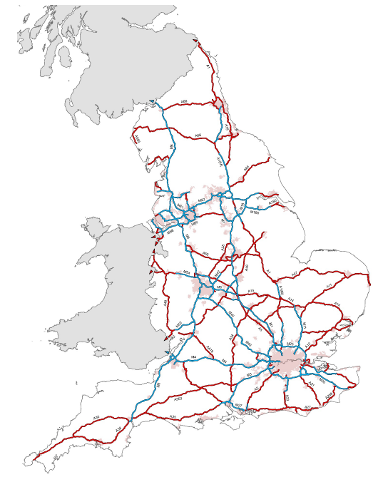
Strategic Road Network & NTIS
Strategic Road Network (Motorways and A roads)
More displacements
No new infrastructure
Reduce Congestion
Increase Capacity
Smart Motorways
Notes:
The Strategic Road Network covers all the motorways and A roads in England.
Currently the amount of displacements is steadily growing, there is an impending need to increase the capacity while simultaneously decreasing the congestion of the network.
Since there is no budget available for developing new infrastructure, laying new roads and bridges, the policy is shifting towards making better use of the available resources, by using smart motorways, and to make this change, we need a network model: [[NEXT SLIDE]]

Slide 7
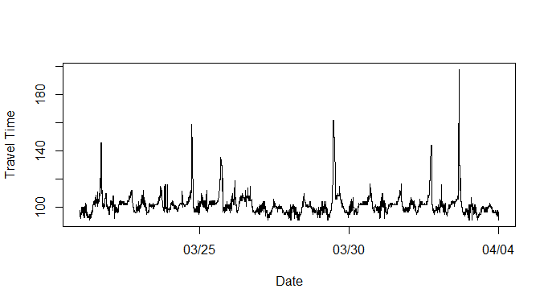
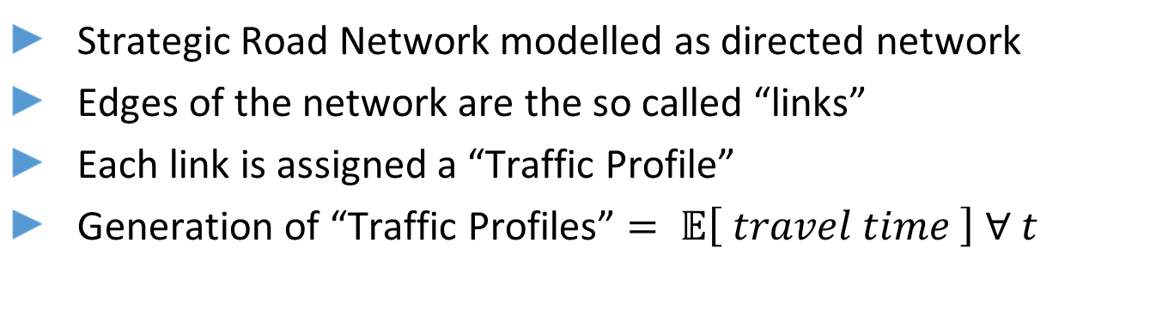
Strategic Road Network & NTIS
Strategic Road Network modelled as directed network
Edges of the network are the so called “links”
Each link is assigned a “Traffic Profile”
Generation of “Traffic Profiles” $= 𝔼\left[ travel time \right] ∀ t$
Notes:
The Strategic Road Network is modelled as a directed network.
In this network, wherever two roads cross, a node will be placed, the edges joining those nodes that can be travelled between are the so called links.
Any link will have a number of induction loops which will measure traffic data.
We will later look at this data in more detail, but for now, the important bit is that each link will be assigned a Traffic Profile created from the historical measurements of the sensors in it.
This profile, as I said before, provides with the expected travel times, for any given time, in the absence of external phenomena such as bad weather and so on.
What we see in the plot, and this will come into play later on, is that for most of the series, travel times oscillates around a mostly stable mean value, with occasional quick large deviations from this.
[[NEXT SLIDE]]

Slide 8
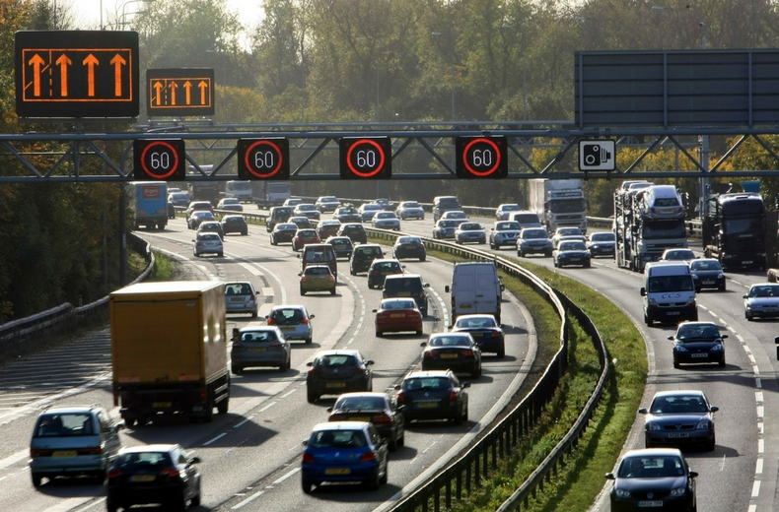
Strategic Road Network & NTIS
NTIS connects subsystems of the Smart Motorways, accessing:
Planned and Unplanned Incidents Database
CCTV cameras
Variable Message Signs
Variable Speed Limits
Variable Lane Configuration
Loop-based Traffic Data
Public expected travel times
Historical Data
Notes:
The National Traffic Information System (NTIS) connects the various subsystems of Highways England and the Regional Control Centres.
These interfaces provide access to all the data, from CCTV cameras to Induction Loop Measurements, that will later be aggregated at link level.
The NTIS makes this information public, theoretically, anyone can set up an account and a subscription, but in reality, it is necessary to develop so many download scripts and to do such high amounts of pre-processing that there really IS a barrier at accessing this data and making use of it.
This is how we did our data selection:[[[[NEXT SLLIDE]]]]

Slide 9
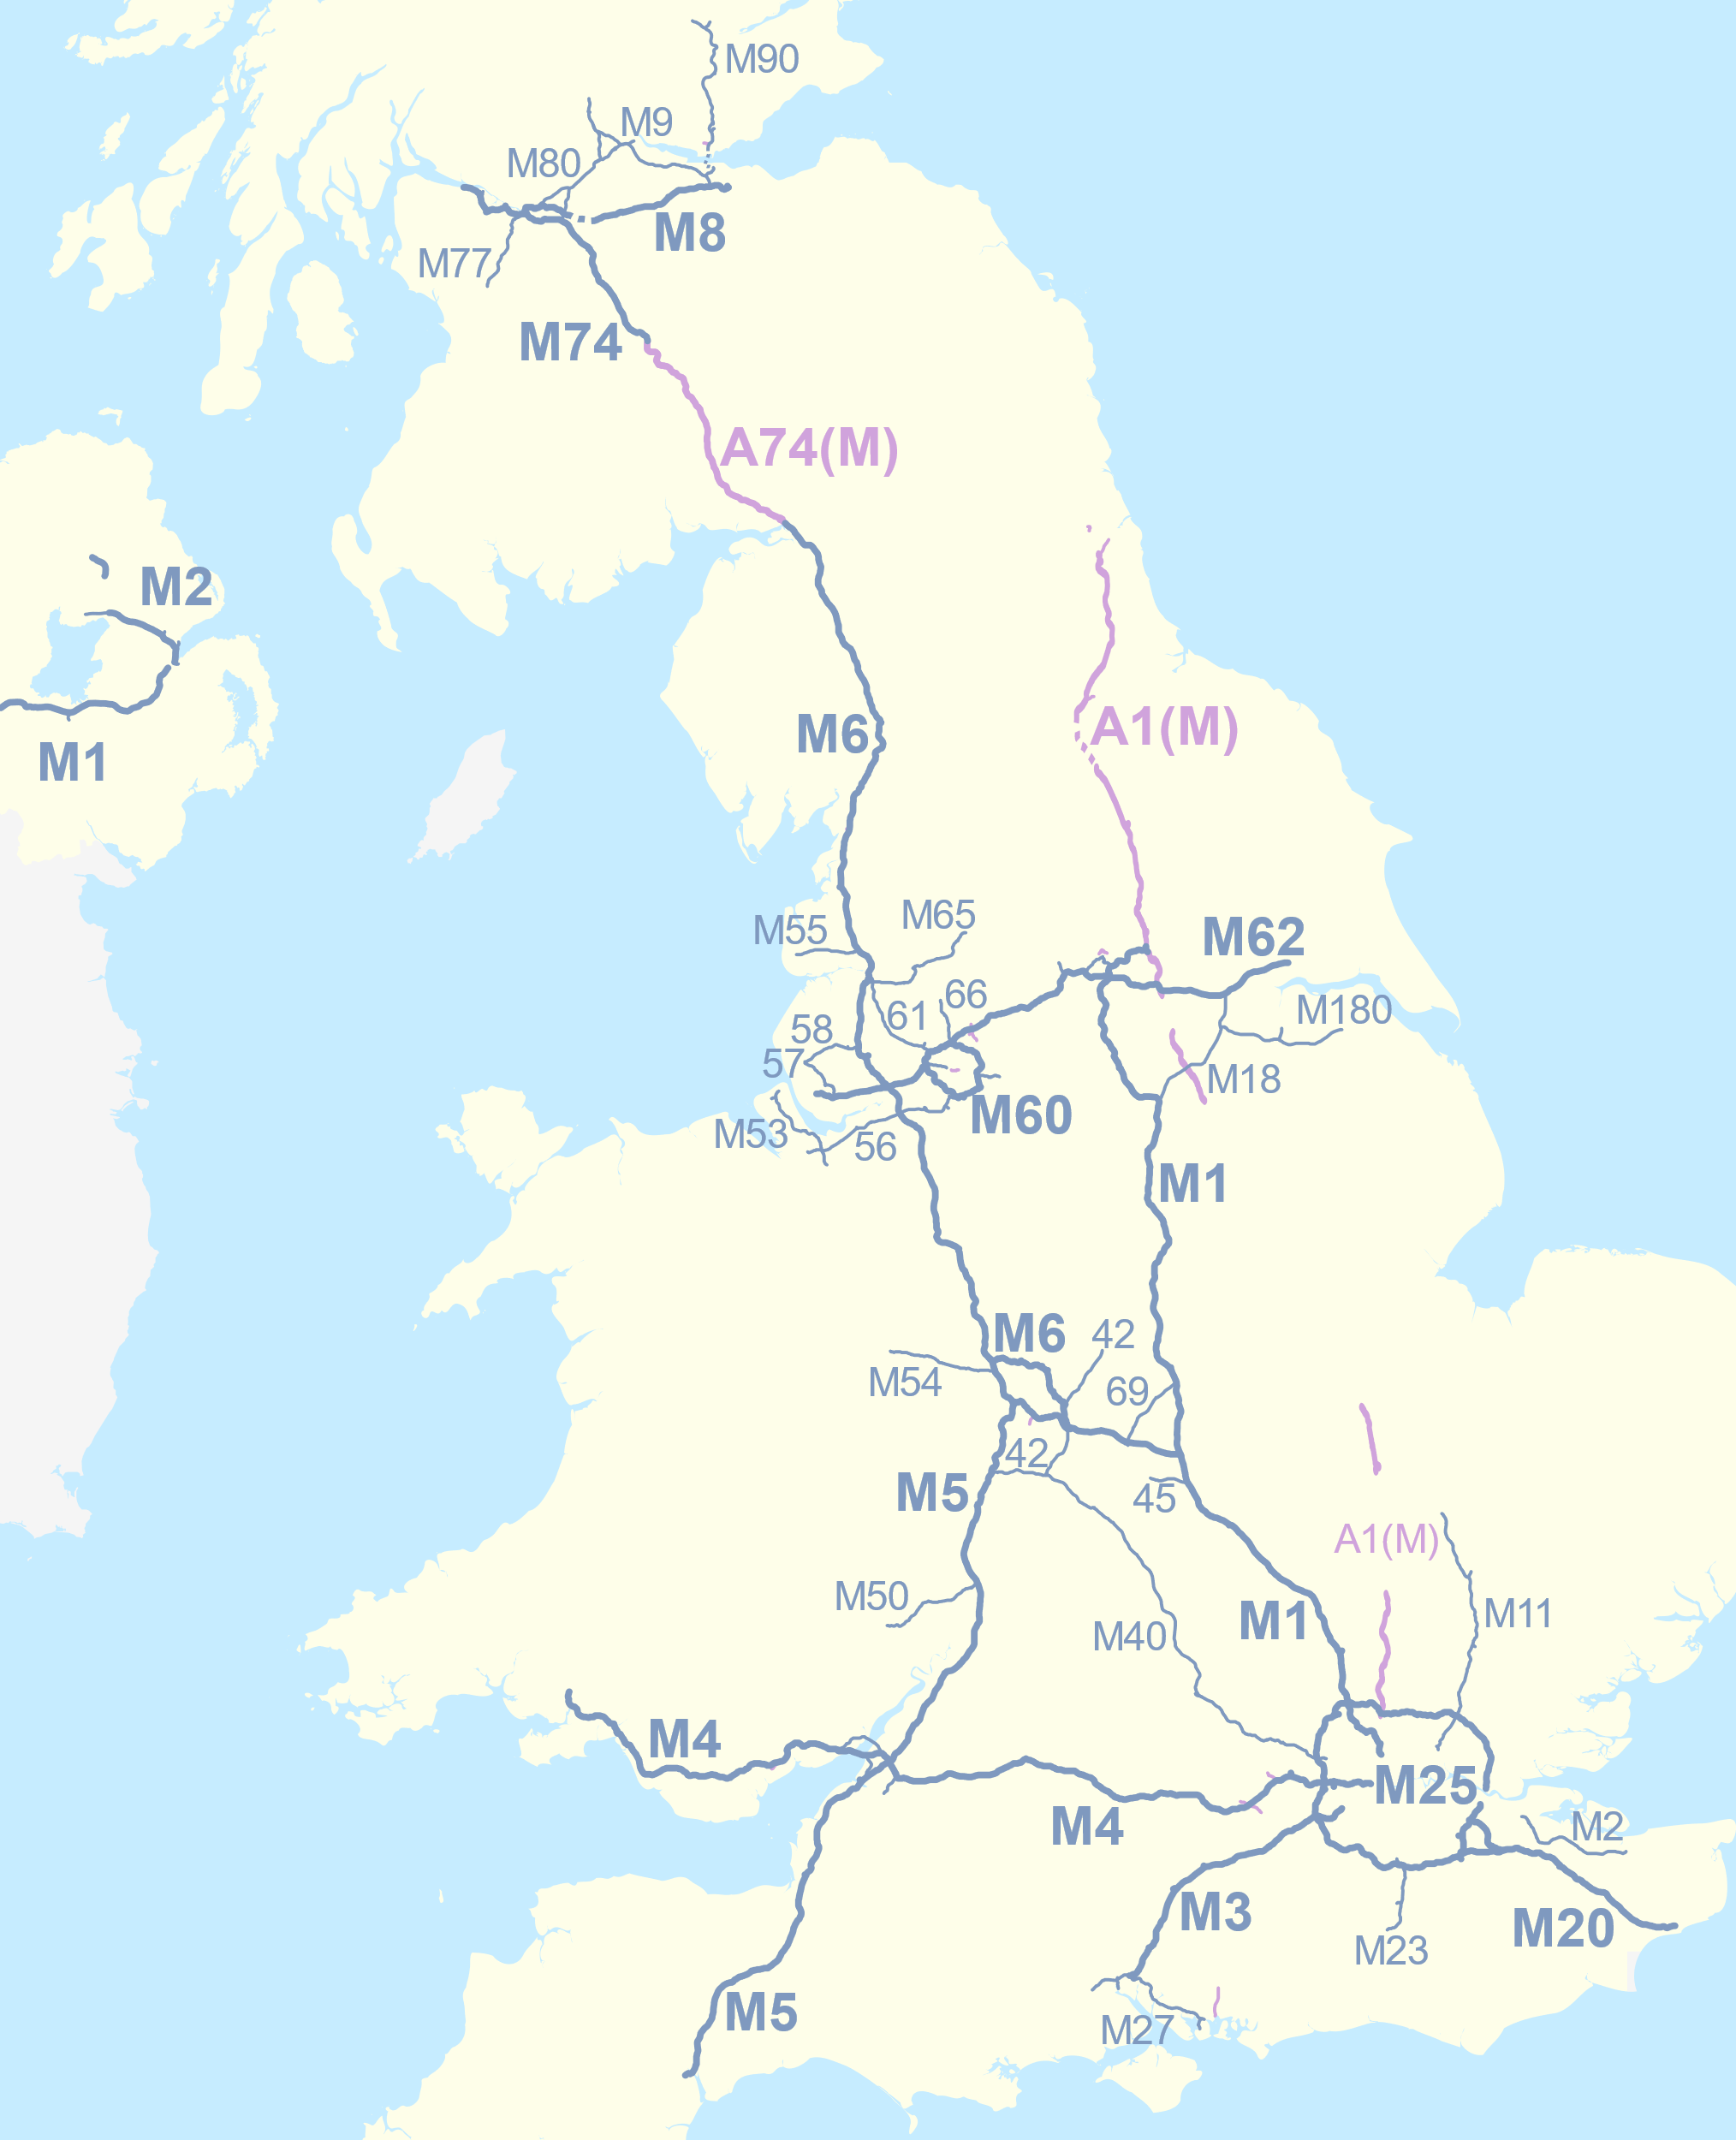
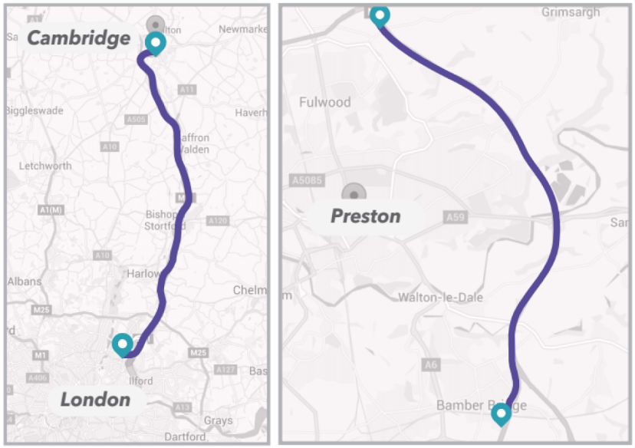
Data Selection and Contents
Notes:
We selected 3 different locations in England.
-The M6 around Preston.
-The M11, between London and Cambridge
-And the M25 around London.
These 3 motorways are characterised by their high recurring congestion, typically being a bit of a nightmare to commuters.
We connected to the NTIS system and downloaded some data, which we processed into something like this: [[NEXT SLIDE]]

Slide 10
Data Selection and Contents
M6 + M11
One entry per minute: 07/Mar/16 – 29/May/16 (12+ weeks)
Link ID | Date | Absolute Time | Travel Time | Profile Time | Free Flow Time | Speed | Flow | Congestion Event | Other Event
# | – | [1-1440] | [s] | [s] | [s] | [Km/h] | [veh/h] | Flag | Flag
Notes:
The data consisted of what you can see in the screen.
Outstanding congestion events are flagged, but since a part of our work focuses on detection, these were ignored. However the “Other event” flag was used to clean the dataset.
Our data from the first 2 motorways contained 12 whole weeks of data. Of this, once we get to the training of the algorithm, we will be using the 8 previous weeks to predict a week ahead, and this process will be repeated 4 times. So our final prediction will contain a 4 week forecast that we will be able to compare against the actual measurements from the motorway.
In the case of the M25, our set contains 9 complete weeks, from which we will be using 3 weeks as training to predict a week ahead, repeating the process 4 times.
This is all very good, but HOW are profiles actually created?
[[[[NEXT SLIDE]]]]

Slide 11
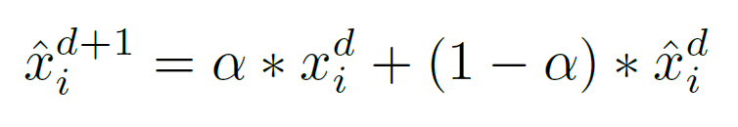
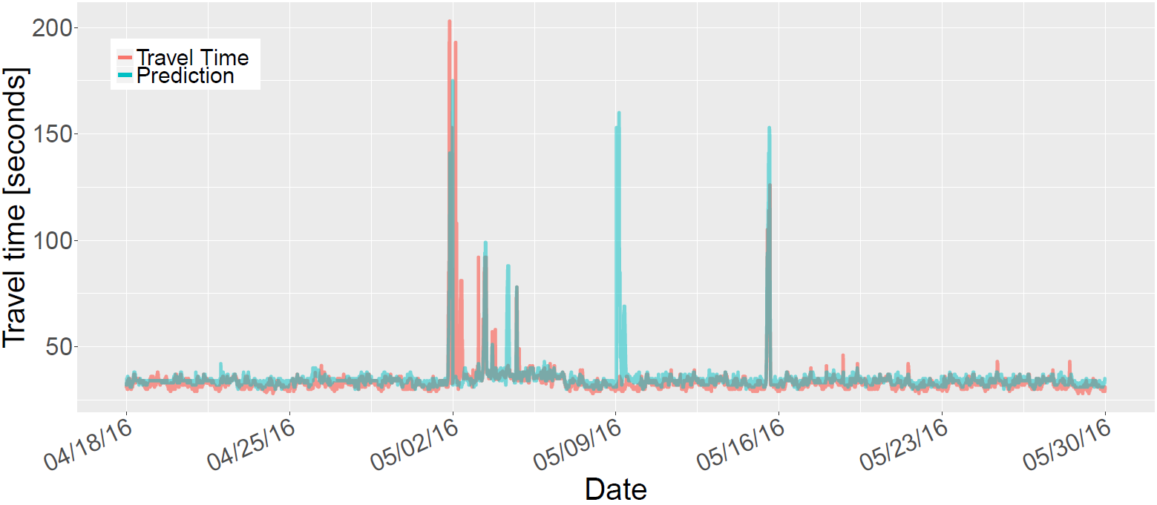
Data Selection and Contents
Current Profile Estimates:
Uses EWMA + Segmentation
Can lead to overestimation or repetition of events
Notes:
The current methodology to calculate these profiles involves heavy use of time-based segmentation and combines it with an exponentially decaying moving average.
This time segmentation implies that the data will placed in different categories and these will be assessed independently.
Once this is done, the Exponentially Weighted Moving Average can be applied on a minute by minute basis.
This means that to generate an estimation of the 10:15 AM today, I will look into the travel times at 10:15 AM over previous days that belong in the same category as today, and apply this moving average over them.
The most obvious and immediate downside of this approach is that it can easily be led into overestimation by any single event that is not filtered out, as you can see in the plot on the screen.
In this case we find a great peak around the 2nd of May. An algorithm using this approach, will replicate this spike on the exactly one week later, but as you can see, it was nowhere to be found.
In this context, we need to generate an algorithm capable of accounting for seasonal changes, without the need of segmentation, and in a way that is resilient to large deviations in the data. Let’s focus first on the seasonality.

Slide 12
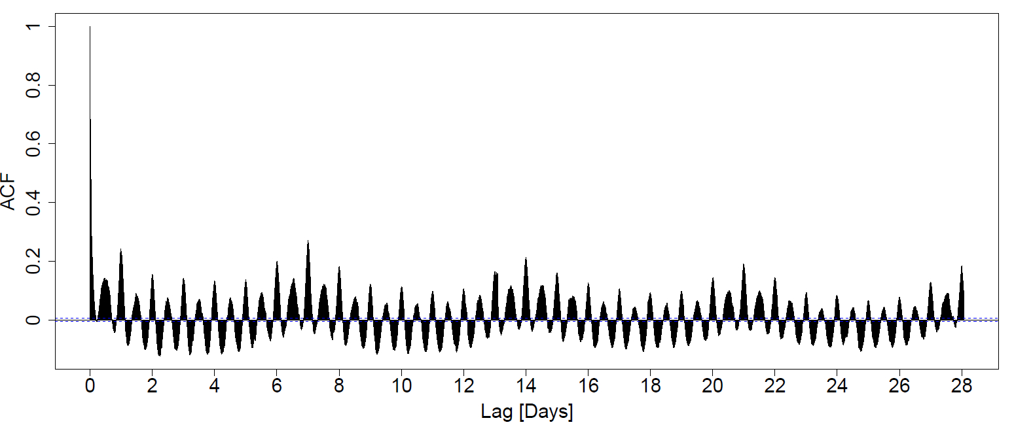
Data Selection and Contents
Notes:
Since we are looking at cases of high recurring congestion, it seems like a reasonable start to look at the autocorrelation function for the travel time time series.
And what we can see here, as far as autocorrelation functions go, is very interesting.
First, the patterns are much clearer than usual.
On top of that, we can see how we have a pattern going on with a period of a day, and at the same time another overarching patter with a period of a complete week.
This leads us to believe, that we will be dealing with a heavy double seasonality (daily and weekly), which otherwise makes sense from what we intuitively know about how we humans operate in terms of time.
So summarizing, so far we have, oscillations around a mean (as we said earlier), quick large deviations and various seasonalities. Let’s see how can we break this down:
[[[NEXT SLIDE]]]

Slide 13
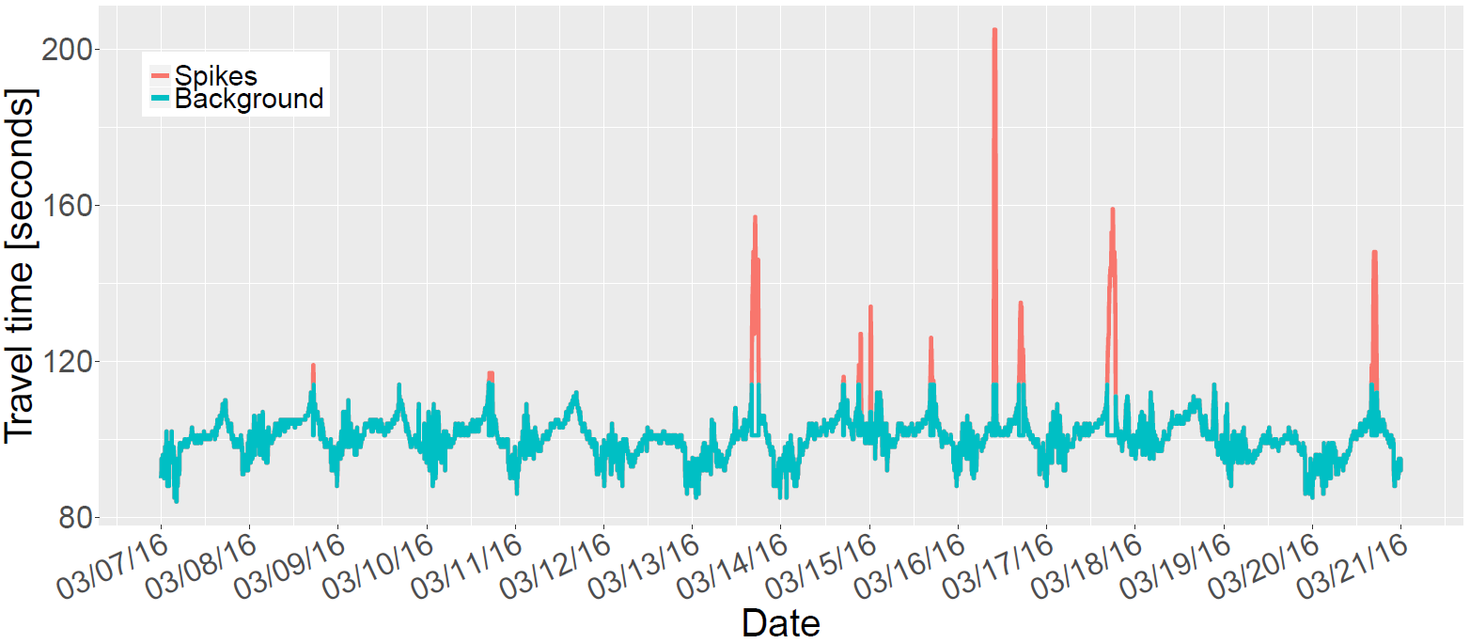
Algorithm: Decomposition
Background
Stable Around Mean
High Frequency – Low Amplitude
Suitable for Spectral Filtering
Spikes
Zero most of the time
Low Frequency – High Amplitude
Suitable for Seasonal Analysis
Notes:
What we though is that traffic appears to operate in 2 very differentiated regimes, that we internally called background and spikes.
The background would comprise what we talked about earlier, some relatively stable series that oscillates with high frequency.
Suitable for Spectral Filtering.
The spikes on the other hand are not there most of the time, and are rare enough to not have intra day patterns, but the weekly patterns were relatively clear. The seasonalities will be extracted by STL decomposition, which is an algorithm developed by Cleveland in 1990.
The separation is done as follows:
Normalisation of travel times in link by free flow time
Applying a threshold. So far we found quite a better way of doing this, but we didn’t have the time to make proper cross validation.
In this manner, we define a indicator function that will tell us whether any given point in the series belongs in a spike or not.
At this point, we take the background signal and start playing with it. [[[[SLIDE]]]]

Slide 14
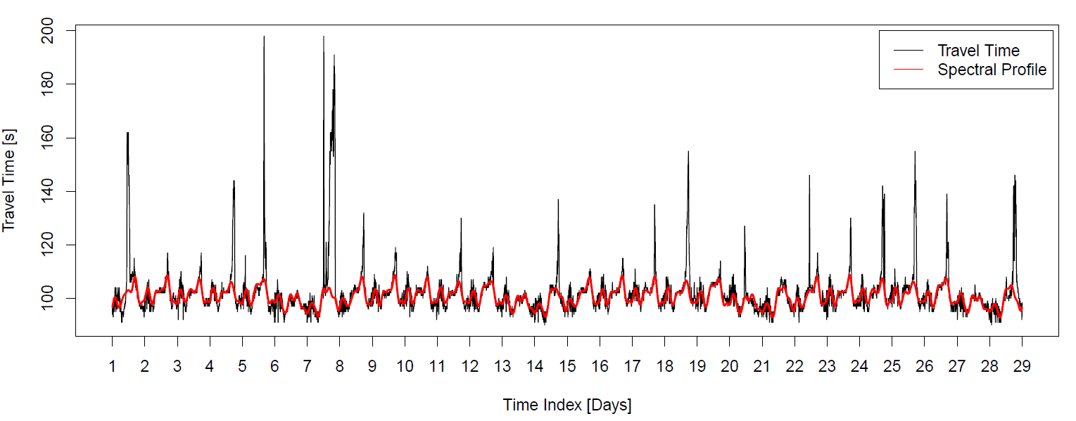
Algorithm: Background Analysis
Notes:
In the case of the background, we separate it from the rest of the time series, and we apply a frequency filter.
With this filter we get rid of all frequencies under 4 hours and over a week.
This way, we aim at eliminating the influence that a short term event may have over the normal functioning of the highway and obtaining a highly smooth series that accurately follows the actual travel times without being dragged into the large deviations. Mind that in this plot, besides containing a few specially bad days, the red line represents forecasts made one week in advance. So it is by itself a good approximation of the “normal” operation of a motorway. THIS WORK EVEN WITHOUT REMOVING THE SPIKES SINCE THEIR EFFECTS USUALLY OPERATE ON SMALL TIMESCALES.
This is however not enough, since we also aim to capture the recurrent component of the congestion, so we turn to seasonal analysis. [[SLIDE]]

Slide 15
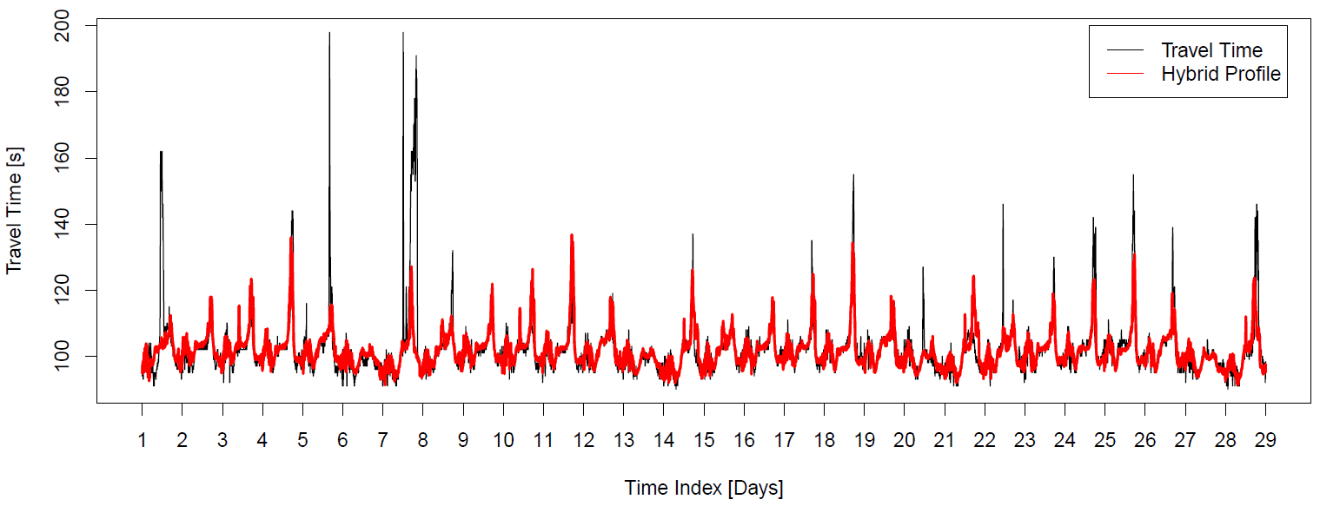
Algorithm: Seasonal Analysis
Notes:
As you can see, here we are learning some patters, but we have not required to make use of any kind of segmentation. This is an intermediate result of our algorithm obtained by using the Seasonal-Trend-Decomposition based on Loess that we talked about earlier.
However, while this series follows much better the large deviations from the baseline, it is also much jumpier than the previous one, making it badly adapted to the times when there is no congestion and smoother flow. Take into account that in this case, we are only taking those periodic components of the signal, and getting rid of everything else.
You can also see that with this component alone, on occasion, phantom spikes are replicated in locations where there are none. [[[SLIDE]]]

Slide 16
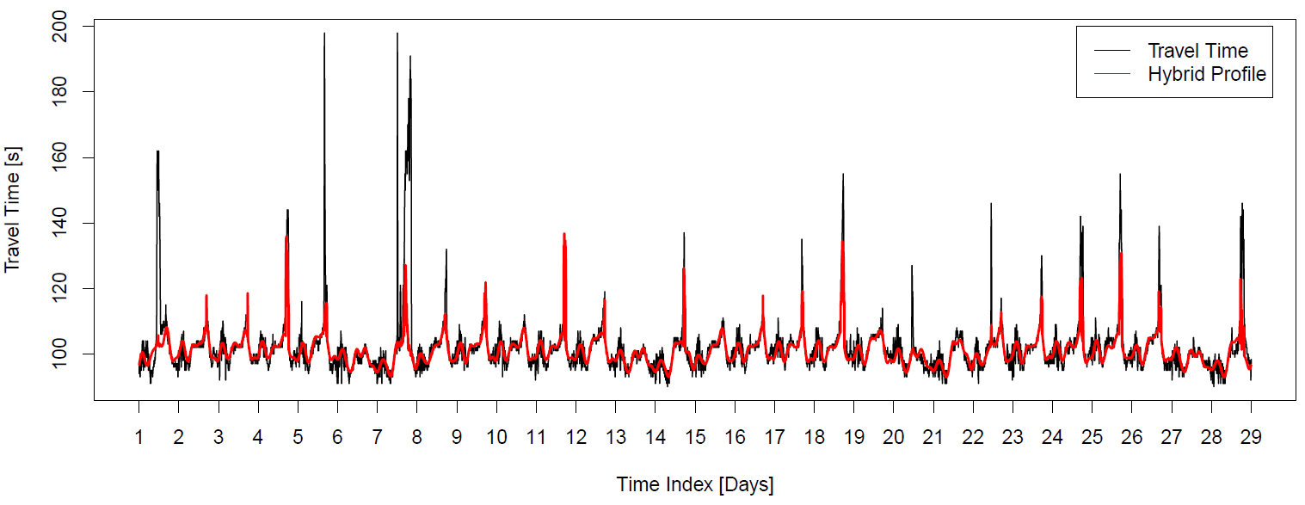
Algorithm: Hybrid Recombination
Notes:
The best predictive power is obtained when we combine these 2 previous results, using the Background whenever the spikes are not present and switching to seasonal analysis when they are (we would use the indicator function we defined previously). In this manner we obtain a system that has the best of both worlds, smooth prediction over long periods of time, being capable of switching to a different mode when density and travel times start to grow.
The separation presented here was done in terms of normalised travel times compared to free flow time, but we got comparable results using density and daily maxima for doing the separation. With a deeper study on the parameters of those approaches, I am confident that they can achieve similar results.

Slide 17
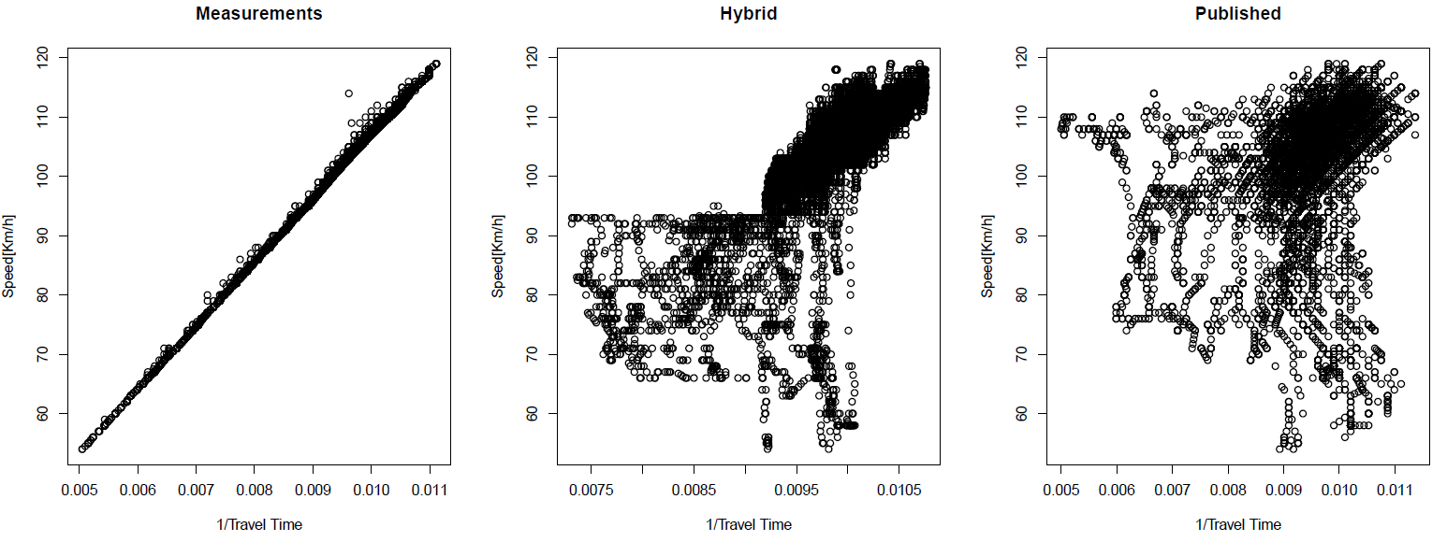
Results – Speed and Travel Time
Notes:
Here we can see how the inverse of the predicted travel time, accommodates to the actual measurements in terms of speed. For a perfect fit, it would follow a perfectly straight line as you can see in the first plot, since the inverse of the travel time will obviously be proportional to the speed. The small variations that you can observe can be attributed to noise in the measurements, and the discrete nature of these.
It can be seen that, without supplying a perfect prediction, our method still heavily restricts the observed spread, generating a much better fit. Here the intuition is that the closer to a straight line, the better.
This results correspond to the first link of the first motorway, otherwise we would have too many points on screen since our dataset comprises almost 10 million data points. So let’s move on to aggregated results next:

Slide 18
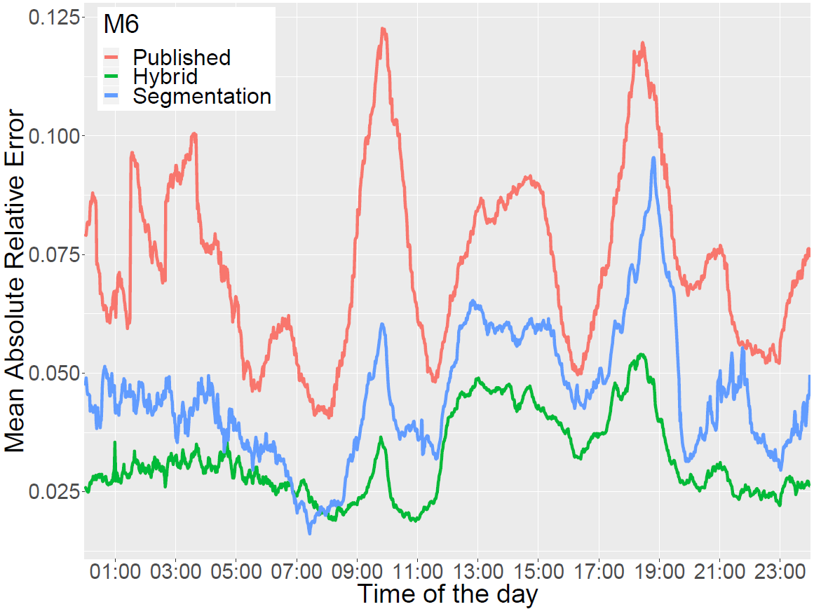
Results – Time of the Day (M6)
Notes:
This you know by heart. GO.

Slide 19
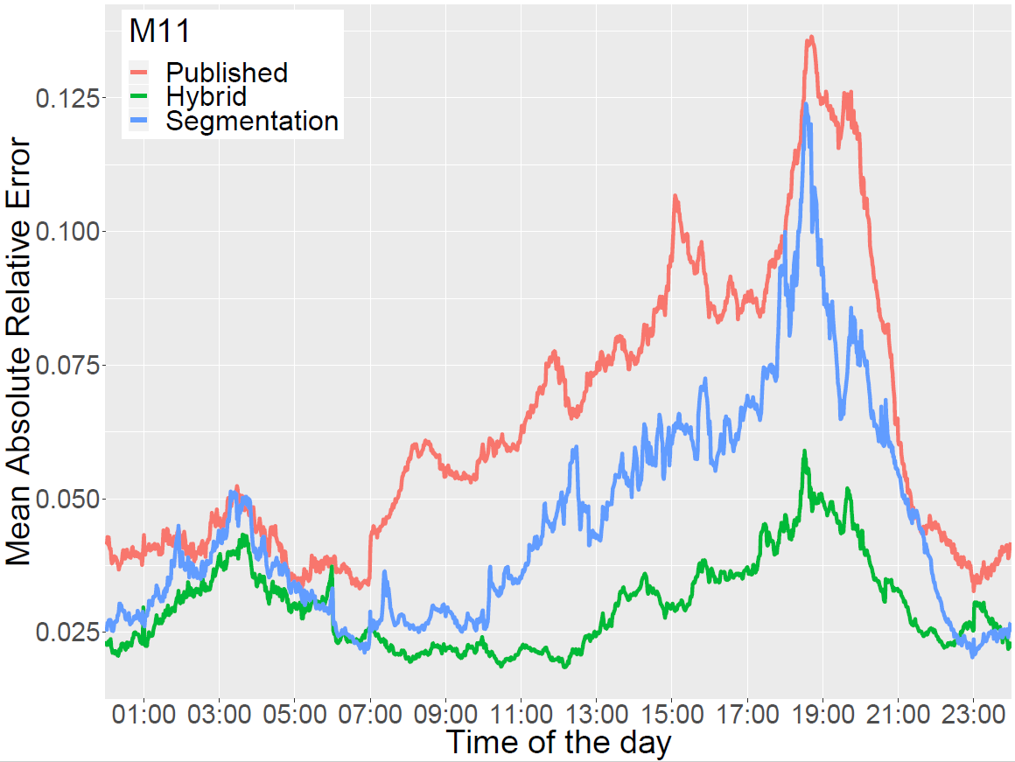
Results – Time of the Day (M11)
Notes:
WORK HERE!!

Slide 20
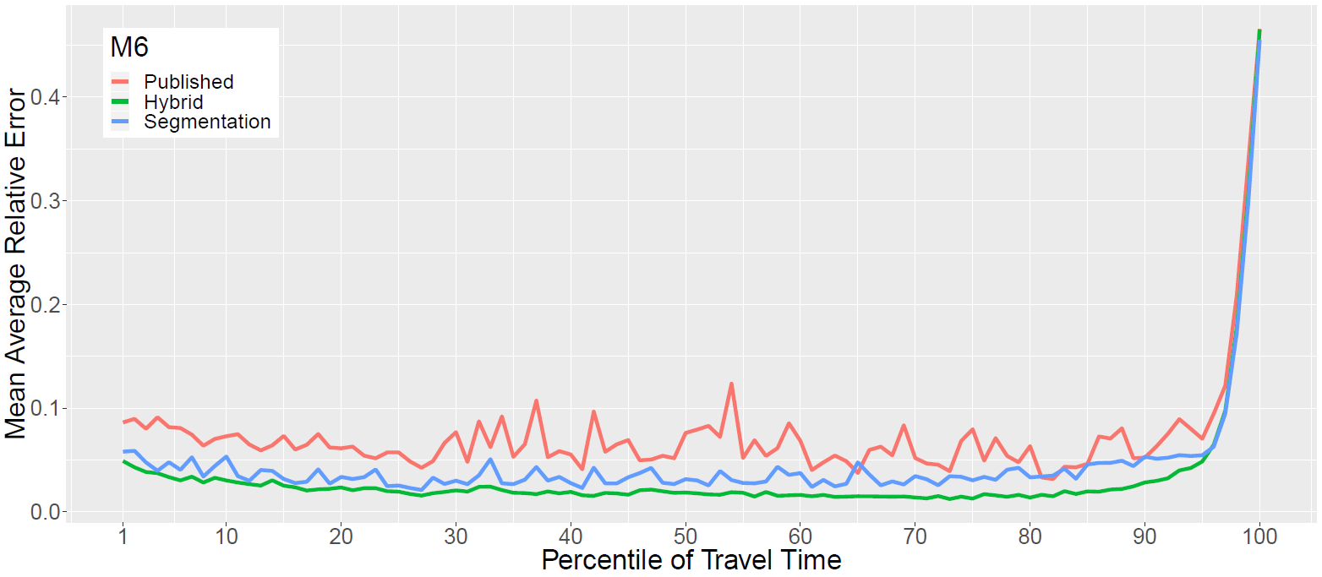
Results – Quantiles of Travel Time (M6)
Notes:
This you know by heart. GO.

Slide 21
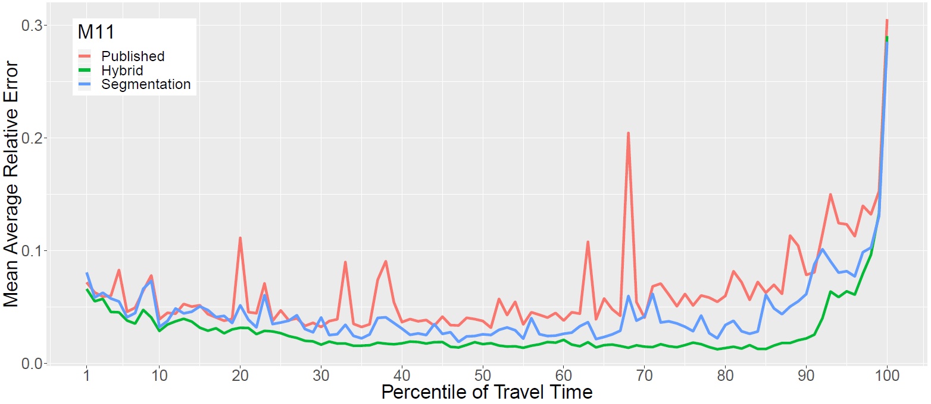
Results – Quantiles of Travel Time (M11)
Notes:
WORK HERE!!

Slide 22
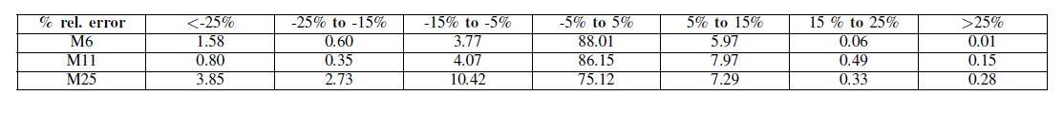
Results – MARE Distribution
Notes:
97.7% within 15% error for the M6
98.2% within 15% error for the M11.
92.8% within 15% error for the M25 with 25% less training data and smart motorway features (variable speed limit, changing number of lanes) which complicates prediction.

Slide 23
Conclusion and Way Forward
Achieved:
Presented an Algorithm for Profile Generation
Based on aggregating all seasonal variation and discarding rare events
Much better accuracy than existing estimation methods
Way Forward:
Improvement of definition of Spikes/Background
Streamline the separation process in terms of natural timescales of the oscillations of the series of travel times

Slide 24

Thank you!
Any questions?

Slide 25
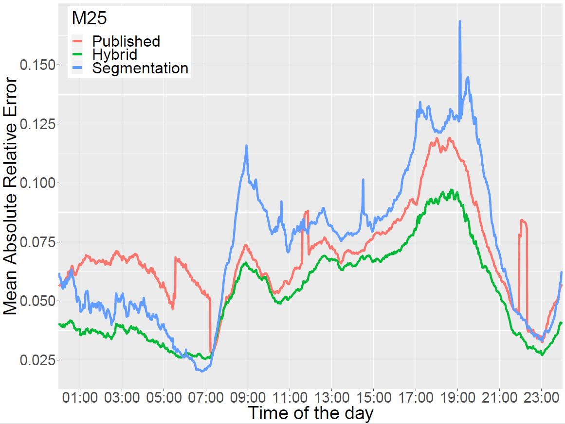
Results – Time of the Day (M25)
Notes:
WORK HERE!!

Slide 26
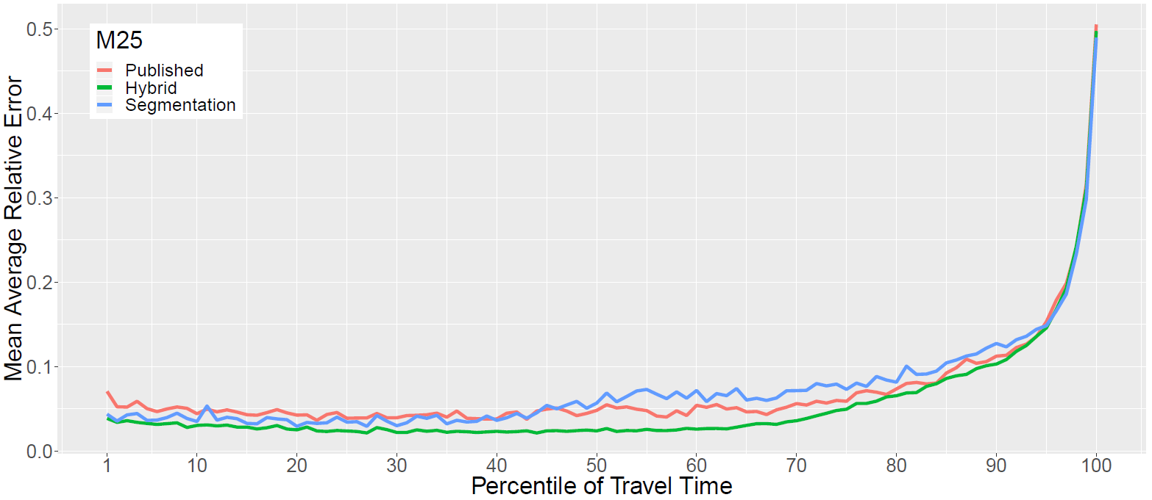
Results – Quantiles of Travel Time (M25)
Notes:
WORK HERE!!

Slide 27
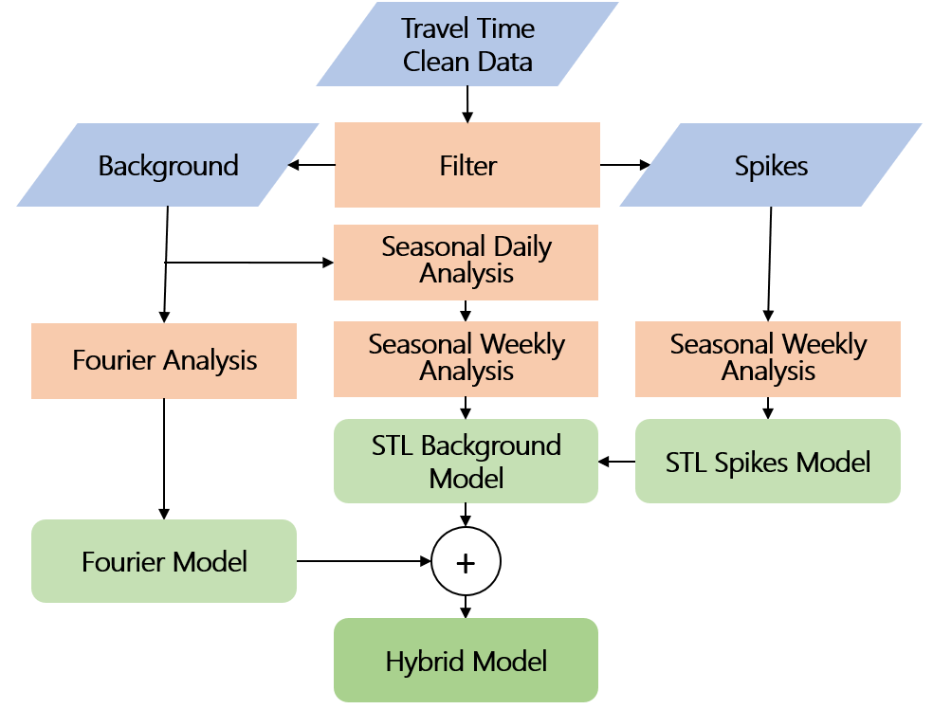
Algorithm: Recombination
Notes:
Split in back + spikes
Background: 2 seasonal components
Plot for fourier
Spikes: Separate periodicity. Trash rest.
By means of STL decomposition.

