Slide 1
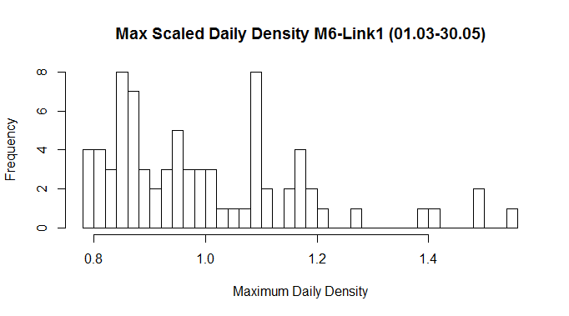
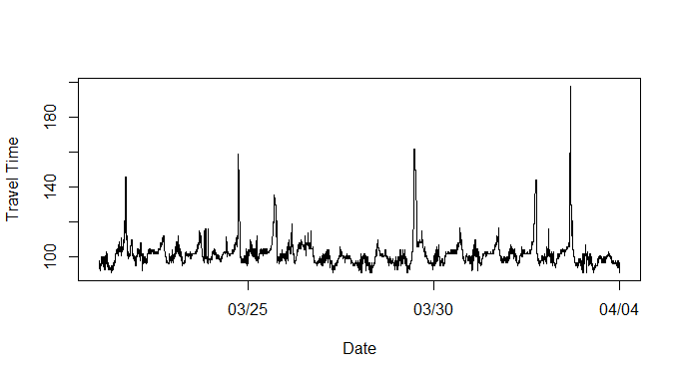
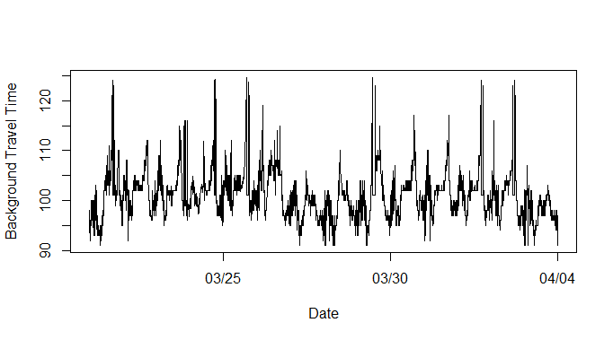
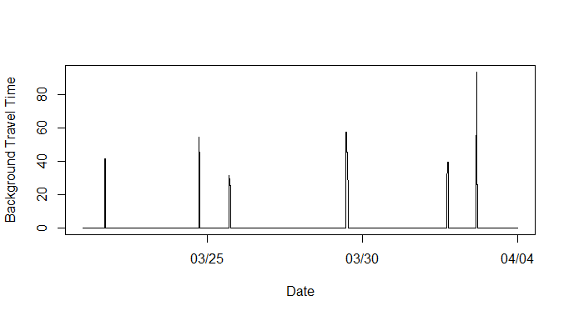
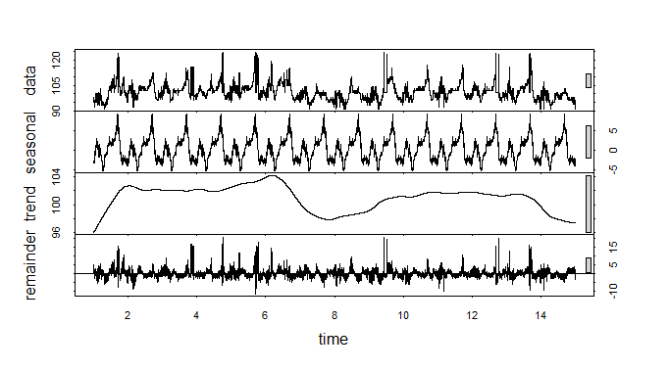
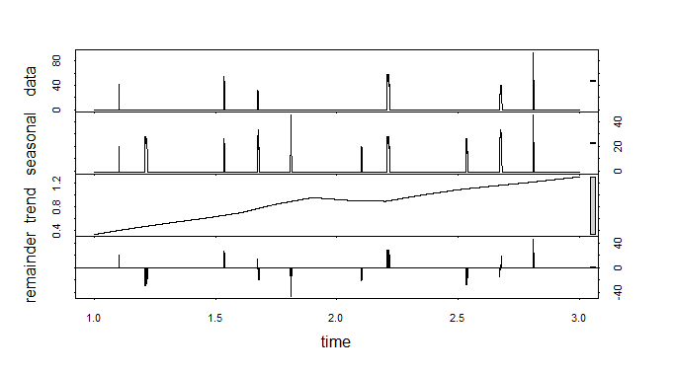
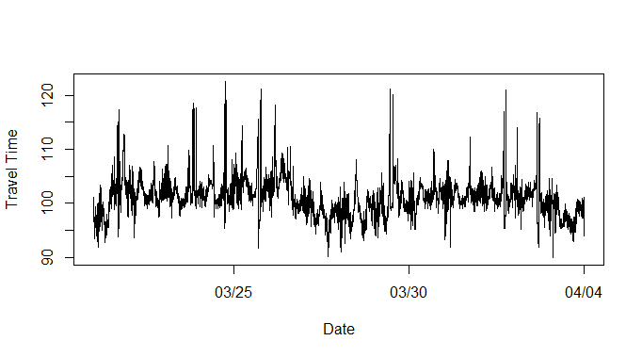
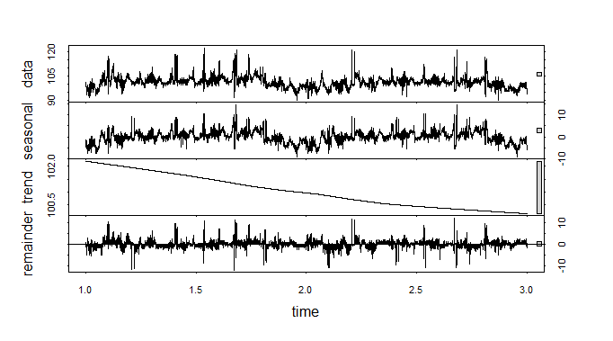
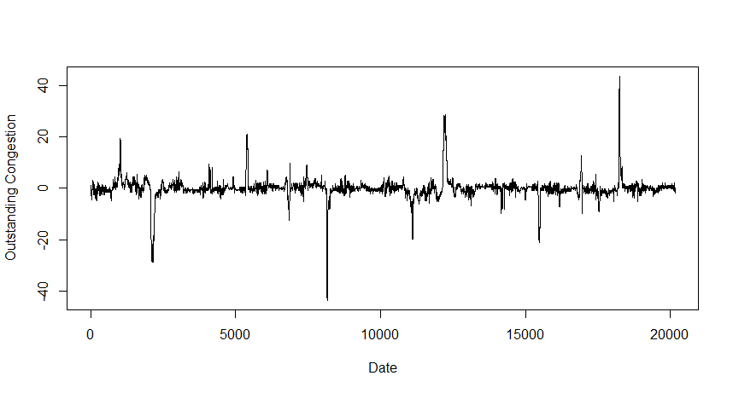
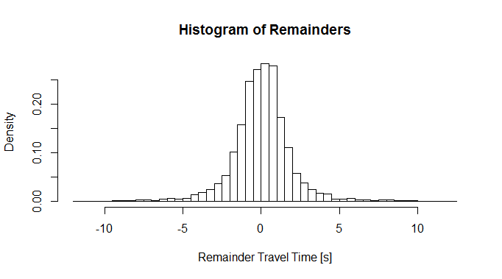
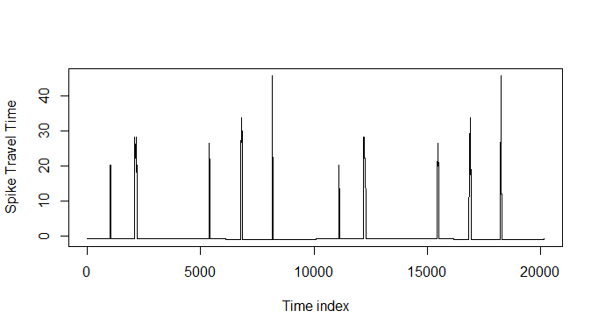
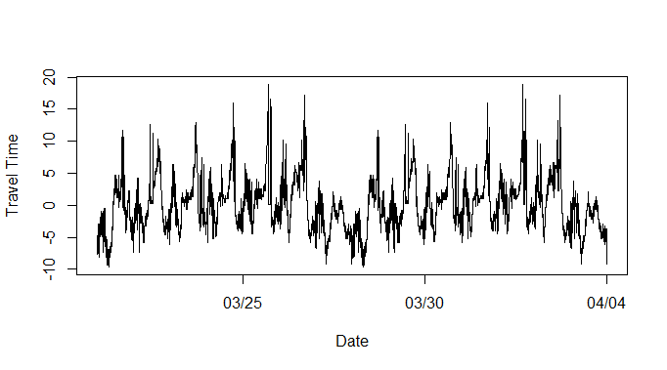
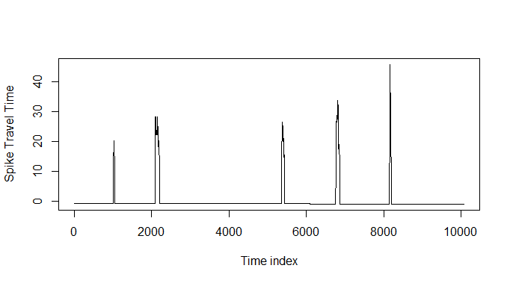
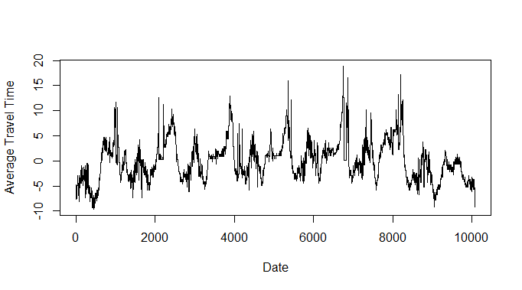
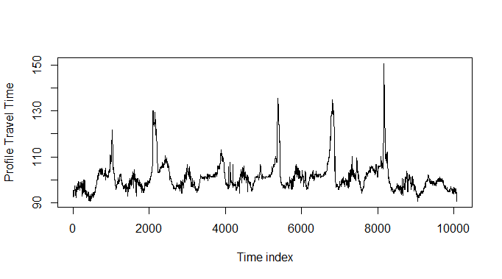
Time Travel
Clean Data
Average Max Daily
Threshold Filter
Background
Spikes
STL
Daily period
STL
Weekly period
Seasonal
Day
Trend
Background
Remainder
Background
Trend
Spikes
Remainder
Spikes
+
+
Deseasonalised data
(Day)
Outstanding Congestion
STL
Weekly period
Seasonal
Week
Trend
Remainder
Seasonal
Spikes
Substitution by median
Distribution check
Average over weeks
+
Seasonal Background
Seasonal Spike Weekly Basis
Average over weeks
Seasonal Background Weekly Basis
+
Profile

